Slide 2
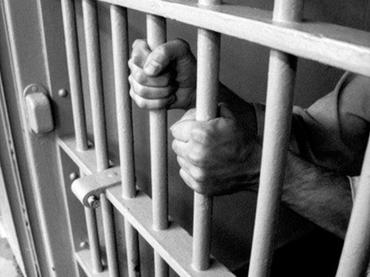
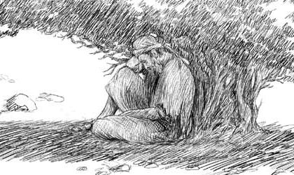
My Outlook is…
Edward Christian Church
Jan 24, 2016
Attitude of…
…Depression
pt1
1 Kings 19

Slide 3
Attitude
Attitude Provides…
  Perspective
  Power
    Mirror- How We See Ourselves
    Lens- How We See Others/ Situations
    Map- How We Choose Our Paths
  Persuasion
    Steers (direction)
    Stations (starts, hinders, stops)

Slide 4



Have You Been Hurt?
God Uses Hurt People…
…to Help Hurting People
Hurt (past tense)
Been through Pain, Grief, Stress, Loss
and
  Came Out on the Other Side
  Became a “Wounded Healer”

Slide 5


Have You Been Hurt?
Hurt People
…Hurt People
There’s a Big Difference Between:
Pain that’s Been…
    Dealt With
    Pushed Down
One Leads to…
    Development (fresh)
    Depression (stagnant)

Slide 6
Have You Been Hurt?
John 16:33, “in this world...tribulation…
...be of good cheer...overcome world”
  Tribulation (stress; pressure) (Affect)
  Be of Good Cheer (Courage) (Attitude)
    Deal with It; Go Forward (Action)
  I Have Already Overcome (Achieved-Acquired)
John 16:33 (MSG) I've told you all this so that trusting me, you will be unshakable and assured, deeply at peace. In this godless world you will continue to experience difficulties. But take heart! I've conquered the world."

Slide 7
Three Things About Depression
It is…
Ancient Problem
Universal Problem
No Respecter of Persons

Slide 8
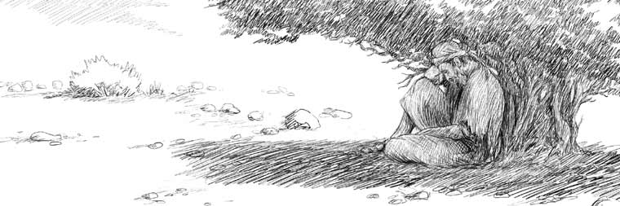

Depression and the Bible
Moses – Numbers 11:1-15
David – Psalms 31:9-13
Job – Job 7:2-3
Jeremiah – 20:14-18
Elijah –I Kings 19

Slide 9
Symptoms of Depression
Weight Loss or Weight Gain
Loss of Sleep and Energy
Lose Interest in Most or All…
…Pleasurable Activities
Reduced Ability to Concentrate
Overcome w/ Feelings of…
    Hopelessness
    Uselessness

Slide 10
The Key To Elijah’s Depression (3,4)
“When He Saw That ….”
Elijah Changed…
His Focus -Ceased to Walk by Faith
“And when he saw that…”
His Force -Boldness to Fear
“he arose, and went for his life…”
His Feelings -Became Depressed
“came to Beersheba, which belongeth to Judah,
and left his servant there. ..Juniper Tree…”

Slide 11

Five Factors of Elijah’s Depression
Elijah Faced…
Physical Exhaustion (5)
  Intense Activity-chap 18
    Rebuilt Altar - Showdown
    Killed 850 False Prophets
    Prayed Intensely for Rain
    Ran for Over 20 Miles
Emotional Exhaustion (3a, 4)
  He’s on Emotional Roller Coaster
    Arose and Ran for His Life (3)
    Take My Life -Kill Me! (4)

Slide 12

Five Factors of Elijah’s Depression
Elijah Faced…
Physical Exhaustion (5)
Emotional Exhaustion (4)
Social Exhaustion (1, 2)
  Relationship Conflict
    Confronted / killed 850 prophets
    Jezebel sent out Death Threats
Spiritual Exhaustion (10, 14)
  Down Played His Work
  Exaggerated His Situation
Lord Just Take Me!!!

Slide 13
You Can BE Set Free!
Psa 126:5,Those who sow in tears will reap w- songs of joy
Psa 143:7-8, Answer me quickly, O Lord; my spirit fails. Do not hide your face from me or I will be like those who go down to the pit. Let the morning bring me word of your unfailing love, for I have put my trust in you. Show me the way I should go, for to you I’ll lift up my soul.
Psa 147:3, He heals the brokenhearted / binds up wounds
Psa 145:14, The LORD upholds all those who fall and lifts up all who are bowed down.
Prov 12:25, Anxiety in a man’s heart weighs it down (depression), but a good word cheers it up
Finding
Freedom !

Slide 15
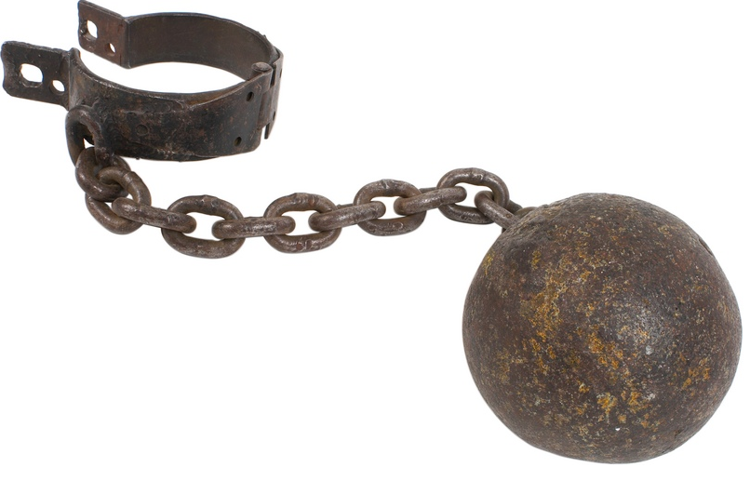

Slide 16
Deut 31:8 – The Lord himself goes before you and will be with you; he will never leave you nor forsake you. Do not be afraid; do not be discouraged.
Deut 33:27 – The eternal God is your refuge, and underneath are the everlasting arms.
2 Sam 22:17-22 – He sent from above, he took me; he drew me out of many waters; (18) He delivered me from my strong enemy, and from them that hated me: for they were too strong for me. (19) They prevented me in the day of my calamity: but the Lord was my stay. (20) He brought me forth also into a large place: he delivered me, because he delighted in me. (21) The Lord rewarded me according to my righteousness: according to the cleanness of my hands hath he recompensed me. (22) For I have kept the ways of the Lord, and have not wickedly departed from my God.
2 Sam 22:29 – You are my lamp O Lord; the Lord turns my darkness into light.
Ecclesiastes 9:4 – Anyone who is among the living has hope.
Psalms 9:9 – The Lord is a refuge for the oppressed, a stronghold in times of trouble.
Psa 27:14 – Wait on the LORD: be of good courage, and He shall strengthen thine heart: wait, I say, on the LORD.
Psa 31:22,24 – You heard my cry for mercy when I called to you for help… Be strong and take heart, all you who hope in the Lord.
Psa 34:18, 19 – The LORD is close to the brokenhearted and saves those who are crushed in spirit. (19) A righteous man may have many troubles, but the Lord delivers him from them all.
Psa 37:23-24 – If the Lord delights in a man’s way, he makes his steps firm; though he stumbles, he will not fall, for the Lord upholds him with his hand.
Psa 43:5 – Why are you downcast, O my soul? Why so disturbed within me? Put your hope in God.
Psa 55:22 – Cast your cares on the Lord and he will sustain you; he will never let the righteous fall.
Psalm 62:5 – Find rest, O my soul, in God alone; my hope comes from him

Slide 17
Psalm 126:5 – Those who sow in tears will reap with songs of joy.
Psalm 143:7-8 – Answer me quickly, O Lord; my spirit fails. Do not hide your face from me or I will be like those who go down to the pit. Let the morning bring me word of your unfailing love, for I have put my trust in you. Show me the way I should go, for to you I’ll lift up my soul.
Psalm 147:3 – He heals the brokenhearted and binds up their wounds.
Psalm 145:14 – The LORD upholds all those who fall and lifts up all who are bowed down.
Proverbs 12:25 – Anxiety in a man’s heart weighs it down (depression), but a good word cheers it up.
Isaiah 26:3-4, Thou wilt keep him in perfect peace, whose mind is stayed on Thee: because he trusts in Thee. Trust ye in the LORD for ever: for in the LORD JEHOVAH is everlasting strength. (Perfect means complete. If I keep my part of the promise by staying steadfastly focused on the Lord Jesus Christ, He will keep His promise to give me His perfect peace. See also Philippians 4:6-7 below)

Slide 18
Part 2

Slide 19
3 Lessons On Conquering Depression
Finding
Freedom !

Slide 20
#1- Fresh Provision (5-8)
“..lay and slept…Angel touched…”
Recuperated -Slept
Reenergized -Ate
Recuperated -Slept
Reenergized -Ate
God was Restoring Him Physically
  Prepared His Food/ Gave Him Rest
God was Restoring Him Spiritually
  Propelled Him to Get to Mt. Horeb

Slide 21
#2- Fresh Profession (9-11)
“What Are You Doing Here”
God Knew that He Needed to Unload…
  To Proper Person –God
  In Proper Way – Mt of God
  1st- We Need to Talk to God About it!
  Then…
  We Need to Find Somebody We Can Trust …
  …to Talk it Out!

Slide 22
#3- Fresh Perspective (11-14, 18)
“What Doest Thou Here Elijah?”
God Showed Him that He Does Not Always Communicate the Same Way
God Showed Him that His Perspective…
…was Wrong
God Showed Him that He Still Had…
…a Group of People He Could Trust
Realize There is More to It Than I See!

Slide 23
#4- Fresh Purpose (15-17)
“…go anoint…”
Go Take Care of Kingdom Work
  Physical
Go Take Care of My Work
  Spiritual
Elijah Mentored Elisha 10 years
God wasn’t Through with him !!!
God is Not Through with You !!!

Slide 24

#4- Fresh Purpose (15-17)
“…go anoint…”
You Decide If You Get Back Up!
You Decide If this is the Last Chapter
You Don’t Have to Be Defined…
…By Your Depression
Get Back Up!!!

Slide 26
I Second That Emotion!
Edward Christian Church
June 27, 2010
Overcoming
Depression
pt1
John 21, Luke 22

Slide 27
Depression
Most People Have Felt Sad or Depressed at Times.
Feeling Depressed can be a Normal Reaction to Loss, Life's Struggles, or an Injured Self-esteem.
But when Feelings of Intense Sadness -- including Feeling Helpless, Hopeless, And Worthless -- Last for Days to Weeks and Keep You from Functioning…
…It May Very Well Be Depression

Slide 28
Symptoms of Depression
Weight Loss or Weight Gain
Loss of Sleep and Energy
Lose Interest in Most or All…
…Pleasurable Activities
4. Reduced Ability to Concentrate.
5. Overcome w/ Feelings of Hopelessness…
…or Uselessness.

Slide 29
Depression and the Bible
Moses – Numbers 11:1-15
David – Psalms 31:9-13
Job – 7:2-3
Jeremiah – 20:14-18
Elijah –I Kings 19

Slide 31
Why Does God Confront?
#1- God Confronted His Actions –v. 9 God did not call Elijah to live in a cave, but to stand up for the Lord. By the way, God did not save you for you to be discouraged and defeated. He saved you to experience His peace and His joy, Phil. 4:6; 1 Pet. 1:8.
#2- God Confronted His Attitude –v. 11-13 Elijah wanted to see the spectacular and the majestic. God had to teach him to look at the little things. (Ill. Too often, we get defeated when God does not do the big things in our lives. If we would learn to praise Him for the little things, we would have plenty to praise Him for! We need to remember that God’s greatest work is the work that moves the heart!)
#3- God Confronted His Assumptions –v. 14-18 Elijah made two foolish assumptions and became defeated as a result.
1. v. 14, 18 Elijah Assumed That He Was Forsaken – God reminded him that he still had 7,000 pure hearts in Israel.
2. v. 15-17 Elijah Assumed That He Was Finished – Elijah thought his life and ministry were over, and he was ready to die. God reminded him that he still had big plans for Elijah’s tomorrow.

Slide 32
How to Get Depressed in 3 Easy Steps
#1- Find a Place By Yourself. Depression shuts out the thing we need most: people. Don’t want to face people.
#2- Focus on the Negative. We all have negative times in our lives, but when we make little things in to big things and let them overwhelm us
#3- Forget God’s Provision.
God provided through a widow who had nothing. Called down fire from heaven, saw one of the greatest revivals in Israel. God had never failed Elijah. Has God ever failed you?

Slide 33
Why Does God Use Broken People?
  1- To Point to Power of the Cross…
      We All Need His Help
  2- To Bring Message of Grace/ Mercy to Life
      Now It’s Personal
  3- To Prompt Reliance upon Him/ Others
      We Can’t Do It Alone
  4- To Show Us/ Others We Can Still Be Used…
      Even in the Worst of Situations
  Move Beyond Guilt to Usefulness Again!

Slide 34
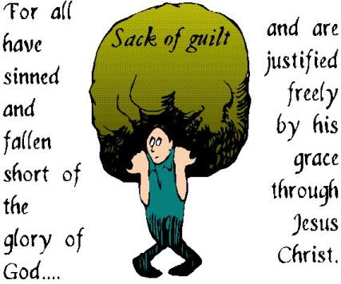

Slide 35


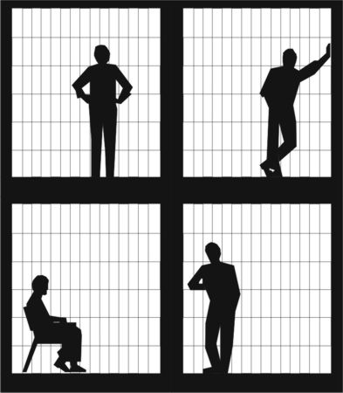

Slide 36
The Key To Elijah’s Depression (3)
“When He Saw That ….”
#1- He Saw The Wrong Things -v3a
-He changes Focus fr. Eternal to Temporal
#2- He Sought The Wrong Things –v3b-4a
-He Changes Force –from Boldness to fear
Elijah “went for his life,” yet he “requested for himself that he might die.”
#3- He Said The Wrong Things –v4b
-He Changes Feelings
Elijah said, “I am not better than my fathers.”

Slide 37
Five Factors of Elijah’s Depression
1.His depression came after a time of intense ministry output.
2. After relational conflict. Problem with boss, breaking up with boyfriend, argument with wife.
3.After physical exhaustion. Just killed 450 false prophets. Prayed intensely for rain, and then in the power of the Holy Spirit ran for over 20 miles.
4. After a major victory. He saw the whole nation of Israel come to revival all at once.
5. After a huge disappointment. He expectations may have been for repentance

Slide 38
Have You Been Hurt?
John 16:33, “in this world...tribulation.
...be of good cheer...overcome world”
#1 The Problem
  “in this world” (we are here)
  “tribulation” (stress; pressure)
      Opportunity to be depressed
#2 The Push
  “I have told you” (He already knows)
  “Be of good cheer...” (attitude)
  Deal with it; go forward (action)

Slide 39
Have You Been Hurt?
#3- The Promise
  “I have overcome the world ”
  Lean on Me
  Draw strength from Me
Realize that you are not the only one.
Others have faced depression too!

Slide 40
Depression
Most People Have Felt Sad or Depressed at Times.
Feeling Depressed can be a Normal Reaction to Loss, Life's Struggles, or an Injured Self-esteem.
But when Feelings of Intense Sadness -- including Feeling Helpless, Hopeless, And Worthless -- Last for Days to Weeks and Keep You from Functioning…
…It May Very Well Be Depression

Slide 41
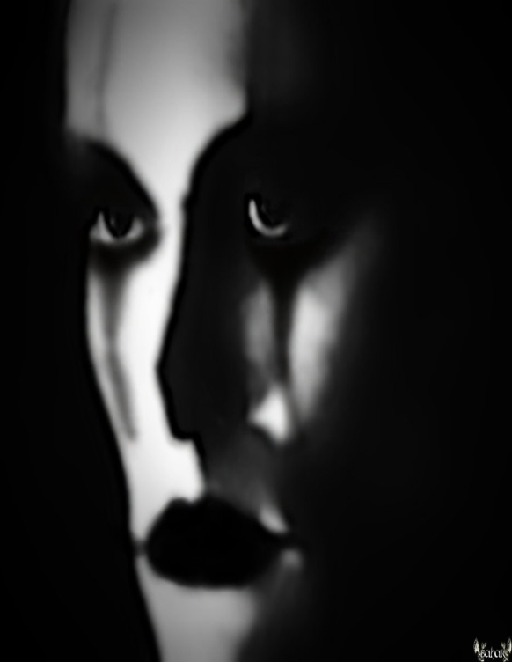
Have You Been Hurt?
Moses
Job
Elijah
Jonah
Saul
David
Jesus in the Garden

