Slide 2
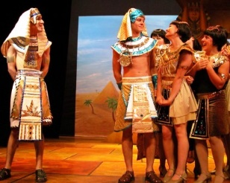
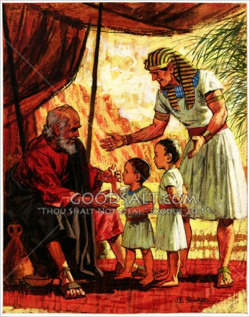
Forgetful and Fruitful
Genesis 41:41-52

Slide 3
We Try Everything We Can to Protect Ourselves from
…The Pains of Life, But Eventually Life Strikes Hard
The Greatest Pain of All Is the Pain of Grief
Grief is a Feeling of Deep Sorrow/ Mental Anguish Due to
the Loss of Persons, Position or Power
When Grief Strikes, We Usually Go Through a Cycle:
Shock...
Protest...
Despair...
Resolution
(Acceptance of the Loss and Reaffirmation of Life)

Slide 4
Perhaps you Have Experienced The Loss of…
Financial Security
Health
Career Opportunity
Important Relationship
Loved One Through Death Or Divorce
Life is a Series Of Gains and Losses
There Is No Way To Live…
Without Experiencing Loss
Victoriously Without Learning to Handle that Loss…
…By Dealing With Grief

Slide 5
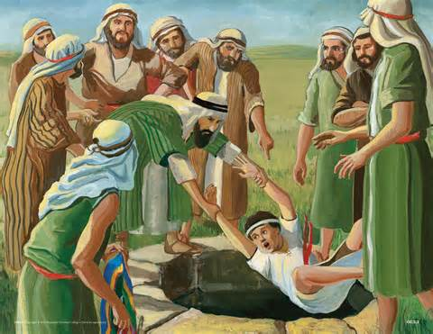
He Learned to Deal with Loss
What Did He Lose?
Family
Brothers Hated Him
Sold Him Into Slavery
He Lost His…
Childhood- Sold at 17
Job at Potiphar’s Because of Pot. Wife
His Dignity Thrown into Prison for 13 yrs
His Freedom Because of a Lie

Slide 6
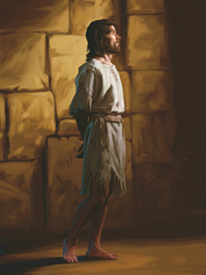
He Learned to Deal with Loss
How Do You Think Joseph Felt During All of This?
Angry at His Brothers?
Angry at God?
Lonely for His Family?
Can You Imagine the Pain/ Loneliness as He Spent Some
of Best Years of His Life- fr 17 to 30 in an Egyptian Prison?
But in All that Joseph Lost:
He Never Lost His Faith
In Egypt He Met The God Of Restoration

Slide 7
Great Loss Turned to Great Gain
To restore= "to bring something back into existence or effect; to bring back to a former or original condition; to put back in a former place or position; to reinstate; or to return."
"He restores my soul" -Ps. 23:3
"But I will restore you to health and heal your wounds" -Jer. 30:17
"The Lord will restore the splendor of Jacob like the splendor of Israel, though destroyers have laid them waste and have ruined their vines" -2:2
Jesus came "to seek and to save what was lost" -Luke 19:10
We are Taught to Restore Those Who Have Fallen -Gal. 6:1-2
God Promises to "make all things new" -Rev. 21:7

Slide 8
The Blessing of Forgetfulness
The Name of Joseph's First Son, Manasseh
"God has made me forget all my trouble and my father's household”
Healing of Painful Memories…
Does Not Mean that He Could Not Recollect the Past
But It Does Mean -He Could Remember It W-out Feelings of…
Crippling Grief
Loneliness
Despair
The Brain Never Forgets Anything…
…it Permanently Stores All Information/ Experiences
Joseph was Enabled to Rise Above the Pain/ Move On w- His Life

Slide 9
He Overcame a...
Dysfunctional Family
Blended Family- Diff. Children Born to Diff. Mothers
Intense Sibling Rivalry
Brothers Despised him, Plotted to Kill Him, Sold Him into Slavery
Father Failed to Support Him-His Dream, so He felt Rejected by Family
Not the Model Family
Youth Crisis
Spent Teen yrs/ Young Adulthood in Prison w-out Family Nurture /
Godly Role Models, Suffering Discrimination, Rejection/ Abuse
Crisis of Faith
Although He Served God, Went Through Extremely Difficult Times
Emotional Baggage
Deal with Intense Negative Feelings of Anger, Doubt/ Resentment

Slide 10
The Blessing of Forgetfulness
When You Add It All Up…
…Joseph had All the Excuses He Needed to Cop Out On Life
But He Didn't -He Allowed God to Minister Such Grace to Him
…That He Forgot His Pain
Joseph Confronts the Victim Mentality of Our Day…
…Which Blames Everyone and Everything

Slide 11
The Blessing of Forgetfulness
He Shines as a Testimony, Regardless of Our…
Upbringing
Environment
Poor Role Models/ Influences
Tragedy/ Loss
God's Grace is Sufficient to Enable Us
…to Forget All Our Troubles
…Move On to an Abundant Life!
God is the Source of Inner Healing
God has Made Me Forget
Release the Pain
Forgive Those Who Hurt Me
Recapture My Dream

Slide 12
The Blessing of Forgetfulness
What Do You Need to Forget?
You've Carried the Memory Long Enough
The Past Has Been an Weight Around Your Neck Too Long
God wants to Bless You with Manasseh
…Enabling You To Forget Your Troubles

Slide 13
The Blessing of Fruitfulness
God Not Only Enables Us to Forget,
…but He Also Gives Another Blessing
Ephraim=
"God has made me twice fruitful in the land of my suffering"
There are Two Key Phrases:
Twice Fruitful= Joseph was blessed with a double portion
In the Land of My Suffering= the blessing of fruitfulness
came while Joseph was still in the land of his suffering
You Can Be Blessed Right Where You Are…
You Don't Have to Get Out of the Negative Circumstance…
…In Order to Be Blessed

Slide 14
You Can Be Blessed Right Where You Are
We See this Principle in Scripture
Isaac was blessed a hundredfold in the year of famine -Gen. 26:12
"After Job had prayed for his friends, the Lord made him prosperous again and gave him twice as much as he had before" -42:10
Naomi said, "Don't call me Naomi [pleasant].... Call me Mara, because the Almighty has made my life very bitter" -Ruth 1:20
"The women said to Naomi: 'Praise be to the Lord, who this day has not left you without a kinsman-redeemer.... He will renew your life and sustain you in your old age'" -4:14-15
"I will repay you for the years the locusts have eaten.... You will have plenty to eat, until you are full, and you will praise the name of the Lord your God, who has worked wonders for you; never again will my people be shamed.... I will pour out my Spirit" -2:25-28
"I chose you / appointed you to go/ bear fruit” “ “that will last" -John 15:16

Slide 15
The Blessing of Fruitfulness
What Have You Lost?
Whom Have You Lost?
Does Grief Weigh Your Heart Down?
God Is Present in the Midst of Your Pain…
… and Offers You Two Gifts:
Manasseh
(He will cause you to forget your pain)
Ephraim
(He will give you a double blessing…
…in the land of your suffering)

Slide 16
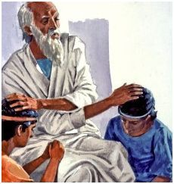
The Power of the Blessing
The Blessing Of Israel -Genesis 48
When Israel Blessed the Two Sons of Joseph
He Blessed Ephraim as the Firstborn…
…when Manasseh was Truly the Firstborn
Ephraim Would Be Blessed Above Manasseh
God Wants Our Fruitfulness To Far Surpass…
…Our Troubles/ Trials

Slide 17
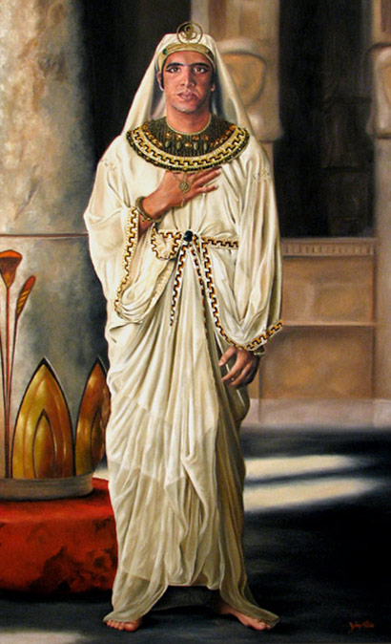
Forgetful and Fruitful

Slide 19
The Tale of Two Sons -Genesis 41:50-41:52 ν Joseph dreamed of being used mightily of God. o A dreamer can see in color what everyone else sees in black and white. o Someone with a dream can see what others say can’t be done. o A dreamer can envision from afar what others cannot see up close. ν Joseph was favored by his father and hated by his brothers. o Thrown into a pit by his brothers that was narrower at the mouth than at the bottom. It was impossible for him to get out on his own. o He was then sold into slavery by his brothers to the Ishmaelites. The Ishmaelites represent the flesh. The non-dreamers love to put fleshly restrictions on the dreamers. o He was sold into Egyptian slavery. If the enemy can enslave a dreamer, perhaps he can prevent the dream from coming true. ν Joseph found himself elevated into leadership again and again. o Faced countless accusations and attempts by the enemy to steal his dream. o From the journey between dream and reality, the circumstances may often look impossible. o Neither the pit nor the prison was the palace where Joseph was headed. But, without the pit and prison, Joseph would never have been prepared for the palace. ν When God brings us through our life to the place He is ultimately taking us, He also has a way of reminding us of where we have come from and also bringing fruitfulness and restoration out of our circumstances. Before the years of famine came, two sons were born to Joseph by Asenath daughter of Potiphera, priest of On. Joseph named his firstborn Manasseh and said, “It is because God has made me forget all my trouble and all my father’s household.” The second son he named Ephraim and said, “It is because God has made me fruitful in the land of my suffering.” Genesis 41:50-52

Slide 20
1. MANASSEH (GOD HAS MADE ME FORGET MY TROUBLE) --Joseph had been through a lot of trouble and problems. He had found himself in positions and places he never anticipated or imagined himself being in. --So many of us have been through so much in our pasts. We can’t even begin to imagine how we ever made it through some of the things we made it through. **Manasseh was a reminder to Joseph that God had erased his past and given him a fresh start!!! Joseph wasn’t in the pit or the prison any longer. God had brought him into the palace. --In Christ, we are given a Manasseh, a reminder that God has erased our past and given us a brand new start. Our past is forgiven and forgotten. --The enemy will always come to us and try to trap us by bringing back the past, trying to get you back in the pit. The enemy knows that when you are in the pit you can’t get into the palace. --When the enemy attacks with our past, we must remind him that we have been delivered, set free, redeemed, and that we no longer reside in the pit. --We have a future with the Lord. We can’t pursue our future while living in the past. --Your past will be either a springboard or an anchor. --Every experience of our life is in preparation for God’s purpose for us. 2. EPHRAIM (GOD HAS MADE ME FRUITFUL IN THE LAND OF MY SUFFERING) *Ephraim = “double fruit” **Ephraim could never have been born without Manasseh being born first; you can’t be fruitful if your past has you trapped. **If God can save me, He can keep me, if He can keep me, He can bless me. --As Joseph was in pursuit of his dream/promise, he encountered much affliction and suffering that tried to get him off course---but, God was faithful to always cause him to be fruitful in the midst of it all. **WHAT THE ENEMY INTENDS FOR EVIL; GOD WILL TURN FOR GOOD!! **WE WILL NEVER FACE ANYTHING THAT IS BIGGER THAN CHRIST IN US. --Joseph was squeezed by circumstances, and fruitfulness and life came out. **THE BLESSING OF ISRAEL (Genesis 48) When Israel blessed the two sons of Joseph, he blessed Ephraim as the firstborn when Manasseh was truly the firstborn. Ephraim would be blessed above Manasseh. **God wants our fruitfulness to far surpass our troubles and trials. In majesty he is like a firstborn bull; his horns are the horns of a wild ox. With them he will gore the nations, even those at the ends of the earth. Such are the ten thousands of Ephraim; such are the thousands of Manasseh. Deuteronomy 33:17 *God desires His people to live blessed and fruitful lives. Even in the midst of great trials and tests, He still longs to bless us and cause us to prosper.

Slide 24
The Blessing of Forgetfulness
The name of Joseph's first son, Manasseh, means "God has made me forget all my trouble and my father's household." The healing of painful memories does not mean that he could not recollect the past, but that he could remember it without feelings of crippling grief, loneliness, and despair. The brain actually never forgets anything, since it permanently stores all information and experiences. Joseph was enabled to rise above the pain and move on with his life. He overcame...
A dysfunctional family. What had Joseph experienced at home? He lived in a polygamous household—different children were born to different mothers, and consequently, there was intense sibling rivalry. Joseph's father played him as his favorite son, which caused his brothers to despise him. His brothers plotted to kill him, but they sold him into slavery instead. Even Joseph's father had failed to support him when he reported his dream, so he felt rejected by his family. Joseph definitely did not have a model family.
A youth crisis. Joseph spent his later teen years and young adulthood in prison without family nurture and godly role models. He suffered discrimination, rejection, and abuse.
A crisis of faith. Although Joseph served God, he went through extremely difficult times.
Emotional baggage. Joseph had to deal with intense negative feelings of anger, doubt, and resentment.

Slide 26
Great Loss Turned to Great Gain
God Placed Him
Second In Command to Pharaoh
Blessed Him With a New Family
He Had Two Sons…
He Gave Them Names That Reflect The Restoration Power Of God:
Manasseh
(God has made me forget all my trouble
and my father's household)
ul And Fruitful!

Slide 27
The Blessing of Forgetfulness
When You Add It All Up…
…Joseph had All the Excuses He Needed to Cop Out On Life
He Could Have Blamed His…
God
Dysfunctional family
Years in prison-influenced by the pagan environment of Egypt.
But He Didn't -He Allowed God to Minister Such Grace to Him
…That He Forgot His Pain.
Joseph Confronts the Victim Mentality of Our Day…
…Which Blames Everyone and Everything

