Slide 1
There once was an out of work actor named Daniel. He was so down and out that he’s ready to accept any acting part that came along. One day he saw an advertisement in the paper: ACTOR NEEDED TO PLAY A GORILLA. "I could do that," Daniel thought. Daniel arranged an interview. The employer turned out to be the local zoo. The zoo had spent too much money renovating the grounds and improving the habitat that they can’t afford the gorilla. So, until they can get more funding, they’ve decided to use an actor in a gorilla suit. Needing the money, Daniel took the job. At first, he felt not only dishonest by fooling the customers but also undignified in the ape suit. But after a few days on the job, he begins to be amused by all the attention and started to put on a show for the spectators—hanging upside-down from the branches, swinging on vines, climbing up cage walls and roaring beating his chest. Soon, Daniel is drawing a sizable crowd. One day, when Daniel was swinging on a vine to show off to some children, his hand slips and he goes flying over the wall into the lion’s den. He panicked. There was a huge lion not twenty feet away, and it looked very hungry. So the man in the gorilla suit started jumping up and down, screaming and yelling, "Help, help! Get me out of here! I’m not really a gorilla! I’m a man in a gorilla suit! Heeellp!" The lion quickly pounced on the man, held him down and said, "Will you SHUT UP! You’re going to get both of us fired!!!" There is a Difference between what is Real and what is Perceived.

Slide 3
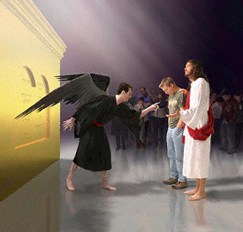
How to Handle the Accuser
Revelation 12:10
Edward Church
February 28, 2016

Slide 4
Many Sermons Have Been Preached Focusing on v11
Power of the…
Blood (His)
Testimony (Mine)
Commitment (Mine)
Let’s Dig a Little Deeper and Focus on v10
Revelation 12:10-11 (KJV)¹⁰ And I heard a loud voice saying in heaven, Now is come salvation, and strength, and the kingdom of our God, and the power of his Christ: for the accuser of our brethren is cast down, which accused them before our God day and night. ¹¹ And they overcame him by the blood of the Lamb, and by the word of their testimony; and they loved not their lives unto the death.

Slide 5
The Accuser
Satan Will Use Any Avenue to
Discourage
Detour
Disrupt
…God Purpose and Power in Our Lives
But One of His Greatest Tools is Accusation

Slide 6
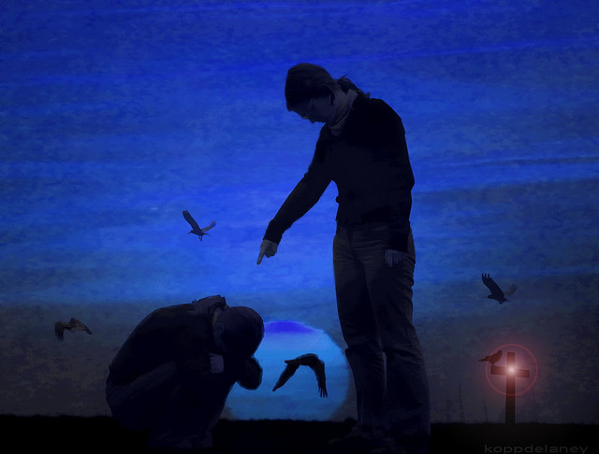
Fighting the Accuser
The Reason So Many Christians Hang On to the Guilt of Their Sin Even Though They Know About God’s Total Forgive­ness…
There Is Someone Who Does Not Want You To Be Free;
…His Name Is Satan.
Not Only Is Satan Called the Father of Lies, but the Accuser
His Purpose / Pleasure is to Make You Feel Guilty
Rev 12:10 Tells Us That Satan Accuses Us Before God Day/ Night
Can You Hear His Voice Accusing You?

Slide 7
A freshman at Eagle Rock Junior High won 1st prize at the Idaho Falls Science Fair w- a scientific survey he conducted. He urged people to sign a petition demanding strict control or total elimination of a chemical known as "Dihydrogen monoxide" Because:
It can cause excessive sweating and vomiting
It is a major component in acid rain
It can cause severe burns in its gaseous state
Accidental inhalation can kill you
It contributes to erosion
It decreases the effectiveness of automobile brakes
It has been found in tumors of terminal cancer patients.
He asked 50 people - 43 said yes -6 were undecided …Only One Knew that the Chemical is ...
Water (2 molecules of Hydrogen/ 1 of oxygen)

Slide 8
Satan’s Desire to Manipulate Mind
1- Devil =Diablos
dia(thru-penetrate) ballo(I Throw)
40 times used in New Test
2- Satan =Accuser
Shantana(to hate/ to accuse)
50 times in OT / NT
3- Angel of Light

Slide 9
Satan’s Desire to Manipulate Mind
2 Corinthians 11:14 (KJV) ¹⁴ And no marvel; for Satan himself is transformed into an angel of light.
Marvel not-
don’t be surprised
Satan-
the accuser
Transformed-
transfigure or disguise
Angel of Light-
Minister of Truth

Slide 10
There is a Difference Between…
…What is Real
…and What is Perceived

Slide 11
Conditioning Process
Satan Knows Most of Us…
…Will Not Fall for an Outright Lie
So He Works a 3 Step…
…Conditioning Process
1st - Starts with Truth… -Gen 3:1
2nd - Then Truth Mixed with a Lie -Gen 3:4
Eventually…
3rd - Then Outright Lie Mixed with Truth -Gen 3:5

Slide 12
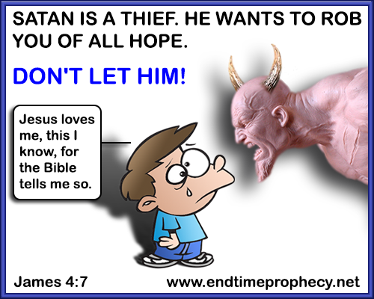
Step 1- Recognize the Voice
When You Have Thoughts That Bring On Condemnation, can you tell the Difference Between God’s Conviction/ Satan’s Accu­sations?
God Convicts Us of Sin for the Sake of Leading Us to Free­dom.
Our enemy taunts for the purpose of keeping us in bondage.
God Wants You to Know/ Receive His Forgiveness for Your Past.
Satan wants you to dwell on how bad you are.
Satan Will Discourage You With Thoughts Like These:
What you did was so bad
You can never be a true Chris­tian with a past like yours
God’s Voice Always Offers Freedom.
“Where the Spirit of the Lord is, there is freedom” -2 Cor 3:17

Slide 13
Conviction vs Condemnation
Conviction
Comes from God
Shows the Fault
Turns UPward (repent)
Leads to Hope
Restoration
and
Life
Condemnation
Comes from Satan
Dwells on the Fault
Turns INward (repress)
Leads to No Hope
Condemnation
and
Death

Slide 14
Step 2- Remember the Cross
Satan’s Accusations Feel Powerful Because in One Sense…
…They Ring True.
In Our Sinful State, We Are Not Worthy of Fellowship with God.
“we all have sinned and fallen short of God’s glory” -Rom 3:23
“wages of sin is death but the Gift of God is Eternal life” -Rom 6:23
If It Were Not For Jesus’ Sacrifice On the Cross, We Would Be Forever Burdened w/ the Condemnation of Sin.
Satan Wants You To Forget The Cross Forever Cancelled Sin! “Therefore, since we have been justified through faith, we have peace with God through our Lord Jesus Christ” -Rom 5:1

Slide 15
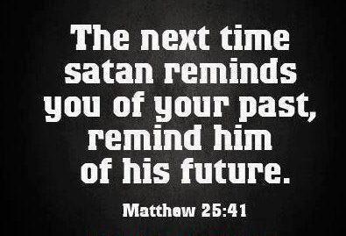
Step 3- Declare the Truth
When You Feel the Sting of Accusation/ Guilt, What Do You Do?
You Pull Out the Enemy’s Fiery Dart / Throw It Back at Him!
Refuse to Believe His Lies / Declare God’s Truth Out Loud- Rom 8:1
“There is no condemnation for me because I’m in Christ Jesus”
“He will turn again, he will have compassion upon us; he will subdue our iniquities; and thou wilt cast all their sins into the depths of the sea” - Micah 7:19
“For I will be merciful to their unrighteousness, and their sins and their iniquities will I remember no more”- Heb 8:12
“As far as the east is from the west, so far hath he removed our transgressions from us” -Psalm 103:12

Slide 19
Step 3- Declare the Truth
Love keeps no record of wrongs (1 Corinthians 13:5). Do you believe this? In Surprised by the Healer, readers heard what Lorraine said, “A time comes to let yourself off the hook.” The name of Lorraine’s hook was abortion. What is the name of yours? Will you name your hook and agree with God that it is time to tear up the record of your wrongs? Will you pray
In the powerful passage about spiritual warfare, Ephesians 6, we are told to put on the armor of God and then to stand. In fact, we are encouraged “to stand” three times in those few verses (Ephesians 6:11, 13, 14). Holding the shield of faith in our left hand and the sword of the Spirit, which is the Word of God, in our right hand, we stand. And just as Jesus did when Satan tempted Him (Matthew 4), we declare Scripture in response to Satan’s taunts: “Satan, you don’t want me to forgive other people or myself because you don’t want me to be free. You want me to be in bondage. You are not going to outsmart me. I am familiar with your evil schemes.”³ When guilt whispers condemnation, what do you do? You worship your King, who forgave you and brought you out of dark­ness into His glorious light. And you sing His praises loudly! When you are refusing and resisting the fiery darts of the enemy, worship is a wall of protection around your soul. So worship, declaring the truth of God’s great love for you! Forgiving yourself may bring about the breakthrough you have been looking for. Your fear of intimacy or determination to stay in control—are they rooted in bondage to the guilt of past sin? How would your life be different if you were truly free?

Slide 20
Guilt Can Be Negative Or Positive
Positive (Helpful)
Comes from Holy Spirit
Productive
Leads to Conviction
Draws us Closer to God
Promotes Relationships
Restores Confidence
Moves Us Forward
Example= Peter
Negative (Harmful)
Comes from Satan
Counterproductive
Leads to Condemnation
Separates from God
Damages Relationships
Destroys Confidence
Stuck in Past
Example= Judas

Slide 21
Satan’s Desire to Manipulate Mind
1- Adversary
2- Roaring Lion
3- Angel of Light
4- Devil =diablos
1-dia (thru-penetrate) 2-ballo (I Throw)
40 times used in New Test
5- Satan / Accuser
Shantana (to hate/ to accuse)
50 times in OT / NT

Slide 22
Guilt Can Be Negative Or Positive
Peter
Repented to God
Turned UPward
Led to Restoration
and
Life
II Cor 7:10, “Godly Sorrow Worketh Repent”
Judas
Repented Self
Turned INward
Led to Condemnation
and
Death
Matt 27:3, “Repented Himself..”

Slide 23
Step 1- Recognize the Voice
When you have thoughts that bring on condemnation, can you tell the difference between God’s conviction and Satan’s accu­sations? God convicts us of sin for the sake of leading us to free­dom. Our enemy taunts for the purpose of keeping us in bondage. One way to discern the voice of God is to distinguish between guilt and shame. Guilt is related to what we have done; shame speaks condemnation over who we are. When God convicts us, we may feel guilty for our sin, but along with that conviction is the invitation to confess our sin and to embrace the forgiveness Jesus offers. Satan’s accusations inevitably lead to shame—an overriding sense of help­lessness and oppression. He will convince you that there is no posi­tive way forward and that you can do nothing to be free. God longs for you to know and receive His forgiveness for your past. Satan wants you to dwell on how bad you are. His flaming arrows (Ephesians 6:16) make you doubt that God could or would completely forgive you. Satan will discourage you with thoughts like these: What you did was so bad. You can never be a true Chris­tian with a past like yours. When you discern the condemning voice of your enemy, remember that God would never cover you with shame. His voice always offers freedom. “Where the Spirit of the Lord is, there is freedom” (2 Corinthians 3:17).

Slide 24
Step 1- Recognize the Voice
His flaming arrows (Ephesians 6:16) make you doubt that God could or would completely forgive you. When you discern the condemning voice of your enemy, remember that God would never cover you with shame.

Slide 25
2- Remember the Cross
If it were not for Jesus’ sacrifice on the cross, we would be forever burdened with the condemnation of sin. Satan desperately wants you to forget the cross. He’s happy for you to wear one around your neck or hang one in your house, as long as you don’t remember that Jesus’ death on the cross forever cancelled sin! “Therefore, since we have been justified through faith, we have peace with God through our Lord Jesus Christ” (Romans 5:1).

Slide 26
Several years ago, a freshman at Eagle Rock Junior High won first prize at the Greater Idaho Falls Science Fair with a scientific survey that he conducted. In his project he urged people to sign a petition demanding strict control or total elimination of a chemical known as "Dihydrogen monoxide" because: 1. It can cause excessive sweating and vomiting. 2. It is a major component in acid rain. 3. It can cause severe burns in its gaseous state. 4. Accidental inhalation can kill you. 5. It contributes to erosion. 6. It decreases the effectiveness of automobile brakes. 7. It has been found in tumors of terminal cancer patients. Then he asked 50 people if they support a ban of this particular chemical. 43 said yes 6 were undecided And only one knew that the chemical is ... water. (2 molecules of Hydrogen/ 1 of oxygen) APPLY: When you know the answer, the question seems silly. Water isn’t really dangerous. Granted it is a major component in acid rain (it’s the rain) And when it’s in its gaseous state (steam) it can cause severe burns And if you accidentally inhale it, you can drown. All of those statements were true. And if you didn’t know any better, you might be afraid of Dihydrogen monoxide". You might ask for this chemical to be either eliminated or controlled by the FDA. You might become afraid of water… that is… IF you didn’t know any better. But when you know better, the fear seems irrational.

Slide 27
Fighting the Accuser
He does not want God to have the glory shown through the miracle of forgiveness. He would much rather Christians walk in a cloud of shame vs freedom Embracing God’s forgiveness may be a theological concept, but it can also have practical implications for your daily life. We want to share with you three steps you can take to find freedom from the enemy’s accusations.

Slide 28
We begin life ALREADY JUDGED.
No chance to ’get it right’.
But once we are born from above,
our sins are ALREADY JUDGED.

