Slide 2
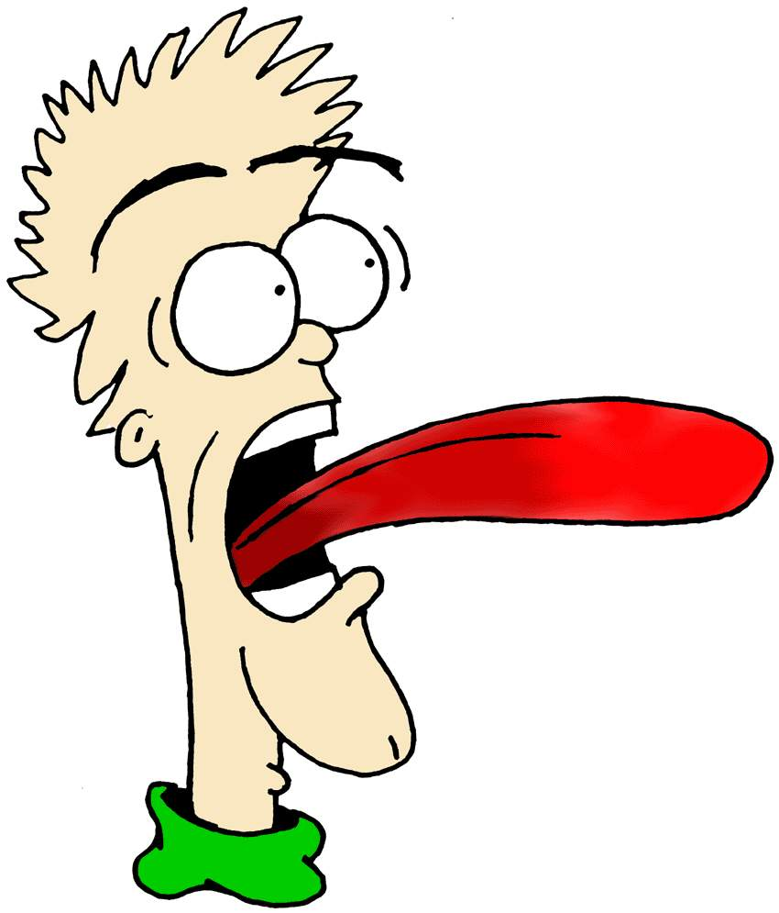
Getting Rid of the Bad Taste in My Mouth “the Power of My Words”
Proverbs 18:21

Slide 3
Is Your Words Leaving…?
Bad Taste
When it’s Coming from Me
I’m Giving It…
Bad Breath
When it’s Coming toward You
I’m Getting It…
Either Way…
…It’s Time to Spit Them Out!

Slide 4
In a Cemetery in Ireland is a Tombstone with the Following Inscription:
"Here Rests in Silent Clay…
…Mrs. Arabella Young
Who on the 21st of May…
…Began to hold her tongue"

Slide 5
"The tongue is the only tool that grows sharper with constant use.“
Washington Irving
It was said of Jesus,
"No one ever spoke the way this man does" -John 7:46
It was said of God,
“As it is written, I have made thee a father of many nations,)
before him whom he believed, even God, who quickeneth the dead,
and calleth those things which be not as though they were” -Rom 4:17
My Momma Said,
“Boy, Don’t let your mouth write a check…
…that your behind can’t cash”

Slide 6
Words are Powerful
Everyone Experiences:
Pain
Heartache
Misunderstanding
Stumbling Blocks
Setbacks
Life is:
5% what Happens to You
95% How You Respond
Our Tongue has a Major Role to Play in that 95%

Slide 7
Power of Your Words
Our Tongue has a Major Role to Play in that 95%
Your Words Can:
Lengthen
Broaden
Deepen
The Gap Between Your Trial and Your Testimony
In that Gap is:
Pain
Self-Pity
Excuses
Blame
Attack

Slide 8
Words are Powerful
Words can…
Wound or Heal
Bless or Curse
Build or Destroy
Redeem or Ruin
Proverbs 18:21
Death and life are in the power of the tongue:
and they that love it shall eat the fruit thereof.
Extremes
Experiences

Slide 9
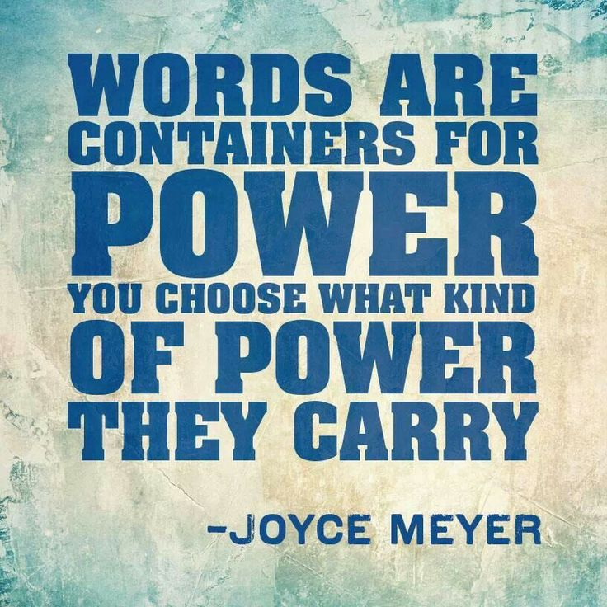
Power of Your Words
Proverbs 18:21, “Death and life are in the power of the tongue:
and they that love it shall eat the fruit thereof”
Death- death, place or state (hades); pestilence, ruin -to kill :crying,
(put to, worthy of) death, destroy (-er), × surely, × very suddenly,
Life- alive; fresh, strong; life, maintenance, + merry, to revive, give (promise)
nourish up, preserve (alive), quicken, recover, repair, restore (to life)
Power- power, means, direction, able, custody, dominion, fellowship, force -hand
Tongue- Speech –language -communication
Eat- burn up, consume, devour
Fruit- Reward –bear, grow fruit/ evidence- first fruit
Words are Actually Seeds

Slide 10
Eliminate Negative, Dysfunctional Speech
How Many…
Lives
Relationships
Marriages
Families
Churches
Businesses
…Are Torn Apart Because of Words?
What Kind of Speech Do We Need to Eliminate ?
The Bible Identifies Ten Negative Forms of Speech.

Slide 11
Bible Identifies Ten Negative Forms of Speech
Verbosity (Prov. 10:19) = talking too much.
Everything can't be solved by more words.
Gossip "gossip betrays a confidence" (11:13) / "separates close friends" (16:28).
"Without wood a fire goes out; without gossip a quarrel dies down" (26:20).
Slander (James 4:11-12) GK=slander is blasphemia.
It can be directed toward God or others.
Devil is diabolos in Gk = "slanderer and false accuser" (Rev. 12:10).
"The evil tongue slays three: the slanderer, the slandered, and the listener."
Judgment (Matt. 7:1-2). we are not qualified to judge
We don't know all the facts of anyone's life and situation
We base our judgment on speculation, assumption, and often hearsay.
The law of God states every matter should be established by 2/3 witnesses.

Slide 12
Eliminate Negative, Dysfunctional Speech
Criticism (Eph. 4:29) Unhealthy -criticism tears down instead of building up
Complaint (James 5:9) Complaining can become a bad habit.
We are told to "do everything without complaining or arguing" (Phil. 2:14).
Anger (Eph. 4:30-32) Anger is not sin, but it can lead us to sin. Angry words can be caused by either a quick outburst or deep-seated pent up feelings
Filthy Language (Col. 3:8) profanity comes from two Latin words—pro, "in front of or outside of," and fanum, "temple." Profanity is speech unfit for a holy place.
Deceit (Col. 3:9) "Do not lie to each other" “shall not give false testimony" (Ex. 20:16)
Doubt (James 1:8). When we waver between faith and doubt create instability.

Slide 14
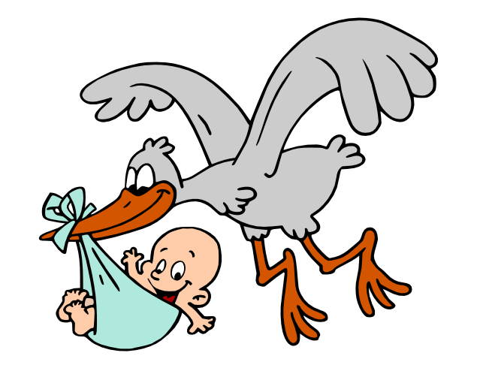
Express Positive, Constructive Speech
John 6:63 "The words I have spoken to you are spirit and they are life"
1 Cor 13:13 is Model to Learn How to Speak Words that Bring Life:
Words of Faith. Communicate in ways that inspire Faith in God (Matt. 17:20)
I can do all things through Christ who strengthens me" (Phil. 4:13)
Words of Hope. Communicate in ways that bring encouragement, enthusiasm, and optimism. Believe the best about situations and people. Hope means that things can change for the better, because "with God all things are possible" (Matt. 19:26).
Words of Love. The greatest of all virtues is love.
Paul describes love in this passage in 1 Corinthians, which also describes the kind of loving words we need to speak.
Read chapter 13 and substitute the phrase "Love is..." with the phrase "Speak words that are..." ("Speak words that are patient, kind, never boasting, never proud...").

Slide 15
Power of Your Words
Consider the Promise/ Caution: "Those who love it will eat its fruit" -Prov. 18:21
Those who enjoy talking will reap the harvest of their words.
This is the law of sowing and reaping.
Words are like seeds sown that produce a harvest.
When James finishes his discourse on the power of the tongue, he says,
"Peacemakers who sow in peace raise a harvest of righteousness" (Ja 3:18)
Your words today will set a harvest in motion for tomorrow.
So let us pray: "May the words of my mouth and the meditation of my heart be pleasing in your sight, O Lord, my Rock and my Redeemer" (Ps. 19:14)

Slide 16
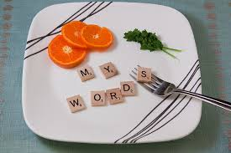
Power of Your Words

Slide 18
Joke
Two snakes slithered down the road. One snake turned to the other and asked, ''Are we poisonous?“ The other snake replied, "I don't know. Why do you ask?"
The first snake replied. "'Because I just bit my lip!“
A guy came to his pastor and said, “Reverend, I only have one talent.” The pastor asked, “What’s your talent? The man said, "I have the gift of criticism." The pastor was wise and replied, "The Bible says that the guy who had only one talent went out and buried it. Maybe that’s what you ought to do with yours.“
Tell Me more- tell me more –I cant – I Have already told u more than I heard
A vacuum salesman appeared at the door of an old lady's cottage and, without allowing the woman to speak, rushed into the living room and threw a large bag of dirt all over her clean carpet. He said, "If this new vacuum doesn't pick up every bit of dirt then I'll eat all the dirt.“ The woman, who by this time was losing her patience, said, "Sir, if I had enough money to buy that thing, I would have paid my electricity bill before they cut it off. Now, what would you prefer, a spoon or a knife and fork?"

Slide 19
Joke
A lady asked a man working in the produce department if she could buy half a head of lettuce. He replied, "Half a head? Are you serious? God grows these in whole heads and that’s how we sell them!" "You mean," she persisted, "that after all the years I’ve shopped here, you won’t sell me half-a-head of lettuce?" "Look," he said, "If you like I’ll ask the manager." She indicated that would be appreciated, so the young man marched to the front of the store. "You won’t believe this, but there’s a lame-braided idiot of a lady back there who wants to know if she can buy half-a-head of lettuce." He noticed the manager gesturing, and turned around to see the lady standing behind him, obviously having followed him to the front of the store. "And this nice lady was wondering if she could buy the other half" he concluded. Later in the day the manager cornered the young man and said, "That was the finest example of thinking on your feet I’ve ever seen! Where did you learn that?" "I grew up in Grand Rapids, and if you know anything about Grand Rapids, you know that it’s known for its great hockey teams and its ugly women." The manager’s face flushed, and he interrupted, "My wife is from Grand Rapids!" "And which hockey team did she play for?"

Slide 20
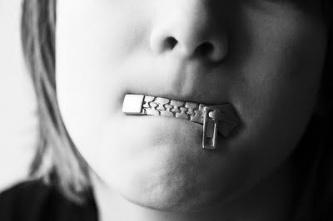
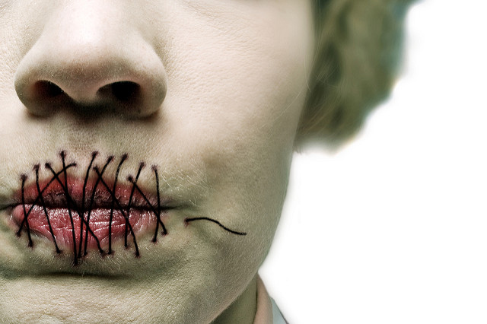

Slide 21
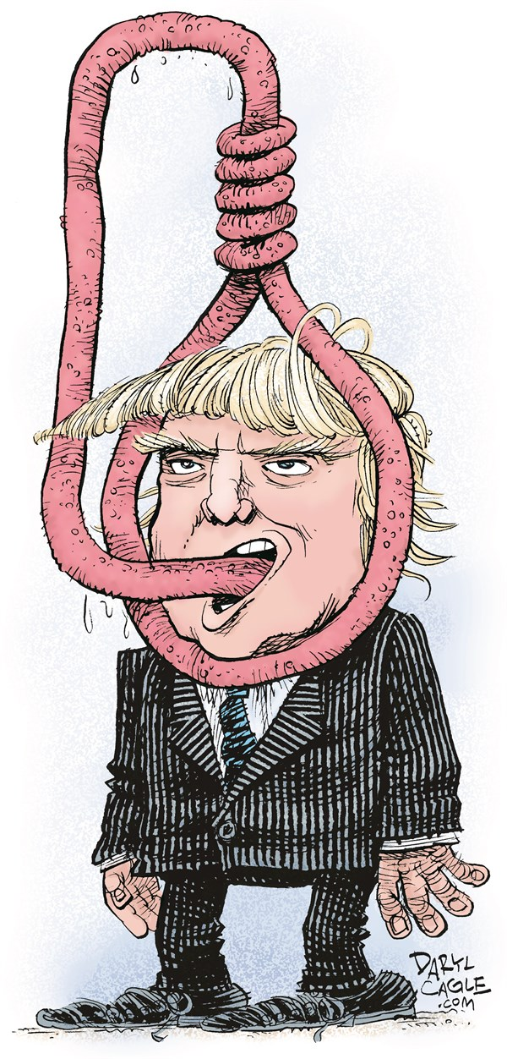
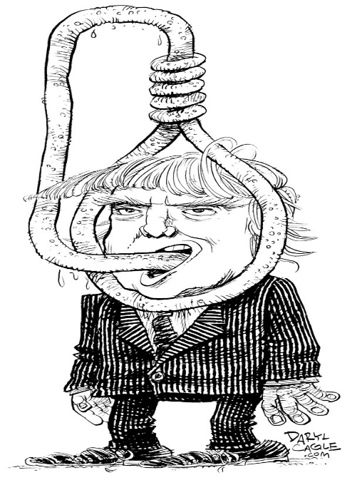
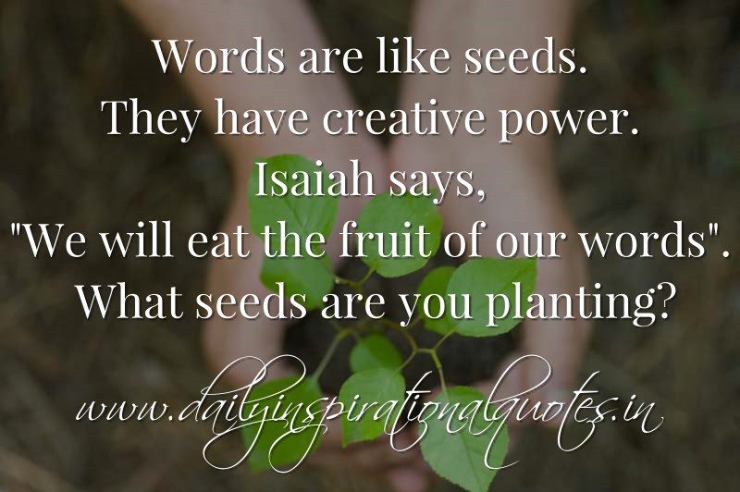

Slide 22
Proverbs 12:18 (KJV) ¹⁸ There is that speaketh like the piercings of a sword: but the tongue of the wise is health.
Proverbs 18:21 (KJV) ²¹ Death and life are in the power of the tongue: and they that love it shall eat the fruit thereof.

Slide 23
Power of Your Words

Slide 24
Power of Your Words

