Slide 2
Lessons from Failure
John 21:1-17
Edward Church
March 13, 2016

Slide 3
Did You Know That...
Henry Ford failed to put a reverse gear in his 1st car?
Thomas Edison failed in 1,000 experiments inventing lightbulb?
Abraham Lincoln lost nine elections/ failed in business twice before being elected president?
Albert Einstein was dismissed from school because he lacked interest in his studies, failed an entrance exam to a school in Zurich/ was later fired from his job as a tutor?
Beethoven's music teacher, said he would never compose any worthwhile music because he failed to follow the rules of musical composition? Plus he was Deaf!
Michael Jordan failed to make the junior-varsity basketball team when he tried out, and later the school principal told him to consider enlisting in the Air Force Academy after high school, which would be his best option for a career?

Slide 4
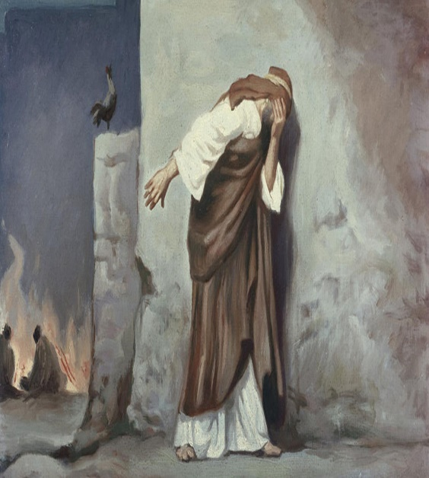
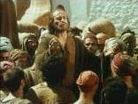
The Road to Success is Lined w- Failures
For Some…
Failure Becomes:
Self…
Description
Restriction
Destruction
For Some…
Failure Becomes:
Fresh…
Challenge
Opportunity
Start

Slide 5
The Road to Success is Lined w- Failures
Some People Want to Play It Safe
They Just Want Security
No Risks
Douglas MacArthur said,
"There is no security on this earth. There is only opportunity"
Chinese Symbol for Crisis (Danger and Opportunity)
It's all in Your Perspective
Until You Are Willing to Risk…
…You Will Remain Imprisoned In Our World Of Fear

Slide 6
Life is Full of Risks
Faith is a Risk
Love is a Risk
Serving God is a Risk
Financial Investing is a Risk
Career Change is a Risk
Following Your Dream is a Risk
Stealing Home Plate is a Risk
Marriage is a Risk
Having Children is a Risk
When You Take the Willingness to Risk Failure and…
…Couple It with Sound Wisdom and Faith in God,
Nothing is Impossible!

Slide 7
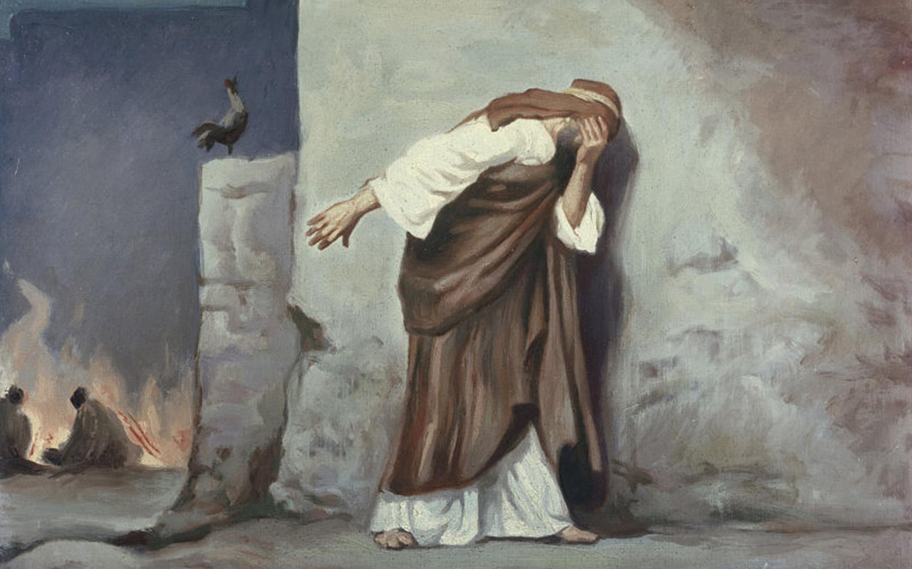
Sometimes Failure Hits Us Hard
Just Like it Did Simon Peter When he Denied Christ
He Went Out from "hall of judgment" and Wept Bitterly
But That's Not Enough
If All You Do Is Weep Bitterly Over Your Failures…
…You Will Never Be Any Better Off For Having Failed
Don't Waste Your Sorrows
Use Your Failures to Become Better, Not Bitter
Remember –God Never Wastes Your Pain!
Five Lessons About Facing Our Failures from Peter's Experience

Slide 8
#1- Failure Is Never Final (4)
After Jesus' Resurrection,
Peter Still Felt So…
Discouraged
Useless
…Because He Denied Jesus
…He Told The Others, "I'm Going Fishing”
... I've Failed …Jesus Can’t Use Me …I'm Going Back (3)
Jesus Came Seeking…
What Joy to Know that Christ Comes Looking For Us When We Fail
"Early in the morning"
Speaks of a New Day, a New Opportunity, a New Beginning
We Can Put the Past Behind Us / Reach For What is Ahead

Slide 9
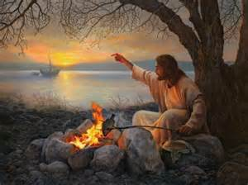
#2- “ “ Does Not Change Our Status W- God (5)
John 21:5 (NIV) He called out to them, “Friends, haven’t you any fish?” “No,” they answered.
"Friends" -a Word of Intimacy
He Called Them Friends the Night of the Last Supper -John 15:15
Its Means that We Are Close to Him/ He Is Close to Us.
Abraham was Called the Friend of God -2 Chronicles 20:7
Moses Spoke W- Him as His Friend -Exodus 33:11

Slide 10
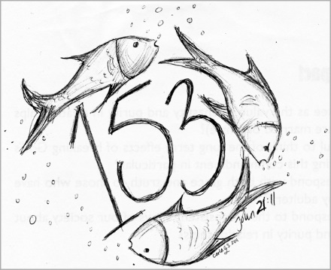
#3- Failure Can Be Transformed Into Success (6)
"Throw your nets in again”
Try again
There is No Shame in Trying and Failing
The Shame Lies in Being Too Afraid to Try in the First Place
Jonah- the Word of the Lord Came the Second Time
They Caught 153 Fish
153 species of fish in the Mediterranean -Jerome
Referred to Their Success to Evangelize the Entire World
Try again!

Slide 11
#4- Failure Does Not Mean You Are a Failure (12)
"Come and have breakfast"
The Communal Meal of Close Friendship is Depicted So Beautifully
Eating is Synonymous with Fellowship
The Bread/ Fish Reminded Them of Feeding the 5,000
Passover
Two Disciples on the Emmaus Road when Eyes were Opened
Failure Does Not Have to Permanently Scar Your Life
In Christ, Old Things Pass Away, and All Things Become New!
Jesus' Invitation is, "Come and have breakfast!"

Slide 12
#5- “ “ Does Not Disqualify Us for Service (15-17)
Jesus told Peter, "Feed my sheep"
Jesus was Giving Him a 2nd Call
4 Years Earlier- "Come, follow me" (Matt 4:19; Mark 1:17)
God is the God of a Second Chance.
We See this Same Principle in
Jonah: "The word of the Lord came to Jonah a 2nd time" (3:1)
Jeremiah: God Spoke to Him a Second Time (33:1)

Slide 13
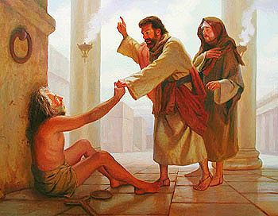
Whatever Failure You Have Experienced,
…Get Back Up Today By Grace
Get Back in the Game of Life
Get Back to Work for Jesus
God's Not Finished with You Yet!

Slide 15
Failure
There was a gentleman in the hospital bed next to me. He was covered with bandages from head to toe.
I said to him, "What do you do for a living?"
He said, "I'm a former window washer."
I asked, "When did you give it up?"
He said, "Halfway down."

Slide 16
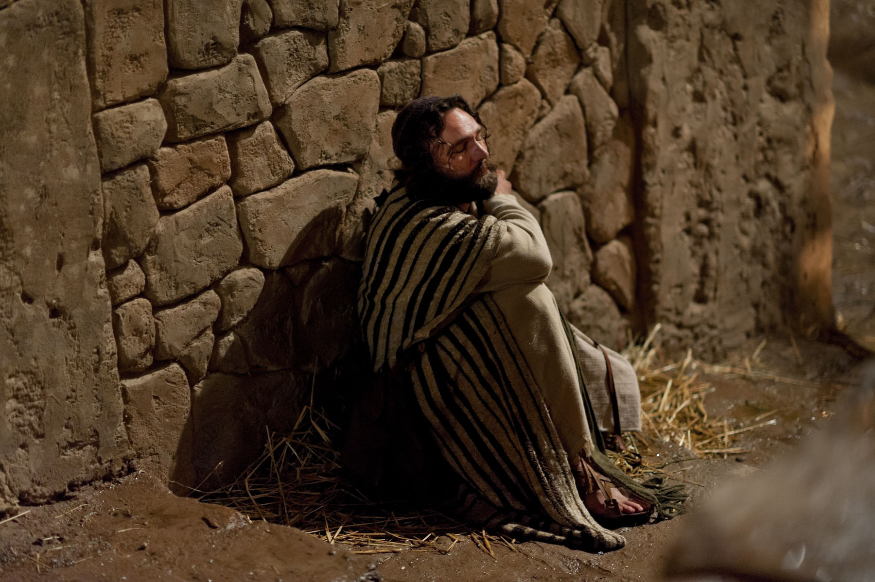

Slide 17
The Road to Success is Lined w- Failures
Fear of Failure keeps more people from trying than any other factor.
Failure, like beauty, is in the eye of the beholder.
For Some, Failure Becomes:
Their Self-Description
Fresh Challenge (Opportunity)

Slide 18
Failure Is Never Final (4)
The Seeking Shepherd. After Jesus' resurrection, Peter still felt so discouraged and useless to God because he denied Jesus that he told the others, "I'm going fishing. Enough of this ministry business. I've failed. I'm going back to my comfort zone" (see v. 3). Then Jesus passed by, and that made all the difference. What a joy to know that Christ comes looking for us when we fail.
"Early in the morning."
The morning speaks of a new day, a new opportunity, a new beginning.
We can put the past behind us and reach for what is ahead.
It is not coincidence that the Resurrection took place in the morning. Luke 24:1, 2 says, "On the first day of the week, very early in the morning... they found the stone rolled away from the tomb." Perhaps that was the fulfillment of Malachi's vision of the Messiah, who said, "The Sun of righteousness shall arise with healing in His wings" (4:2, NKJV).
Night may have set in your life, but the Sun of righteousness will shine on you because failure is never final.

Slide 19
Failure Does Not Change Our Status W- God (5)
"Friends" What a word of intimacy. He called them friends the night of the Last Supper (John 15:15). Let me remind you of two vital aspects of Christ's friendship, which, by the way, does not bring God down to our level nor us up to His. It does mean that we are close to Him, and He is close to us. Even Abraham was called the friend of God (2 Chronicles 20:7), and Moses spoke with Him as His friend (Exodus 33:11). By the way, have you seen the new bumper sticker, "Friends don't give friends fruitcakes"?
The Prodigal Son: servant or son? After the Prodigal Son comes to his senses and realizes what a colossal mess he's made of his life, he says to himself, "I will set out and go back to my father and say to him: 'Father, I have sinned against heaven and against you. I am no longer worthy to be called your son; make me like one of your hired men'" (Luke 15:18, 19). Why does he make such a statement? Because he cannot fathom a forgiveness great enough to restore his relationship with his father like it was before he left. As far as he was concerned, his youthful rebellion and indulgent lifestyle, which had cost him his inheritance and left him penniless, was enough to permanently ruin their relationship. Now for the rest of the story:
So he got up and went to his father. But while he was still a long way off, his father saw him and was filled with compassion for him; he ran to his son, threw his arms around him and kissed him. The son said to him, "Father, I have sinned against heaven and against you. I am no longer worthy to be called your son." But the father said to his servants, "Quick! Bring the best robe and put it on him. Put a ring on his finger and sandals on his feet. Bring the fattened calf and kill it. Let's have a feast and celebrate. For this son of mine was dead and is alive again; he was lost and is found" (vv. 20-24).
Do you get the picture? The Prodigal refers to himself as a servant. But his father calls him "my son." There's a world of difference between a servant and a son. The point is, the father's forgiveness had fully restored their relationship as if it had never been severed.

Slide 20
#2- “ “ Does Not Change Our Status W- God (5)
"Friends" What a word of intimacy.
He called them friends the night of the Last Supper -John 15:15
Its mean that we are close to Him, and He is close to us.
Abraham was called the friend of God -2 Chronicles 20:7
Moses spoke with Him as His friend -Exodus 33:11
The Prodigal Son: servant or son?
comes to his senses/ realizes what a colossal mess he's made of his life, he says to himself, "I will set out and go back to my father and say to him: 'Father, I have sinned against heaven and against you. I am no longer worthy to be called your son; make me like one of your hired men'" -Luke 15:18, 19
he could not fathom a forgiveness great enough to restore his relationship with his father like it was before he left.
he goes to his father.
But while he was still a long way off, his father saw him and ran to his son, threw his arms around him and kissed him. For this son of mine was dead and is alive again; he was lost and is found" (vv. 20-24).
The Prodigal refers to himself as a servant. But his father calls him "my son." There's a world of difference between a servant and a son. The point is, the father's forgiveness had fully restored their relationship as if it had never been severed.

