Slide 2
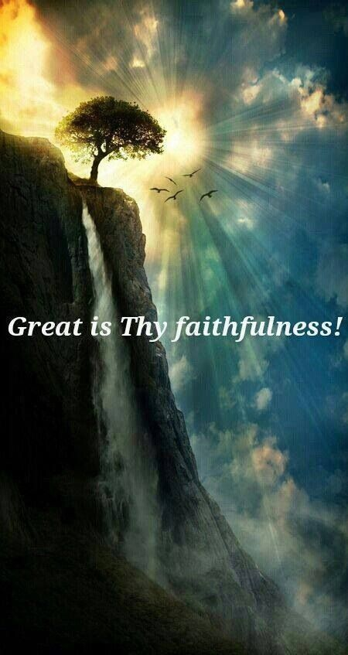
God’s Faithfulness Greater Than My Failure
Lam 3:19-25
Pt 1
Edward Church
March 20, 2016

Slide 3
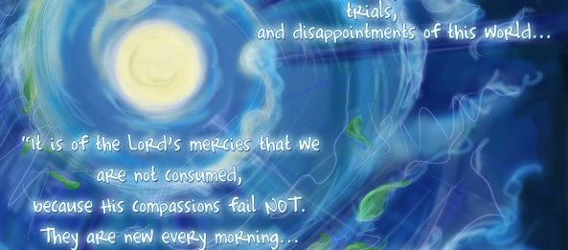
Failure is:
Common
Painful
Teacher
Vacuum
Zaps Our Hope
This was the Problem with Jeremiah
He was About to Find…
…Hope Greater Than His Hurt

Slide 4
In Ancient Times, Ships Would Have a "Forerunner"
Gk: proderomos- "who went before us"
Known as the “Anchorarius"
This Forerunner was in Charge of the Ship's Main Anchor.
W- a Group of Sailors, He Would Carry the Anchor in a Smaller Boat into a Safe Harbor/ Set It There.
Although the Ship Remained Outside the Harbor,
It Was Anchored Within/ Held Secure Against the Wind/ Waves…
…that Could Carry It Out to Sea or
…Dash It Against Rocks Along the Shoreline

Slide 5
Forerunner
The One Person Chosen to Arrive at a Designated Place Before Others in the Group
Arriving First for Three Purposes:
Give Notice of Their Approach
Take Possession in Their Name
Prepare for Their Arrival

Slide 6
Jesus is Our Forerunner
As Our Forerunner, Christ is Your…
Steadfast Hope
Anchoring You Within the Safe Harbor of Heaven
He Secures You Here On Earth
Assures You of Your Eventual Safe Arrival There
"We have this hope as an anchor for the soul, firm and secure. It enters the inner sanctuary behind the curtain, where Jesus, who went before us, has entered on our behalf. He has become a high priest forever, in the order of Melchizedek." -Hebrews 6:19-20

Slide 7
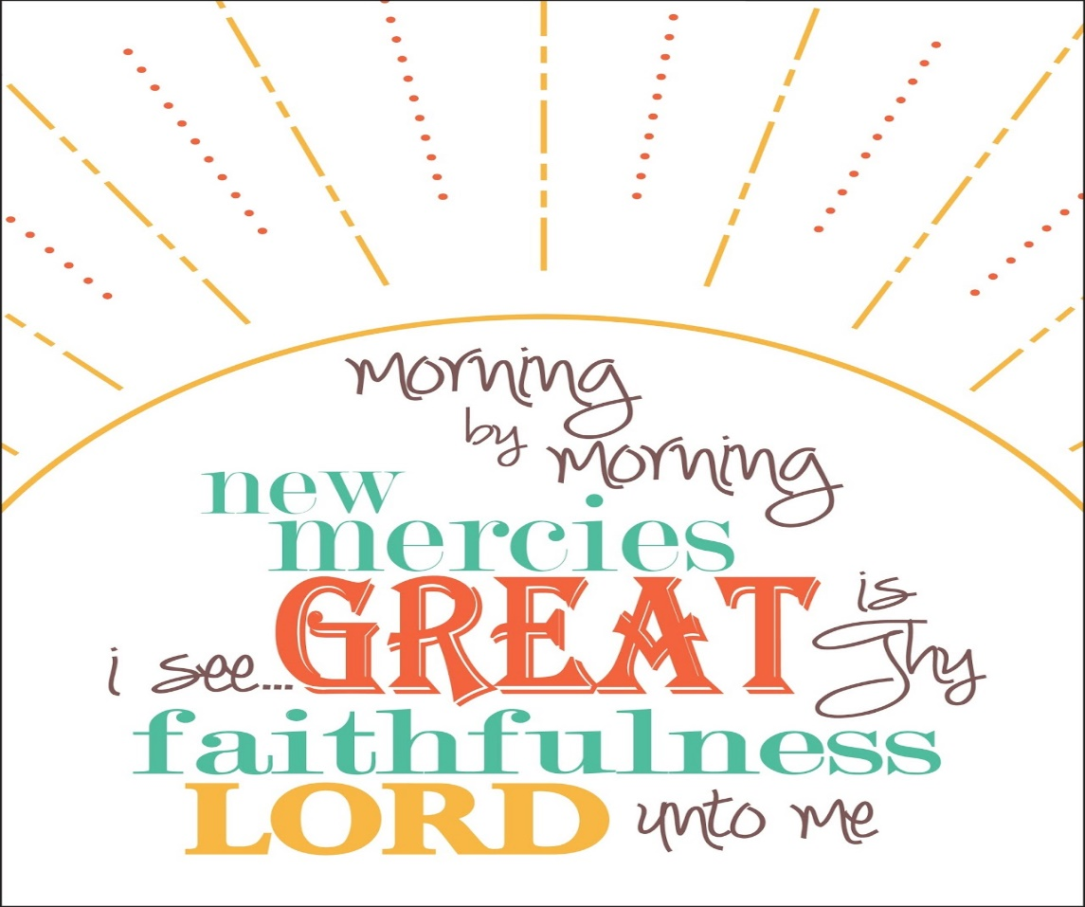
Jesus is Our Forerunner
Our “Forerunner" Jesus Arrived at a Designated Place Before Us
…Arriving First for Three Purposes:
Give Notice of Their Approach
Acts 1 –He Was Taken Up
Take Possession In Their Name
Mark 16 –In My Name
Prepare For Their Arrival
John 14 –I Go To Prepare A Place

Slide 8
Regaining Our Hope
Regaining a Hopeful Outlook On Life is Not Complicated
All It Requires is a Shift in Focus…
Not On "The Storm"
But On God / His Hope in the Storm
Because of God's Faithfulness…
…Hope Anchored In His Character
…Will Hold Us True in Any Storm

Slide 9
Regaining Our Hope
Meditating On God's Unfailing Promises…
…In His Unchanging Word
…Will Supply All the
…Stability You Will Ever Need
For I know the thoughts that I think toward you, saith the LORD, thoughts of peace, and not of evil, to give you an expected end. Jeremiah 29:11 (KJV)
I know what I'm doing. I have it all planned out—plans to take care of you, not abandon you, plans to give you the future you hope for.
Jeremiah 29:11 (MSG)

Slide 10
Jeremiah 29:11
God’s Plan
Satan’s Plan
Prosper
Not Harm
Hope
Future
Prevent
Harm
Destroy Hope
No Future
John 10:10 (KJV) ¹⁰ The thief cometh not, but for to steal, and to kill, and to destroy: I am come that they might have life, and that they might have it more abundantly.

Slide 11
Regaining Our Hope
Your Deepest Failures in Life Cannot Thwart God's Faithfulness
Do You Know the Genuine Goodness of God in Your Life—
Immense Mercy
Constant Compassion
Everlasting Love?
Will Be Faithful to You Forever
Do You Know How to Experience Such a Hope that Will…
…Anchor You Through Any Storm?
…Put Your Hope in Him
When You are in the Midst of the Storm- Say…
"I will hope in him" -Lamentations 3:24 ESV

Slide 12
Lamentations 3:19-25 (NLT)
¹⁹ The thought of my suffering/ homelessness is bitter beyond words.
²⁰ I will never forget this awful time, as I grieve over my loss.
²¹ Yet I still dare to hope when I remember this:
²² The faithful love of the LORD never ends! His mercies never cease.
²³ Great is his faithfulness; his mercies begin afresh each morning.
²⁴ I say to myself, “The LORD is my inheritance; therefore,
…I will hope in him!”
²⁵ The LORD is good to those who depend on him,
…to those who search for him.

Slide 13
Lamentations 3:19-25 (MSG)
¹⁹ I'll never forget the trouble, the utter lostness, the taste of ashes,
… the poison I've swallowed.
²⁰ I remember it all-oh, how well I remember-
…the feeling of hitting the bottom.
²¹ But there's one other thing I rem,/ remembering,
…I keep a grip on hope:
²² GOD's loyal love couldn't have run out,
…his merciful love couldn't have dried up.
²³ They're created new every morning. How great your faithfulness!
²⁴ I'm sticking with GOD (I say it over and over). He's all I've got left.
²⁵ GOD proves to be good to the man who passionately waits,
…to the woman who diligently seeks.

Slide 15
Part 2 ?

Slide 16
Look
Look at the Situation Accurately (19-20)
"I remember my affliction and my wandering, the bitterness and the gall. I well remember them, and my soul is downcast within me"
There are Times,
God Allows Us to Be UnComfortable in the Present…
…In Order for Us to Be Productive Later

Slide 17
Line
Line Up Your Thinking with What Gives You Hope (21)
"This I call to mind and therefore I have hope"

Slide 18
Learn
Learn What Gives Hope in the Midst of this Situation (22)
"Because of the Lord's great love we are not consumed, for his compassions never fail"
Sometimes God Leads Us Into Deep Water…
…Not to Drown Us
…But to Cleanse Us

Slide 19
Linger
Linger On this Fact: Every Day God Will Be Faithful to You (23)
"They are new every morning; great is your faithfulness"
New
The mercy and “unfailing love of the LORD never ends! His “mercies begin afresh each day" (Lam 3:19-24 NLT) His mercy is brand spanking new every morning! Everyday you are given a second chance and a fresh start at life! “Oh, give thanks to the God of heaven! For His mercy endures forever. (Ps 136:26 NKJV)
Great
Faithfulness

Slide 20
Let
Let the Lord Fulfill You Totally—not Just Partially (24)
"The Lord is my portion; therefore I will wait for him”
Lord
My
Portion
I Will Wait

Slide 21
Lean
Lean On this Truth to Receive Hope for Your Heart (25)
"The Lord is good to those whose hope is in him, to the one who seeks him"
Good
Hope
In
Seeks

Slide 24
Lamentations 3:19-25 (AMP)
¹⁹ [O Lord] remember [earnestly] my affliction and my misery, my wandering and my outcast state, the wormwood and the gall. ²⁰ My soul has them continually in remembrance and is bowed down within me. ²¹ But this I recall and therefore have I hope and expectation: ²² It is because of the Lord's mercy and loving-kindness that we are not consumed, because His [tender] compassions fail not. ²³ They are new every morning; great and abundant is Your stability and faithfulness. ²⁴ The Lord is my portion or share, says my living being (my inner self); therefore will I hope in Him and wait expectantly for Him. ²⁵ The Lord is good to those who wait hopefully and expectantly for Him, to those who seek Him [inquire of and for Him and require Him by right of necessity and on the authority of God's word].

Slide 25
Lamentations 3:19-25 (KJV)
¹⁹ Remembering mine affliction/ my misery, the wormwood/ the gall. ²⁰ My soul hath them still in remembrance, and is humbled in me. ²¹ This I recall to my mind, therefore have I hope. ²² It is of the LORD'S mercies that we are not consumed,
…because his compassions fail not. ²³ They are new every morning: great is thy faithfulness. ²⁴ The LORD is my portion, saith my soul; therefore will I hope in him. ²⁵ The LORD is good unto them that wait for him,
…to the soul that seeketh him.

