Slide 2
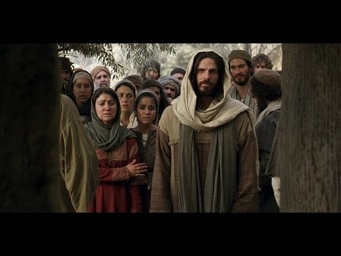
What If Jesus Had Been There?
John 11:21
Edward Church
March 6, 2016

Slide 3
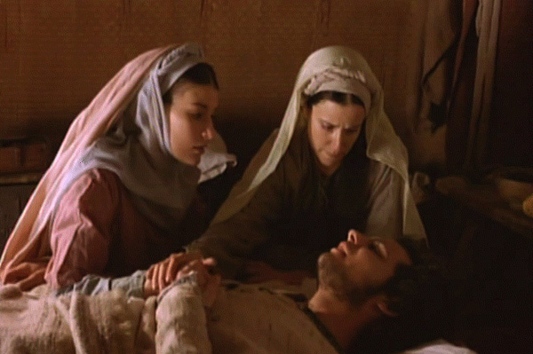
What If Jesus Had Been There?
John 11:21,“Then said Martha unto Jesus, Lord, if thou hadst been here, my brother had not died”
Let’s Look at the Story of Lazarus –Mary / Martha
from a Different Viewpoint
1st- the Place
Bethany = House of Joy
= House of Pain
Its an Intriguing Fact of Life…
…the Thing that can be a Source of Joy
…can Also be a Source of Pain

Slide 4
What If Jesus Had Been There?
John 11:21,“Then said Martha unto Jesus, Lord, if thou hadst been here, my brother had not died”
Let’s Look at the Story of Lazarus –Mary / Martha
from a Different Viewpoint
He Wants to Perfect You…
…Not Pamper You
…And Challenge Your Faith
If Jesus Had of Been There…
…They Would NOT have Discovered
…Seven Things We Need to Know

Slide 5
#1- God Always Hears Our Cries (1-5)
1-5 (Phillips) …Lazarus who became seriously ill. So the sisters sent word to Jesus: "Lord, your friend is ill." When Jesus received the message, he said, "This illness is not meant to end in death; it is going to bring glory to God - for it will show the glory of the Son of God." ⁵ So when he heard of Lazarus' illness he stayed where he was two days longer
Daniel 10:12, "Don't be afraid, Daniel..the 1st day..began to pray- I heard”
Mk 4:38, “Master carest not that we perish?” Mk 4:38
Whatever He Permits to Enter the Arena of Our Lives…
…He Has Purpose Wrapped Up In It
The Reason We Don’t Always…
See
Feel
Experience
…Immediate Answers (the Next 6 Things Give Insight)

Slide 6
#2- It’s Always Too Early to Give Up on God (4)
“When He heard this, Jesus said, “This sickness is not unto death. NO, it is for God’s glory so that God’s Son may be glorified through it.”
2 Things – God has a Plan and Timing
“When Jesus heard that, he said, This sickness is not unto death, but for the glory of God, that the Son of God might be glorified thereby”
“And I am glad for your sakes that I was not there, to the intent ye may believe; nevertheless let us go unto him”
Delays are Not Denials
⁵ Now Jesus loved Martha, and her sister, and Lazarus. ⁶ When he had heard therefore that he was sick, he abode two days still in the same place where he was

Slide 7
#2- It’s Always Too Early to Give Up on God (4)
So What Does This Mean To You Today?
Being a Christian Does Not Mean We Will Never Go Thru Storms
When Sits Enter Your Life Bigger than Your Capacity to Handle…
…Take It to the Lord in Prayer
When You Pray, Rem you are Not Sending Breaking News to God…
…He Knows Everything that Has/ Will Ever Happen to Us
Whatever He Permits to Enter the Arena of Our Lives…
…He has Purpose Wrapped Up in It
His Timing is Not Our Timing
Never Give Up On God…
…No Matter How Grim the Circumstances May Seem!

Slide 8
#3- God Can Resurrect Your Dead Things! (17)
“ ‘ ‘Jesus found that Lazarus had already been in tomb for 4 days”
Waits Two More Days / Then Takes Off for Bethany
Arrives After He had Been Dead for 4 Days
By this Point He Was Legally Dead
Jewish Custom -Wait Until the 4th day to Ensure Truly Dead
Jesus Arrives After…
Professional Mourners There
Body Prepared For Burial/ Wrapped It In Grave Clothes
Body Had Already Begun to Stink
Seemed Hopeless..
…But Jesus Was About to Remove All Doubt!

Slide 9
#4- Our God is Compassionate/ Cares for Us! (35)
“Jesus wept”
When Jesus Saw Her Weeping
He Was Deeply Moved in His Spirit
He Asked Where They Had Laid Him/ Was Taken There
This is Where Jesus Wept
Our God is Compassionate and Cares About Us:
Jesus Cried Like We Cry
Shed Tears Like We Shed Tears
Moved Like We Are Moved
We Do Not Serve A Distant And Despondent God.
God that came down/ lived like we live so that He could meet us where we are
Jesus loved Mary, Martha, and Lazarus / He also loves us
So Don’t Afraid to Take Your Concerns to God

Slide 10
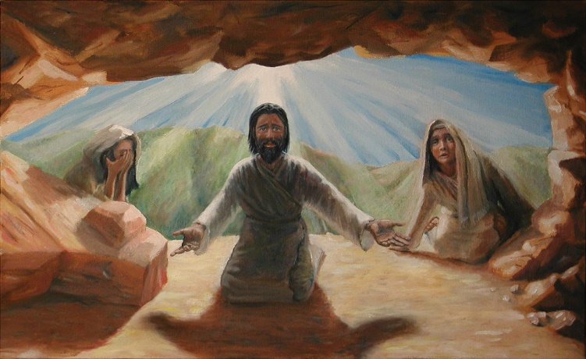
#5- When Life is Out of Control… …God is Always in Control! (34)
“Therefore many of the Jews who had come to visit Mary/ had seen what Jesus did, put their faith in Him”
Interest (34) -Where Have You Laid Him
Invitation (39) -Roll Away Stone
Involved-Empower (43) -Lazarus Come Forth!
Invest (44) -Loose Him And Let Him Go

Slide 11
#5- When Life is Out of Control… …God is Always in Control! (45)
So What Does This Mean to You Today?
Sometimes Bad Things Happen to Good People, for the Glory of God
When God Brings You Through a Storm, Share Your Testimony, so that God Would Get the Glory
Learn from Other People’s Experiences so that God Would Not Have to Send You Through All the Experiences Yourself
It’s Never Too Late for God and it is Not Over Until He Says It’s Over
God is Always in Control!
Delay Does Not Mean Denial!
Whatever God Permits to Enter the Arena of Your Life, He Has Purpose Wrapped Up In It!

Slide 12
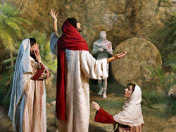
#6- We Have a Part in Our Miracle -Taking Away the Stone! (39)
“Take away the stone” He said.
He was Saying…
You Have a Part
Faith Without Works is Dead -James 2:17
Have to Put Feet On Our Prayers
Remove Our Man-Made Barriers
You Do What You Can Do…
…God Will Do What You Can’t Do

Slide 13
#7- God is Able to Do Far Above What… …You Can Imagine/ Think (43)
“And when he thus had spoken, he cried with a loud voice, Lazarus, come forth”
John 11:44-45, “And he that was dead came forth, bound hand and foot with graveclothes: and his face was bound about with a napkin. Jesus saith unto them, Loose him, and let him go. ⁴⁵ Then many of the Jews which came to Mary, and had seen the things which Jesus did, believed on him”
When He Speaks ..
Your Lazarus will Come Forth!
You Will Know God Did It!
Others Will Know God Did It!

Slide 14
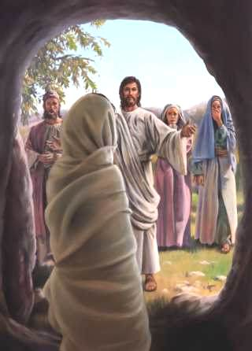
What Needs to Resurrect in Your Life!

Slide 16
Lazarus -heb is Eliezer—God my Helper.
Surely a fitting name for one who was so mightily helped by God.

Slide 18
#2- It’s Always Too Early to Give Up on God (4)
“When He heard this, Jesus said, “This sickness is not unto death. NO, it is for God’s glory so that God’s Son may be glorified through it.”
2 Things – God has a Plan and Timing
When Jesus heard that, he said, This sickness is not unto death, but for the glory of God, that the Son of God might be glorified thereby.
And I am glad for your sakes that I was not there, to the intent ye may believe; nevertheless let us go unto him
Delays are not Denials
⁵ Now Jesus loved Martha, and her sister, and Lazarus. ⁶ When he had heard therefore that he was sick, he abode two days still in the same place where he was
So what does this mean to you today?
1. Being a Christian does not mean that we will never go through any storms. 2. Whenever situations enter your life that are bigger than your capacity to handle, take it to the Lord in prayer. 3. When you pray, remember that you are not sending breaking news to God, like a reporter on the front lines. He knows everything that has and will ever happen to us. 4. Whatever He permits to enter the arena of our lives, He has purpose wrapped up in. 5. His timing is not our timing. 6. Never give up on God, no matter how grim the circumstances may seem!

Slide 19
#3- God can Resurrect Your Dead Things! (17)
“On His arrival, Jesus found that Lazarus had already been in the tomb for four days”
Jesus hung around where He was for two more days and then takes off for Bethany
So here it is, Jesus finally arrives at the scene and not only is Lazarus dead, but he had been dead for four days. By this point he was legally dead. It was the Jewish custom to wait until the fourth day to legally pronounce death, as if to ensure that the person was truly dead.
Jesus arrives after the professional mourners had already mourned his death with the family. Jesus arrives after they had already prepared the body for burial and wrapped it in grave clothes. Jesus arrives after the Jews had already legally pronounced his death. Jesus arrives after rigor mortis had set in and the body had already begun to stink. It was a terrible situation, but Jesus was now on the scene!

Slide 20
#5- When Life is Out of Control -God is Always in Control! (45)
“Therefore many of the Jews who had come to visit Mary/ had seen what Jesus did, put their faith in Him”
We have walked through the entire Lazarus account. It started off with Jesus receiving word that Lazarus was sick. He said, “This sickness will not end in death, No it is for God’s glory that God’s Son may be glorified through it” when He found out. Yesterday we saw that Lazarus was raised from the dead after four days and then loosed of his grave clothes. This morning’s text bring closure to the whole matter. Many of the Jews who had been there mourning with Mary and Martha were present when Jesus raised Lazarus from the dead. This tremendous miracle served as evidence to them that Jesus was the Messiah and they put their faith in Him. Jesus’ statement that this sickness was for God’s glory was made manifest. God did get the glory and the Good Shepherd received new sheep because of it. But we also have to remember that for these people to come to God and for God to get the glory, there was a family in the middle of the story that had to go through a tremendously painful ordeal. Lazarus had to experience sickness and eventual death for four days. Mary and Martha had to experience the loss of their brother and the hurt in knowing that Jesus had received word, but that He had not yet arrived. God permitted this tragedy to enter the arena of this family’s life and remember that these were people that He loved.
So what does this mean to you today? A few things:
1. Sometimes bad things happen to good people, for the glory of God. 2. When God brings you through a storm, share your testimony, so that God would get the glory. 3. Learn from other people’s experiences so that God would not have to send you through all the experiences yourself. 4. It’s never too late for God and it is not over until He says it’s over. 5. God is always in Control! 6. Delay does not mean denial! 7. Whatever God permits to enter the arena of your life, He has purpose wrapped up in!

