Slide 2
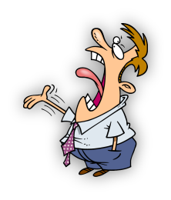
Complain Remain…
Edward Church
April 10, 2016
Philippians 2:14

Slide 3
Complaining
It Can Be…
Action
Spoken and Unspoken
Attitude (Strong Hold)
It is From…
State of Discontent
UnMet Expectations
Cry of the Flesh (Spt Prob)
It Will Harm…
Peace
Joy
Harmony –in a Family, Relationship, Church

Slide 4
Complaining DENIES God’s Sovereignty
But the men that went up with him said, We be not able to go up against the people; for they are stronger than we (13:31)
Would God that we had died in the land of Egypt! or would God we had died in this wilderness! ³ Wherefore hath the LORD brought us unto this land, to fall by the sword, that our wives / our children should be a prey? were it not better for us to return into Egypt? ⁴ And they said one to another, Let us make a captain,/ let us return into Egypt (14:1-4)
Success in Promise Land Depended on the Sovereignty of God
So When They Murmur and Complain…
…Act. Questioning God’s Ability to Carry Out His Will
Complaining is Just the Surface Symptom of Deeper Problem…
…Discontent /Lack of Trust

Slide 5
Philippians 2:14
Do everything readily and cheerfully—no bickering, no second-guessing allowed! (2:14)
Every Complaint Against Our Circumstances,
every grumble about the weather
about the way people treat us
about the daily trials of life…
…is Directed Against the One Who Works All Things
…After The Counsel Of His Own Will (Eph 1:11).
Complaining is a Symptom of a Deep Seated Spiritual Problem…
Failure to Trust God / Be Submissive to His Providential Provision
Complaining is a Serious Sin -- We Tend to Take It Lightly/ Do It Often
But God Doesn’t Take it so Lightly (Num 11:1)

Slide 6
Complaining DISRUPTS Christian Unity
Num 13:30-33, And Caleb stilled the people before Moses, and said, Let us go up at once, and possess it; for we are well able to overcome it. ³¹ But the men that went up with him said, We be not able to go up against the people; for they are stronger than we. ³² And they brought up an evil report of the land which they had searched unto the children of Israel, saying, The land, through which we have gone to search it, is a land that eateth up the inhabitants thereof; and all the people that we saw in it are men of a great stature. ³³ And there we saw the giants, the sons of Anak, which come of the giants: and we were in our own sight as grasshoppers, and so we were in their sight.
"We can’t do what God has told us to do, it’s too hard, people are too big"
Which is Bigger? – Opposition (Giants) or Promise (God)?
All the congregation lifted up their voice, and cried; /the people wept that night. ² /all the children of Israel murmured against Moses / against Aaron

Slide 7
Complaining DISCREDITS Christian Testimony
And there we saw the giants, the sons of Anak, which come of the giants: and we were in our own sight as grasshoppers, and so we were in their sight. (33)
We Talk About God..How Much We Love Him…How Good He Is…
…But Do We Really Believe?...
…Murmuring/ Complaining All The Time
“Do all things without murmurings and disputings." (2:14)
A Grumbling/ Complaining Christian is Harmful
Nobody Likes to Be Around Complaining People

Slide 8
How to Stop Complaining
Know the Warning Signs
Know When You are About to Start Complaining,
…Figure Out Why/ Tell Yourself to Move On From There
Stop it Before it Begins.
2 Cor 2:11 (KJV) Lest Satan should get an advantage of us: for we are not ignorant of his devices. (plots-plans)
Think of the Good Aspects of the Situation
Learn to See the Good in Situations/ Stop Focusing on Bad
Phil 4:8 –think on these things- (Dwell)
true, noble, reputable, authentic, compelling, gracious—the best, not the worst; the beautiful, not the ugly; things to praise

Slide 9
How to Stop Complaining
Be Mindful and Aware
Try to Think Sensibly/ Consciously Understand Your Surroundings
Not Be So Quick to Jump to Conclusions and Judgements
1 Peter 5:8 (KJV) Be sober, be vigilant; because your adversary the devil, as a roaring lion, walketh about, seeking whom he may devour:
Stop Judging So Much
Why So Critical?
Learn To Stop Judging…esp. When Nagging Over Small Stuff
Matt 7:1-5 (MSG) "Don't pick on people, jump on their failures, criticize their faults—unless, of course, you want the same treatment. ² That critical spirit has a way of boomeranging. ³ It's easy to see a smudge on your neighbor's face/ be oblivious to the ugly sneer on your own. ⁴ Do you have the nerve to say, 'Let me wash your face for you,' when your own face is distorted by contempt?”

Slide 10
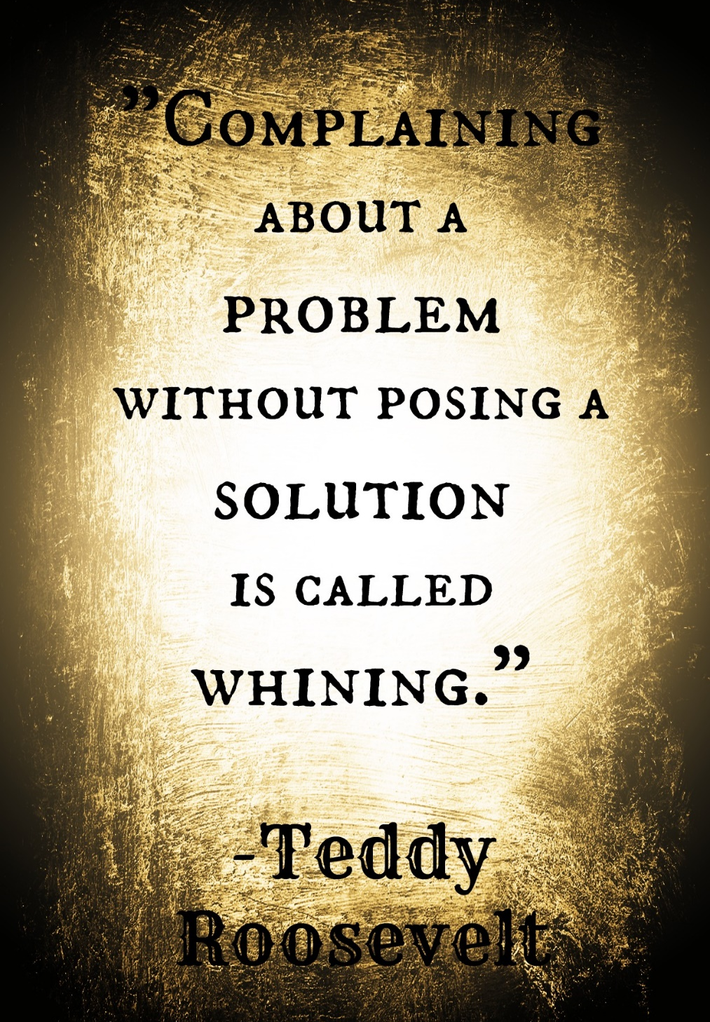
How to Stop Complaining
Look Forward and Stay Positive
Consider your Wellbeing/ Keep Heading Forward w- a Positive Perspective.
Philippians 3:13-14 (KJV)¹³ Brethren, I count not myself to have apprehended: but this one thing I do, forgetting those things which are behind, and reaching forth unto those things which are before, ¹⁴ I press toward the mark for the prize of the high calling of God in Christ Jesus.
Learn to Adapt and Welcome Change
Life is Full of Changes -Be Solution Minded vs Problem Minded
Rem- Complaining Will Definitely Get You Nowhere (Fast)
Phil 4:13 –I can Do all things through Christ…
…Ready for Any Challenge

Slide 11
How to Stop Complaining
Be Content
Philippians 4:11 (MSG) Actually, I don't have a sense of needing anything personally. I've learned by now to be quite content whatever my circumstances.
Learn to Be Content with What You Have (Now!)
By Being Content, You Push Away the Urge to Complain.
You Will Find The Happiness You Need…
…Too Fulfilled to Even Think About Whining.
Whether You Complain About Smaller or Bigger Things In Life,
…Consider Living Complaint Free and Keep Your Spirit at Ease

Slide 12
The Church is Not Just…
…To Bring the Good News
…But
…To Be the Good News

Slide 14
Key Scriptures
2 Cor 2:11 (KJV) Lest Satan should get an advantage of us: for we are not ignorant of his devices.
2 Cor 2:11 (MSG) After all, we don't want to unwittingly give Satan an opening for yet more mischief—we're not oblivious to his sly ways!
Phil 4:8 (KJV) Finally, brethren, whatsoever things are true, whatsoever things are honest, whatsoever things are just, whatsoever things are pure, whatsoever things are lovely, whatsoever things are of good report; if there be any virtue, and if there be any praise, think on these things.
Phil 4:8 (MSG) Summing it all up, friends, I'd say you'll do best by filling your minds and meditating on things true, noble, reputable, authentic, compelling, gracious—the best, not the worst; the beautiful, not the ugly; things to praise, not things to curse.

Slide 16
And they told him, and said, We came unto the land whither thou sentest us, and surely it floweth with milk and honey; and this is the fruit of it. ²⁸ Nevertheless the people be strong that dwell in the land, and the cities are walled, and very great: and moreover we saw the children of Anak there. ²⁹ The Amalekites dwell in the land of the south: and the Hittites, and the Jebusites, and the Amorites, dwell in the mountains: and the Canaanites dwell by the sea, and by the coast of Jordan.³⁰ And Caleb stilled the people before Moses, and said, Let us go up at once, and possess it; for we are well able to overcome it. ³¹ But the men that went up with him said, We be not able to go up against the people; for they are stronger than we. ³² And they brought up an evil report of the land which they had searched unto the children of Israel, saying, The land, through which we have gone to search it, is a land that eateth up the inhabitants thereof; and all the people that we saw in it are men of a great stature. ³³ And there we saw the giants, the sons of Anak, which come of the giants: and we were in our own sight as grasshoppers, and so we were in their sight.
Numbers 14:1-12 (KJV) ¹ And all the congregation lifted up their voice, and cried; and the people wept that night. ² And all the children of Israel murmured against Moses and against Aaron:

Slide 17
Complaining DENIES God’s Sovereignty
Success in Promise Land Depended on the Sovereignty of God
So When They Murmur and Complain…
…Act. Questioning God’s Ability to Carry Out His Will
Complaining is just the surface symptom of deeper problem--
…Discontent
But the men that went up with him said, We be not able to go up against the people; for they are stronger than we -13:31
Would God that we had died in the land of Egypt! or would God we had died in this wilderness! ³ And wherefore hath the LORD brought us unto this land, to fall by the sword, that our wives and our children should be a prey? were it not better for us to return into Egypt? ⁴ And they said one to another, Let us make a captain, and let us return into Egypt -14:1-4

Slide 18
Complaining DISRUPTS Christian Unity
Numbers 13:30-33. They were in effect saying, "We can’t do what God has told us to do, it’s too hard, the people are too big." Would you say that verse 33 is an exaggeration? Have you ever done that, exaggerated your problems? See Numbers 14:36. The ten spies affected the whole nation of Israel. The spies started the complaining, and the whole congregation picked it up. This sin is so contagious that it spreads like wildfire. When one dogs begins to bark, a number of dogs begin to bark. When one frog begins to croak in a pond, others begin to croak. You get one disgruntled complainer, and it won’t be long before it spreads to many. I used to think people complained because they had a lot of problems; however, I have come to realize that they have a lot of problems because they complain. Complaining doesn’t change anything or make situations better. It amplifies frustration, spreads discontent and discord (which God s - Prov 6:16-19).

Slide 19
How to Stop Complaining
Be Content
And of course, learn to be content with what you have at present. By being content, you push away the urge to complain. You find the happiness you need- too fulfilled to even think about whining. No dissatisfaction here! Only good-natured pleasure as you find comfort in the beautiful aspects of life that keep you at ease throughout your days.
Whether you complain about the smaller or bigger things in life, consider living complaint free and keep your spirit at ease.
Philippians 4:11 (MSG) Actually, I don't have a sense of needing anything personally. I've learned by now to be quite content whatever my circumstances.

