Slide 1
The Sacrifice
Civil War:
~625,000
World War I:
116,516
World War II:
405,399
Total soldiers killed in this great war: 35 Mill.

Slide 2
The Sacrifice
Korea:
36,516
Vietnam:
58,209
Total dead from all sides in this strategic conflict: some three million, four-hundred thirty-four thousand.

Slide 3
The Sacrifice
Desert Storm:
293
Afghanistan
2,145 +
Iraq:
4,486 +

Slide 4
The Sacrifice
The sacrifice of one’s life for one's country is a truly awesome act.
As our Marines remind us:
“all gave some, but some gave all.”
Today honors those who set a great example of faith for us to follow.

Slide 6
Beautiful Brokenness
Edward Church
May 29, 2016
Psalm 147:1-3

Slide 7
Ever Feel this Way?
Broken
Shattered
Set On a Shelf
Tossed Aside
Thrown Away
World’s Reply…
“It takes too much work to try to restore” …
…“Just get a new one”
“Don’t let anyone see the broken flaws”
Such Reality in the Way We Often Live in This World

Slide 8
World is Full of Brokenness
Broken…
Families
Marriages
Relationships
Dreams
Lives

Slide 9
But the Word is Full of Promises
Psalm 147:3 (YLT) Who is giving healing to the broken of heart / is binding up their griefs
Isaiah 53:1-5 (MSG) ¹ Who believes what we've heard and seen? Who would have thought GOD's saving power would look like this? ² The servant grew up before God—a scrawny seedling, a scrubby plant in a parched field. There was nothing attractive about him, nothing to cause us to take a second look. ³ He was looked down on and passed over, a man who suffered, who knew pain firsthand. One look at him and people turned away. We looked down on him, thought he was scum. ⁴ But the fact is, it was our pains he carried— our disfigurements, all the things wrong with us. We thought he brought it on himself, that God was punishing him for his own failures. ⁵ But it was our sins that did that to him, that ripped and tore and crushed him—our sins! He took the punishment, and that made us whole. Through his bruises we get healed.

Slide 10
Japan = Kintsugi
Japan, Made an Art Out of Restoring Broken Things…
…An Ancient Practice Called Kintsugi =
…“Golden Joinery” or “Patch With Gold”
An Age-Old Custom of Repairing Cracked Pottery w- Real Gold,
…Not Only Fixing the Break, but Greatly Increasing it’s Value
Instead of Hiding the Flaws, Highlight Them…
…Bringing Unique Beauty to the Original Piece
The Pottery Becomes More Beautiful/ Valuable in the…
…Restoration Process
…Though It Was Once Broken
…It Not Only Has History
…But a New Story

Slide 11
There are Times…
In Weak Moments, When You’ve…
Lost Your Grip
Come Crashing Down
Feel Beyond Repair This Time
Tossed Aside… Forgotten... Shamed… Rejected
Yet God Breaks Through All that Mess
You are Never Beyond Healing
You are Never Too Broken for Restoration
Do Not Be Ashamed of Your Scars…
…They Have an Amazing Story to Tell

Slide 12
Here is Truth
Just Because We’ve Been Broken Doesn’t Mean We Are…
Thrown Away
Un-usable
Set on a Shelf
Forgotten
Brokenness has the Power…
…Unlike Anything Else to Bring Forth
…New Beauty, Strength/ Inspiration to Others
Often In the Moments that We’ve Tasted Deep Suffering…
…We Noticed
…We Were Made For More
…There’s Purpose for Our Lives
…God Will Use This Moment for My Good

Slide 13
Remember…
The Scars of Life
…the Healed Wounds
…the Deep Lines
…All Have Stories to Tell
…Don’t Hide Them
Isa 53:3-5 (AMP) He was despised and rejected and forsaken by men, a Man of sorrows and pains, and acquainted with grief and sickness; and like One from Whom men hide their faces He was despised, and we did not appreciate His worth or have any esteem for Him. ⁴ Surely He has borne our griefs (sicknesses, weaknesses, and distresses) and carried our sorrows and pains [of punishment], yet we [ignorantly] considered Him stricken, smitten, and afflicted by God [as if with leprosy]. ⁵ But He was wounded for our transgressions, He was bruised for our guilt and iniquities; the chastisement [needful to obtain] peace and well-being for us was upon Him, and with the stripes [that wounded] Him we are healed and made whole.

Slide 14
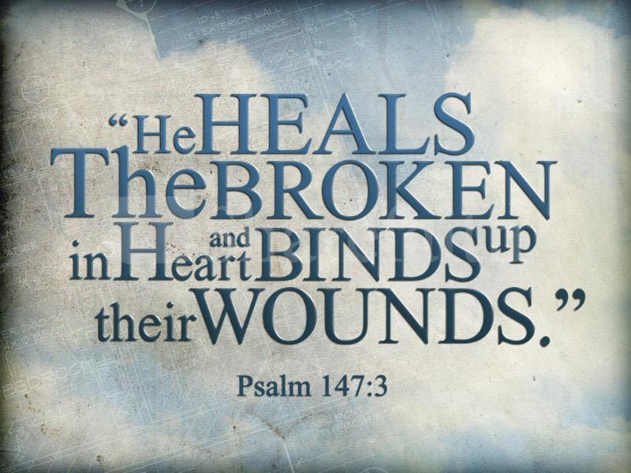
We Have a Healer
One Who Repairs
Who Can Fit the Broken Pieces that No Longer Seem to Fit Right Into a Perfect Design
He Often Works Behind the Scenes…
…Mending, Fitting Together
…Creating a Better Work of Art
…More Than We Ever Dreamed Possible

Slide 15
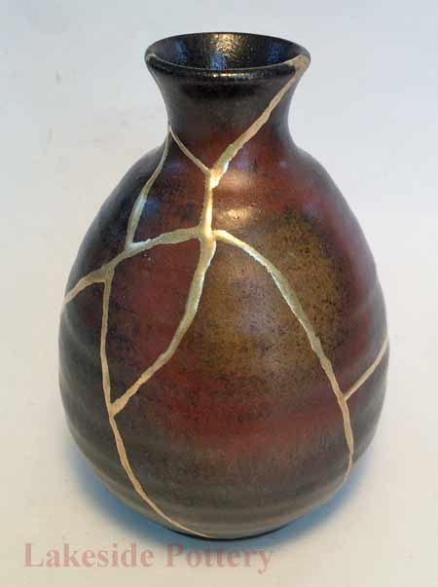
He Makes All Things Beautiful
Especially in the Broken.
You Are Not Just Simply Patched Back Together,
…As He Secretly Hopes the Glue Will Stick this Time.
Your Repair and Healing Is Never Intended to be Invisible.
But Beautifully Lined with Shining Grace Through…
…Every Scar and Broken Space.
Gold Filled Crevices of Our Heart…
…Now Stronger
…Better
…More Beautiful Than Before.

Slide 16
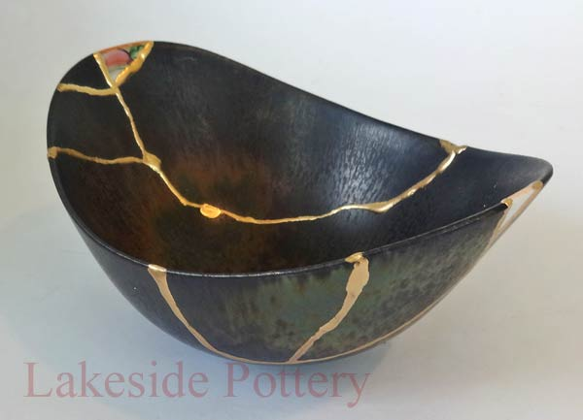
Psalm 147:1-3 (AMP) ¹ PRAISE THE Lord! For it is good to sing praises to our God, for He is gracious and lovely; praise is becoming and appropriate. ² The Lord is building up Jerusalem; He is gathering together the exiles of Israel. ³ He heals the brokenhearted and binds up their wounds [curing their pains and their sorrows].

Slide 18
Psalm 147:3 (KJV) He healeth the broken in heart, and bindeth up their wounds.
Psalm 147:3 (YLT) Who is giving healing to the broken of heart, And is binding up their griefs.
Luke 4:18
Isa 53:1-5
Heb 4:14-16

Slide 22
Beautiful Brokenness
Edward Church
May 29, 2016
Psalm 147:1-3

