Slide 2
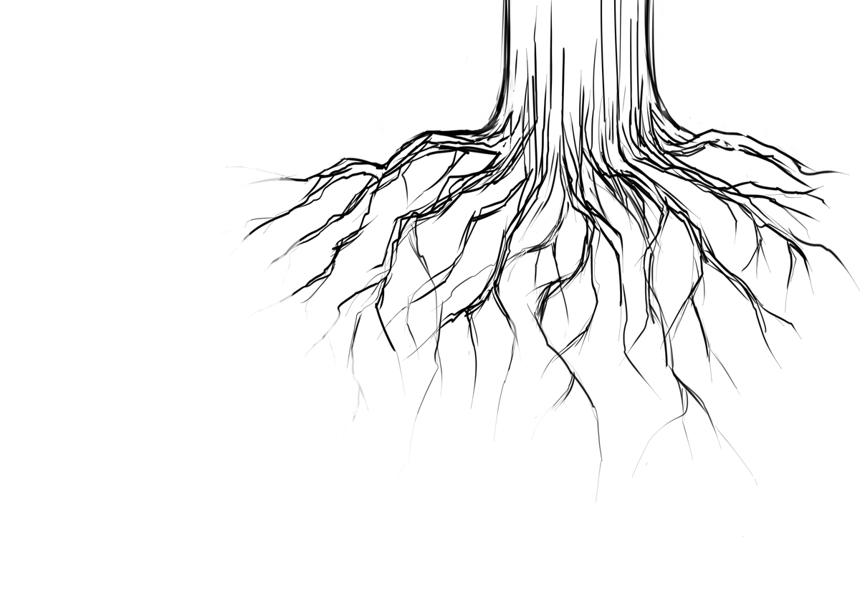
Unforgiveness and the Sycamine Tree
Edward Church
May 1, 2016
Luke 17:1-6

Slide 3
Luke 17:1-6
If ye had faith as a grain of mustard seed, ye might say unto this sycamine tree, Be thou plucked up by the root, and be thou planted in the sea;
and it should obey you

Slide 4
Luke 17:1-6
¹ Then said he unto the disciples, It is impossible but that offences will come: but woe unto him, through whom they come! ² It were better for him that a millstone were hanged about his neck, and he cast into the sea, than that he should offend one of these little ones. ³ Take heed to yourselves: If thy brother trespass against thee, rebuke him; and if he repent, forgive him. ⁴ And if he trespass against thee seven times in a day, and seven times in a day turn again to thee, saying, I repent; thou shalt forgive him. ⁵ And the apostles said unto the Lord, Increase our faith. ⁶ And the Lord said, If ye had faith as a grain of mustard seed, ye might say unto this sycamine tree, Be thou plucked up by the root, and be thou planted in the sea; and it should obey you.

Slide 5
Luke 17:1-6
Jesus was Teaching His Disciples About…
Offenses –Complex/ Complete
Bitterness/ Unforgiveness –Complex/ Complete
Likened Forces to the Sycamine Tree
How to Remove These Evil Forces From One’s Life
By Understanding the Sycamine Tree,
…Understand Bitterness and Unforgiveness.
“...If ye had faith as a grain of mustard seed..say unto This sycamine
tree, Be thou plucked up by the root planted in the sea…obey you.”
The Word “this” Indicates that…
…Jesus was Pointing Out Something Very Specific to Them

Slide 6
Sycamine Tree
Forgiving Once is Already a Challenge… But
…Forgive Someone Seven Times in One Day Sounds Impossible
This Statement was the Equivalent of Saying,
“Lord, we don’t know if we have enough faith to forgive so many
times in one day. You’ll have to increase our faith if we’re going to
do this seven times in one day!”
When Jesus Used the Word “This,” He was Saying,
“Bitterness and unforgiveness are just like the sycamine tree - and if you really want to be free of these attitudes, you can speak to this menacing growth in your life / command it to be planted in the sea!”

Slide 7
Sycamine Tree
Before We Can Understand What Jesus Taught About…
…Getting Rid of Bitterness and Unforgiveness,
Understand Why He Used the Sycamine Tree to Illustrate…
…These Destructive Forces.
Why He Didn’t Use an Oak Tree, Apple Tree, Palm Tree?
Look at the Characteristics of the Sycamine Tree…
…to Compre­hend Why Jesus Used this Tree
…to Symbolize the Detrimental Effects of
…Bitterness and Unforgiveness in a Person’s Life

Slide 8
Syc. Had Very Large/ Deep Root Structure
The Sycamine Tree was Known For…
deep root structure
grew to a height of 30 ft+
difficult to kill -Hot weather/ blistering temperatures
tapped into a water source down deep under the earth.
Even Cutting It to Its Base Would Not Guarantee Its Death
Its Roots, Hidden Deep Under the Ground
Would Draw From Underground Sources of Water
Enabling It to Keep Resurfacing Again / Again
In Other Words…
…This Tree Was Very Difficult to Get Rid Of

Slide 9
Syc. Had Very Large/ Deep Root Structure
Jesus Used this Tree as Ex. of Bitterness/ Unforgiveness
Like the Sycamine Tree, Bitterness/ Unforgiveness
…Must Be Dealt w- at the Roots Or
…They Will Keep Springing Up
Roots of Bitterness/ Unforgiveness Go Down Deep in the Soul
fed by any offense hidden in the soil of the heart
source of offense will cause these evil forces to resurface…
…over and over again.
It Takes a Deci­sion to Rip Those Roots of Bitterness/ Offense Out of Heart Once / For All So They Can’t Grow Back in the Future

Slide 10
Syc. Wood was Preferred Wood for Caskets
In Middle East, the Sycamine Tree was the Preferred for Caskets
grew quickly/ any environment
accessible in many different places
grew best in dry conditions
The Sycamine Tree is Ideal for Portraying Bitterness/ Unforgiveness
Just as the Sycamine Tree Grew Very Quickly…
…So Does Bitterness and Unforgiveness
Quickly getting Out of Control/ Take Over the Whole Place!
…Not Only Spoil the Condition of Heart/ Ruin Relationships
Just as Sycamine Grew Easily in any Environment, so does Bitterness.
It Matters Not Where you are From, Live, or Position in Life…
…Bitterness/ Unforgiveness Grow/ Influence Hearts Every­where

Slide 11
Syc. Wood was Preferred Wood for Caskets
It Grew Best Where Little Rain Fell / Water Was Sparse
Just like Bit­terness/ Unforgiveness?
Negative Attitudes Flourish where Spiritually Dry Conditions Exist
Bitterness/ Unforgiveness Grow/ Blossom where there is No Repentance,
No Joy/ No Fresh Rain of the Spirit
Sycamine Wood was the Preferred Wood for Building Caskets
It tells us that Bitterness/ Unforgiveness are Deadly
Harboring bitterness will spiritually bury you quicker than anything else!
These attitudes are the materials that Satan uses to put you 6 ft under!
Stress Point: If you permit bitterness / unforgive­ness to grow in your life, it won’t be long until these attitudes have killed your joy, stolen your peace, and canceled out your spiritual life!

Slide 12
Syc. Produced a Fig that Was Very Bitter to Eat
Mulberry
Sycamine
Looked Like Sycamine
Fruit Looked Similar
Sweet Taste
Expensive
Only Rich Partook
Eat All At Once
Looked Like Mulberry
Fruit Looked Similar
Bitter Taste
Cheap
Only Poor Partook
Eat a Bit At a Time

Slide 13
Syc. Tree was Pollinated Only by Wasps
The Sycamine Tree Was Not Naturally Pollinated
The Pollina­tion Process Was…
Initiated by a Wasp Only
Stuck Its Stinger Right into the Heart of the Fruit
Ever Heard a Bitter Person Say:
“I’ve been stung by that person once, but I’m not going to be stung again!”
“They hurt me so badly, I’ll never let him get close enough to sting me again!”
People who make such a statement have been “stung” by a situation that the devil especially devised to pollinate their hearts/ souls with bitterness/ unforgiveness.

Slide 14
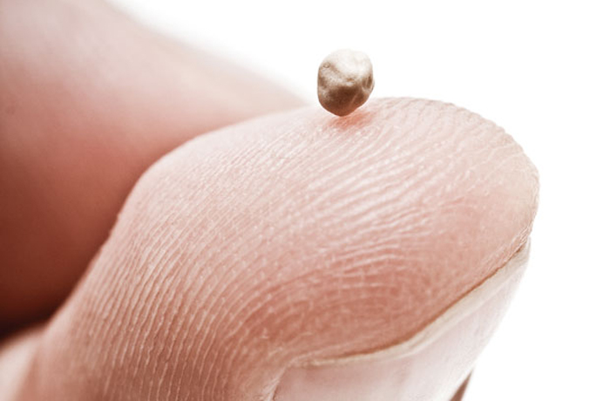
Solution to the Pollution
To Rid This, You Need Faith the Size of “a grain of mustard seed”
See It
Acknowledge the Problem (offense)
Act Upon the Process
Say It
Speak to the Problem (be ye removed)
Seize It
Seal the Deal (cast into the sea)

Slide 15
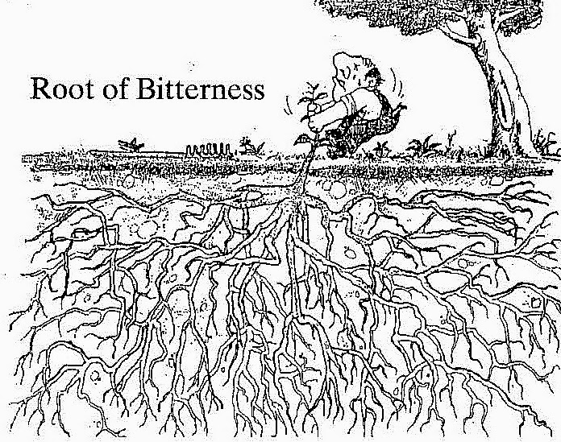
If You Need Another Reason

Slide 17
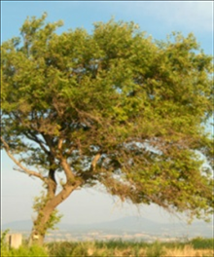
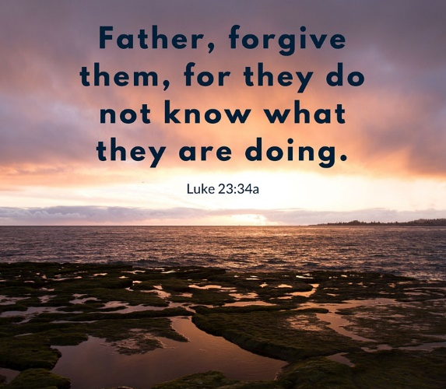
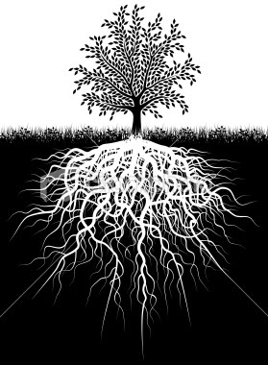
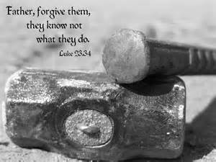

Slide 18
MY PRAYER FOR TODAY
Lord, thank You for speaking to my heart about getting rid of bitterness, unforgiveness, and offense. I know from experience that these attitudes are a killer to my spiritual life. When I am filled with bitterness and unforgiveness, I become a sour hostage to my memories. When I am consumed with offense, I lose my joy and peace and my relationships with other peo­ple are horribly affected. I thank You for giving me all the faith I need to deal with this issue, Lord. Today I am asking You to help me start the process of ripping those foul roots out of the soil of my heart and soul.
I pray this in Jesus’ name!
MY CONFESSION FOR TODAY
I confess that I genuinely wish to be set free from bitterness, unforgiveness, and offense. I am weary of the way these poisonous roots have produced their deadly fruit in my life for so long. I am ready to do whatever is required to rip those roots clear out of my heart so they won’t be able to resurface in my life again. By the power of the Holy Spirit and the authority God has given me, I repent of these detrimental attitudes that have been killing my joy, stealing my peace, and nullifying my spiritual life. By faith I am walking free from these enemies of my soul.
I declare this by faith in Jesus’ name!

Slide 19
QUESTIONS FOR YOU TO CONSIDER
Have you been harboring ill feelings deep inside your soul that are now begin­ning to affect your spiritual life? Have you been feeling “dead” on the inside as a result of your tight hold on bitterness, unforgiveness, and offense?
Who is that person or group of people against whom you have been harboring these feelings? Did those who offended you do anything to you that you haven’t been guilty of doing to someone else in the past?
Has it helped you to hold on so tightly to these feelings of unforgiveness? Has bit­terness improved the quality of your life? Have your relationships become richer and fuller as a result of your clinging to offense? What fruit has been produced in your life because you’ve allowed these negative attitudes to fester and grow

Slide 20
Luke 17:1 (Phillips NT)
Then Jesus said to his disciples, "It is inevitable that there should be pitfalls, but alas for the man who is responsible for them! It would be better for that man to have a mill-stone hung round his neck and be thrown into the sea, than that he should trip up one of these little ones. So be careful how you live. ³ "If your brother offends you, take him to task about it, and if he is sorry, forgive him. Yes, if he wrongs you seven times in one day and turns to you and says, 'I am sorry' seven times, you must forgive him." ⁵ And the apostles said to the Lord, "Give us more faith." ⁶ And he replied, "If your faith were as big as a grain of mustard seed, you could say to this fig-tree, 'Pull yourself up by the roots and plant yourself in the sea', and it would do what you said!"

Slide 21
Forgiving once is already a challenge for most people. But to forgive someone seven times in one day almost sounds impossible to many folks. It must have sounded preposterous to the disciples as well, for they said, “…Lord, Increase our faith” (Luke 17:5). This statement was the equivalent of their saying,“Lord, we don’t know if we have enough faith to forgive so many times in one day. You’ll have to increase our faith if we’re going to do this seven times in one day!”
That is when Jesus began to teach His disciples about speaking to bitterness and unforgiveness. He said, “...If ye had faith as a grain of mustard seed, ye might say unto this sycamine tree.…” When Jesus used the word “this,” it was the equivalent of Jesus’ telling them, “Bitterness and unforgiveness are just like the sycamine tree - and if you really want to be free of these attitudes, you can speak to this menacing growth in your life and command it to be planted in the sea!”

Slide 22
In Luke 17:1-6, Jesus taught His disciples about bitterness and unforgiveness and about how to remove these evil forces from one’s life. As an illustration, Jesus likened these forces to the sycamine tree that was so well known in that part of the world. The word “sycamine” comes from the Greek word sukaminos, and it is the Greek word that refers to a tree that grew throughout the Middle East.
When you understand everything that is connected to the sycamine tree, you’ll know exactly why Jesus chose to use this tree as an example of bitterness and unforgiveness in Luke 17:6. In that verse, Jesus told His disciples, “...If ye had faith as a grain of mustard seed, ye might say unto this sycamine tree, Be thou plucked up by the root, and be thou planted in the sea; and it should obey you.” Notice that Jesus said, “…Ye might say unto this sycamine tree…” The word “this” indicates that Jesus was pointing out something very specific to them.

Slide 23
Keep in Mind
Jesus Was Speaking of
Getting Rid of Bitterness and Unforgiveness.
He Told the Disciples that They Needed to
…Forgive Those Who Sinned Against Them. Luke 17:3
Even If a Brother Does Something Wrong
Seven Times In One Day
Keep on Forgiving that Offending Brother

Slide 24
Syc. Produced a Fig that Was Very Bitter to Eat
The sycamine tree and the mulberry tree were very similar in appearance;
the two trees even produced a fruit that looked identical.
However, the fruit of the sycamine tree was extremely bitter.
Its fruit looked just as luscious and delicious as a mulberry fig. But when a person tasted the fruit of the sycamine fig, he discovered that it was horribly bitter.
Mulberry figs were delicious and therefore expensive. Because of the cost of this fruit, it was primarily eaten by wealthier people. But the sycamine fig was cheap and therefore affordable to poorer people. Because the poor couldn’t afford the luscious mulberry fig, they munched on the sycamine fig as a substitute.
However, the sycamine fig was so bitter that it couldn’t be eaten whole. In order to consume an entire sycamine fig, the eater had to nibble on it a little bit at a time. After a pause, the eater would return to nibble on it again, but he could never devour a entire piece of this fruit at one time; it was just too tart and pungent to eat at one sitting.

Slide 25
Syc. Produced a Fig that Was Very Bitter to Eat
Jesus lets us know that like the sycamine fruit, the fruit of bitterness and unforgiveness is bitter, tart, and pungent. Like the fig, most people who are bitter and filled with unforgiveness chew on their feelings for a long time. They nibble on bitterness for a while; then they pause to digest what they’ve eaten. After they have reflected deeply on their offense, they return to the memory table to start nibbling on bitterness again - taking one little bite, then another little bite, then another. As they continue to think and meditate on their offense, they internalize their bitter feelings toward those who have offended them. In the end, their perpetual nibbling on the poisonous fruit of bit­terness makes them bitter, sour people themselves.
And just as the primary consumers of the sycamine fruit were poor people, those who sit around and constantly meditate on every wrong that has ever been done to them are usually bound up with all kinds of poverty. Their bitter attitude not only makes them spiritually poor, but they are also frequently defeated, depressed, sick, and financially poor as well.

