Slide 2
Rubbing People the Right Way
Acts 4:36
Edward Church
June 12, 2016

Slide 3
EGR
Extra Grace Required
Ever Met Someone that Rubbed You the Wrong Way?
They May Not…
Mean to
Try to
Realize it
…But Still They DO!

Slide 4
Then There Are Those Who Rub Folks the Right Way
These Are People Who Give Encouragement
One Such Person was Joseph
Maybe Called “Good Ole Joe”
Disciples Gave His a New Name
“Barnabas – Son Of Encouragement”
From the Life and Ministry of Barnabas We Learn…
…How to Rub People the Right Way

Slide 5
Determine to Be an Encourager- Acts 4:36-37
Joseph/Barnabas was a Levite from Cyprus
Barnabas…
Godly Background
Sought to Please God
Determined to Make a Difference
By His Sacrificial Giving Barnabas
Encouraged the Early Church
Made a Difference
God Used Him Greatly

Slide 6
Discouragement
Discourage= “to dishearten, to depress the spirits of, to lack confidence; that which destroys or abates courage.”
Common Causes of Discouragement: Personal Failure, Cont. Battle, Cont. Unanswered Prayer, Emotional Strain, Physical Illness…
…Not Understanding That All Things Work Together for Good
Discouragement Comes Before God is Going to Do Something Great
It is Dangerous to Be Discouraged…
You May Make Wrong Decisions
Say Things You Don’t Mean
Do Things You Will Later Regret
Discouragement Is Costly

Slide 7
“God never uses a discouraged Christian.
…He must change him first and then use him.”
…Billy Graham

Slide 8
Encouragement
Encouragement is Different from Teaching or Correction
It Is Not Aimed at Educating
It Is Aimed at Strengthening
Hebrew= “To Fasten Oneself So As to Strengthen, Cure, Help, Repair and Fortify”
An Encourager Fastens Himself or Herself to Another Person…
…Providing Support and Strength For the Other
This Is a Worthy Ministry that Every Person Can Do Proverbs 27:17 (NLT) ¹⁷ As iron sharpens iron, so a friend sharpens a friend.

Slide 9
How Can You Be An Encourager?
Encouragers Must Be Encouraged In God Personally
They Must Have a Strong Heart and Spirit
Enough Energy in Their Own Battery to Jump Another’s
Must Receive from God So that They Can Pour It Out
Encouragers Must Look for Opportunities to Encourage
Not Self-Centered or Always Concerned about Themselves
Encouragers Must Take Time Out For Others
Must Come Alongside the Person and Get On Their Level
Encouragers Must Use Words of Faith to Build Up Others
Words of Approval, Love, Acceptance, Praise
The Power of Words Can Never Be Underestimated
Let It Be Words of Life/ Encouragement!

Slide 10
Look for the Best in Others- Acts 9:26-27
Saul (Paul) Was Fully Committed to Destroying the Early Church
Supervised Stephen’s Stoning
On Way to Damascus to Find/ Arrest Christians
Jesus Confronted Him/ was Transformed
Preached In Synagogues, Jesus Had Risen
Paul’s Life was Threatened so He Traveled to Jerusalem
Disciples Would Not Accept Paul as a True Believer
Barnabas Convinced Them Paul Could Be Trusted
An Encourager Is One Who Champions the Underdog
Like Barnabas Encouragers Don’t Look to the Past…
…But to the Future

Slide 11
Look for the Best in Others -Acts 9:26-27
Barnabas Didn’t Look at What Paul Had Done…
…He Looked at What Paul Could Do
Some People Seem to Look for the Worst in People
Often How a Person Sees Others is a Reflection of Self
Some People Have the Habit of Rubbing People the Wrong Way
“Some people have a chip on shoulder…
…some the whole lumberyard”
If I Am a…
…Trusting Person
…Critical Person
…Caring Person
I Will See Others as…
…Trustworthy
…Critical
…Compassionate

Slide 12
Try Looking at Others Perspective- Acts 15:36-40
Barnabas Believed In Giving People A Second Chance
He had the Gifts of Grace / Mercy
He Wanted To Do All He Could To Help Out His Cousin, John Mark (Colossians 4:10)
Paul Believed John Mark Wimped Out -When Going Got Tough
He Was Opposed To Having John Mark Rejoin Missionary Team.
Barnabas Saw Something In Mark that Paul Didn’t See

Slide 13
Try Looking at Others Perspective- Acts 15:36-40
Later John Mark Worked w- Peter/ Recorded Gospel of Mark
Later in Life Paul Also Saw the Value of John Mark:
“Get Mark/ bring him w- you, he is helpful…in my ministry.” -2 Tim 2:11
Christian Workers May Not Always See Eye To Eye…
…that Shouldn’t Keep Them From
…Continuing to Go Forward in the Lord

Slide 14
Try Looking at Others Perspective- Acts 15:36-40
Barnabas Felt So Strongly About Young John Mark…
…He Was Willing to Overlook Mark’s Youthful Mistake
…And Give Him Another Chance
Aren’t You Glad You Have a Savior Who Never Gives Up On You?
Regardless of the Times You Fail…
…Jesus is There Willing to Give You Another Chance
We All Need A Barnabas In Our Lives To Love Us
…And Encourage Us
…For Who We Are And Not For What We Do

Slide 15
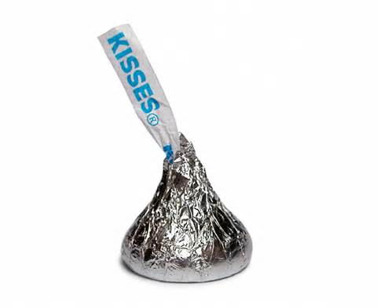
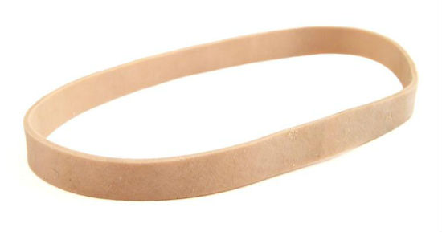
Encourager Survival Kit
Toothpick
Rubber Band
Band Aid
Pencil
Eraser
Chewing Gum
Mint
Candy Kiss
Tea Bag

Slide 16
If You Want to Rub People the Right Way
Determine to Be an Encourager
Be Interested in Others
Believe in Their Potential
Try to See Things from Their Perspective

