Slide 2
The Miserable Blessing
Luke 1

Slide 3
The Message of Prosperity…
…Has Not Only Softened
…the Gospel Message
…it has Softened Many Pilgrims

Slide 4
This Mindset has Crept into the Church
We Want to Be An Overcomer…
..With Out the Challenge of Overcoming
We Want the Spoils of Victory …
…Without the Scars of the Battle
That Has Never Been God’s Plan

Slide 5
That Has Never Been God’s Plan
He is Raising Up a Mighty Army…
…Not Afraid to Face the Challenge
…Not Afraid to Collect Scars
…to Stand in this Last Generation
…and Declare…
We Will Not Go Silently in the Night!

Slide 6
Easy to Loose Sight of REAL BLESSINGS
Real Blessings Don’t Always Come…
without Struggle
without Pain
with Answers
Often Leaves You Asking..
Lord…
If I Am SO BLESSED…
…Then Why Am I So Miserable?

Slide 7
Blessing = Building
Building = Struggle
Struggle = Misery (temporary)
Misery = Blessing
2 Corinthians 4:17
For our light affliction, which is but for a moment, worketh for us a far more exceeding and eternal weight of glory;
Affliction=distress, tribulation, misery

Slide 8
The Promise - Time
Abraham Seed
The Problem - Test
Barren
The Path - Testimony
Let Go and Let God
Not Matter of Earning Blessing
But Matter of Letting God
Build You to Be Able to Handle Blessing
Rem the Blessing Glorifies God

Slide 9
The Miserable Blessing Starts…
Zacharias and Elisabeth
Zacharias Doubts Message -Miserable
Zacharias Stricken Dumb -Miserable
Elisabeth Happy but Hiding -Miserable
Baby Not Moved til Mary Arrives - -Miserable
Zacharias Mouth Opens When Delivers Name

Slide 10
Luke 1:26-31 (KJV) ²⁶ And in the sixth month the angel Gabriel was sent from God unto a city of Galilee, named Nazareth, ²⁷ To a virgin espoused to a man whose name was Joseph, of the house of David; and the virgin's name was Mary. ²⁸ And the angel came in unto her, and said, Hail, thou that art highly favoured, the Lord is with thee: blessed art thou among women. ²⁹ And when she saw him, she was troubled at his saying, and cast in her mind what manner of salutation this should be. ³⁰ And the angel said unto her, Fear not, Mary: for thou hast found favour with God. ³¹ And, behold, thou shalt conceive in thy womb, and bring forth a son, and shalt call his name JESUS.

Slide 11
The Miserable Blessing Story Continues…
Angel Appears to Mary and Says…
…You Are
Highly Favored
Blessed
…And He Could Have Added
…Stressed!

Slide 12
1st- Mary Has Trouble Believing Angel -Miserable
2nd- Joseph Has Trouble Believing Mary –Miserable
3rd- Trip To Bethlehem(90-100 mi =10 mi / day) –Miserable
4^{th-} Upon Arrival “No Room” but a Cave- Miserable
5th- Shepherds Maneuvered in Night–Miserable
6th- Wise Men-Travelled 2 years –at Night –Miserable
7th- Uprooted Middle Of Night – Miserable
8th- Herod Kills All Male Children 2 / under -Miserable

Slide 13
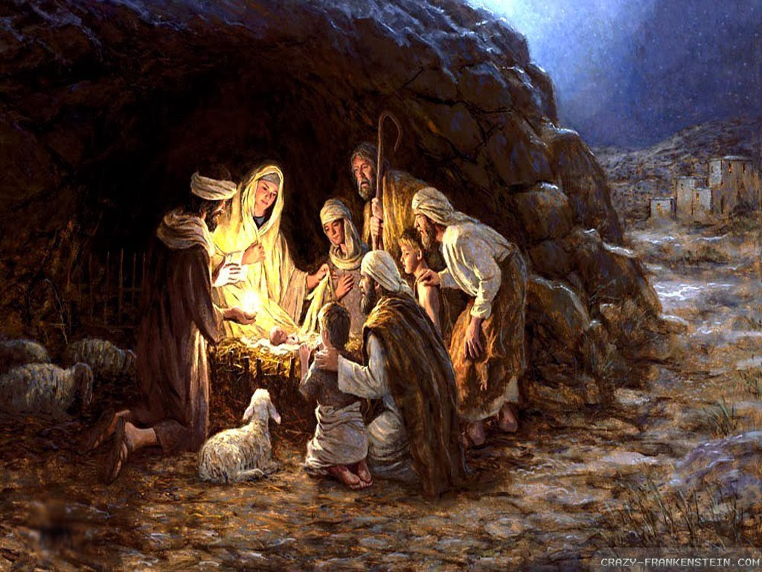
You Never Judge Your Blessing
During the Process
But By the End Product

Slide 14
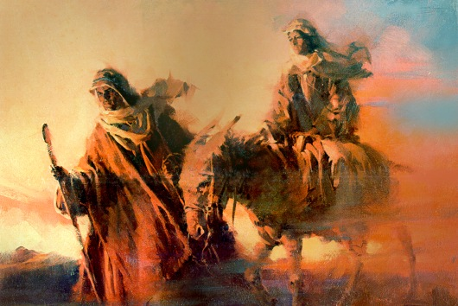
Process Makes You Tough
Wilderness is There to Purge Your…
Motives
Faith
Fear
Isaiah 43:1-3 (KJV) ¹ But now thus saith the LORD that created thee, O Jacob, and he that formed thee, O Israel, Fear not: for I have redeemed thee, I have called thee by thy name; thou art mine. ² When thou passest through the waters, I will be with thee; and through the rivers, they shall not overflow thee: when thou walkest through the fire, thou shalt not be burned; neither shall the flame kindle upon thee. ³ For I am the LORD thy God, the Holy One of Israel, thy Saviour

Slide 15
Isaiah 43:1-3 (NLT) ¹ But now, O Jacob, listen to the LORD who created you. O Israel, the one who formed you says, “Do not be afraid, for I have ransomed you. I have called you by name; you are mine. ² When you go through deep waters, I will be with you. When you go through rivers of difficulty, you will not drown. When you walk through the fire of oppression, you will not be burned up; the flames will not consume you. ³ For I am the LORD, your God, the Holy One of Israel, your Savior.
Isaiah 43:1-3 (MSG)
¹ But now, GOD's Message, the God who made you in the first place, Jacob, the One who got you started, Israel: "Don't be afraid, I've redeemed you. I've called your name. You're mine. ² When you're in over your head, I'll be there with you. When you're in rough waters, you will not go down. When you're between a rock and a hard place, it won't be a dead end— ³ Because I am GOD, your personal God, The Holy of Israel, your Savior. I paid a huge price for you: all of Egypt, with rich Cush and Seba thrown in!

Slide 16
Thank God for… …Our Miserable Blessings

Slide 18
Shallow Victory

Slide 19
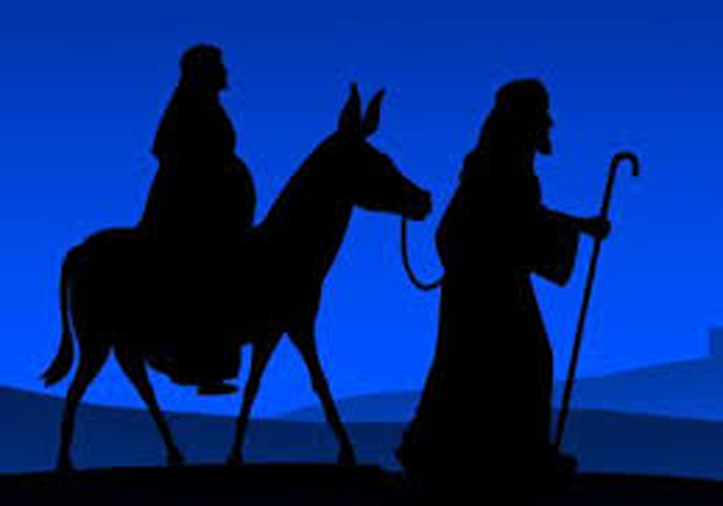

Slide 20
Distress
Tribulation
Misery

