Slide 2
Anger
Edward Church
Ephesians 4:26-27
Kicking the Cat
April 30, 2017

Slide 3
Anger’s Nature
Anger is a God Given Powerful Emotion…
…Response to an Injustice or Pain or Threat…
...a Person Makes the Conscious Choice
…to Take Action to Immediately Stop the
…Threatening Behavior of
…Another Outside Force.
Moses Got Angry
David Got Angry
God Got Angry
Jesus Got Angry

Slide 4
What Are the Four Sources of Anger?
Hurt
Your Heart Is Wounded.
Injustice
Your Right Is Violated.
Fear
Your Future Is Threatened.
Frustration
Your Effort Is Unsuccessful.

Slide 5
Anger’s Nurture
Anger is Fed by Feelings of…
Disappointment
Rejection
Embarrassment
Anger Pits You Against Whatever Sparked the Emotion.
It Is The Opposite of the Feeling of Love.
Love Draws You Toward the Person…
…Anger Sets You Against the Person.

Slide 6
Anger Is Never Neutral
It Always has Consequences…
Challenge
(healthy)
Compound
(unhealthy)
Collapse
(unhealthy)
Contagious
(unhealthy)
Contaminates
(unhealthy)
...Confrontation
...Explode
…Implode
…Rubs Off
…Changes Atmosphere

Slide 7
Anger’s Negatives
Psalms 37:8 Refrain from anger, and forsake wrath! Fret not yourself; it tends only to evil.
Psa 37:8 HCSB Refrain from anger and give up your rage; do not be agitated—it can only bring harm
Proverbs 29:22 A man of wrath stirs up strife, and one given to anger causes much transgression.
Prov 29:22 Message Angry people stir up a lot of discord; the intemperate stir up trouble.
Loss of…
Confidence:
Energy
Faith
Freedom
Identity
Perspective
Sensitivity
Vision

Slide 8
Just a Thought
Your Temper is like a fire. It gets very Destructive when it gets Out of Control.
A Shut Mouth Gathers No Foot.
He Who Throws Dirt Loses Ground.
Swallowing Angry Words before you say them is Better Than having to Eat Them Afterwards.
Anger is a Stone Thrown at a Wasp's Nest.
People who Fly Into Rage ALWAYS make a Bad Landing.

Slide 11
Anger’s Nucleus
Loss of
Confidence: Feeling insecure about your relationship with God and your ability to respond wisely to difficulties
Energy: Lacking strength for your service to God and others
Faith: Failing to believe that God is working in your life
Freedom: Becoming a prisoner of your emotions and unable to serve God freely
Identity: Becoming like the person toward whom you are bitter rather than becoming like Christ
Perspective: Allowing your emotions to distort your thinking
Sensitivity: Failing to hear the Spirit of God speaking to your heart
Vision: Losing a sense of God's purpose for your life

Slide 12
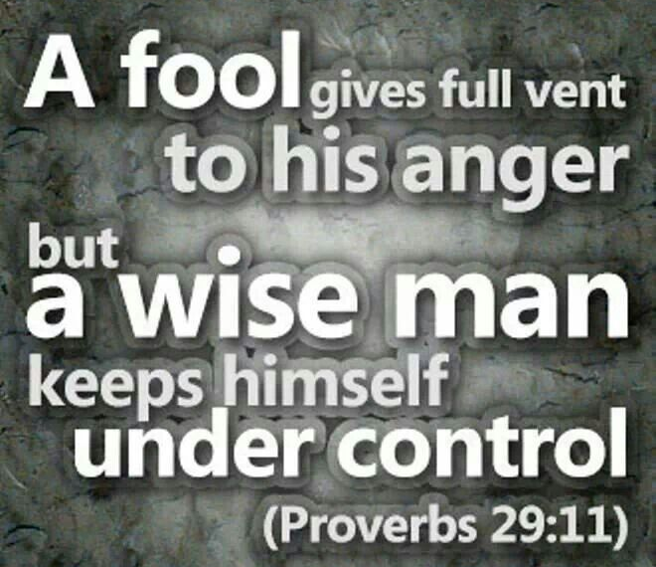
OJ overcame extreme odds
In the End
Couldn’t overcome his Anger

Slide 13
How Do I Handle My Anger?
Principle 1: Admit the Sin in Your Anger -4:26
P #2: Confront Anger by Seeing Satan in It- 4:27
4th Step Is To “Diffuse It”
Deal w- it so it doesn’t Explode…
…becoming a Doorway
Travel Light
1- God Does Not Stay Angry -Micah 7:18, Psa 30:5
2- Settle Matters Quickly -Eph 4:27
3- Refuse to recreate Satan’s Character

Slide 14
Dangerous Anger
Made Cain Kill Abel.
Made Saul Lose His Throne.
Made Moses Smite the Rock.
Warning!
When Anger is Not Met with a Biblical Solution
…You Can End Up Killing Yourself.
If it does not kill you - Physically
it gets you - Emotionally
Ultimate End is to Kill You - Spiritually.

Slide 15
