Slide 2
How Low Can You Go? I Kings 20:1-3
Edward Christian Church
June 4, 2017
God of the
Mountains
and the
Valleys

Slide 3
God Prepared Them for the Journey
Deuteronomy 11:11 (KJV) But the land, whither ye go to possess it,
is a land of hills and valleys, and drinketh water of the rain of heaven:
Unique Demands Expected
Physically
Spiritually

Slide 4
God Prepared Them for the Journey
This was Called..
The Promised Land …
Full of Bounty and Blessing
Not Called the ..
The Problem Free Land
Full of Giants and Battles
Luke 19:13, “…Occupy til I Come..”

Slide 5
Two Major Battles in this Chapter
Same People
Same Enemy
Today We Examine the First One
Key Verse 23

Slide 6
Lessons from Satanic Attacks
He Will…
Attack…
Not a Matter of “If” …
…But “When” ?
Never Takes Defeat Lightly
Will Attack Again
Continually Look for a Doorway

Slide 7
Mountain Top
It is a Place of…
Peace
Power
Provision
But There Is Also…
Danger
Attacks

Slide 8
Why Mountain Top Attacks?
Over Confident
…can’t Go Down
Over Looked
…get Sloppy/ Careless
Over Expectation
…Wings of Revival
…Not Expecting..esp “Babe in Christ”
This is the Place Satan Thinks He
…Has a Chance to Overcome You
…with Little Effort!

Slide 9
Confident Boast (1-3)
Ben Hadad (built up)
Ben (son of) +
Hadad (to be Sharp / Severe)
Type of Satan
Isaiah 14- I will ascend..
Attacks- Sharp/ Severe
32 Kings (forced allies)
Those Under His Influence…
…Who Gave into the Pressure

Slide 10
The Trial (1-8)
Siege (1)
Besieged (cramped, put in bags)
Warred (feed on, devour)
Squeeze/ Shut Off/ Isolation
Communication
God
Other Christians
Supply
Nothing Good -In or Out
Only Crumbs
Thoughts of “Giving in” to Pressure

Slide 11
The Trial (1-8)
Siege (1)
Besieged (cramped, put in bags)
Warred (feed on, devour)
Surrender (4-7)
Identity - Manhood, Self-Respect
Potential - Seed, Fruit, Future
Stand Up (8-11)
Sought Proper Counsel -Elders(been there)
Bought Proper Counsel -Got Back Up!

Slide 12
The Trust (12)
Not Taken Seriously (12)
…Gave Syrians False Hope
Taken Seriously by God
…Gave God’s People True Hope

Slide 13
The Triumph (13-15)
Began with Clear Word (13)
Confidence
I Cor 14:8, “If Trump uncertain sound.”
Direction
13-15
Moved to Obedience (14-15)
Action
Expectation
Moved Thru to Victory (16-21)
v23

Slide 14
¹⁹ So these young men of the princes of the provinces came out of the city, and the army which followed them.
²⁰ And they slew every one his man: and the Syrians fled; and Israel pursued them: and Benhadad the king of Syria escaped on an horse with the horsemen.
²¹ And the king of Israel went out, and smote the horses and chariots, and slew the Syrians with a great slaughter.
²² And the prophet came to the king of Israel, and said unto him, Go, strengthen thyself, and mark, and see what thou doest: for at the return of the year the king of Syria will come up against thee.
²³ And the servants of the king of Syria said unto him, Their gods are gods of the hills; therefore they were stronger than we; but let us fight against them in the plain, and surely we shall be stronger than they.

Slide 16
1 Kings 20The Message (MSG)
20 ¹⁻³ At about this same time Ben-Hadad king of Aram mustered his troops. He recruited in addition thirty-two local sheiks, all outfitted with horses and chariots. He set out in force and surrounded Samaria, ready to make war. He sent an envoy into the city to set his terms before Ahab king of Israel: “Ben-Hadad lays claim to your silver and gold, and to the pick of your wives and sons.”
⁴ The king of Israel accepted the terms: “As you say, distinguished lord; I and everything I have is yours.”
⁵⁻⁶ But then the envoy returned a second time, saying, “On second thought, I want it all—your silver and gold and all your wives and sons. Hand them over—the whole works. I’ll give you twenty-four hours; then my servants will arrive to search your palace and the houses of your officials and loot them; anything that strikes their fancy, they’ll take.”
⁷ The king of Israel called a meeting of all his tribal elders. He said, “Look at this—outrageous! He’s just looking for trouble. He means to clean me out, demanding all my women and children. And after I already agreed to pay him off handsomely!”

Slide 17
⁸ The elders, backed by the people, said, “Don’t cave in to him. Don’t give an inch.”
⁹ So he sent an envoy to Ben-Hadad, “Tell my distinguished lord, ‘I agreed to the terms you delivered the first time, but this I can’t do—this I won’t do!’”
The envoy went back and delivered the answer.
¹⁰ Ben-Hadad shot back his response: “May the gods do their worst to me, and then worse again, if there’ll be anything left of Samaria but rubble.”
¹¹ The king of Israel countered, “Think about it—it’s easier to start a fight than end one.”
¹² It happened that when Ben-Hadad heard this retort he was into some heavy drinking, boozing it up with the sheiks in their field shelters. Drunkenly, he ordered his henchmen, “Go after them!” And they attacked the city.
¹³ Just then a lone prophet approached Ahab king of Israel and said, “God’s word: Have you taken a good look at this mob? Well, look again—I’m turning it over to you this very day. And you’ll know, beyond the shadow of a doubt, that I am God.”

Slide 18
¹⁴ Ahab said, “Really? And who is going to make this happen?”
God said, “The young commandos of the regional chiefs.”
“And who,” said Ahab, “will strike the first blow?”
God said, “You.”
¹⁵ Ahab looked over the commandos of the regional chiefs; he counted 232. Then he assessed the available troops—7,000.
¹⁶⁻¹⁷ At noon they set out after Ben-Hadad who, with his allies, the thirty-two sheiks, was busy at serious drinking in the field shelters. The commandos of the regional chiefs made up the vanguard.
A report was brought to Ben-Hadad: “Men are on their way from Samaria.”
¹⁸ He said, “If they’ve come in peace, take them alive as hostages; if they’ve come to fight, the same—take them alive as hostages.”
¹⁹⁻²⁰ The commandos poured out of the city with the full army behind them. They hit hard in hand-to-hand combat. The Arameans scattered from the field, with Israel hard on their heels. But Ben-Hadad king of Aram got away on horseback, along with his cavalry.
²¹ The king of Israel cut down both horses and chariots—an enormous defeat for Aram.

Slide 19
²² Sometime later the prophet came to the king of Israel and said, “On the alert now—build up your army, assess your capabilities, and see what has to be done. Before the year is out, the king of Aram will be back in force.”
²³⁻²⁵ Meanwhile the advisors to the king of Aram said, “Their god is a god of the mountains—we don’t stand a chance against them there. So let’s engage them on the plain where we’ll have the advantage. Here’s the strategy: Remove each sheik from his place of leadership and replace him with a seasoned officer. Then recruit a fighting force equivalent in size to the army that deserted earlier—horse for horse, chariot for chariot. And we’ll fight them on the plain—we’re sure to prove stronger than they are.”

Slide 21
Why Satan Attacks in Valley
1- Loss of Confidence
a- Physically Tired
b- Spiritually Tired
2- Loss of Vision
a- Hard to See Beyond Your Valley
3- Loss of Hope
a- Expectation Less than Positive or
b- Expectation Negative
Here is Where…
…Satan Thinks He Can Overcome You
…with Little Effort!

Slide 22
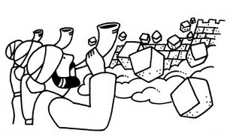
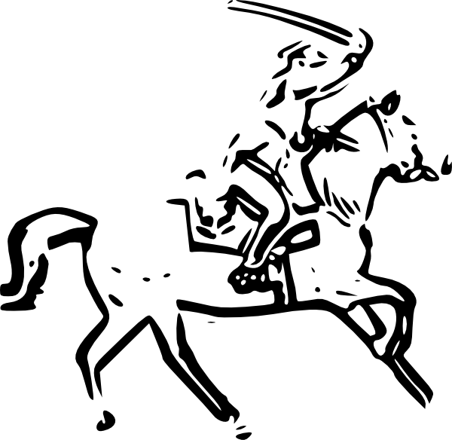

Slide 23
