Slide 2
12 Top Reasons It’s Good to Be a Man.
1: Phone conversations are over in 30 seconds flat.
2: A 5-day holiday requires only one suitcase.
3: When clicking through the channels…
…you don’t have to stall at every shot of somebody crying.
4: Guys in hockey masks don’t attack you ...
….unless you’re playing hockey.
5: You only need 2 or 3 pairs of shoes.
6: Car mechanics tell you the truth.

Slide 3
12 Top Reasons It’s Good to Be a Man.
7: You can admire Clint Eastwood without...
…starving yourself to look like him.
8: Gray hair and wrinkles only add character to men.
9. We can do our nails during 1 traffic light.
10: If another guy shows up at the party in the same outfit…
…you just might become lifelong buddies.
11: The occasional well-rendered belch is practically expected.
12. We get to be Dads!

Slide 4
Father’s Day 2017
June 18, 2017
Dying Words- Life Words
1 Chronicles 22:9-10 I Chron 28:9
Edward Church

Slide 5
Fathers When we die…
Not if I die, when I die,
Would you love to leave behind
words of wisdom for your children?

Slide 6
This morning we are going to look at words though not Last words certainly came at the end of a full and productive life.
King David has come to the end of his rule and his life
prepares to meet his God
begins to put house in order.
assembles the leaders of Israel together so they can witness the transfer of leadership to his son, Solomon.

Slide 7
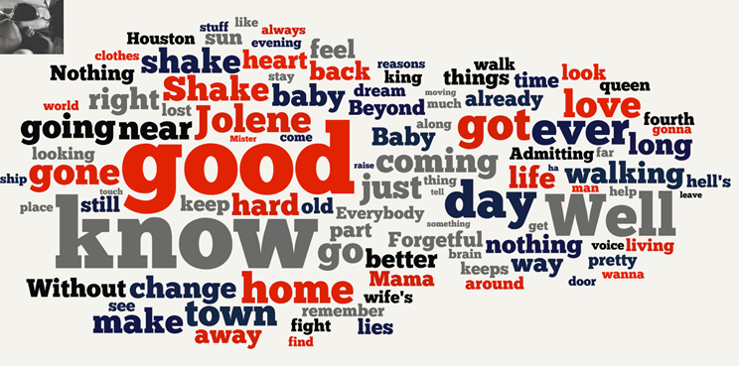
Now not only is David giving his son the responsibility to rule Israel
…David holds out his dreams for his son to embrace.
Isn’t that the way of Fathers? Hoping that sons will
do what we couldn’t do,
achieve what we couldn’t achieve
be what we couldn’t be?

Slide 8
David had dreamed of building a temple for God
more important then the Kingdom he gave to his son
was the vision for the kingdom that he gave to his son,
and the challenge that he presented.
I Chron 28:3 KJV But God said unto me, Thou shalt not build an house for my name, because thou hast been a man of war, and hast shed blood.
I Chron 22:9 NLT But you will have a son who will be a man of peace. I will give him peace with his enemies in all the surrounding lands. His name will be Solomon, and I will give peace and quiet to Israel during his reign.

Slide 9
Joke
And we are told in 1 Kings 3:3 (quickview) Solomon loved the Lord. So the Lord loved Solomon and Solomon loved the Lord, sounds like a good combination to me. Just to kind of finish off who Solomon was, in 1 Kings chapter 3 verses 4-6 we are told that the Lord appeared to Solomon in a dream, and God said, “What do you want? Ask, and I will give it to you!”
What a great offer, I heard a story that a Pastor and his staff were out one day and an Angel appeared to them and made the same offer, well what he actually said was you can have anything you want, you could be the most famous pastor in the world, your church could have incredible wealth or you could have immense wisdom and be the smartest man in the world. Well the pastor thought back to what happened with Solomon and said “I’ll take the wisdom” The angel replied ok it’s as you asked”, and he disappeared, the associate Pastors gathered around to hear this new found wisdom of their leader and one of them said “well, what are you thinking” and the pastor looked up and said “I should have taken the money”

Slide 10
1 Chronicles 28:9
“ As for you, my son Solomon, know the God of your father, and serve Him with a loyal heart and with a willing mind; for the LORD searches all hearts and understands all the intent of the thoughts. If you seek Him, He will be found by you; but if you forsake Him, He will cast you off forever.
“And you, Solomon my son, get to know well your father’s God; serve him with a whole heart and eager mind, for GOD examines every heart and sees through every motive. If you seek him, he’ll make sure you find him, but if you abandon him, he’ll leave you for good. Look sharp now! GOD has chosen you to build his holy house. Be brave, determined! And do it!” The Message

Slide 11
Search
1 Chronicles 28:9 As for you, my son Solomon,
Know the God of your father
Know= Relationship
Train up a child in the way he should go: and when he is old, he will not depart from it. -Prov 22:6
Hebrew Midwives- Sugar/ honey mixture- create sucking sensation

Slide 12
Serve
1 Chronicles 28:9 As for you, my son Solomon,
Know the God of your father
Serve Him
Serve him…
Serve= Bondslave -worship

Slide 13
Satisfied
1 Chronicles 28:9 As for you, my son Solomon,
Know the God of Your Father,
Serve Him
with a Perfect Heart
Perfect= finished, complete (keeping covenant)
Heart= knowledge, courage, emotions

Slide 14
Surrendered
1 Chronicles 28:9 As for you, my son Solomon,
Know the God of your father,
Serve Him
with a Perfect Heart
with a Willing Mind
Willing= Delight, Desire
Mind= mind, will, emotions

Slide 15
Savor
1 Chronicles 28:9 As for you, my son Solomon,
Know the God of your father,
Serve Him
with a Loyal Heart
with a Willing Mind
the LORD Searches All Hearts/ Understands All the Intent of the Thoughts
He’s On Top of It!

Slide 16
Words of Life from Dad
Son You Have a Great Task Ahead of You…
…You Will Finish What I Started
…It Can Only Be Done with God’s Help
Search For God
Serve Him
Satisfied by Him
Surrender to Him
Savor in Him
…And You WILL SUCCEED

