Slide 2
Getting Past Your Past -pt2
Independence Week
2017
Edward Church
July 9, 2017

Slide 3
Philippians 3:13, 14 instructs us to focus on the future, not the past: “One thing I do, forgetting those things which are behind and reaching forward to those things which are ahead, I press toward the goal for the prize of the upward call of God in Christ Jesus”
One Thing (First, Primary)
In Order to Move Forward…
…You Have to Let Go of the Past

Slide 4
Instead Of Focusing Our Thoughts/ Energies
On the Opportunities of Today…
…We Allow Painful Memories to Fill Our Minds
…And Sap Our Strength.
We Simply Can’t Seem to Let Go of Our Pain…
…So We Relive It Again and Again . . .
…With Predictably Unfortunate Consequences.
Thankfully, God Has Other Plans
This is the day which the LORD hath made; we will rejoice and be glad in it. Psa 118:24

Slide 5
Focusing Too Intently On the Past Is, Almost Without Exception, Futile
No Amount of Anger or Bitterness…
…Can Change What Happened Yesterday.
Tears Can’t Change the Past;
Regrets Can’t Change It.
Our Worries Won’t Change the Past,
Our Complaints Wont Either

Slide 6
When We Find Ourselves Focusing Too Intently On the Past…
…It’s a Sign That We Need To Focus on
…Moving Forward
…Through Forgiveness
…Beyond the Pain
…Reaching unto a New S.T.A.R.T.

Slide 7
S= Stop Making Excuses

Slide 8
S= Stop Making Excuses
A Man Good At Making Excuses is Seldom Good at Anything Else
Ben Franklin
Excuses are the Nails that Build a House of Failure
Abe Lincoln
There are Only Two Options: Make Progress…
…or Make Excuses

Slide 9
T - Take An Inventory Of My Life

Slide 10
T - Take An Inventory Of My Life
I Need to Evaluate All My Assets, Abilities / Experiences
What’s Left Over After I’ve Discarded What Needs to Be Behind
We Get So Busy Focusing On What We Lost…
…We Lose Sight of What We Have and Even Gained
Galatians 3:4, "You have experienced many things. Were all those experiences wasted? I hope not."
Challenge- Make 3 Columns: 1-(Lost) 2-(Kept) 3-(Gained)
After Proper Inventory…
…See How Things Really Look

Slide 11
Move Forward
It May Take a While
You May Feel Stuck
Can’t Go By Feelings
It Requires Acting by
Hope
Faith
Courage

Slide 12
A - Act in faith
We Need to Look Up,/ Look Out.
Launch Out Into New Territory.
If We Don’t Grow/ Move Ahead, We Get Stagnant
The Key to Changing Anything is Faith.
If We Want to Change Our Circumstances It Will Take Faith.
R - Refocus
I Need to Refocus My Thoughts If I Want to Change My Life.
Proverbs 4:23, “Keep vigilant watch over your heart…
…that’s where life starts”

Slide 13
S - Stop Making Excuses
T - Take An Inventory Of My Life
A - Act in faith
R - Refocus
T – Trust
Trust God to Help Us Succeed.
Depend On Him, Not Ourselves.
We’ve Already Proven that We Can’t Do It On Our Own.
That’s Why We’ve Failed.
We Can’t Change Who, What, When- Only God Can Do That.
Giving God Control Of My Life.

Slide 14
Accepting The Past
Three Things You Can Do with Mistakes or Hurts:
Resolve…
To Never Make Another Mistake or Be Hurt Again.
That Is Impossible.
Retreat
Let Mistakes and Hurts Make a Coward Of You.
That is Foolish.
Rebound
Learn from Your Mistakes, Move Beyond Your Hurts
This is Profitable.

Slide 15
Simply Put…
The Past Is…
…And Always Will Be
…the Past
…Forever!

Slide 16
Shake the dust from your past, and move forward in His promises
Kay Arthur
Leave the broken, irreversible past in God’s hands, and step out into the invincible future with Him. -Oswald Chambers
We can’t just put our pasts behind us. We’ve got to put our pasts in front of God. -Beth Moore
The Lord says, “Forget what happened before, and do not think about the past. Look at the new thing I am going to do. It is already happening. Don’t you see it? I will make a road in the desert and rivers in the dry land.” ISA 43:18, 19 NCV

Slide 19
So, "S" in START the New Year, stands for Stop making excuses.
T - Take An Inventory Of My Life
I need to take an inventory of my life. That means I need to evaluate all my assets, abilities, and experiences. What’s left over after I’ve discarded everything that needs to be left behind. Take an inventory of my life’s achievement in regards to my life with God.
Galatians 3:4 4 Have you experienced so much in vain—if it really was in vain?[6] Another version is, "You have experienced many things. Were all those experiences wasted? I hope not."
A - Act in faith
This is the third step in getting a fresh start. Act in faith. We need to look up, and look out. We need to launch out into new territory. If we don’t grow and move ahead, we get stagnant and moldy. The Bible says that the key to changing anything is faith. If we want to change our circumstances it will take faith. If we want to change who we are, it takes faith.
R - Refocus
I need to refocus my thoughts if I want to change my life. Proverbs 4:23 tells us to be careful how we think. Our life is shaped by your thoughts.
T – Trust
Trust God to help us succeed. Depend on Him. We don’t need depend on ourselves. We’ve already proven that we can’t do it on our own. That’s why we’ve failed. Some people just don’t get it. They stumble and fall and then they get up and say, “I’ll just try harder!” It’s like you go up to a wall and bang your head against it and the wall doesn’t fall down. You try it again and Bang! Again. You keep doing it thinking, “Maybe it will fall over this time.” That’s the definition of insanity – doing the same thing over and over and over and expecting different results. If we keep doing the same thing then we will keep getting the same result. We can’t change who we are, only God can do that. I am not speaking about the outward man but the inner man. The real person is the hidden person of the heart. Success in the Christian life is not trying harder, but living smarter. Giving God control of my life.

Slide 20
Some Of Life’s Greatest Roadblocks are Not the Ones We See…
….Through the Windshield
…But the Ones that Fill the Rearview Mirror.
Because We Are Imperfect Human Beings Who
Lack Perfect Control Over Our Thoughts…
…Become “Stuck” In the Past
…Even Though We Know Better.
The Lord says, “Forget what happened before, and do not think about the past. Look at the new thing I am going to do. It is already happening. Don’t you see it? I will make a road in the desert and rivers in the dry land.” ISA 43:18, 19 NCV

Slide 21
The Lord says, “Forget what happened before, and do not think about the past. Look at the new thing I am going to do. It is already happening. Don’t you see it? I will make a road in the desert and rivers in the dry land.” ISAIAH 43:18, 19 NCV
And we know that all things work together for good to those who love God, to those who are the called according to His purpose. ROMANS 8:28 NKJV
But also I am writing a new command to you, and you can see its truth in Jesus and in you, because the darkness is passing away, and the true light is already shining. 1 JOHN 2:8 NCV
But may the God of all grace, who called us to His eternal glory by Christ Jesus, after you have suffered a while, perfect, establish, strengthen, and settle you. 1 PETER 5:10 NKJV

Slide 22
Questions…
Can You Summon the Courage and Wisdom…
…To Accept Your Past and Move On With Your Life?
Can You Accept The Reality that Yesterday…
…And All the Yesterdays Before It— Are Gone?
Can You Entrust All Those Yesterdays to God?
With God’s Help You Can.

Slide 24
Col 3:13 NLT Make allowance for each other's faults, and forgive anyone who offends you. Remember, the Lord forgave you, so you must forgive others.

Slide 25
Some of life’s greatest roadblocks are not the ones we see through the windshield; they are, instead, the roadblocks that seem to fill the rearview mirror.
Because we are imperfect human beings who lack perfect control over our thoughts, we may allow ourselves to become “stuck” in the past—even though we know better.
Instead of focusing our thoughts and energies on the opportunities of today, we may allow painful memories to fill our minds and sap our strength. We simply can’t seem to let go of our pain, so we relive it again and again . . . with predictably unfortunate consequences.
Thankfully, God has other plans.

Slide 26
Shake the dust from your past, and move forward in His promises. KAY ARTHUR
Leave the broken, irreversible past in God’s hands, and step out into the invincible future with Him. OSWALD CHAMBERS
We can’t just put our pasts behind us. We’ve got to put our pasts in front of God. BETH MOORE
Finish every day and be done with it. You have done what you could; some blunders and absurdities have crept in; forget them as soon as you can. RALPH WALDO EMERSON
Resolutely slam and lock the door on past sin and failure, and throw away the key. OSWALD CHAMBERS

Slide 28
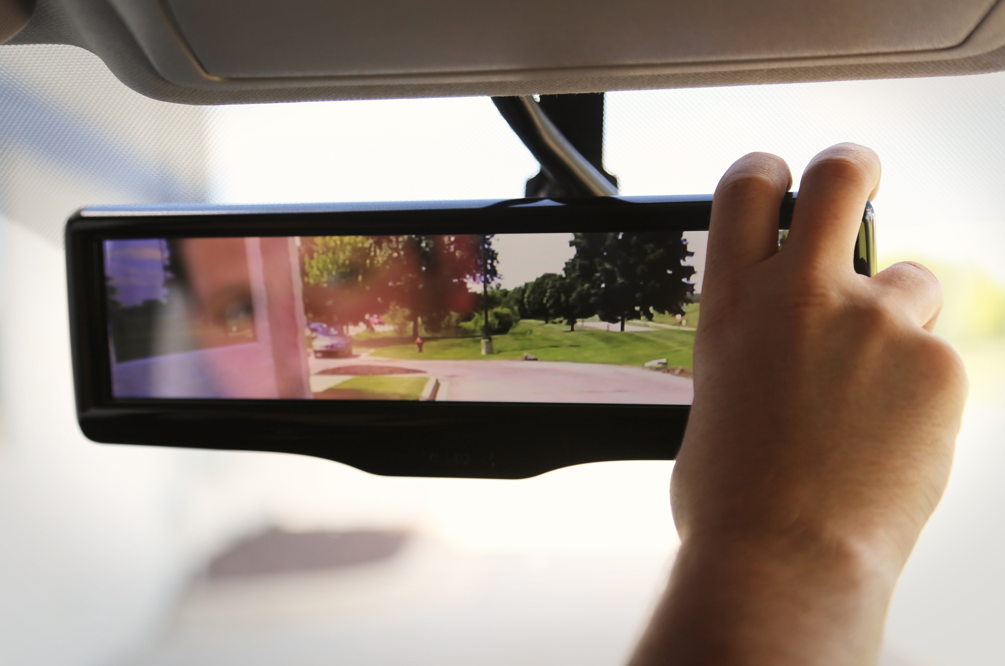

Slide 29
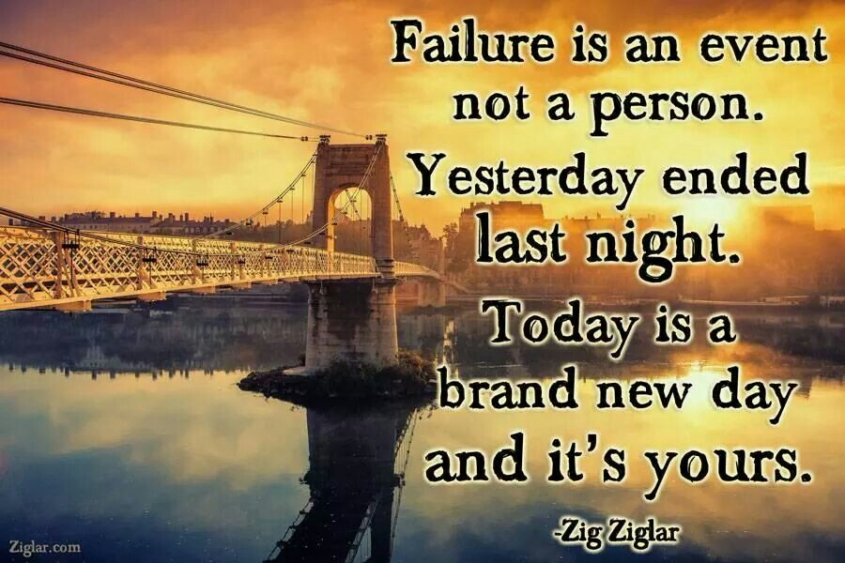
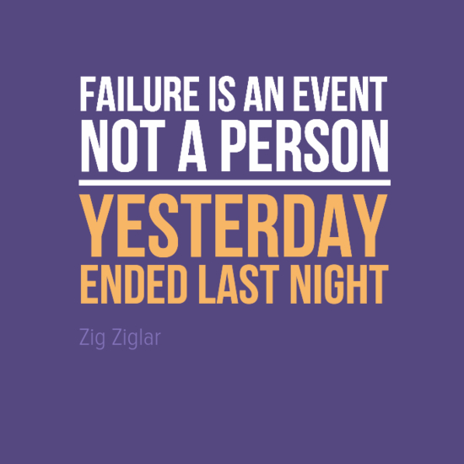
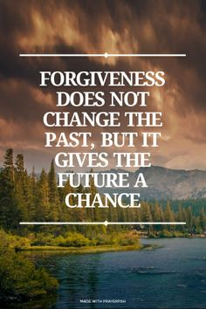
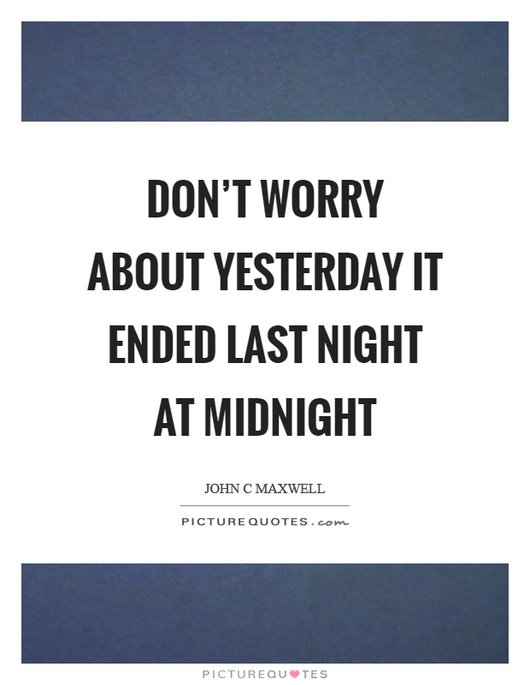

Slide 30
