Slide 2
Part 2
Edward Church
July 30, 2017
Psalm 109

Slide 3
Victim Mentality is on the Rise
Victim Mentality is a Product of Trauma
Spiritual
Emotional
Mental
Physical
It Sweeps You Off Balance…
…Keeps You Off Balance
…Satan Keeps You Bound
…with Invisible Chains

Slide 4
This is why Terrorism is So Successful
It Makes Us More than Victims…
…It Causes Us to Develop
…a Victim Mentality
…Our Lives Change
…For the Worse
In the Beginning of this Psalm…
…David has Become a Victim
…but By the End He Refuses
…to be a Victim but Instead a Victor!

Slide 5
Three Things the Victim Mentality Creates
1st- David Feels the Peace of God Has Been Withheld (1)
First Target of VM –Your Peace
Hold not thy peace, O God of my praise; For the mouth of the wicked and the mouth of the deceitful are opened against me: they have spoken against me with a lying tongue. They compassed me about also with words of hatred; and fought against me without a cause. For my love they are my adversaries: but I give myself unto prayer. And they have rewarded me evil for good, and hatred for my love.” (1-5)

Slide 6
When Your Peace is Under Attack… Remember
John 14:27 “Peace I leave with you, my peace I give unto you: not as the world giveth, give I unto you. Let not your heart be troubled, neither let it be afraid”
I am leaving you with a gift—peace of mind and heart. And the peace
I give is a gift the world cannot give. So don’t be troubled or afraid (NLT)
Philippians 4:7 “And the peace of God, which passeth all understanding, shall keep your hearts and minds through Christ Jesus.”
Then you will experience God’s peace, which exceeds anything we can understand. His peace will guard your hearts and minds as you live in Christ Jesus. (NLT)

Slide 7
It is Not God That Has Taken Your Peace;
…It Is Only When We Let The Devil Distort the Truth
…that We Lose Peace.
God Desires You to Have Peace…
… Beyond Human Understanding

Slide 8
Three Things the Victim Mentality Creates
2nd- David Felt Was that Others Were Talking About Him. (2-3a)
The Next is Darts of Paranoia
Feeling that everyone else is watching/ talking about you,
Paranoia is Based on Our…
Hurts (improper process)
Fears (no repair- )
Mistrust (it will happen again)
Unreal expectations (their lying in wait for opportunity)
Elijah= I’m the only one

Slide 9
Elijah= I’m the Only One
He replied, “I have been very zealous for the Lord God Almighty. The Israelites have rejected your covenant, torn down your altars, and put your prophets to death with the sword. I am the only one left, and now they are trying to kill me too.”
18Yet I reserve seven thousand in Israel—all whose knees have not bowed down to Baal and whose mouths have not kissed him.”
Keep Your Perspective

Slide 10
Three Things the Victim Mentality Creates
3rd- David Felt He Was Innocent, Yet…
…Received Hatred For His Love. (3b-5)
The Next is a Perplexing Response
It Didn’t Make Sense
He Had Given…
His All
To Meet a Need
Received What He Didn’t Need

Slide 11
Develops a Poisonous Perspective
He Tells God What He Wishes Would Happen to the Offender
“Set thou a wicked man over him: and let Satan stand at his right hand. When he shall be judged, let him be condemned: and let his prayer become sin. Let his days be few; and let another take his office. Let his children be fatherless, and his wife a widow. Let his children be continually vagabonds, and beg: let them seek their bread also out of their desolate places. Let the extortioner catch all that he hath; and let the strangers spoil his labour.” (6-20)
He Became Poisonous
Pour it on Hard God…
…and Don’t Stop Pouring
…Even After He’s Gone

Slide 12
Reality Check
David Was A Man After God’s Own Heart;
He Was Very Yielded To God But …
He Still Had Those Feelings.
It’s Ok To Acknowledge Those Feelings
It Is Not Ok To React To Life Based On Your Feelings
Feelings Are Always Apt To Change

Slide 13
GROW
G-
…Give Offence to God
R-
…Respond Vs React (Reach Up Not Down)
O-
…Own Your Response (Quit Blame Game)
W-
…Walk It Out (Word)

Slide 14
How God Tells Us to Treat Mis-Treaters
We have a Father in Heaven We Can Turn When We Get Hurt
Call upon Me in the day of trouble -Psalm 50:15
Cast your burden on the LORD and He will sustain you -Psalm 55:22
We have a Positive Example of the Lord Jesus Christ Himself.
When He was reviled, He did not revile in return; when He suffered He did not threaten; but He trusted to Him Who judges justly - 1 Peter 2:23
We are to Follow that Example
Repay no one evil for evil, but take thought for what is noble in the sight of all... Beloved, never avenge yourselves but leave it to the wrath of God, for it is written 'Vengeance is mine, I will repay, says the Lord.’ Rom 12:17,19
Vengeance then is God's prerogative, not ours.
It is natural to want to retaliate and 'get even.’
But the Christian Faith is not natural—it is a supernatural Faith.
The Holy Spirit, enables us to act / not act, differently from the Norm

Slide 17
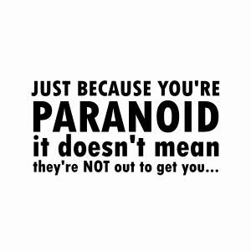
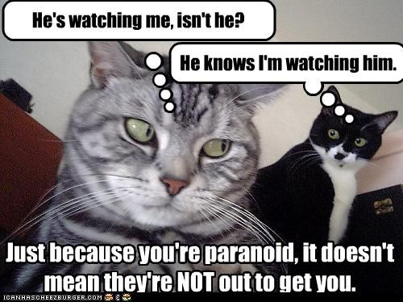
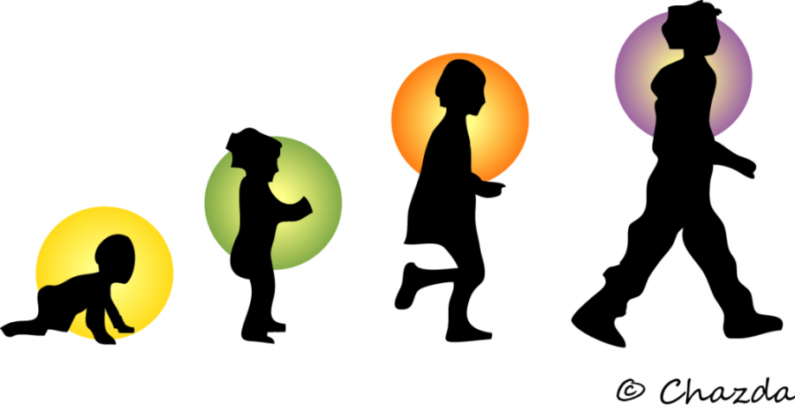
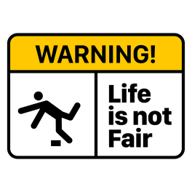
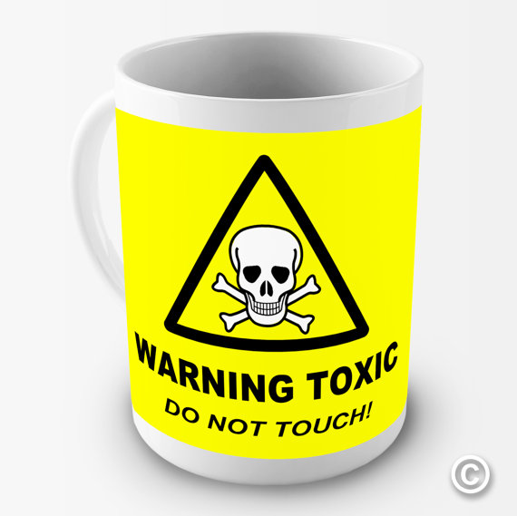

Slide 18
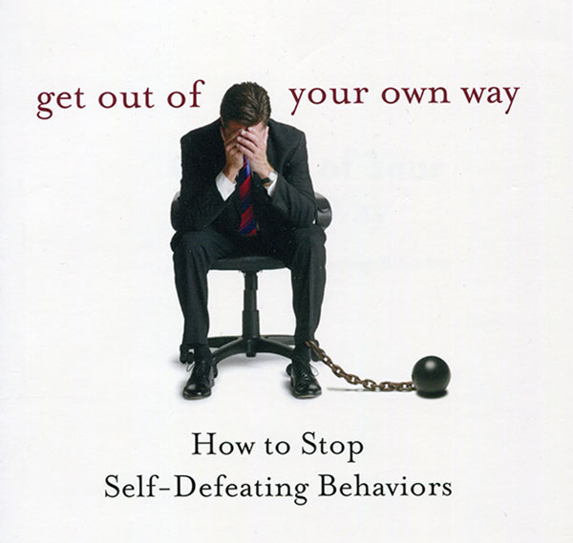
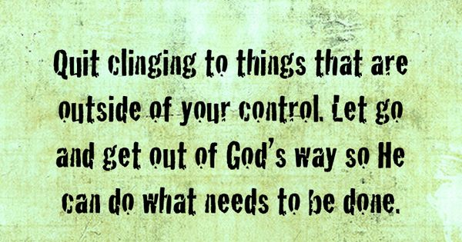

Slide 19
Reality Check
David was a man after God’s own heart;
He was very yielded to God but still had those feelings.
It’s Ok to Acknowledge those feelings
It is not OK to react to life based on your feelings
Jer 17…heart is decietful
The wonderful thing about feelings is that they can be changed.
David begins that change in the next verse as he declares what he wants God to do for him.
v21 says, “But do thou for me, O GOD the Lord, for thy name's sake: because thy mercy is good, deliver thou me.” David wanted what everyone who has experienced traumatic events in life wants: mercy and deliverance. David has been honest with God. In the same way, it is important to bear your heart to God.

Slide 20
Psalm 51:6 “Behold, thou desirest truth in the inward parts: and in the hidden part thou shalt make me to know wisdom.” God will not save someone until they confess their sin in repentance. Understand that David was not coming to force God to do his own will; he was simply confessing to God that he has had these feelings toward someone else. Then saying in effect, “But God, I don’t want these feelings, what I really want is mercy and deliverance. I want to be delivered from the pain that is in my heart right now. I want you to show mercy on me and give me peace instead of hurt.” Be careful that you do your confessing to God and not to other people. It can become sin if you let it become gossip. God is not glorified in the bad feelings themselves, He is glorified in the fact that you bring them to Him recognizing that He is the only one that can deliver you from them.

Slide 21
It is Not God That Has Taken Your Peace;
…It Is Only When We Let The Devil Distort the Truth
…that We Lose Peace.
God Desires You to Have Peace…
… Beyond Human Understanding

Slide 22
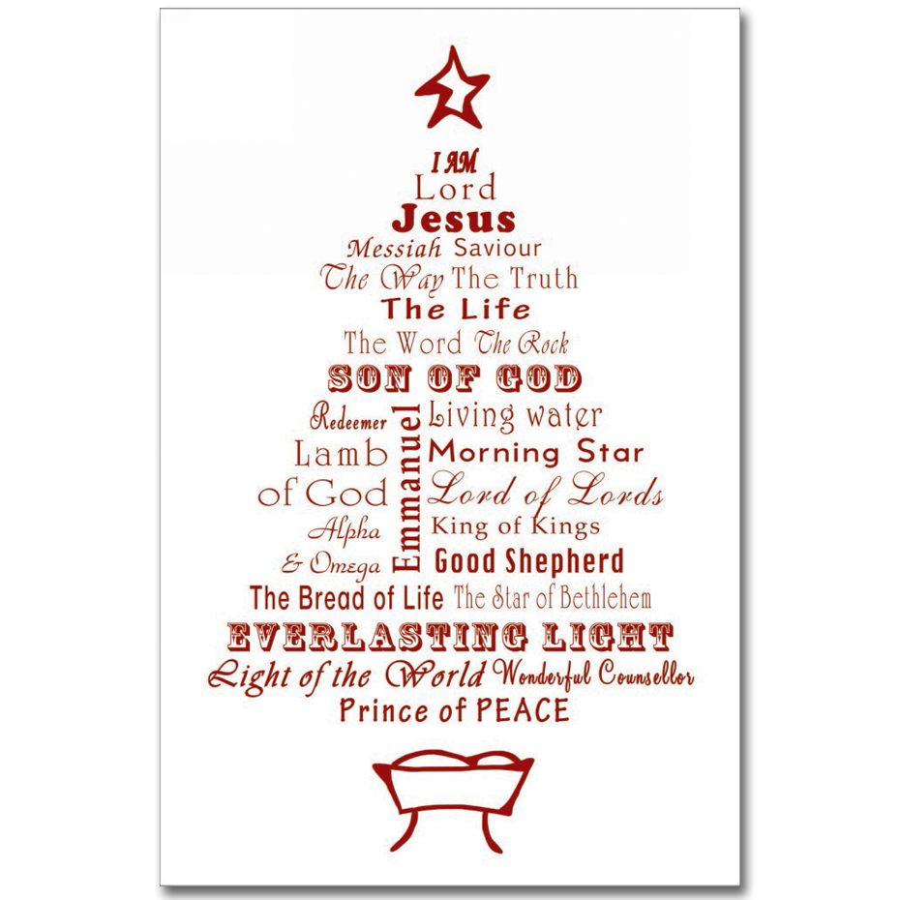
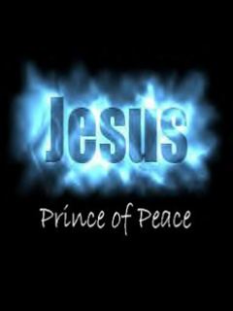
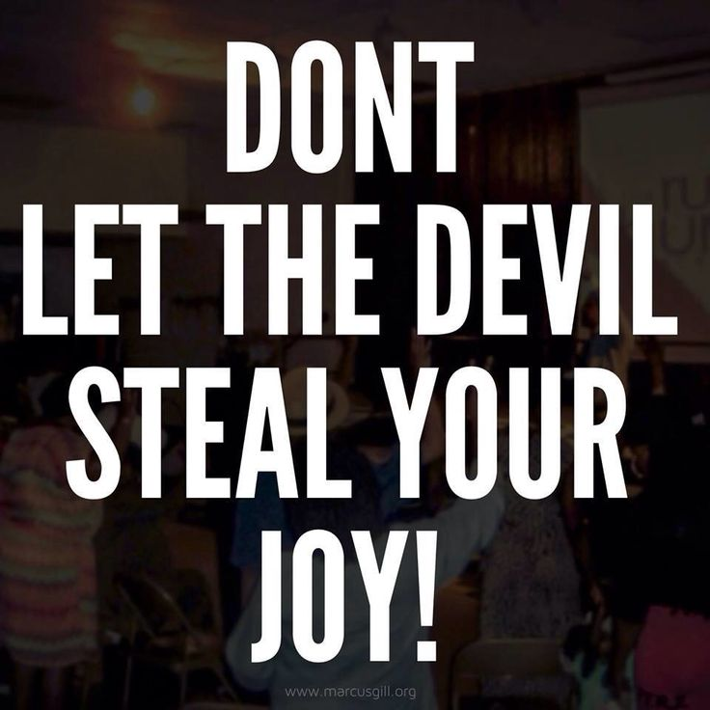
End of part 1

Slide 23
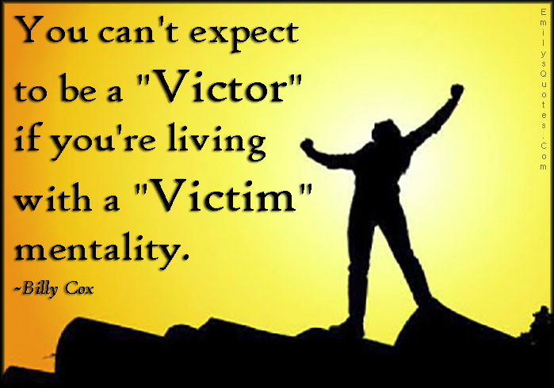
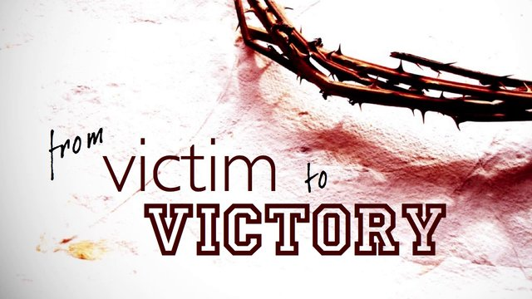
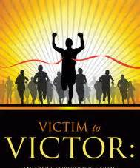
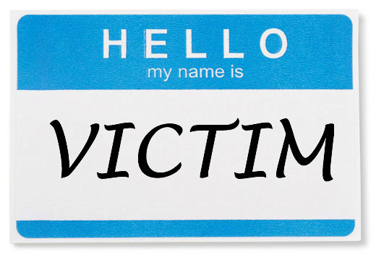
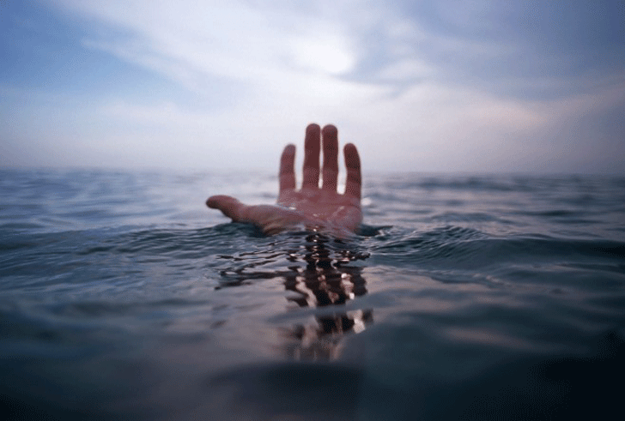

Slide 24
Part 3

Slide 25
Four Of The Emotional Consequences That Accompany Trauma - 22-25
“For I am poor and needy, and my heart is wounded within me. I am gone like the shadow when it declineth: I am tossed up and down as the locust. My knees are weak through fasting; and my flesh faileth of fatness. I became also a reproach unto them: when they looked upon me they shaked their heads.”
1. You may have a wounded heart. You may feel a deep hurt that you are unsure whether you can ever recover from. You may have fallen prey to the feeling that you can never feel “normal” again. Beware of the extreme thinking of “never” and “always”. Few things in life are this way, and by following the Scriptures you can overcome this trial, too. Remember Philippians 4:13 “I can do all things through Christ which strengtheneth me.”
2. The second emotional consequence is that of withdrawing. The Psalmist says that he is gone like the shadow when it declineth. Have you withdrawn from others? Do you desire to be alone instead of facing people? Have you had an emotional withdraw, building up walls so that people cannot get close enough to hurt you? You may have thought something was wrong with you, when the truth is that you are responding just as a normal person does, just like David did. Hold on! God has an answer coming for you; He has deliverance for you.
3. Next, the Psalmist says that he is tossed up and down like the locust. We may express this by saying, “I’m on an emotional roller coaster. I can’t seem to control my emotions.” Remember this was the same response King David had before he applied the cure that God gave him.
4. The last emotional consequence David experienced was that he had a sudden health change. He lost weight, a noticeable altering of his physical appearance. Those around him could see the change. You may have experienced the opposite, gaining weight instead of losing it. You may have become trapped in a cycle of eating disorders. If you have fallen into an eating disorder since your traumatic event, you need to be cautious that you are not giving heed to doctrines of Devils as it says in I Timothy 4:1-3.

Slide 26
So what is the answer? How did David go on and overcome this traumatic event? More specifically, how can you overcome the trauma that you have experienced?
The answer is two parts and is found in the last few verses of the chapter. Verses 26-30, “Help me, O LORD my God: O save me according to thy mercy: That they may know that this is thy hand; that thou, LORD, hast done it. Let them curse, but bless thou: when they arise, let them be ashamed; but let thy servant rejoice. Let mine adversaries be clothed with shame, and let them cover themselves with their own confusion, as with a mantle. I will greatly praise the LORD with my mouth; yea, I will praise him among the multitude.”

Slide 27
The first step that David took was to acknowledge that everything that happened to him, happened by the will of God. Wait a minute! I didn’t say God did it. What I did say is that the Scripture teaches us that God prohibits or allows ALL things that happen to us in life. The Biblical example of this is Job. In Job 1:6-12 it says, “Now there was a day when the sons of God came to present themselves before the LORD, and Satan came also among them. And the LORD said unto Satan, Whence, comest thou? Then Satan answered the LORD, and said, From going to and fro in the earth, and from walking up and down in it. And the LORD said unto Satan, Hast thou considered my servant Job, that there is none like him in the earth, a perfect and an upright man, one that feareth God, and escheweth evil? Then Satan answered the LORD, and said, Doth Job fear God for nought? Hast not thou made an hedge about him, and about his house, and about all that he hath on every side? thou hast blessed the work of his hands, and his substance is increased in the land. But put forth thine hand now, and touch all that he hath, and he will curse thee to thy face. And the LORD said unto Satan, Behold, all that he hath is in thy power; only upon himself put not forth thine hand. So Satan went forth from the presence of the LORD.”
Here we find that Satan was not able to attack Job due to the hedge of thorns that God had placed around him and all that he had. Even when God allowed Satan access to Job, he was still limited in what he could do. You may ask the same question that many have: Why would God allow the Devil access to me? Job’s friends had all sorts of reasons why, and none of them were right. The conclusion of Job seems to be that God is God, and He does not have to answer to you nor me. We look at life in a finite manner; we do not see the whole picture. God sees not only where we are now, but also where we are going. He knows that there are things we will never learn without trauma. I had a friend die at a young age several years ago. I began to ask the question, why did You have to take someone so young? Then God directed me to I Kings 14:12-13 “Arise thou therefore, get thee to thine own house: and when thy feet enter into the city, the child shall die. And all Israel shall mourn for him, and bury him: for he only of Jeroboam shall come to the grave, because in him there is found some good thing toward the LORD God of Israel in the house of Jeroboam.” God was preparing to judge the house of Jeroboam.
This child of Jeroboam was taken to keep him from the judgment that was going to befall his father’s house. God was being merciful to him. God’s mercy is sometimes seen by us as a catastrophe. Job found a truth in chapter 19:6 “Know now that God hath overthrown me, and hath compassed me with his net.” It is God that allowed the trauma in Job’s life. Acknowledging this takes power away from your enemy. Those who have traumatized you have no power over you if you acknowledge that God is in control of all things that happen in your life.

Slide 28
Romans 8:28 which says, “And we know that all things work together for good to them that love God, to them who are the called according to his purpose.”
The Scripture does not tell us that all things that happen to those who love God will be good. Many things that happen are bad. God did not promise to keep all bad things from happening to us, but He did promise that if we will allow Him to work His will in our lives, that all things good and bad would work together for good.
I believe that the two verses prior to this verse give us an indication of the fact that bad things happen in life when they say, “Likewise the Spirit also helpeth our infirmities: for we know not what we should pray for as we ought: but the Spirit itself maketh intercession for us with groanings which cannot be uttered. And he that searcheth the hearts knoweth what is the mind of the Spirit, because he maketh intercession for the saints according to the will of God.”
God is saying that when you cannot understand why things have happened in your life, when you do not even know how to pray, He knows what you need. Traumatic events bring us to an end of our abilities. They bring us to the place that we have to turn to God, when there are no other options. It is at those times that God says, turn to me and I will make these bad things in life work together for good.
Your enemy has power over you as long as you believe that they control what they did to you. When you change that belief and acknowledge that they could do nothing to you except what God allowed, then they are powerless.
No longer do you need to fear them. No longer do they have the power; now all things are as they should be. All power belongs to God. He is in control and we are yielded to His authority.

Slide 29
The next thing that David did was to praise God for what had happened to him.
1 Thessalonians 5:18 “In every thing give thanks: for this is the will of God in Christ Jesus concerning you.” It is not just God’s will for you to give thanks when things get worked out for good, but to give thanks for the traumatic events that happen to you as well. This is a very difficult thing to do, to actually thank God for the bad thing that happened to you. This is a foreign concept to us, but is exactly what the Scripture requires for us to do. Ephesians 5:20 “Giving thanks always for all things unto God and the Father in the name of our Lord Jesus Christ;” Praising God for the traumatic event that happened in your life takes power away from the adversary, the Devil. Do you remember what the Devil said Job would do if God removed the hedge of protection from him? He said that Job would curse God to his face. What do you suppose it does to the Devil, when instead of causing you to curse God, you begin to praise God for the trauma in life? The last thing that the Devil wants is to see God praised. Praising God for trauma is a sure way to get the Devil to flee.
Praising God also begins to remove the cloud of depression that often shrouds those who have been burdened down with trauma. Isaiah 61:3 “To appoint unto them that mourn in Zion, to give unto them beauty for ashes, the oil of joy for mourning, the garment of praise for the spirit of heaviness; that they might be called trees of righteousness, the planting of the LORD, that he might be glorified.”
Praising God takes your mind off of you and puts it on Him.
It also trains your mind to think on things that are profitable to you. Philippians 4:8 says, “Finally, brethren, whatsoever things are true, whatsoever things are honest, whatsoever things are just, whatsoever things are pure, whatsoever things are lovely, whatsoever things are of good report; if there be any virtue, and if there be any praise, think on these things.”
Praising God is the essence of thinking on these things. It may help you to make lists of things that you are thankful to God for. You can use a notebook or 3x5 cards. Make it a habit to list more things every day.
Daniel did this three times each day. Daniel 6:10 “Now when Daniel knew that the writing was signed, he went into his house; and his windows being open in his chamber toward Jerusalem, he kneeled upon his knees three times a day, and prayed, and gave thanks before his God, as he did aforetime.”
David praised God seven times a day. Psalm 119:164 “Seven times a day do I praise thee because of thy righteous judgments.” You would be surprised how many things that you have to thank God for. You should thank Him for everything you can see. If you have an enemy, you should look for things about them to thank God for. Even in the worst circumstances we are to thank God.

Slide 30
Once you have done these two things,
acknowledging God’s control in your life and
praising Him for the trauma in your life,
then you will have given all the power back to God.
That is when He will take all things and work them together to good. David ended Psalm 109 with verse 31, “For he shall stand at the right hand of the poor, to save him from those that condemn his soul.” You see, God stands ready to deliver and save you from condemnation. It may be from the condemnation of others, or it may be from yourself. When you give to God the position and praise He is due, it opens the door to Him to deliver you.

Slide 31
Isa 61:1-3
The Spirit of the Lord God is upon me, because the Lord has anointed me to bring good news to the poor; he has sent me to bind up the brokenhearted, to proclaim liberty to the captives, and the opening of the prison to those who are bound; to proclaim the year of the Lord's favor, and the day of vengeance of our God; to comfort all who mourn; to grant to those who mourn in Zion— to give them a beautiful headdress instead of ashes, the oil of gladness instead of mourning, the garment of praise instead of a faint spirit; that they may be called oaks of righteousness, the planting of the Lord, that he may be glorified.

Slide 33
“Hold not thy peace, O God of my praise; For the mouth of the wicked and the mouth of the deceitful are opened against me: they have spoken against me with a lying tongue. They compassed me about also with words of hatred; and fought against me without a cause. For my love they are my adversaries: but I give myself unto prayer. And they have rewarded me evil for good, and hatred for my love.” (1-5)
My God, don’t turn a deaf ear to my hallelujah prayer. Liars are pouring out invective on me; Their lying tongues are like a pack of dogs out to get me, barking their hate, nipping my heels— and for no reason! I loved them and now they slander me— yes, me!— and treat my prayer like a crime; They return my good with evil, they return my love with hate. – (1-5) Message

Slide 34
1-Do not keep silent, O God of my praise!
2-For the mouth of the wicked and the mouth of the deceitful Have opened against me; They have spoken against me with a lying tongue.
3-They have also surrounded me with words of hatred, And fought against me without a cause.
4-In return for my love they are my accusers, But I give myself to prayer.
5-Thus they have rewarded me evil for good, And hatred for my love.
My God, don’t turn a deaf ear to my hallelujah prayer. Liars are pouring out invective on me; Their lying tongues are like a pack of dogs out to get me, barking their hate, nipping my heels— and for no reason! I loved them and now they slander me— yes, me!— and treat my prayer like a crime; They return my good with evil, they return my love with hate. – (1-5) Message

