Slide 2
How to Stay Strong During Life Challenges Remind Me Again
Edward Church
October 8, 2017

Slide 3
Reminder #1
You Have a 100% Track Record for
…Getting Through Everything in Your Life.
We’ve been surrounded and battered by troubles, but we’re not demoralized; we’re not sure what to do, but we know that God knows what to do; we’ve been spiritually terrorized, but God hasn’t left our side; we’ve been thrown down, but we haven’t broken. 2 Cor 4:7-8 (MSG)
You’re still breathing, heart beating…you have what it takes to walk ahead powerfully.
Remind Yourself Every Day – “I will be okay”
God Always Get Me Through Somehow. “I trust Him”

Slide 4
Reminder #2
This Too Shall Pass
So we’re not giving up. How could we! Even though on the outside it often looks like things are falling apart on us, on the inside, where God is making new life, not a day goes by without his unfolding grace. These hard times are small potatoes compared to the coming good times, the lavish celebration prepared for us. There’s far more here than meets the eye. The things we see now are here today, gone tomorrow. But the things we can’t see now will last forever. 2 Cor 4:16-18(MSG)
Storms Will Come and Go….You Will Outlive It
Remember, This is a Season, It Will Eventually Pass

Slide 5
Reminder #3
Diamonds are Made Under Pressure, and So are You…
…Your Challenges Will be the Making of You
There’s more to come: We continue to shout our praise even when we’re hemmed in with troubles, because we know how troubles can develop passionate patience in us, and how that patience in turn forges the tempered steel of virtue, keeping us alert for whatever God will do next. Romans 5:3-5 (MSG)
Life Challenges Pressuring You are Softening Your Rough Edges
On The Other Side of this Challenge, You Will Shine Again,
…Brighter Than Before.

Slide 6
Reminder #4
All Challenges Can Turn Into Wisdom
And if any of you needeth wisdom, ask he of God, which giveth to all men largely [that giveth to all men largely], and upbraideth not; and it shall be given to him. James 1:5
Difference in Knowledge and Wisdom
Knowledge is “Know How”
Wisdom is “How to Use the Know How”
Challenges Form Greater Understanding, Skills and Life Wisdom
There Is Purpose To What You Are Going Through. Trust God.

Slide 7
Reminder #5
Sometimes Things Fall Apart So That …
…Better Things Can Fall Together
Moreover we know that to those who love God, who are called according to his plan, everything that happens fits into a pattern for good. Rom 8:28 Phillips
Sometimes It's Actually God's Way of Spring Cleaning You…
…To Prepare You for the Coming Season o f Your Life.
When it Seems life is beating down on you…
…maybe the slate is being wiped clean in order
…that something better can form.

Slide 8
Reminder #6
What We Resist Persists…
…So, It's Vital to Let Go and Flow.
Your Attitude is EVERYTHING when it comes to Staying Strong.
You will be a Victim or you will Rise Up and be a Victor…
…The Choice is Yours

Slide 9
Reminder
1- 3 fingers – pitcher
2- bowl weavel- peanuts georgia

Slide 10
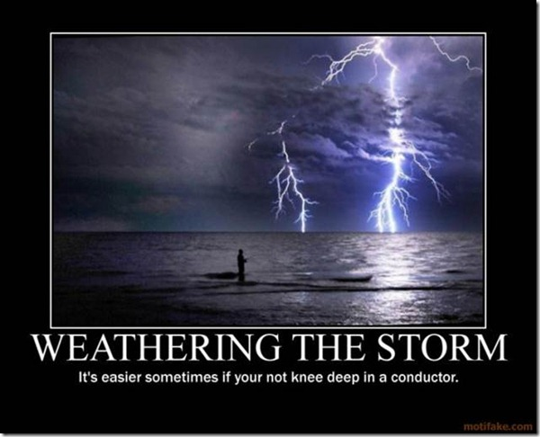
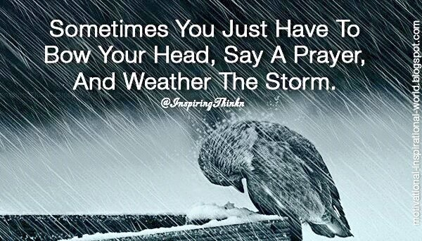

Slide 11
