Slide 2
Five Reasons Why Christmas Is Good News
Dec 17, 2017
Edward Church
Luke 2:4-14

Slide 3
4 Joseph also went up from Galilee, out of the city of Nazareth, into Judea, to the city of David, which is called Bethlehem, because he was of the house and lineage of David, 5 to be registered with Mary, his betrothed wife, who was with child. 6 So it was, that while they were there, the days were completed for her to be delivered. 7 And she brought forth her firstborn Son, and wrapped Him in swaddling cloths, and laid Him in a manger, because there was no room for them in the inn. 8 Now there were in the same country shepherds living out in the fields, keeping watch over their flock by night. 9 And behold, an angel of the Lord stood before them, and the glory of the Lord shone around them, and they were greatly afraid. 10 Then the angel said to them, "Do not be afraid, for behold, I bring you good tidings of great joy which will be to all people. 11 For there is born to you this day in the city of David a Savior, who is Christ the Lord. 12 And this will be the sign to you: You will find a Babe wrapped in swaddling cloths, lying in a manger." 13 And suddenly there was with the angel a multitude of the heavenly host praising God and saying: 14 "Glory to God in the highest, And on earth peace, goodwill toward men!” Luke 2:4-14

Slide 4
The Gospel is the Good News to a World that Needs It!
The Good News Broken Down is…
“For God so loved the world that He gave His only begotten Son, that whoever believes in Him should not perish but have everlasting life.” - John 3:16
“And the Word became flesh and dwelt among us, and we beheld His glory, the glory as of the only begotten of the Father, full of grace and truth” -John 1:14
Five Reasons Why Christmas is Good News

Slide 5
Because It Banishes Fear (10)
Fear is the Most Crippling Human Emotion.
It Paralyzes Christians and Can Shut Them Totally Down
365 Times in the Bible You Find the Words Fear Not.
2 Tim 1:7,“For God has not given us a spirit of fear; but of power,
and of love, and of sound mind.”
God Wants Fear Out of Your Life.
1 John 4:18,“There is no fear in love; but perfect love casts fear.”
The Angel Brought Good News – We Don’t Need To Fear.

Slide 6
Because It Brings Great Joy (10)
Notice the Bible Doesn’t Say Great Happiness
Happiness Comes and Goes – but Joy Endures Forever.
When Elizabeth saw Mary the Bible says John the Baptist, who was Still in His Mother’s Womb, Leaped for Joy.
One of the Manifestations of the Fruit of the Spirit is Joy

Slide 7
Because It is for Everybody (10)
It is for Everyone; Red Yellow Black or White.
Everyone Regardless of Age, Gender, Height or Shortness, Educational Level, the Whosoever Will / the Whosoever Won’ts
This Is Good News It’s for Everyone.

Slide 8
Because it is for Me (11)
This is About God’s Christmas Present to Me.
God So Loved Me That If He Sent His Son – That If I Believe In Him I Will Not Perish – But I’ll Have Eternal Life.
Not Enough to Know that Jesus Died.. But that He Died for Me
“Behold I stand at the door and knock. If anyone hears My voice and opens the door. I will come in to him and dine with him, and he with me.” Rev. 3:20

Slide 9
Because it is About a Savior (11)
If we were having a plumbing problem we would need a plumber.
If we were having a car problem we would need a mechanic.
If we were having an electrical problem…need an electrician.
But we have a sin problem – we need a Savior –
That is what God sent….Jesus Who is the Christ.
That’s Why It’s Good News!

Slide 10
Thank God
for the
Good News!

Slide 12
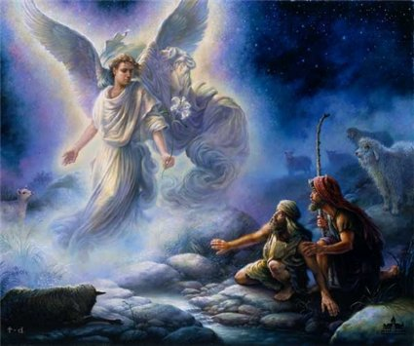
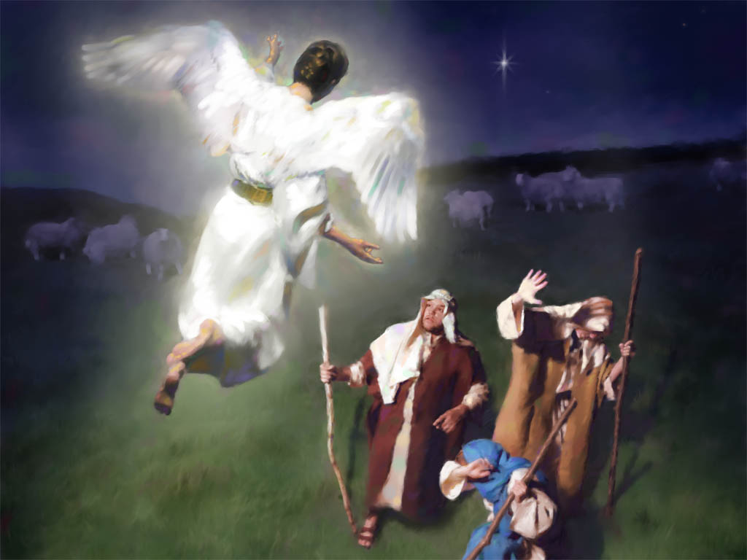
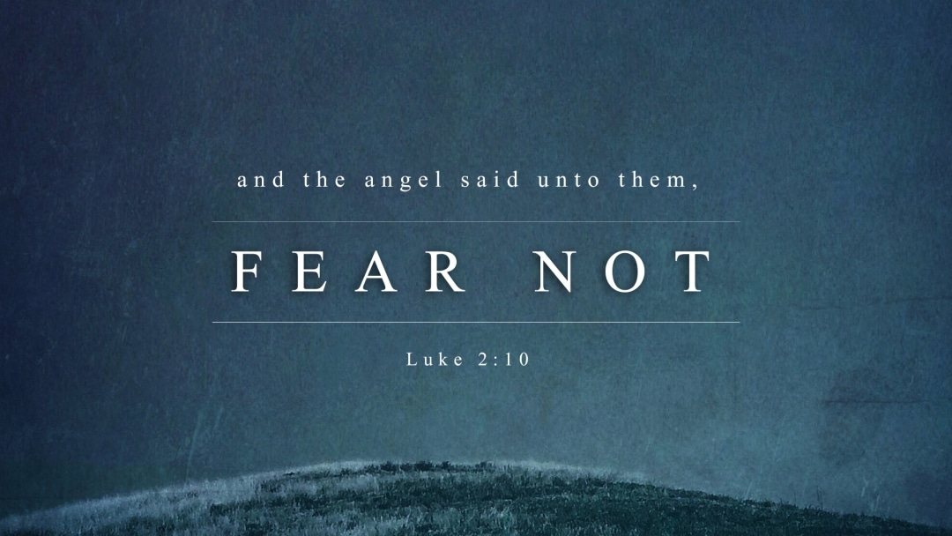

Slide 13
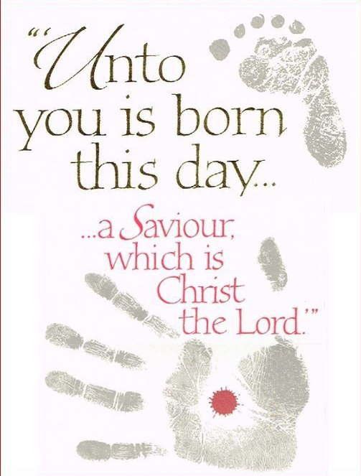
Edward Church

