Slide 2
Turning Our Pains into Praises
Edward Church
II Cor 12:7-10
Dec 10, 2017

Slide 3
God Promises an Exchange

Slide 4
Paul’s “thorn in the flesh” has had a Lot of Interpretations
“Skolop” = a Pointed Thing.
Something
of a Bodily Annoyance/ Disability.
Pain that Bothers us….
…Physically, Mentally, Emotionally, Spiritually
Paul Prayed that His “Thorn” Be Taken Out.
But God Seemed Responded…
“Let the Pain Remain, Paul, it’s Good for You”.

Slide 5
Raise a
Barrier
Shield
Defend
Make More than Enough

Slide 6
Paul learned God can turn our pains into praises”
We too must allow God to transform our “thorns of pains” into “horns of praises”
There are a few Steps to Undertake…
…then we can open our lives and allow God to accomplish
…His work, transforming our pains into praises.

Slide 7
Accept the Presence of Your Pains! (7)
..To keep me from becoming conceited, there was given me a thorn in my flesh, a messenger of Satan, to torment me.
Paul’s pain was Not an Offer.
It was Given.
God Gave It.
And If God Gave It, It Must Be Good for Paul.
We are a Comfort-Oriented and a Success-Driven Generation.
We View the Presence of Pain / Problems to Be Unwanted, Let Alone Needed, Ingredients of Life.

Slide 8
Accept the Presence of your Pains! (7)
Pain Keeps Our Feet on the Ground.
“To keep me from becoming conceited”… (7)
Above Measure= “to exalt self above measure”.
Prevents Conceit …Improper View -Focus Lost
Protects Us from Us …Implosion
Pain Becomes
Eye-Opener.
God’s Tool to Protect us.

Slide 9
Accept the Presence of your Pains! (7)
Pain Keeps Our Faith On the Grind!
“A Messenger of Satan to Torment Me…”
Buffet= “torment” “strike with a fist”.
It was meant to put Paul on the Anvil of God
One good reason to simply accept our pains
…they sharpen our faith.
…that can conquer the most dreadful trials.
…Pain is God’s tool to perfect us.

Slide 10
Appreciate the Essence of your Pains! (9)
… I will boast all the more gladly about my weaknesses,
so that Christ's power may rest on me.
How could a sane person appreciate pain?
But Paul was saying,
“boast all the more gladly about our weaknesses”
Infirmities= weakness-corruption- pain
Focus Changed

Slide 11
Appreciate the Essence of your Pains! (9)
Pain is a Projection of Christians’ Gladness.
“I will boast all the more gladly…
boast all the more”= “to rejoice in the highest degree”.
Our Rejoicing becomes an Invitation
Pain is God’s Workshop of Joy.
Pain is a Platform for Christ’s Greatness.
“…Christ’s power may rest on me…”
Rest= build a tent- working within- giving help
The Power of Christ is our fortress that is built-in
Pain is God’s Workshop of Peace.

Slide 12
Apply the Consequence of your Pains! (10)
… for Christ's sake, I delight in weaknesses, ..insults, in hardships, in persecutions, difficulties. For when I am weak, then I am strong.
The best result of pain is a refined character.
Life is 10% what Happens to you and 90% how we respond
Our Pain Enhances our Contentment!
“I delight in weaknesses…”
Delight=“to be willing and to take pleasure”.
Weak= “impotency or unable to do anything”
Strong=“able to do everything”.
God uses pain as a Measure of our faith.
When stripped of Human Strength that we can be …
…useful and Mighty in His Strength

Slide 16
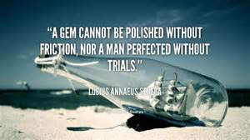
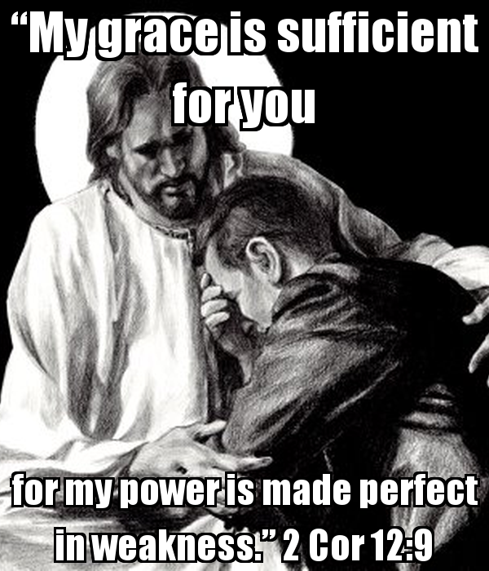
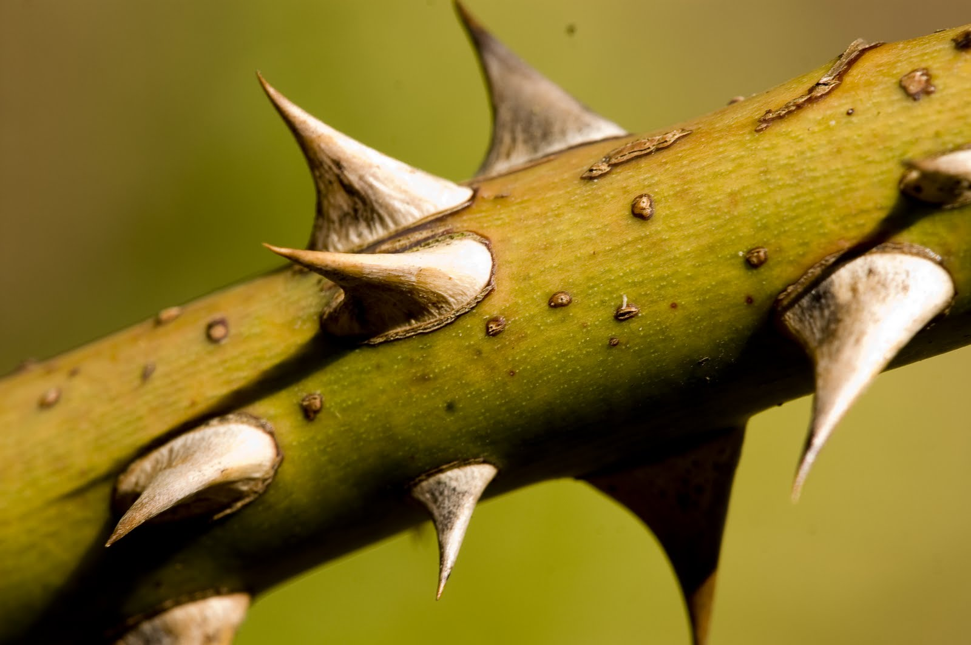

Slide 17
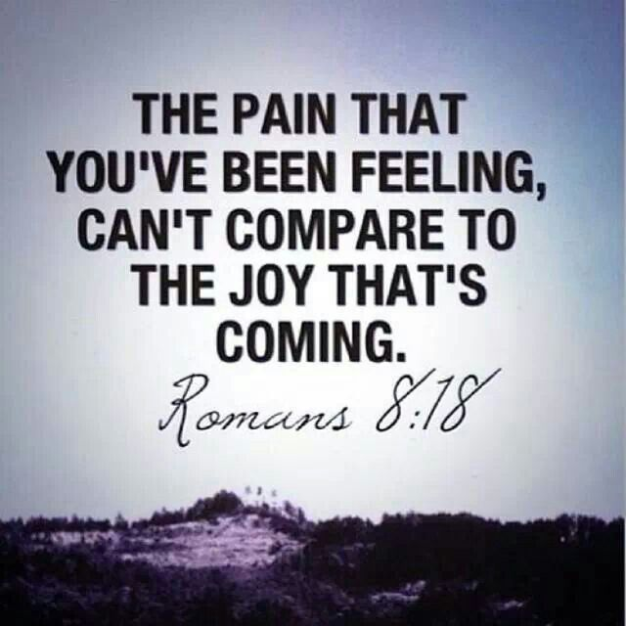
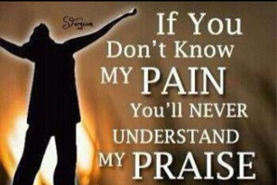
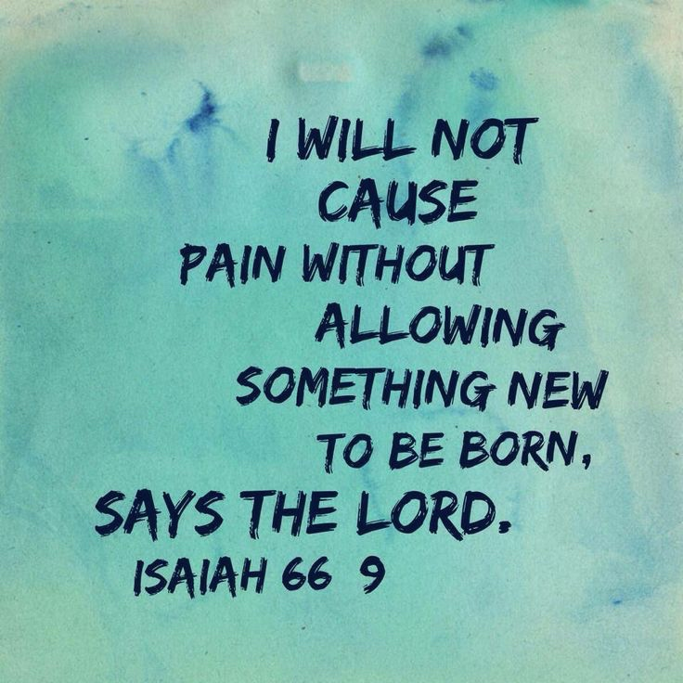

Slide 18
