Slide 1
As Long as You Live By Faith… …Your Faith WILL BE TESTED
Faith demonstrated by Inactivity –
having done all to stand-stand –God may be silent but never idle
Sometimes it requires us to Step Forward in Faith (Priests at Jordan)
Faith Demonstrated by Activity
Either way Faith Requires Courage- Not the Absense of Fear but the Sensing of God’s Presence
Either way Faith w/ out Works is Dead(corpse) –
Both the Above are Works in Progress
II. Fear Gives Many Opportunities A. (15) Given a Second Chance - “If you be ready...”

Slide 2
Cheaper to Pay the Bully
There used to be this bully who would demand my lunch money every day. Since I was smaller, I would give it to him. Then I decided to fight back. I started taking karate lessons. But then the karate lesson guy said I had to start paying him five dollars a lesson. So I just went back to paying the bully. Too many people feel it is easier just to pay the bully than it is to learn how to defeat him.

Slide 3
Give Me a High Five… …Faith Facts
Edward Church
December 3, 2017
Daniel 3:10-18

Slide 4
Satan Desires to
Strain Us
Drain us
Rearrange Us
He Seeks to Destroy Our Faith
He Knows…
Without faith it is imposs to please God
James 2:26 (NCV)
²⁶ Just as a person’s body that does not have a spirit is dead, so faith that does nothing is dead!
Mark 2:5
When Jesus saw their Faith…

Slide 5
¹⁶⁻¹⁸ Shadrach, Meshach, and Abednego answered King Nebuchadnezzar, “Your threat means nothing to us. If you throw us in the fire, the God we serve can rescue us from your roaring furnace and anything else you might cook up, O king. But even if he doesn’t, it wouldn’t make a bit of difference, O king. We still wouldn’t serve your gods or worship the gold statue you set up.”

Slide 6
High Five #1 We are Not Careful to Answer Thee
We Need a Faith that…
…Cannot Be Threatened or Intimidated
…that Does Not Give in to Pressure
The King was Trying to Intimidate Them
II Tim 1:7, Not given spirit of
Fear- timidity –faithless -fearful
Power- dunamis- power- ability
Love- the ability to love the unloveable
Sound Mind –ability to think under pressure

Slide 7
High Five #2 17 - If It Be So...
We Need A Faith that Can…
…Stand Up in the Face of Reality
Yes, You have the power to cast us into the furnace
Our Faith Needs to Face the Reality- We May Go Through The Fire
Isa 43:2, When you go through deep waters, I will be with you. When you go through rivers of difficulty, you will not drown. When you walk through the fire of oppression, you will not be burned up; the flames will not consume you.

Slide 8
High Five #3 God Is Able to Deliver Us…
We Need a Faith that is…
…Always Subject to the Divine Will of God
Our lives are always subject to the Divine Will of God
These three men knew God was Able and we need a Faith that
…Knows God is able....
…also realizes that our Life is Subject to God’s Divine Will
and we leave it all in His hands ........... That Takes Faith

Slide 9
High Five #4 And Will Deliver Us Out Of Your Hand...
We Need a Faith that Knows…
…God Will Deliver Us from the Hand of the Enemy
Difference between the Furnace and the Hand of the Enemy
They First said “GOD IS ABLE” and then said “GOD WILL”
They had resolved that if God’s will took them into the Furnace,
…He Could Deliver them From the king

Slide 10
High Five #5 But If Not....We Will Not Serve Thy Gods
We Need a Faith that Will Be…
…Committed to God Regardless of Outcome
Too many people put conditions on God
“I’ll serve you if....., I’ll follow you if...., I’ll live for you if
“BUT IF NOT” faith says “I’ll serve you regardless...
It takes a strong faith to say “But if not...”
It takes complete trust and security in God

Slide 11
Delivered Through ..Not From
Their Hebrew Names Were Their Testimomy
Shadrach- Hananiah= Jehovah has favored
Meshach- Mishael= Who is like God
Abednego- Azariah= Jehovah has helped
The proof –the Son of God walking with them
Furnace had No Power Over Them
Hair Not Singed
Coats Not Changed
No Smell

Slide 13
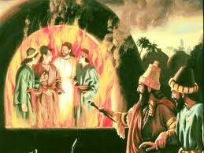
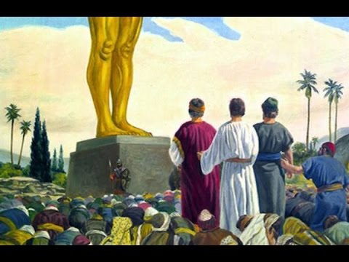
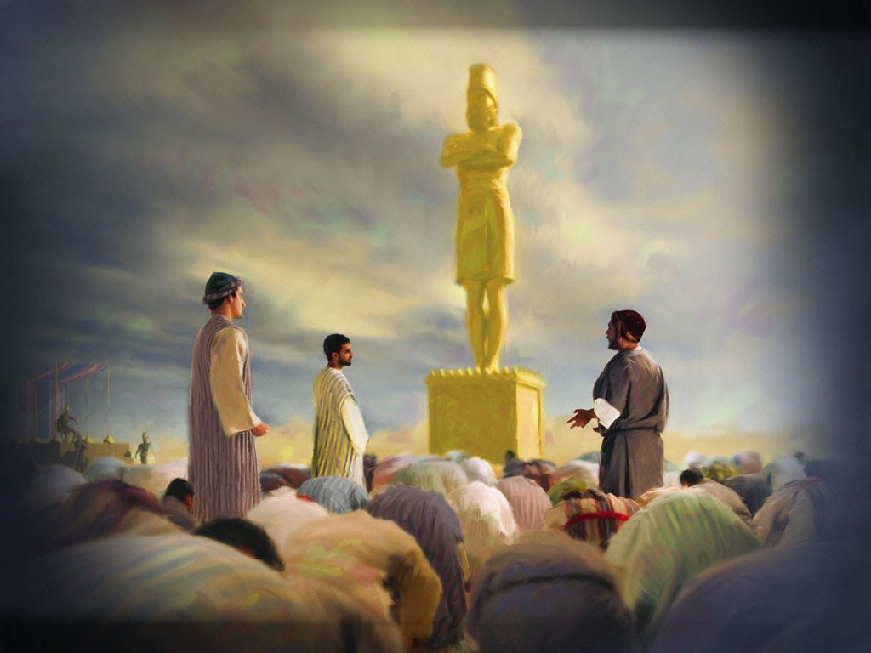
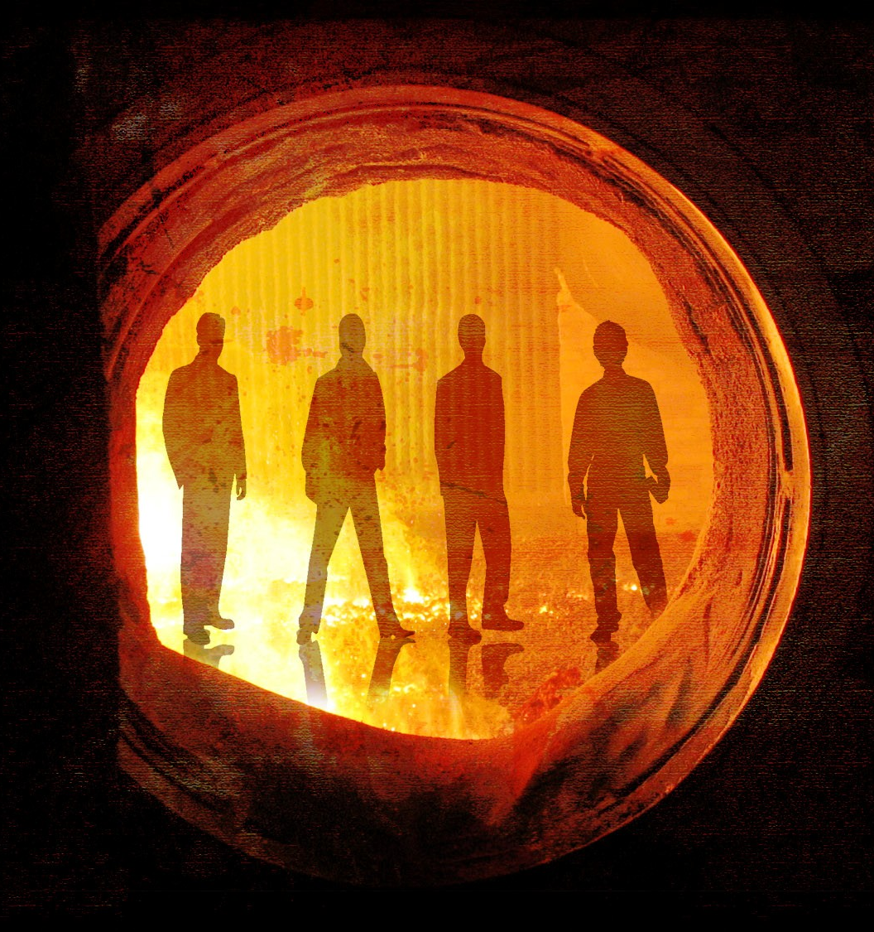
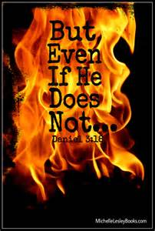
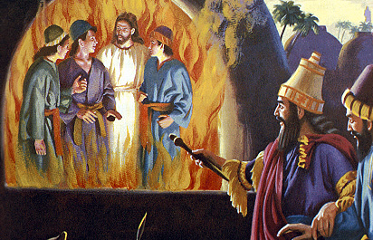

Slide 14
