Slide 2
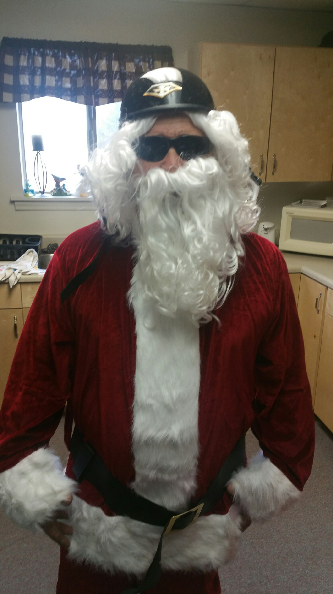

Slide 3
The Perfect Christmas
DEC 24, 2017
Edward Church
Micah 5:2-5

Slide 4
But you, O Bethlehem of Ephrathah, who are one of the little clans of Judah, from you shall come forth for me one who is to rule in Israel,
He will stand and shepherd his flock in the strength of the Lord, in the majesty of the name of the Lord his God. And they will live securely, for then his greatness will reach to the ends of the earth. And he will be their peace.-5:2-5

Slide 5
The Grinch
Gifts and Festivities are Great but that is Not the Real Ingredient for a Perfect Christmas…
Every Who Down in Who-ville, the tall and the small, was singing! Without any presents at all!

Slide 6
He Gives You Strength (4)
He will stand and shepherd in the strength of the Lord. (4)
Christmas is about this:
You Don’t have to do it on your own.
You can turn to God for strength, and he will give it to you.
cast all his cares on Jesus -1 Peter 5:7
"the weakness of God is stronger than man’s strength." -1 Cor 1:25
That’s the kind of strength Jesus offers.

Slide 7
He Gives You Strength (4)
That’s what Christmas is all about.
It means you are not alone.
You are not a victim of the circumstances of your life.
You have a shepherd, and you can live in his strength.
I know many of you are facing challenges right now that are bigger than you.
You are in a battle that you don’t have the strength to win on your own – God will be your strength.

Slide 8
He Gives You Security (4)
And they [his flock] shall live secure, for now he shall be great to the ends of the earth. (4)
We live in an insecure world.
The things we turn don’t have the ability to offer true security.
Jesus offers the security of knowing that he is control, and he has the power and ability to take care of us.
I myself will be the shepherd of my sheep, and I will make them lie down, says the Lord GOD. 16 I will seek the lost, and I will bring back the strayed, and I will bind up the injured, and I will strengthen the weak (34:15-16).

Slide 9
God Made this Promise to Us:
“Never will I leave you, never will I forsake you." -Heb13:5
"My sheep listen to my voice. I know them, and they follow me. I give them eternal life, and they shall never perish; no one can snatch them out of my hand." -John 10:27-28
He Offers a Kind of Security the World Cannot Offer…
…security based not on things and circumstances
…based on his Greatness and never-ending love for you.
"There is no place you can go, or nothing that can happen, that extends beyond the power of God to take care of you."

Slide 10
He Gives You Serenity (5)
And he will be their peace (5)
We don’t live in a peaceful world.
Jesus came to bring peace to all who follow him. Micah said....
Jesus’ birth was announced by the angels, who said...
"Glory to God in the highest, and on earth peace to men...(Luke 2:14)
Peace I leave with you; my peace I give you....Do not let your hearts be troubled and do not be afraid. (John 14:27)
Jesus came to give us peace. Even when we can’t experience peace in the world around us, we can experience his peace in our inner world.

Slide 11
Jesus came into the world to not to take away all the things that destroy our peace.
He wants to carry your burdens; he wants to lift your anxieties, he wants to take away your sins.
Those things that tend to make your life miserable are the very things Jesus came to take care of.
That’s what he wants to do. He wants to be your shepherd. He wants to give you peace.

Slide 14
It’s humbling to admit we can’t take care of ourselves, but that’s exactly what we must admit.
It is hard to face the fact that our worlds are so fragile and insecure.
And it is impossible to create peace.
But there is a child who was born in a manger. And now it is not just this day that has meaning. Our lives do.
For this child has given us the incredible gift of strength, security and peace.
In all the circumstances of this day, know the meaning: God has become a man to give you strength, security and peace.

Slide 15
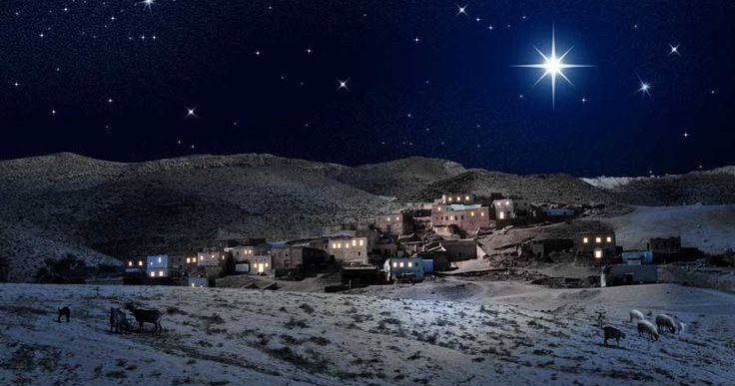
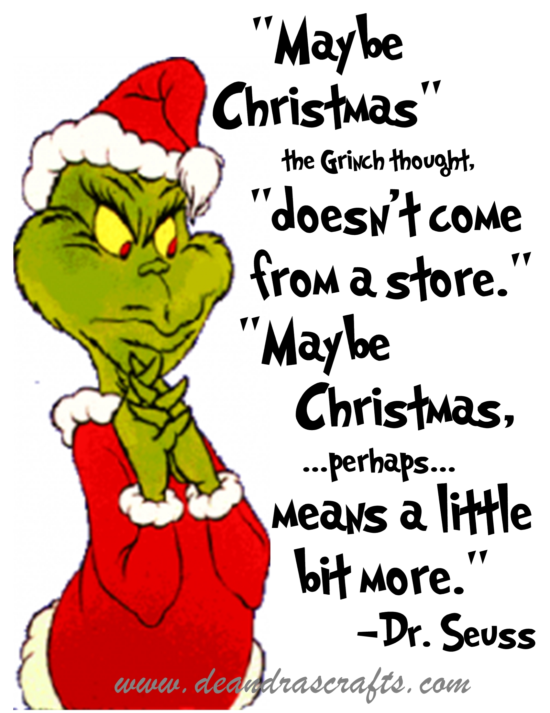
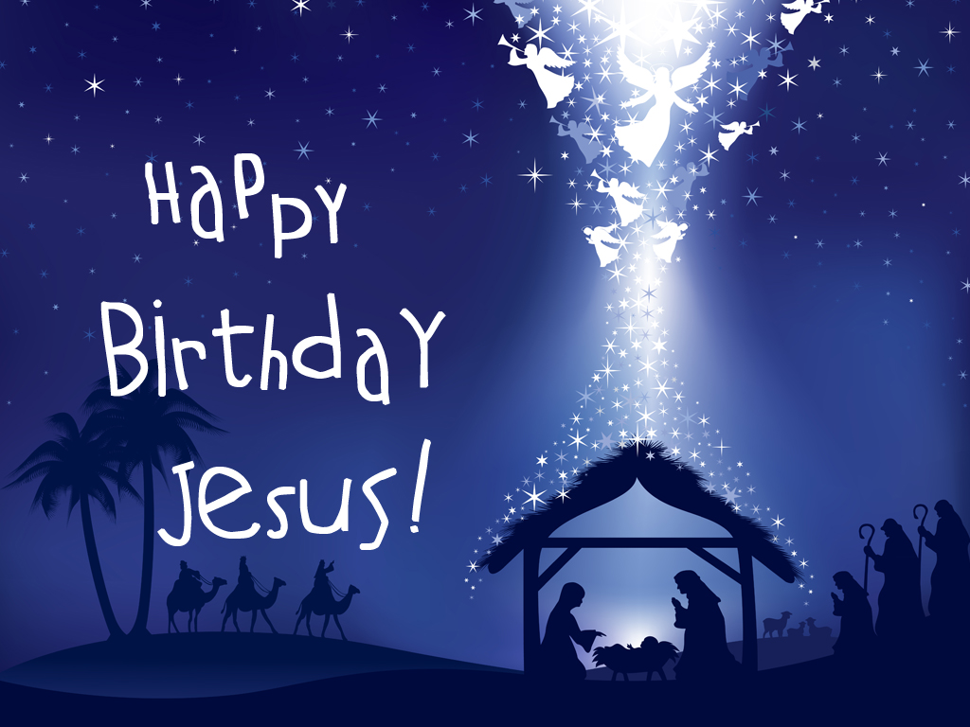

Slide 16
