Slide 2
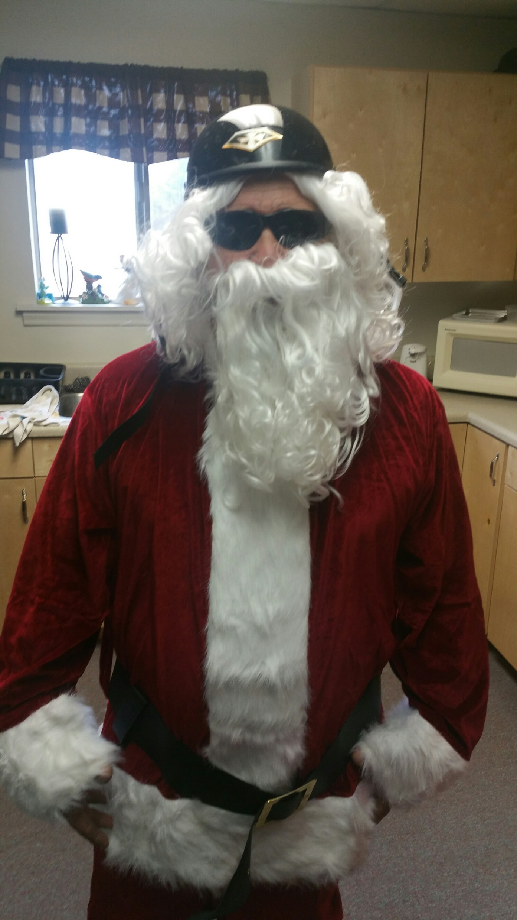

Slide 3
2018 Time for a…
Edward Church
Proverbs 3:1-32
Dec 31, 2017

Slide 5
What’s Gone Is Gone
Last year at this time, some of you were saying,
"This year, things are going to be different! I’m going to change!”
I’m going to…
be a better spouse.
spend more time with my family.
spend more time reading my Bible.
Spend More time praying
Spend More time serving others.
This is the year I get my ducks in a row!"
Just By a Simple Show of Hands…
Who Has Stuck to Their New Years Resolutions?

Slide 7
They Deal with Things to…
Make Us Look Better and Live Longer
Make Us Have More
Help Us to Get Along with Everyone
ie….
Longevity…
Prosperity…
…Peace
In Order to Effect…
…Our Lives
We Must be Move From
Resolutions= Thoughts
To
Revolution= Attitudes

Slide 8
My son, forget not my law; but let thine heart keep my commandments:
² For length of days, and long life, and peace, shall they add to thee.
³ Let not mercy and truth forsake thee: bind them about thy neck; write them
upon the table of thine heart: ⁴ So shalt thou find favour and good
understanding in the sight of God and man. ⁵ Trust in the Lord with all thine
heart; and lean not unto thine own understanding. ⁶ In all thy ways
acknowledge him, and he shall direct thy paths. ⁷ Be not wise in thine own
eyes: fear the Lord, and depart from evil. ⁸ It shall be health to thy navel, and
marrow to thy bones. ⁹ Honour the Lord with thy substance, and with the
firstfruits of all thine increase: ¹⁰ So shall thy barns be filled with plenty, / thy
presses shall burst out with new wine. ¹¹ My son, despise not the chastening of
the Lord; neither be weary of his correction: ¹² For whom the Lord loveth he
correcteth; even as a father the son in whom he delighteth. -Prov 3:1-12

Slide 10
Revolution (Attitude) #1
Let Love and Faithfulness Never Leave You (3-4)
3 Let love and faithfulness never leave you; bind them around your neck, write them on the tablet of your heart. 4 Then you will win favour and a good name in the sight of God and man.
Love and Faithfulness - Let these 2 qualities be the guiding lights
These must be foundational to all we do.
Definition of Love =more than a feelings/ chremisty
man with nails in his hands
Definition of Faithfulness= keeping faith; maintaining allegiance; constant; loyal, showing a strong sense of duty or responsibility; conscientious; reliable; [a faithful copy]

Slide 12
Revolution (Attitude) #2
Trust In The Lord With All Of Your Heart. (5-6)
5 Trust in the LORD with all your heart and lean not on your own understanding; 6 in all your ways acknowledge him, and he will make your paths straight. [Or will direct your paths.]
Definitions of the Trust:
firm belief in or confidence in, integrity, reliability, justice, etc. of another person or thing; faith in or reliance on the person or thing
Trust in the LORD with all your heart =will, emotions, intellect
Definitions of the Acknowledge:
to recognize the authority or claims of
to verify receipt of (a letter, gift, favor, payment

Slide 14
Revolution (Attitude) #3
Do Not Be Wise In Your Own Eyes (7-8)
7 Do not be wise in your own eyes; fear the LORD and shun evil. 8 This will bring health to your body and nourishment to your bones.
Did you pray about your new years resolutions?
Did you ask God for guidance about what you are to work on?

Slide 16
Revolution (Attitude) #4
Honor The Lord With Your Wealth (9-10)
9 Honour the LORD with your wealth, with the firstfruits of all your crops; 10 then your barns will be filled to overflowing, and your vats will brim over with new wine.
This Starts with Tithing
Makes Several Declarations
To God= I Trust You
To Satan= I will Not live by Fear but Faith
To Me= I Refuse To Depend On Me Alone

Slide 17
Revolution (Att) #4
Because I am a tither and a giver, the windows of heaven are open to me and God rebukes the devourer for my sake. I am blessed ﬁnancially and receive a blessing that I cannot contain. (Mal 3:10, Luk 6:38)
I do not worry about lack, knowing God supplies all my needs richly and abundantly; therefore I am able to sow freely and liberally.(Phi 4:19)
I choose to sow cheerfully, generously and bountifully, knowing I will reap bountifully. I have in abundance every favour and earthly blessing; All my needs are met and I abound in every good work (2 Cor 9:6-8, Pro 11:24-25).
Because I obey Him, the Lord blesses everything I put my hand to. He grants me abundant prosperity. He makes me the head and not the tail, above and not beneath. The blessings of God are chasing me and overtaking me! (Deu 28:1-14).
Because God loves to see me prosper, I am believing Him for: jobs and better jobs, advancements, raises and bonuses, sales and commissions, God-ideas and strategies, debts paid off, expenses decrease, blessings and increases, ﬁnancial freedom and breakthroughs.(Phi 4:19, Psa 35:27, Deu 8:18, Psa 112:3, 2 Cor 8:9) DECLARATIONS

Slide 19
Revolution (Att) #5
Do Not Despise The Lord’s Discipline V 11-12
11 My son, do not despise the LORD’s discipline and do not resent his rebuke, 12 because the LORD disciplines those he loves, as a father the son he delights in.
Will you make the changes that you are prompted to make?
Disciple is not always NEGATIVE

Slide 21
#1 - Discipline is a sign of LOVE! –Heb 12:5b-6
If God didn't love you - he wouldn't bother. God loves us just the way we are. But he loves us too much to let us stay that way.
#2 - Discipline is a sign of FAITH! –Heb 12:10-11
You discipline someone not just because you love them, but because you believe in what they can become.
#3 - Discipline is a sign of RELATIONSHIP! -Heb 12:7-8
So be encouraged. It means that He believes in you and that he is investing in the future harvest of greatness in your life.
Therefore, strengthen your feeble arms and weak knees. “Make level paths for your feet,” so that the lame may not be disabled, but rather healed. Hebrews 12:12-13

Slide 23
End of Part 1

Slide 24
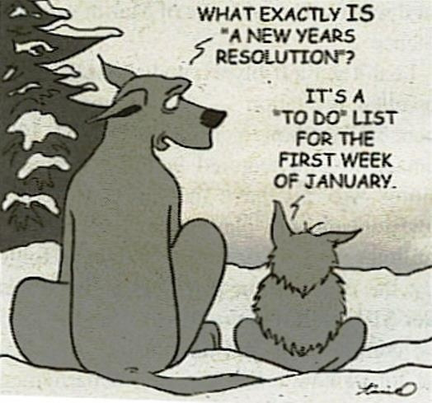

Slide 26
Resolution #6

Slide 27
Resolution #7

Slide 29
Top Five New Year’s Resolutions
#5- take up a new hobby.
#4- make more money.
#3- improve relationships.
#2- stop smoking.
The most popular New Years resolution…
…you guessed it,
#1- losing weight.

