Slide 2
New Years Resignation pt 1
Jan 21, 2017
Edward Church
James 4:6-10

Slide 3
The Need For Control
There is An Attack On the Church Today
It Sneaks in the Back Door
It Pretends It Is the Voice Of Reason
One of the Biggest Addictions In the Church World Today Is:
The Addiction to Control
Bred by Fear -protect
Led by Pride -promote
Both of these Components are
Dangerous
Deceptive

Slide 4
God Never Wants His Children…
…to be Consumed By
…this Terrible Duo (Pride/ Fear)
…Or It’s By-Product (Control)

Slide 5
Dangers of Fear
Fear
Brings Torment
Breeds Bondage
Exaggerates
Builds up the Negative
Tears Down the Positive
1 John 4:18 (NKJV)
¹⁸ There is no fear in love; but perfect love casts out fear, because fear involves torment. But he who fears has not been made perfect in love.

Slide 6
Dangers of Fear
Fear Will Cause You to..
Run When No One Is Chasing You
Hear What No One Is Saying
Close Your Own Door of Opportunity
Dread Your Own Shadow

Slide 7
Dangers of Pride
Pride Makes Us Independent…
Pride causes us to not seek counsel -1 Cor 8:1-2
Pride is Often the Motivator for Sins…
The first sin to be committed in the earth was due to pride -Gen 3:9
Pride Makes Us Oblivious to Danger…
“Pride goeth before destruction/ an haughty spirit before a fall.” -Prov 16:18
Pride Makes Us Blind…
Luke 18:9-14 In the parable the pharisee could not see his spiritual condition because of pride resulting in his self righteousness.
Pride Makes Us Foolish…
Prides gives men a foolish sense of wisdom -Prov 1:7; 1 Cor 3:18-20

Slide 8
Together They Become a…
…Deadly Force
…That Demands to Be In Control;
…Causing Us to Take God’s Place
Say This Together…

Slide 9
Good morning!
This is God.
I will be handling all of your problems today.
I will not need your help,
so have a miraculous day.

Slide 11
End of Part 1

Slide 12
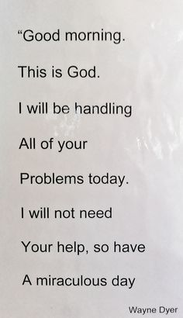

Slide 13
Dangers of Pride
Pride makes us independent…
Pride causes us to not seek counsel (1 Cor 8:1-2)…
Pride is often the motivator for other sins…
The first sin to be committed in the earth was due to pride (Gen 3:9).
Pride makes us oblivious to danger…
“Pride goeth before destruction, and an haughty spirit before a fall.” (Prov 16:18 KJV
Pride makes us blind…
We become blind to our own condition and state before God. The pharisee’s are a prime example of those who were infected with pride and spiritual blindness. In the parable of the Pharisee and Publican, Jesus addresses pride and spiritual blindness (Luke 18:9-14). In the parable the pharisee could not see his spiritual condition because of pride resulting in his self righteousness.
Pride makes us foolish…
Prides gives men a foolish sense of wisdom (Prov 1:7; 1 Cor 3:18-20)…
Pride makes us independent…
Pride causes us to not seek counsel (1 Cor 8:1-2)…

Slide 14
# 1: Take a Knee
“But he gives more grace. Therefore it says, ‘God opposes the proud but gives grace to the humble.’ Submit yourselves therefore to God” (vv. 6-7a). Humility doesn’t come naturally to most of us. It’s the virtue which, if you think you have it, you probably don’t. D. L. Moody used to pray, “Lord, make me humble, but don’t let me know it.” No one likes being told what to do. We would rather be in charge of our own affairs, and that’s why the whole notion of surrendering our pride to the Lord sounds strange at first. But there is no other way to get better. There is no other way to be healed. There is no other way to be forgiven. There is no other way to find a new life. We can fight the Lord, or we can surrender everything to his control. When we fight, we lose. When we surrender in faith, we win. Some friends saw this sign painted on the side of a bus in Nigeria: “Man no be God.” That sums it up, doesn’t it? You aren’t God, you never were, and you never will be. Start there, and you’ll be on the right path. Humility grows best in the rich soil of God’s grace. Don’t pray for more humility; pray for more grace. Pray that God will pour out his grace in your heart so that you will only boast in the Lord. The proud man must constantly remind you how great he is. He brags because he wants you to praise him. But if you have to tell me how great you are, how great could you possibly be? The braggart brags because he’s trying to convince you (and himself) of how great he is. The humble man doesn’t brag because the truth speaks for itself. He leaves his reputation in the Lord’s hands because it doesn’t matter to him what others think. He wants God’s reputation to become great in the land. What happens to him doesn’t matter as long as the Lord’s cause goes forward. Walking in humility means you confess your sins, you forgive your enemies, you admit your mistakes, and you don’t brag about how great you are. It also means you serve others with a smile, not with a frown. “God opposes the proud.” Don’t let that happen to you! “But gives grace to the humble.” So pray for the grace you need. Take a knee. You’ll be glad you did.

Slide 15
# 2: Fight Back
“Resist the devil, and he will flee from you” (v. 7b). This is both a command and a promise. If we submit to God, we may be sure that when we resist the devil, he will flee from us. We have no power in ourselves against the devil, but he has no power to use against us when we fight with God’s power. By ourselves, we can’t win; with God’s help, we can’t lose. The word “resist” is a military term. It means you stand and fight. You don’t run away. We are to flee temptation, but we are to fight the devil. That means taking up the armor of God and standing in the evil day (Ephesians 6:10-17). Satan is like a football coach studying the opposing team. He has “game film” on us, he knows our weaknesses and our strengths, and he uses what he knows against us. If he can get you discouraged, he’s already won the battle. He knows when you lose your temper. Satan isn’t equal to God, but he’s a lot smarter than you or me. Don’t be surprised when he hits you out of the blue. Fight back! Don’t be surprised when he comes to you with a seductive temptation. Fight back! Don’t be surprised when he whispers in your ear in a moment of weakness. Fight back! The devil is a murderer by nature (John 8:44). He will destroy your career, your marriage, your family, and your ministry if you let him. You’ve got to stand and fight. Fight back with the Word of God. Fight back by singing great hymns. Fight back by praying to Jesus. Fight back by leaning on your brothers and sisters. Fight back by confessing Christ openly. Fight back by coming to the Lord’s Table. Fight back by fleeing every temptation. Stand and fight, child of God! Resist the devil, and he will flee from you.

Slide 16
# 3: Draw Near
“Draw near to God, and he will draw near to you” (v. 8a). The question is not, how near is God to us, but rather how near are we to him? Every married couple understands that proximity is one thing, but intimacy is something else. A couple may be seated on the same couch but be miles apart from each other. They may sleep together but not share the same bed spiritually. It is quite possible to be married and live entirely separate lives. Drawing near to God starts in the heart. Take another married couple and watch them for a moment. She may be knitting or playing the piano. He may be reading a book or listening to her play the piano. Minutes may pass without a word being spoken, but they are happy together. He has drawn near to her, and she has drawn near to him. If we come to God with that same desire to know him, he will draw near to us. You do not need to be an advanced Christian or a super-saint or a deep Bible student. The newest saint and the weakest believer may know God’s presence. Years ago I heard the question put this way, “If God feels far away from you, who moved?” It’s never the Lord. We may know his presence and feel his pleasure if we truly want it. He will draw near to you if you draw near to him.

Slide 17
# 4: Clean Up
“Cleanse your hands, you sinners, and purify your hearts, you double-minded” (v. 8b). We must cleanse our hands because they are dirty with sin. We must purify our hearts because they are divided, and we are distracted. This means we stop making excuses for bad attitudes, for casual unkindness, for clever put-downs, for dabbling in pornography, for bragging about our accomplishments, for envy of others, for bitterness, for a critical spirit, for our prayerlessness, for our need to be in control, for giving in to despair, for hating our enemies instead of loving them, and for our failure to do what we ought to do. Here’s a useful way to apply this truth. Take some time to get alone with God. Pray this simple prayer: “Lord, show me the truth about myself.” Then write down what the Lord shows you. In my experience, you can’t do this in ten minutes, and you can’t do this when you are busy. It takes time to open your heart to the Holy Spirit. When I have done this, I have been appalled at what the Lord reveals to me about my own heart, but then I have been glad for the cleansing that comes from confession and repentance. Hosea 10:12 offers us a wonderful promise:
“Plow up the hard ground of your hearts, for now is the time to seek the LORD, that he may come and shower righteousness upon you” (NLT).
Plowing is hard work because it means digging up the rocks and pulling the weeds that keep the good fruit from growing. But if we by God’s grace do the hard thing, the Lord promises to send the rain that produces a new life with new joy and fresh fruit from heaven.

Slide 18
# 5: Get Serious
“Be wretched and mourn and weep. Let your laughter be turned to mourning and your joy to gloom” (v. 9). This isn’t exactly “your best life now,” and it doesn’t sound like the “abundant life” or the “life that wins.” In fact, this verse runs counter to the “I want to be happy all the time” version of Christianity that is very popular in the West. Be wretched—Who wants to be wretched? Mourn—Don’t worry, be happy. Weep—That’s a real downer. If we laugh, we should stop it and start mourning. If we have joy, turn it into gloom. I’ll be the first to agree that this verse, stated this way, seems like a downer. But let’s step back and ask ourselves what James means by all this. Is he a killjoy? No, that can’t be right. Is he a Nattering Nabob of Negativism? Whatever that is, that’s not who he is. Is he a frowning Puritan? That’s not fair because the Puritans were supremely happy in God. James wants us to get serious about our relationship with God. When theologian R. C. Sproul died in December 2017, Russell Pulliam wrote an assessment of his life in the Washington Post. He located Sproul’s huge influence in the fact that he believed in the theology of John Calvin. That led to this sentence:
Sproul believed that we are more sinful than we usually think we are.
That’s spot-on accurate, both as a statement of what Sproul believed and of the true American self-assessment. Most people, even those who don’t go to church, would agree they are sinners. That is, no one’s perfect, we all make mistakes, and so on. It’s not hard to get people to agree with that concept. But the Bible goes much further. It tells us that sin has infected every part of human life, that we are spiritually dead, spiritually blind, lost, separated from God, and without hope in the world. The Bible reveals the solemn truth that “all have sinned” (Romans 3:23). We have all missed the mark. The whole human race is lost, broken, dead, blind, deaf to God’s truth, in a state of perpetual rebellion, and so separated from God that we are under his wrath, and bound for eternal punishment in hell. That’s what God says about the whole human race. That’s God’s verdict on you and me. If you don’t believe that, or if you think that’s too harsh, or if you can’t handle the truth, then this verse will make no sense to you. It all depends on how messed up you think you are. Small sinners need a small Savior. Moderate sinners need a moderate Savior. Bigtime sinners need a bigtime Savior. We are all bigtime sinners! Once we see our sin as it really is, we will be wretched and mourn and weep. We’ll stop laughing and start crying. We’ll let our joy be turned to mourning. And that opens the door to the abundant life we all seek. Weeping may endure for a night, but joy comes in the morning. This promise comes true whenever we decide to take God seriously.

Slide 19
# 6: Stay Low
“Humble yourselves before the Lord, and he will exalt you” (v. 10). When my friend Don Lough became the Executive Director of Word of Life a few years ago, he asked his mentor Howard Hendricks for his advice. His reply was simple: “Lie low and exalt Christ.” That’s a good word for all of us. We can brag on ourselves, or we can exalt Christ, but we can’t do both at the same time. That sentence stands as a powerful admonition for every Christian. It is great advice because it describes two choices. You can exalt yourself, or you can exalt Christ, but you can’t do both. When we decide to lie low and exalt Christ, there is no limit to what the Lord may choose to do through us. I began this sermon by talking about one football player who shouted at another football player, “Humble yourself!” What he said to his rival, God says to us. His message is crystal clear. We can be blessed, but we must humble ourselves. We can change, but we must humble ourselves. We can experience the abundant life, but we must humble ourselves. In the early days of 2018, many of us are thinking about how we can get a fresh start and make a new beginning. James 4:6-10 shows us the path that will jumpstart your spiritual life: Take a Knee. Fight Back. Draw Near. Clean Up. Get Serious. Stay Low. In the Kingdom of God, the way up is down. If you humble yourself, the Lord will raise you up. One final thought keeps ringing in my head. Verse 6 reminds us that God “opposes” the proud. Ponder that for a moment. Could a Christian be an enemy of God? Yes. If that is not true, then these words of James have no application to most of us. Could God be “opposed” to one of his own children, even though he loves them with an everlasting love? The answer is yes because God loves us so much that he will not leave us the way we are. His love leads him to “oppose” our pride, our anger, our loose tongue, our lust, our unkind spirit, and all the excuses we make for our sin. It’s like those old Fram oil filter commercials where the mechanic says, “You can pay me now or you can pay me later.” If you humble yourself now, God won’t have to do it later. A wise pastor friend told me “the first price you pay is always the cheapest.” He’s right. The price for dealing with our problems never goes down; it always goes up. That’s true personally, and it’s true for our relationships. We put off dealing with our issues because we think it will cost too much to deal with them now. But that’s a huge mistake. Sin left untouched always grows. It’s like a deadly cancer you leave untreated. Sin always spreads because it is the cancer of the soul. We can humble ourselves in the eyes the Lord, or we can go on living the way we want until the time God decides to humble us. The choice is ours. Every blessing awaits those who will humble themselves before the Lord. This is the promise of God, and it is good news indeed. May God help us to take these words to heart. O Lord, grant us grace that we might humble ourselves in your sight. Show us where pride has taken root. Shine the light of your Word on the hidden parts of the heart. Where we have sinned, have mercy. Restore us, O Lord, that we may rejoice in you once again. Amen

Slide 20
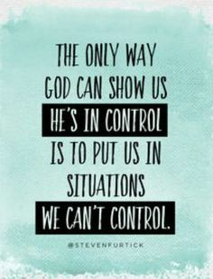
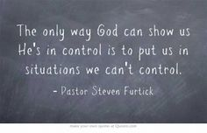

Slide 21
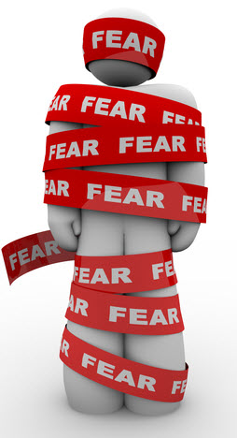
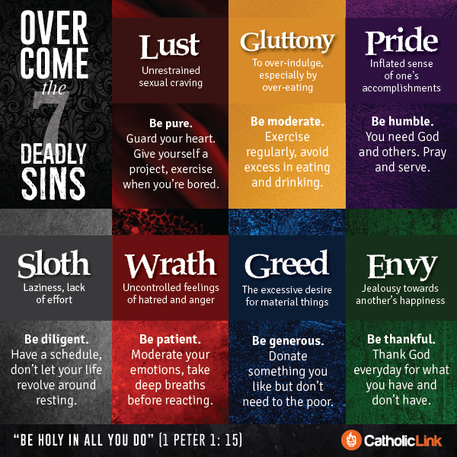
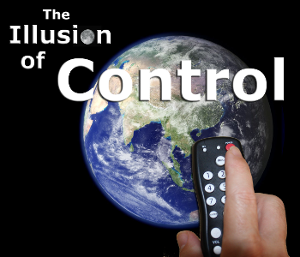

Slide 22
Dangers of Pride
Intro.
1. Jesus was the most humble man who ever lived, Phil. 2:5-8.
2. Christians must be humble in heart and life, Matt. 18:1-4.
3. The danger of pride is its self-deceiving nature:
a. When we consider our sins, who says, "My problem is pride"? ("I'm so proud to be so humble"!)
b. Pride is worldly, putting trust in self and the flesh, 1 Jno. 2:16.
4. Pride: "the character of one who, with a swollen estimate of his own powers or merits, looks down on others and even treats them with insolence (rude, disrespectful, jrp) and contempt" (Thayer).
a. Vainglory: “an insolent and empty assurance, which trusts in its own power and resources and shamefully despises and violates divine laws and human rights…an impious and empty presumption which trusts in the stability of earthy things” (OBG Lexicon)
b. An exaggerated regard for self – when one thinks too highly of himself/herself (Rom. 12:3).
I. PRIDE IS DEFILING, Mk. 7:22.
A. Pride is the Way of the World, 1 Jno. 2:15-16.
1. Pride offers a form of godliness for the world to see, but pride denies the power of godliness due to its self-centered world view! 2 Tim. 3:1-5
2. Pride is driven by lust for attention and acclaim, yet forfeits them all for a fraudulent and faithless view of self and the world.
B. Pride Develops in a Heart that has Turned to Evil, Mk. 7:21.
1. Grows in an evil heart of unbelief, cf. Heb. 3:12.
2. When the heart is given over to sin, pride grows up as a defensive barrier from the rebukes and pleadings of truth to repent!
3. It corrupts the entire person, Mk. 7:23.
C. Pride Produces:
1. Strife and shame, Prov. 13:10; 11:2.
2. Rude and cruel speech, Prov. 14:3.
3. Greedy spirit, Prov. 28:25 (instead of reliance on God).

Slide 23
Dangers of Pride
II. PRIDE IS DECEPTIVE, Gal. 6:3.
A. Pride is Haughty in its View and Treatment of Others, Prov. 6:17.
1. It uses a false standard to judge self and others, Prov. 30:11-13.
2. Condescending, arrogant treatment of others (words/deeds) is absolutely a part of pride, cf. Rom. 1:30; 12:16 (conceit).
3. Pride not only lifts us up above man, but ultimately above God - the definitive insult against God, Job 38:1-4; 42:1-6.
B. Pride Deceives Us by Leading us to Trust in Personal Knowledge Instead of Loving God and being Known by God, 1 Cor. 8:1-3.
1. When we view any subject in terms of "us" and what we "know" instead of "God" and His will for us, we are being prideful.
2. Puffed up in treatment of others, cf. Prov. 21:24 ("Scoffer").
-Acts in "proud wrath" (KJV) - Violent anger toward others.
III. PRIDE IS DESTRUCTIVE, Prov. 16:18; 18:12.
A. Pride Destroys a Proper View of Self, Jer. 10:23.
1. Pride convinces us we are (always) right, Prov. 16:20.
2. In fact, pride takes us downward, Prov. 29:23.
B. Pride Destroys a Proper View of Others, cf. Lk. 18:9, 11, 14.
1. As pride overestimates its own value it devalues others, which in turn is played out in our treatment of others, cf. Matt. 7:12.
2. Pride does not (cannot) serve others! Matt. 20:28; Phil. 2:5-8
C. Pride Destroys Respect for Christ and His Word, 1 Tim. 6:3-5.
1. But it is God (His word) who is always right, Psa. 19:9.
2. Pride disregards truth and accepts the lies that generate self- importance, 1 Tim. 6:3 (proud: "superior, lifted up", lifted up with haughtiness).
Conclusion
1. The proud trust the imaginations (dispositions) of their hearts, but God scatters them (lays waste), Lk. 1:51 (Prov. 15:25).
2. God resists the proud, but gives grace to the humble, 1 Pet. 5:5-7 (Jas. 4:6).
a. Pride refuses to submit to men and God where humble submissiveness is required and beneficial, 1 Pet. 5:5.
b. Only by humbling ourselves to God will He lift us up, 1 Pet. 5:6 (Lk. 18:14).
c. Even refusing to cast our care (anxiety) on the Lord is evidence of pride in our hearts! 1 Pet. 5:7
3. You will obtain grace from God when you humble yourself to Him and obey His gospel of salvation. Isa. 57:15

Slide 24
Proverbs Chapter 6
¹⁶ These six [things] doth the LORD hate: yea, seven [are] an abomination unto him:
¹⁷ A proud look, a lying tongue, and hands that shed innocent blood,
¹⁸ An heart that deviseth wicked imaginations, feet that be swift in running to mischief,
¹⁹ A false witness [that] speaketh lies, and he that soweth discord among brethren.

Slide 25
Proverbs 16:18
“Pride goeth before destruction, and an haughty spirit before a fall.”
The message
First pride, then the crash— the bigger the ego, the harder the fall.
Repent

Slide 26
“Pride in the religious sense is the arrogant refusal to let God be God.
It is to grab God’s status for oneself. In the vivid language of the Bible,
pride is puffing yourself up in God’s face. Pride is turning down God’s invitation
to join the dance of life as a creature in his garden and wishing instead to be the creator,
independent, reliant on one’s own resources. Never does pride want to pray for strength,
ask for grace, plead for mercy, or give thanks to God. Pride is the grand illusion,
the fantasy of fantasies, the cosmic put-on. The fantasy that we can make it as little gods,
it leaves us empty at the center. Once we decide to have to make it on our own,
we are attacked by the demons of fear and anxiety. We are worried that we cannot keep our
balance as long as we carry no more inside our empty heart than what we can put there.
We suspect that we lack the power to become what our pride makes us think we are…”
hole in every man that cannot be filled by any created thing, but only by God the Creator.
This God shaped void is why all of our prideful attempts to make ourselves “
little gods” in control of our little worlds are doomed to lead to fear and anxiety.
We cannot fill the vacuum within us, only God can.
through an article in our church newsletter a couple years ago.)
In an article from 2012 entitled “Lent: Emptiness, Fear, and Fullness” Tish

Slide 27
Dear God…
…I QUIT!
Signed _________
We can fight the Lord, or we can surrender everything to his control
“If God feels far away from you…
…who moved?”

