Slide 2
New Years Resignation pt 2
Jan 28, 2017
Edward Church
James 4:6-10

Slide 3
The Need For Control
There is An Attack On the Church Today
It Sneaks in the Back Door
It Pretends It Is the Voice Of Reason
One of the Biggest Addictions In the Church World Today Is:
The Addiction to Control
Bred by Fear -protect
Led by Pride -promote
Both of these Components are
Dangerous
Deceptive

Slide 4
God Never Wants His Children…
…to be Consumed By
…this Terrible Duo (Pride/ Fear)
…Or It’s By-Product (Control)

Slide 5
# 1: Take a Knee
Humble yourself before the Lord.
Relinquish control of your life to God.
Literally, rank yourself under Him.
Let God to be your Captain, and obey Him.

Slide 6
# 1: Take a Knee
“But he gives more grace. Therefore it says, ‘God opposes the proud but gives grace to the humble.’ Submit yourselves therefore to God” -6-7a
Humility doesn’t come naturally to most of us.
It’s the virtue which, if you think you have it, you probably don’t.
D. L. Moody - “Lord, make me humble, but don’t let me know it.”
We can fight the Lord, or we can Surrender everything to His Control.
When We Fight, We Lose. When We Surrender In Faith, We Win.

Slide 7
# 2: Fight Back
Resist the devil and he will flee from you. -4:7
You don’t have to let Satan ruin your life anymore.
Just submit to God and resist the devil.

Slide 8
# 2: Fight Back
“Resist the devil, and he will flee from you” -7b
This is both a Command and a Promise.
We have no power in ourselves against the devil…
…but he has no power to use against us when we fight with God’s power.
By ourselves, we can’t win; with God’s help, we can’t lose.
The word “resist” is a military term. It means you stand and fight.
You Never Run Away
Satan isn’t equal to God, but he’s a lot smarter than you or me.

Slide 9
# 3: Draw Near
Draw near to God, and He will draw near to you.-4-8
Stop running away from God.
Instead, turn around and take just one step towards Him;
…for when you do
…He will take a thousand steps towards you.

Slide 10
# 3: Draw Near
“Draw near to God, and he will draw near to you” -8a
The question is not, how near is God to us, but rather how near are we to him?
Drawing near to God starts in the heart (attitude)…
…Moves through the hand (actions)
You do not need to be an advanced Christian or a super-saint or a deep Bible student.
The newest saint/ the weakest believer may know God’s presence.

Slide 11
# 4: Clean Up
Cleanse your hands, you sinners. 4:8
Purify your hearts, you double-minded.
Wash your hands and your hearts.
Clean up your Act and your Attitude.

Slide 12
# 4: Clean Up
“Cleanse your hands, you sinners, and purify your hearts, you double-minded” -8b
We Must Cleanse Our Hands = Actions
We Must Purify Our Hearts =Attitudes
This Means We Stop Making Excuses For…
Bad Attitudes
Unkindness
Bitterness
Critical Spirit
Our Need To Be In Control

Slide 13
# 5: Get Serious
“Be wretched and mourn and weep. Let your laughter be turned to mourning and your joy to gloom” – 9
Be wretched—Who wants to be wretched?
Mourn—Don’t worry, be happy.
Weep—That’s a real downer.
Step Back/ Ask Ourselves…
…Are We Taking His Work Seriously?

Slide 14
#6 Stay Low
“Humble yourself before the Lord, and he will exalt you.”
Relinquish control of your life to the Lord.
Stop trying to get YOUR way, and let God have HIS way
It won’t diminish you. On the contrary, it elevates you.
Martin Luther put it this way:
“God creates out of nothing. Therefore, until a man is nothing, God can make nothing out of him”
In the Kingdom of God, the way up is down.
If you humble yourself, the Lord will raise you up

Slide 15
Good morning!
This is God.
I will be handling all of your problems today.
I will not need your help,
so have a miraculous day.

Slide 18
End of Part 1

Slide 19
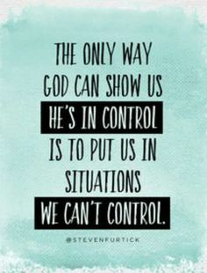
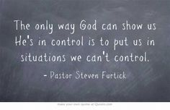
Stay Low

Slide 20
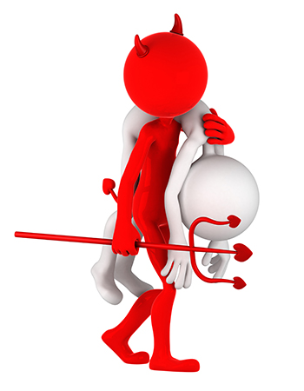
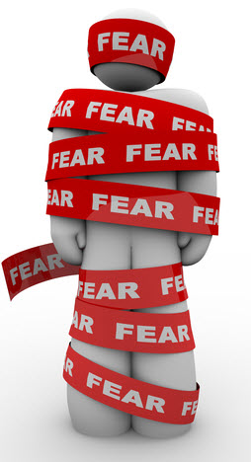
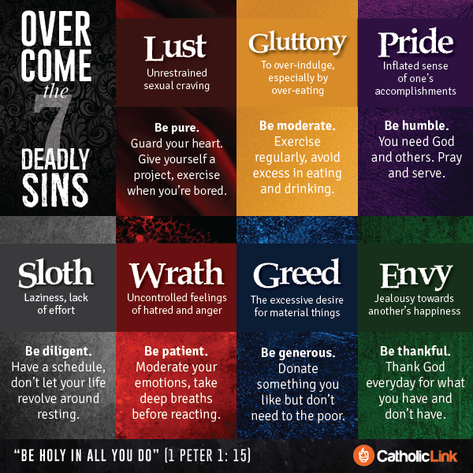
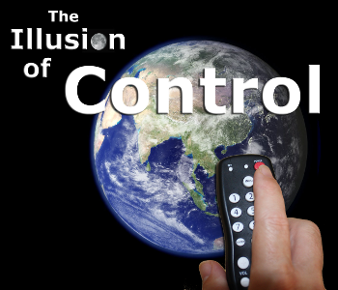

Slide 21
Dangers of Pride
Intro.
1. Jesus was the most humble man who ever lived, Phil. 2:5-8.
2. Christians must be humble in heart and life, Matt. 18:1-4.
3. The danger of pride is its self-deceiving nature:
a. When we consider our sins, who says, "My problem is pride"? ("I'm so proud to be so humble"!)
b. Pride is worldly, putting trust in self and the flesh, 1 Jno. 2:16.
4. Pride: "the character of one who, with a swollen estimate of his own powers or merits, looks down on others and even treats them with insolence (rude, disrespectful, jrp) and contempt" (Thayer).
a. Vainglory: “an insolent and empty assurance, which trusts in its own power and resources and shamefully despises and violates divine laws and human rights…an impious and empty presumption which trusts in the stability of earthy things” (OBG Lexicon)
b. An exaggerated regard for self – when one thinks too highly of himself/herself (Rom. 12:3).
I. PRIDE IS DEFILING, Mk. 7:22.
A. Pride is the Way of the World, 1 Jno. 2:15-16.
1. Pride offers a form of godliness for the world to see, but pride denies the power of godliness due to its self-centered world view! 2 Tim. 3:1-5
2. Pride is driven by lust for attention and acclaim, yet forfeits them all for a fraudulent and faithless view of self and the world.
B. Pride Develops in a Heart that has Turned to Evil, Mk. 7:21.
1. Grows in an evil heart of unbelief, cf. Heb. 3:12.
2. When the heart is given over to sin, pride grows up as a defensive barrier from the rebukes and pleadings of truth to repent!
3. It corrupts the entire person, Mk. 7:23.
C. Pride Produces:
1. Strife and shame, Prov. 13:10; 11:2.
2. Rude and cruel speech, Prov. 14:3.
3. Greedy spirit, Prov. 28:25 (instead of reliance on God).

Slide 22
Dangers of Pride
II. PRIDE IS DECEPTIVE, Gal. 6:3.
A. Pride is Haughty in its View and Treatment of Others, Prov. 6:17.
1. It uses a false standard to judge self and others, Prov. 30:11-13.
2. Condescending, arrogant treatment of others (words/deeds) is absolutely a part of pride, cf. Rom. 1:30; 12:16 (conceit).
3. Pride not only lifts us up above man, but ultimately above God - the definitive insult against God, Job 38:1-4; 42:1-6.
B. Pride Deceives Us by Leading us to Trust in Personal Knowledge Instead of Loving God and being Known by God, 1 Cor. 8:1-3.
1. When we view any subject in terms of "us" and what we "know" instead of "God" and His will for us, we are being prideful.
2. Puffed up in treatment of others, cf. Prov. 21:24 ("Scoffer").
-Acts in "proud wrath" (KJV) - Violent anger toward others.
III. PRIDE IS DESTRUCTIVE, Prov. 16:18; 18:12.
A. Pride Destroys a Proper View of Self, Jer. 10:23.
1. Pride convinces us we are (always) right, Prov. 16:20.
2. In fact, pride takes us downward, Prov. 29:23.
B. Pride Destroys a Proper View of Others, cf. Lk. 18:9, 11, 14.
1. As pride overestimates its own value it devalues others, which in turn is played out in our treatment of others, cf. Matt. 7:12.
2. Pride does not (cannot) serve others! Matt. 20:28; Phil. 2:5-8
C. Pride Destroys Respect for Christ and His Word, 1 Tim. 6:3-5.
1. But it is God (His word) who is always right, Psa. 19:9.
2. Pride disregards truth and accepts the lies that generate self- importance, 1 Tim. 6:3 (proud: "superior, lifted up", lifted up with haughtiness).
Conclusion
1. The proud trust the imaginations (dispositions) of their hearts, but God scatters them (lays waste), Lk. 1:51 (Prov. 15:25).
2. God resists the proud, but gives grace to the humble, 1 Pet. 5:5-7 (Jas. 4:6).
a. Pride refuses to submit to men and God where humble submissiveness is required and beneficial, 1 Pet. 5:5.
b. Only by humbling ourselves to God will He lift us up, 1 Pet. 5:6 (Lk. 18:14).
c. Even refusing to cast our care (anxiety) on the Lord is evidence of pride in our hearts! 1 Pet. 5:7
3. You will obtain grace from God when you humble yourself to Him and obey His gospel of salvation. Isa. 57:15

Slide 23
Proverbs Chapter 6
¹⁶ These six [things] doth the LORD hate: yea, seven [are] an abomination unto him:
¹⁷ A proud look, a lying tongue, and hands that shed innocent blood,
¹⁸ An heart that deviseth wicked imaginations, feet that be swift in running to mischief,
¹⁹ A false witness [that] speaketh lies, and he that soweth discord among brethren.

Slide 24
Proverbs 16:18
“Pride goeth before destruction, and an haughty spirit before a fall.”
The message
First pride, then the crash— the bigger the ego, the harder the fall.
Repent

Slide 25
“Pride in the religious sense is the arrogant refusal to let God be God.
It is to grab God’s status for oneself. In the vivid language of the Bible,
pride is puffing yourself up in God’s face. Pride is turning down God’s invitation
to join the dance of life as a creature in his garden and wishing instead to be the creator,
independent, reliant on one’s own resources. Never does pride want to pray for strength,
ask for grace, plead for mercy, or give thanks to God. Pride is the grand illusion,
the fantasy of fantasies, the cosmic put-on. The fantasy that we can make it as little gods,
it leaves us empty at the center. Once we decide to have to make it on our own,
we are attacked by the demons of fear and anxiety. We are worried that we cannot keep our
balance as long as we carry no more inside our empty heart than what we can put there.
We suspect that we lack the power to become what our pride makes us think we are…”
hole in every man that cannot be filled by any created thing, but only by God the Creator.
This God shaped void is why all of our prideful attempts to make ourselves “
little gods” in control of our little worlds are doomed to lead to fear and anxiety.
We cannot fill the vacuum within us, only God can.
through an article in our church newsletter a couple years ago.)
In an article from 2012 entitled “Lent: Emptiness, Fear, and Fullness” Tish

Slide 26
Dear God…
…I QUIT!
Signed _________
We can fight the Lord, or we can surrender everything to his control
“If God feels far away from you…
…who moved?”

Slide 27
Dangers of Fear
Fear
Brings Torment
Breeds Bondage
Exaggerates
Builds up the Negative
Tears Down the Positive
1 John 4:18 (NKJV)
¹⁸ There is no fear in love; but perfect love casts out fear, because fear involves torment. But he who fears has not been made perfect in love.

Slide 28
Dangers of Fear
Fear Will Cause You to..
Run When No One Is Chasing You
Hear What No One Is Saying
Close Your Own Door of Opportunity
Dread Your Own Shadow

Slide 29
Dangers of Pride
Pride Makes Us Independent…
Pride causes us to not seek counsel -1 Cor 8:1-2
Pride is Often the Motivator for Sins…
The first sin to be committed in the earth was due to pride -Gen 3:9
Pride Makes Us Oblivious to Danger…
“Pride goeth before destruction/ an haughty spirit before a fall.” -Prov 16:18
Pride Makes Us Blind…
Luke 18:9-14 In the parable the pharisee could not see his spiritual condition because of pride resulting in his self righteousness.
Pride Makes Us Foolish…
Prides gives men a foolish sense of wisdom -Prov 1:7; 1 Cor 3:18-20

Slide 30
God Never Wants His Children…
…to be Consumed By
…this Terrible Duo (Pride/ Fear)
…Or It’s By-Product (Control)

Slide 31
Dangers of Pride
Pride makes us independent…
Pride causes us to not seek counsel (1 Cor 8:1-2)…
Pride is often the motivator for other sins…
The first sin to be committed in the earth was due to pride (Gen 3:9).
Pride makes us oblivious to danger…
“Pride goeth before destruction, and an haughty spirit before a fall.” (Prov 16:18 KJV
Pride makes us blind…
We become blind to our own condition and state before God. The pharisee’s are a prime example of those who were infected with pride and spiritual blindness. In the parable of the Pharisee and Publican, Jesus addresses pride and spiritual blindness (Luke 18:9-14). In the parable the pharisee could not see his spiritual condition because of pride resulting in his self righteousness.
Pride makes us foolish…
Prides gives men a foolish sense of wisdom (Prov 1:7; 1 Cor 3:18-20)…
Pride makes us independent…
Pride causes us to not seek counsel (1 Cor 8:1-2)…

