Slide 2
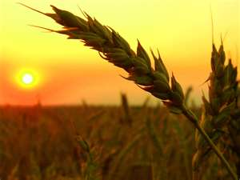
February 18, 2018
Edward Christian Church
Galatians 6:7-10
7 Laws of the Harvest -pt 2

Slide 3
This
is
a
Year
of..

Slide 4
God Set Up a System of Laws
None are More Important or Significant
Than the Principles that …
…Govern the Harvest We Reap
The Law of Harvest:
whatsoever a man sows that shall he also reap.

Slide 5
The Law of the Harvest
The Law of Harvest Can Be Divided into…
…7 Laws and
…3 Basic Principles
The First Principle…
#1- Harvest is a Consequence
“You Will Always Reap What You Sow”

Slide 6
We Reap Only What Has Been Sown
The First Law Can Be Divided into:
Reaping From What We Sow
Reaping From What Others Sow
Sowing Always Involves Seeds
Seeds = Potential
Seeds Always Produces a Harvest
Harvest = Results

Slide 7
We Reap the Same In Kind As We Sow
Seed Always Surrenders to the…
…Law of Reproduction
Genesis 1:11-13, 21-25
Grass, Seed Plants & Trees (11-12)
Sea Creatures (21a)
Birds (21b)
Land Creatures (24-25)
Not Just Natural Seeds…
⁷ Be not deceived; God is not mocked: for
whatsoever a man soweth, shall he also reap.

Slide 8
Whatsoever
Seed Always Surrenders to the…
…Law of Reproduction
Not Just Natural Seeds…
…But
Seeds of…
Attitudes
Actions
This Involves Spiritual, Mental, Emotional Seeds

Slide 9
We Reap the Same In Kind As We Sow
Job 4:8 (AMP)
As I myself have seen, those who plow iniquity
And sow trouble and mischief reap the same.
Proverbs 11:18 (NASB)
The wicked earns deceptive wages, But he who sows
righteousness gets a true reward.
Matthew 7:12 (KJV)
Therefore all things whatsoever ye would that men
should do to you, do ye even so to them: for this is
the law and the prophets.

Slide 10
We Reap More Than We Sow
Seed Always Surrenders to the…
…Law of Reproduction
Seed Also Surrenders to the…
…Power of Reproduction
“We Always Reap More Than We Sow”

Slide 11
We Reap More Than We Sow
The Power of Reproduction
1 Kernel of Corn Will Produce 1 Corn Stalk
On Average, Each Stalk will Produce 3 Ears
The Average Ear of Corn has 250 Kernels
So a Single Kernel of Corn …
…will Yield a 750X Increase
What Do You Need?

Slide 12
We Reap More Than We Sow
Seed Always Surrenders to the…
…Law of Reproduction
Seed Also Surrenders to the…
…Power of Reproduction
“We Always Reap More Than We Sow”
And to the Path of Reproduction
“We Always Reap Where We Sow”

Slide 13
We Reap More Than We Sow
If You Want to Reap…
Better Marriage
…Sow into Your Marriage
Better Work Relationships
…Sow into Work Relationships
Better Personal Relationships
…Sow into Personal Relationships
Better Spiritual Life
…Sow into Spiritual Things

Slide 14
We Reap More Than We Sow
What Do You Need?
Love
Joy
Peace
Help
Physical
Mental
Financial
Spiritual
Quit Placing Blame and…
Start Planting Seed!!!

Slide 15
We Reap More Than We Sow
You Can Count the Number of Seeds…
…in an Apple
You Cannot Count the Number of Apples…
…in a Seed

Slide 16
Reaping From What We Sow
What are You Sowing?
Positive?
Negative?

Slide 18
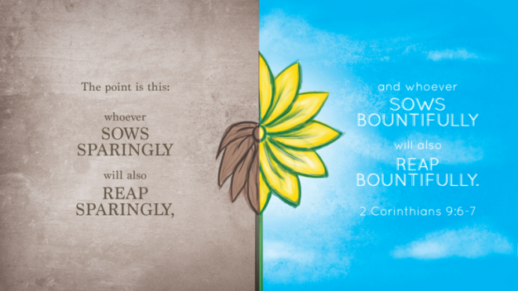

Slide 19
God Set Up a System of Laws
These Laws or Principles…
Govern and Guide Man
His Spiritual Development And Maturity
Govern Nature and the Universe
These Laws Are:
Universal
Simple
Absolute
Stable

Slide 20
We Reap More Than We Sow
Mark 4:1-8
the First Case the Seed Produces Nothing
the Second it Produces Only the Blade
the Third it is Near the Point of Producing Fruit, but Fails to Bring Forth to Harvest
the Fourth it Yields Fruit, but in Different Measures

Slide 21
We Reap More Than We Sow
If You Want to Reap a Good Crop
It Requires Proper …
Planning
Preparation
Planting
Patience

Slide 22
We Reap More Than We Sow
Mark 4:1-8
Jesus Showed us the Potential of the Seed
A Single Grain Grew to be a Plant that Produced
Thirty, Sixty, or a Hundred More Seeds.
Reaping More than We Sow is Fundamental to the Laws of the Harvest.
Every Farmer Lives by this Principle. If His Work Only Returned Exactly What He had Planted in the Ground, His Labor Would be Futile.

Slide 23
We Reap the Same In Kind As We Sow
Seed Always Surrenders to the…
…Law of Reproduction
Not Just Natural Seeds…
…But
Gal.6:7 (KJV) ⁷ Be not deceived; God is not mocked: for whatsoever a man soweth, that shall he also reap.

Slide 24
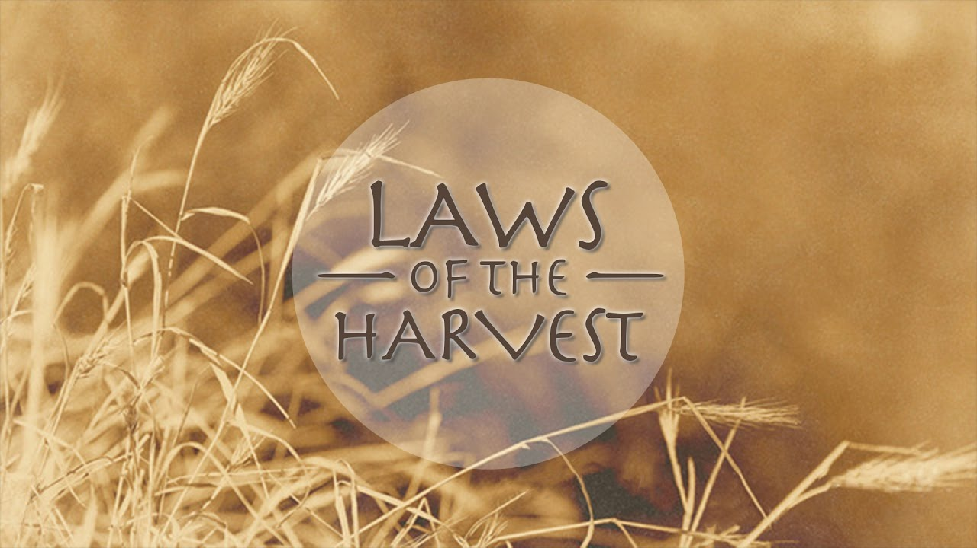

Slide 25
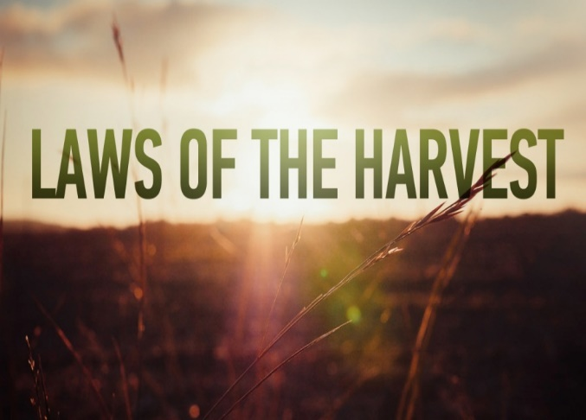
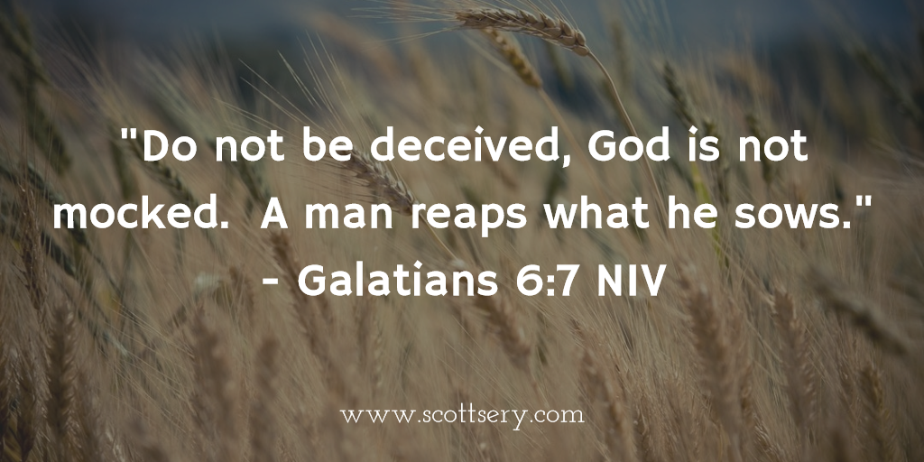
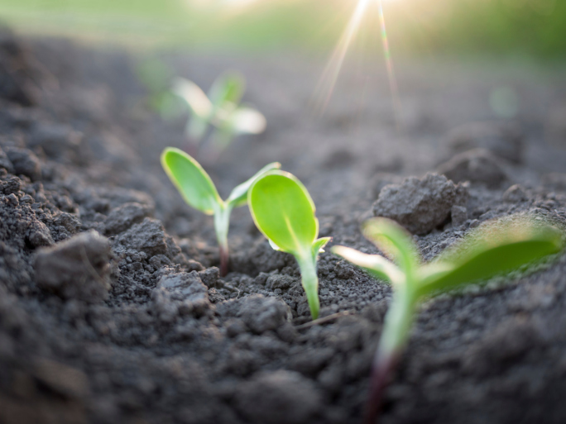
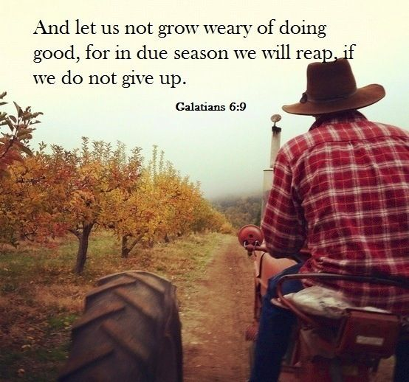
Universal
Simple
Absoute
Stable

Slide 26
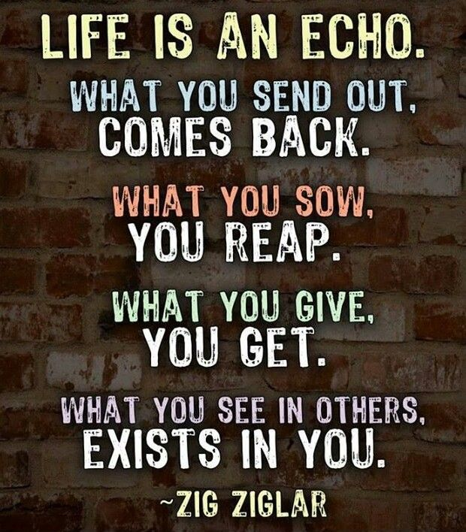
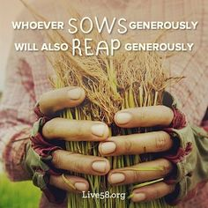
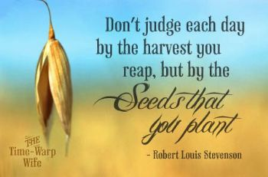
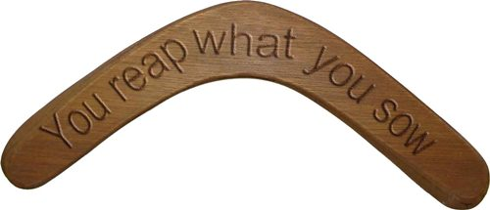

Slide 27
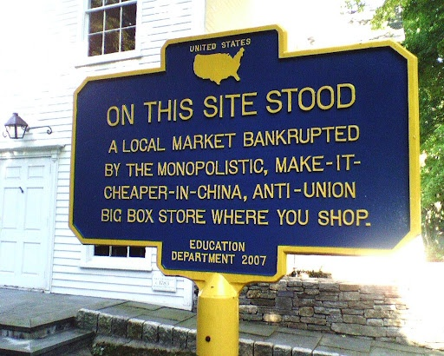
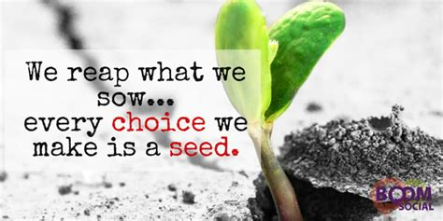

Slide 28
This Year is a Year of…
Perfect Government
Turnaround
Potential
But in Order to See it Fully…
…In Our Own Lives
…We Have to Fulfill Our Part

Slide 33
We Reap in a Different Season than” “”
#1- Harvest is a Consequence
“You Will Always Reap What You Sow”
#2- Harvest is a Process
“It Takes Time”

Slide 34
We Reap in a Different Season than” “”
The World is made up of certain laws

Slide 35
We Reap In Proportion to What We Sow
The World is made up of certain laws

Slide 36
We Reap the Full Harvest Of the Good Only if We Persevere
The World is made up of certain laws

Slide 37
We Can’t do Anything About Last Year’s Harvest…but We Can About This Year’s
The World is made up of certain laws

Slide 39
You Reap
What you Sowed
Where you Sowed
More than you Sowed
Longer than you Sowed
Therefore –this Eternal Principle can be..
Positive or Negative

Slide 40
Harvest
Life is filled with choices, choices that affect us on an everyday basis in everything we do which means our everyday choices are not without significance. Our choices affect us and others in dramatic ways whether we see it immediately or not. While earth remains, no man will mock God by changing for even one time these laws of the harvest.

Slide 41
Reaping From What Others Sow
Positive -Blessings We Reap Because of …
What God Has Done on Our Behalf
The Cross (decision + action)
What Others Have Done In Our Behalf
Right Choices (decisions)
Right Actions (decisions carried out)
Negative
We Reap the Wrong Others Have Sown
Bad Choices
Bad Actions

Slide 42
Reaping From What We Sow
We Receive Positive or Negative…
…From the Seeds We Plant
Choices
Action
Remember…
…Every Choice
…Every Action
= Seed (potential)

Slide 43
Reaping From What We Sow
Negative…
"He that soweth iniquity shall reap vanity" -Prov 22:8
"For they have sown the wind, and they shall reap the whirlwind" -Hosea 8:7
James 4:17 (KJV) ¹⁷ Therefore to him that knoweth to do good, and doeth it not, to him it is sin.

Slide 44
God Set Up a System of Laws
The Law of Gravity:
whatever goes up must come down
The Law of Mathematics:
two parallel lines do not meet
1 + 1 = 2 (except with hamsters)
The Law of Housekeeping:
as you make your bed so you will sleep on it
The day you clean it is the day the kids bring guests
The Law of the Prophets:
what you want men to do to you do the same to them

Slide 45
Reaping From What We Sow
Positive…
Psalms 126:5-6 ^{5 “}They that sow in tears shall reap in joy. ⁶ He that goeth forth and weepeth, bearing precious seed, shall doubtless come again with rejoicing, bringing his sheaves with him.”
Galatians 6:9-10 (KJV) ⁹ And let us not be weary in well doing: for in due season we shall reap, if we faint not. ¹⁰ As we have therefore opportunity, let us do good unto all men, especially unto them who are of the household of faith.

