Slide 2
Eight Reasons to Praise the Lord
Edward Church
March 11 , 2018
Pt 2

Slide 3
Praise is…
Expression
Hallel= to boast, celebrate, make BIG!
Yah= Yaw weh -Strong One
Attitude
Conditions Don’t Effect My Praise
My Praise Effects My Conditions
Contagious

Slide 4
“Let everything that has breath praise the Lord” -Psalm 150:6
Everything (All Creation)
Hath Breath (Has Life)
Praise (Brag on God)
Seven times each day I stop and shout praises for the way you keep everything running right. Psalm 119:164 message
God…
Deserves It
Desires It
Delights in It
Dwells in It
We Call to Him!

Slide 5
Praise Is Where God Lives
And Thou [art] holy, Sitting -- the Praise of Israel. Psalm 22:3 YLT
God is “Enthroned upon the praises of Israel” (Psalm 22:3)
God is Moved Into a…
…Position of Honor
…to Be Praised/ Worshipped
He Comes Us! (Responds)

Slide 6
Praise Enables Access to God
“Enter His gates with thanksgiving and His courts with praise” -Psalm 100:4
We Are Moved Into a…
…Position of Humility
…to Bring Praise/ Worship
We Come to Him (Respond)

Slide 7
Praise Chases Away Despair
As for those who grieve over Zion, God has sent me to give them a beautiful crown in exchange for ashes, To anoint them with gladness instead of sorrow, to wrap them in victory, joy, and praise instead of depression and sadness. -Isa 61:3
Change Your Focus…
..Exchange Your Outlook
“the oil of gladness instead of mourning”
God Changes Us

Slide 8
Praise Brings Deliverance
And at midnight Paul and Silas prayed, and sang praises unto God: and the prisoners heard them. Acts 16:25
Pity (break-down- Sorrow)
Pouty (break-down- Complain)
Pushy (break-down- Argue)
Praise (Break-Through!)
And it came to pass at the seventh time, when the priests blew with the trumpets, Joshua said unto the people, Shout; for the Lord hath given you the city. Joshua 6:16

Slide 9
Praise Brings Protection
Psalm 71:6-8 “By thee have I been holden up from the womb: thou art he that took me out of my mother’s bowels: my praise shall be continually of thee. I am as a wonder unto many; but thou art my strong refuge. Let my mouth be filled with thy praise and with thy honour all the day”
David says..
God had Protected Him in His Mother’s Womb
And He will Continue to Praise God, as God is His Defence.
When We Praise God We Are Protected from Dangers…
…And Provided a Strong Refuge

Slide 10
Praise is an Effective Weapon Against the Devil
2 Parts
Part #1- It Irritates Satan…
It Reminds Him of His…
Past –Isa 14- Led Praise
Present –Our Praise Invites God’s Presence
Future- We Will Praise in God’s Presence
As He Bakes in a Lake
He Has Hated Praise Ever Since Because…
…Its Reminder of What He Gave Up and Can’t Regain
Praise Shuts Him Down

Slide 11
Praise is an Effective Weapon Against the Devil
Mighty Army
Head Up
Stay Strong
Smile by Faith
Move Forward
Part #2- It Invites God to Do Battle
Our Praise…
Moves God Out Front
Makes Him Big
Moves Us Out of God’s Way
“when they began to sing/ to praise, the LORD set ambushments against the children of Ammon, Moab, / mount Seir, which were come against Judah; / they were smitten” - 2 Chron 20:22

Slide 13
PRAISE
Pleases the Lord
Raises your Spirit
Affirms the Authority of Christ
Instills Peace and Confidence
Stimulates Enthusiasm
Expands and Extends Your Vision

Slide 15
7 Reasons to Praise God! Psa 150 –Heb 13:15 Edward Christian Church
1. Praise is where God Lives We read in Psalm 22:3 “But thou art holy, O thou that inhabitest the praises of Israel”. God loves to be praised and heavens rejoice when the name of the Lord is praised. Our God is worthy to be praised, a lifetime is not adequate to praise God. Praise God and feel his presence! I assure you, you will never want that feeling to let go you.
2. Praise is the Access we are given to the Presence of God When we praise God, we become closer to God and we have the access easier to God similar to the access card we hold to enter certain places. The Psalmist says in Psalm 100:4 “Enter into his gates with thanksgiving, and into his courts with praise: be thankful unto him and bless his name” . If you reflect on this you will discover that you have actually got access to God through praise.
3. Praise is a God-given garment that Drives the Spirit of Heaviness We read in the book of Isaiah 61:3 “…the oil of joy for mourning, the garment of praise for the spirit of heaviness;…” Praise is a garment given by God that drives away the spirit of heaviness, every being who undergoes the spirit of heaviness will comforted by the garment of praise and God’s peace only when he/she praises God.
4. Praise brings Deliverance – Acts 16:25 When you praise god, be sure that you are going to be delivered from the clutches of darkness and from the bondage of the Satan. Psalm 50:23 says “Whoso offered praise(attitude) glorifieth me: and to him that ordereth his conversation(actions) aright will I shew the salvation of God”. When you are delivered from the worldly bondage you are saved and salvation of God will overwhelm you.
5. Praise brings Protection When we praise God we protect ourselves from external dangers, ignorantly we are protected by God. David magnificently writes in Psalm 71:6-8 “By thee have I been holden up from the womb: thou art he that took me out of my mother’s bowels: my praise shall be continually of thee. I am as a wonder unto many; but thou art my strong refuge. Let my mouth be filled with thy praise and with thy honour all the day”, He says that God has protected us from the instant we have been in our mother’s womb and He will continue to praise God, as God is the defence.
6. Praise is a Weapon which can be used Against Your Enemies As followers of Christ we should know when and where to use the powerful weapon that we have within ourselves – Praise. In Psalm 149:6-9 it is written “Let the high praises of God be in their mouth, and a two-edged sword in their hand;…. Praise ye the LORD”. When we use praise as a weapon against our enemies, unquestionably the success is ours. The Bible also says in 2 Samuel 22:4 “I call to the LORD, who is worthy of praise, and I am saved from my enemies”. The Lord will save us from our enemies if we use praise as our weapon and our God is always worthy of praise.
Satan was once good angel lucifer- led praise in heaven- was kicked out of heaven and doomed to hell- he has hated praise ever since because it reminds him what he gave up and cannot regain.
7. Praise Invites God to do battle for you You should not be terrified of your enemies instead be certain that God will fight the battle for you,
2 Chronicles 20:22 says “And when they began to sing and to praise, the LORD set ambushments against the children of Ammon, Moab, and mount Seir, which were come against Judah; and they were smitten”. When we praise God, He fights the battle for us and also conquers it for us.
I suggest you to take note of each reason and start you week with one reason a day and focus the whole day on that to praise God. I believe by end of the week you will see a greater blessing passing thorough your life.

Slide 16
Make a joyful noise unto the Lord, all the earth: make a loud noise, and rejoice, and sing praise. - Psalm 98:4

Slide 17
Mighty Army
Head Up
Stay Strong
Smile by Faith
Move Forward

Slide 18
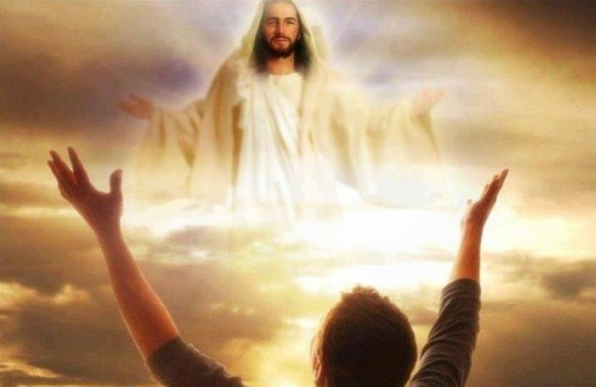

Slide 19
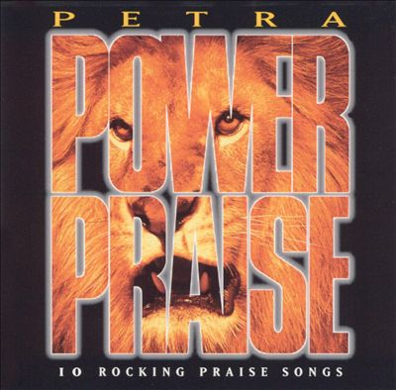

Slide 21
