Slide 2
10 Relationship Principles –pt2
Edward Church
April 22, 2018

Slide 3
How Would You Like…
… to See a
Positive Difference
…In Any and All Relationships?

Slide 4
Communication Can Be...
Negative
Discouraging- cannibal
Distrust– caution
Disharmony- can’t com
Disruption- cease com
Positive
Encouragement
Trust
Harmony
Connection

Slide 5
#1- We See People Through Our Own Lens
#2- People Don’t Care How Much You Know…
…Till They Know How Much You Care.
#3- Learn to Listen From the Heart
#4- Believing the Best in People Usually Brings Out Best of People
#5- Hurting People Hurt People

Slide 6
Principle #6
Admit Wrongs and Forgive Quickly
Taking Responsibility for our Actions…
…is Core to Healthy/ Productive Relationships
If You Make a Mistake, Own It.
If You Treat Someone Poorly, Ask Forgiveness.
Getting Defensive or Bowing Up Never Makes a Relationship Better.
You Might Be Right, But If You Need to Win…
…You’ll Lose in the Long Run.
When You Are Wronged, Forgive Quickly.
You’ll Live W- Less Stress / Enjoy Life More Fully

Slide 7
Principle #7
Always Give More Than You Take
Purpose To Be Generous Anyway.
You Can Set Your Sights to Give More Than You Take.
This Is Not About a Scorecard.
If You Keep Track, You’ve Missed the Point.
It’s A Heart Level Thing.
It’s A Way Of Living / When Your Motives Are Pure…
…It Will Bring You Great Joy

Slide 8
Principle #8
Add Value to People
You Can Add Value To People in Simple/ Big Ways.
Adding Value= How You Contribute To Their Life, So It Is Better.
It Can Be As Simple As An Encouraging Word,
…And It Can Be As Involved As A Lifetime Of Mentoring.
Sometimes It Involves Enough Love / Courage…
…to Have a Tough / Honest Conversation.
The Gift of Eternal Life is the Greatest Value You Can Bring

Slide 9
Principle #9
You Can Never Encourage Anyone Too Much.
Have You Ever Been Encouraged Too Much By Someone?
…of Course Not.
All Relationships Take the Time to Give Frequent…
…and Sincere Encouragement

Slide 10
Principle #10
Trust is the Lifeblood of All Relationships
When It Comes to a Relationship, Trust Is Like a Promise…
…and You Should Never Break A Promise.
That’s The Essence Of Trust.
People Are Counting On You To Keep Your Promises
No Reasonable Person Expects Perfection, But They Do Expect Honesty, Kindness / Doing What You Say You’ll Do.

Slide 13
“Oil and perfume make the heart glad, and the sweetness of a friend comes from his earnest counsel.”
[Proverbs 27:9]
John 15:13
Greater love has no one than this: to lay down one’s life for one’s friends.

Slide 14
“Be careful with your words. Once they’re said, they can only be forgiven not forgotten.”
“Words scar more than you think.”
“The tongue has no bones, but is strong enough to break a heart.”

Slide 15
Communication
Brings Connection
Builds a bridge or a wall

Slide 16
Communication Musts…
Clear
Consisitent
Credible
Confident
Concise

Slide 17
Principle #1
We See People Through Our Own Lens.
The Way You View Yourself / Life Shapes…
… How You See/ Relate To Others.
Your Self-Awareness- where am I
Self-Esteem- who am I
Self-Worth- Am I good enough
…Establish the Foundation of All Your Relationships.
Whether you see the cup as half full or half empty will transfer
Prov 23:7, “for as he thinketh in his heart, so is he…..”

Slide 18
Principle #2
People Don’t Care How Much You Know…
…Till They Know How Much You Care.
Caring About People Isn’t Automatic.
Not Everyone Cares.
You Can’t Learn to Care, It’s Not a Skill..
…But You Can Decide to Care.
You Can Ask God to Help You Become More Caring.

Slide 19
Principle #3
Learn to Listen From the Heart
One of the Greatest Gifts you can give someone is to truly listen.
You Can Listen to Understand or to Respond
Listening to Understand Communicates Value
It Requires Listening From the Heart
It Makes a Soul Level Connection
You Communicate Empathy, Interest and a Desire to be Helpful Far More By Listening than Merely By Your Words.

Slide 20
Principle #4
Believing the Best in People Usually Brings Out Best of People
Even a Broken Clock is Right Twice a Day
What You Look For You Will Find
We Are All Flawed and Imperfect
…But When Someone Calls Out the Best In Us
…We Often Rise to that Higher Standard

Slide 21
Principle #5
Hurting People Hurt People
When the Response Is Greater Than the Issue at Hand
…The Real Issue Is Always About Something Else.
We Need to Learn How to Get to the Real Issue
People Who Are Hurting Don’t Want To Hurt People, But ..
…It’s Like a Lion W- a Thorn In His Paw, He Can’t Help It.
If We Can Help People Take the Thorn Out…
…We Can Help Them Live Better.
…Your Life Becomes Better Too.

Slide 22
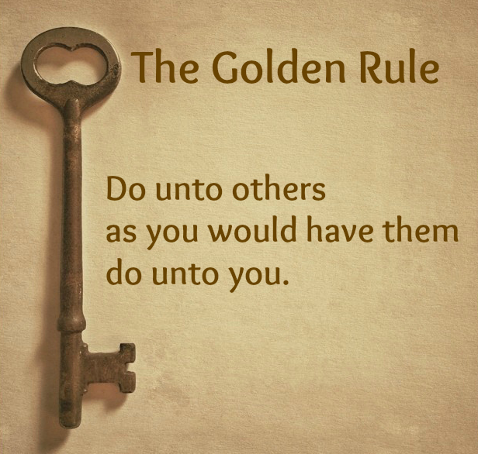

Slide 23
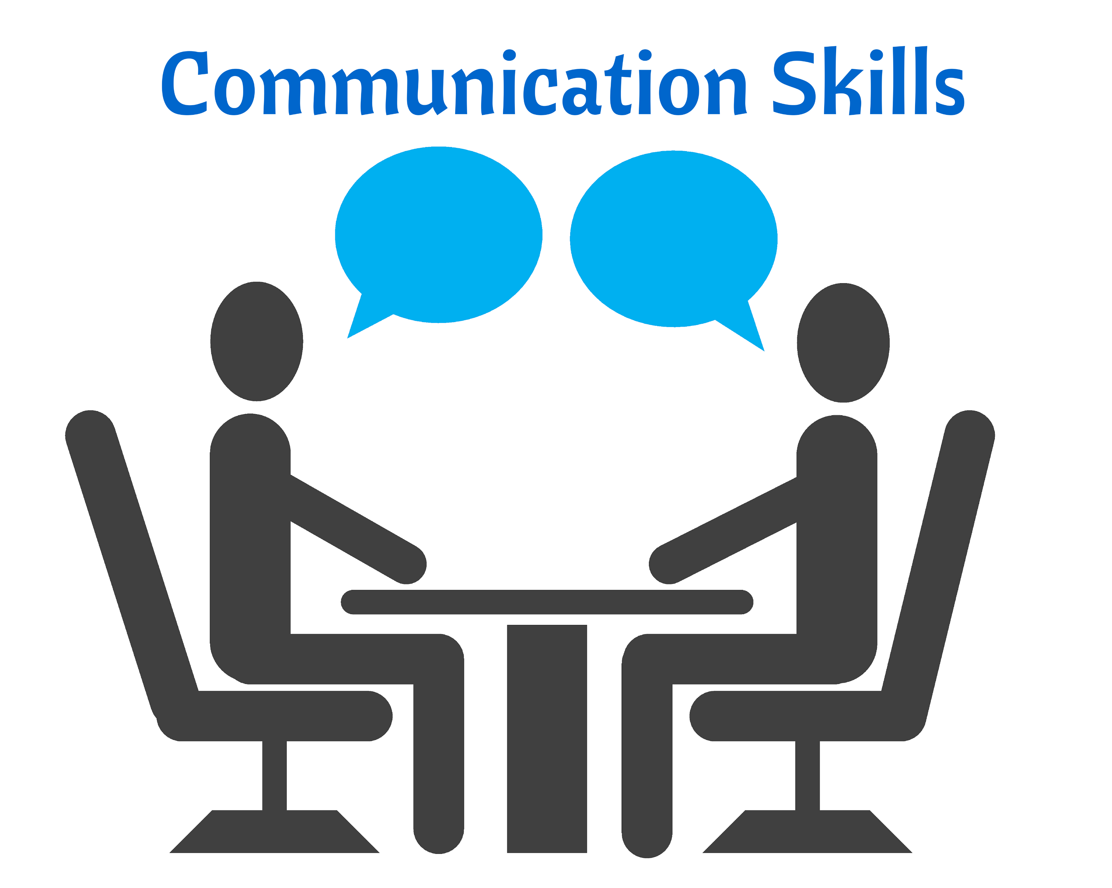
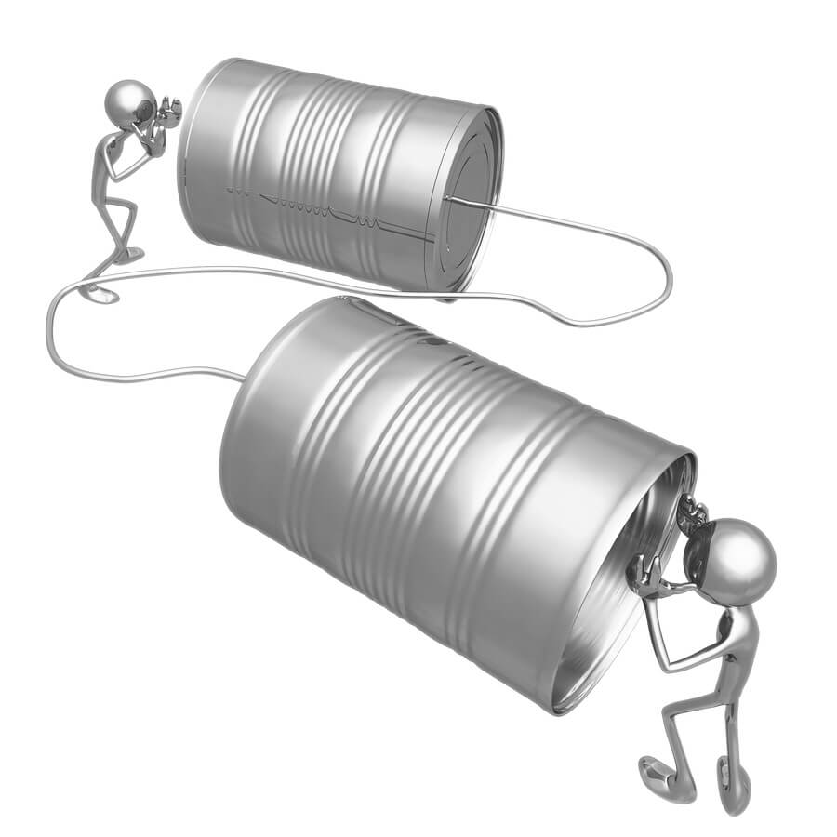
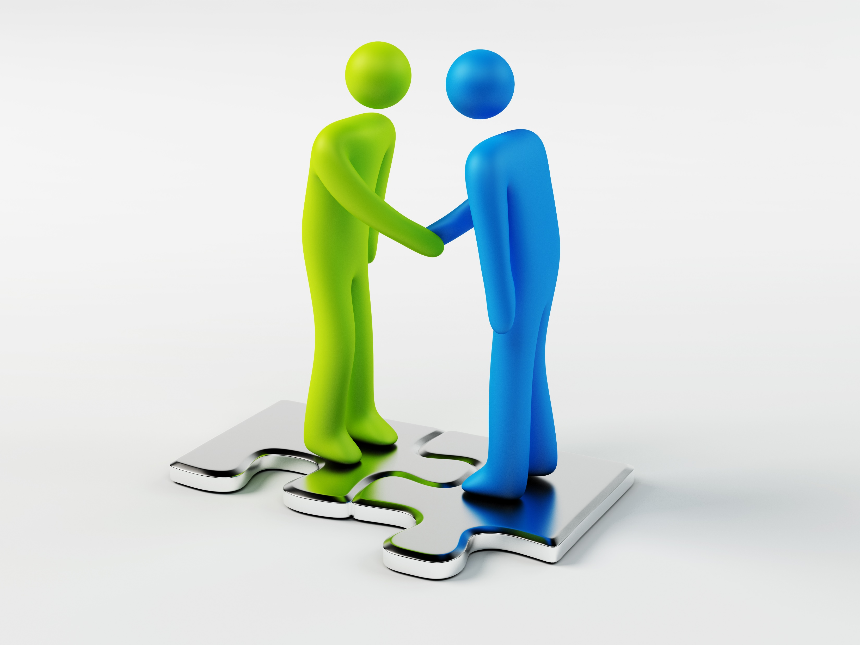
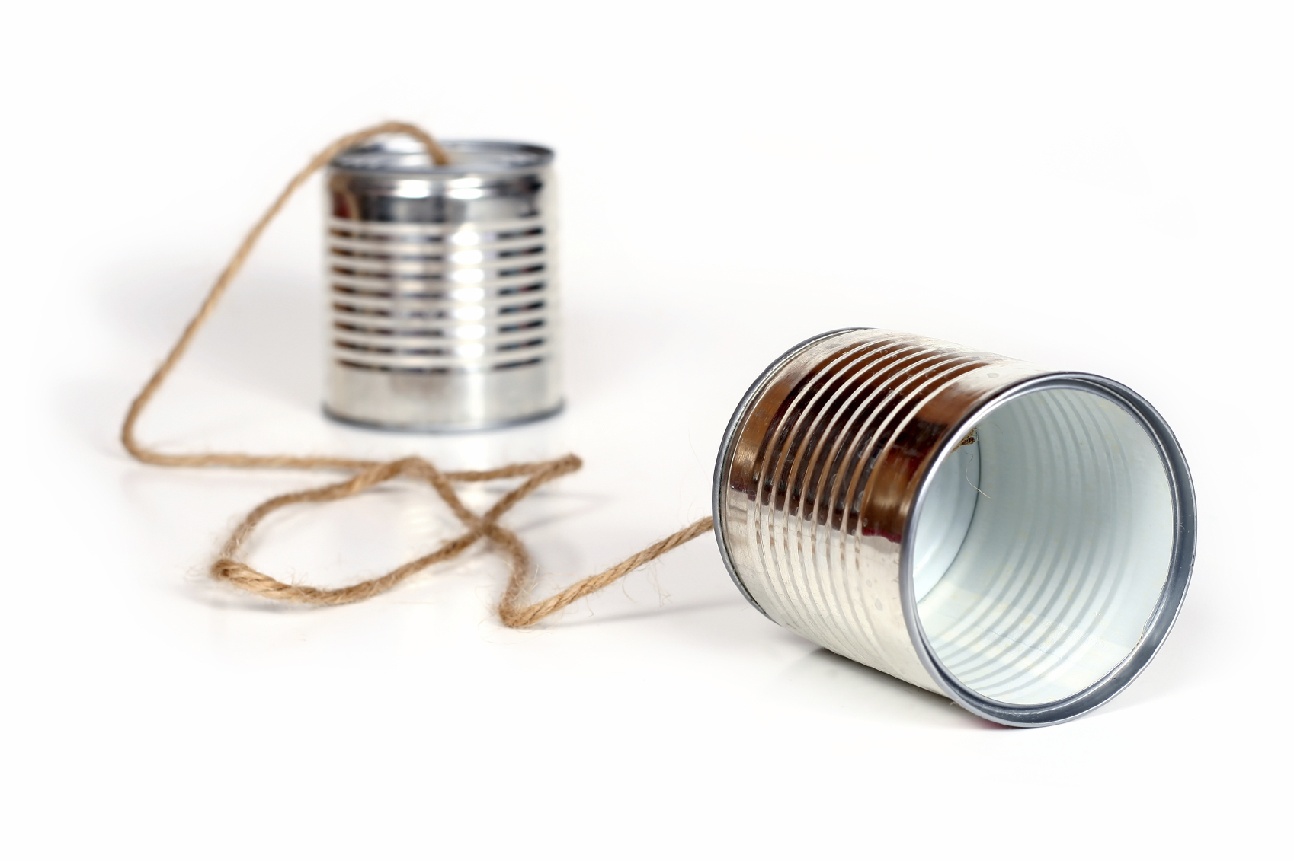
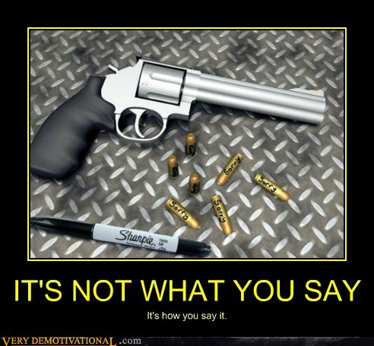

Slide 24
Communication Positive or Negative Can Be...
Negative
Discouraging- cannibal
Distrust– caution
Disharmony- cant com.
Disruption- cease com
Positive
Encouragement
Trust
Harmony
Flow

