Slide 2
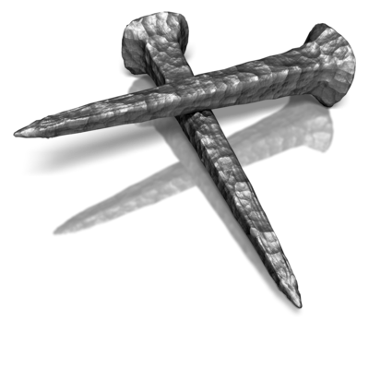
The Power of the Nail
Col 2:11-15
Edward Church
April 1, 2018

Slide 3
The Great Debt
The Greatest Debt We Face Today
Not the National Debt
Not our Corporate Debt
Not our Personal Debt
But Our Sin Debt

Slide 4
Before Calvary
Legally we were Dead in Our Sin
Romans 3:23, For all have sinned, and come short of the glory of God;
Ceremonially we were Unclean
Like the leper we have been damaged by our Sin
Eternally we were Doomed
Romans 6:23, For the wages of sin is death; but the gift of God is eternal life through Jesus Christ our LO RD.
Our Debt of Sin Weighed Us Down

Slide 5
Our Sin…
…Racked Up a Debt
…That we could
…Never Pay

Slide 6
Debt is Cancelled
Paid in Full
When a Debt was Incurred…
…a Bill was Written
…it Stood Legal
…and in Force
Until…
…the Nail

Slide 7
Debt
Nailed
to Tree
In Public For All to See
The Debtor is
Released
And
Free from
All Charges

Slide 8
He that Knew No Sin
…Took on our Sin
He that Knew No Debt
…Took on Our Debt
He that was Innocent
…Took on Our Guilt
He Became Guilty as Charged

Slide 9
Lets Bring This Home
Lets Get Real
The Romans that Drove Those Nails
It Was Our Sin
It Was My Sin

Slide 10
The Power of the Nail

Slide 11
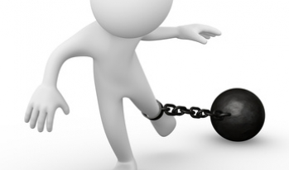
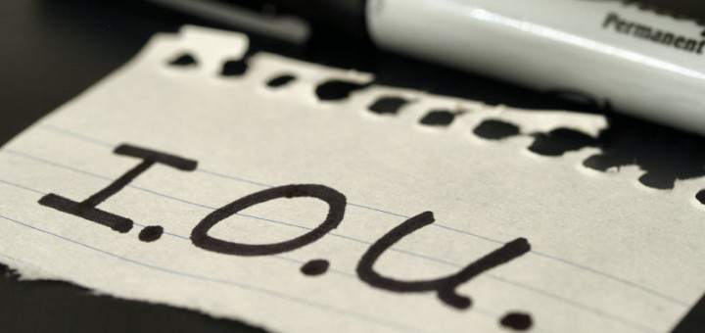

Slide 13
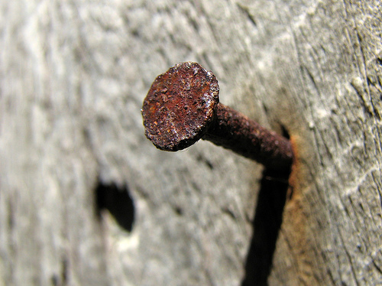
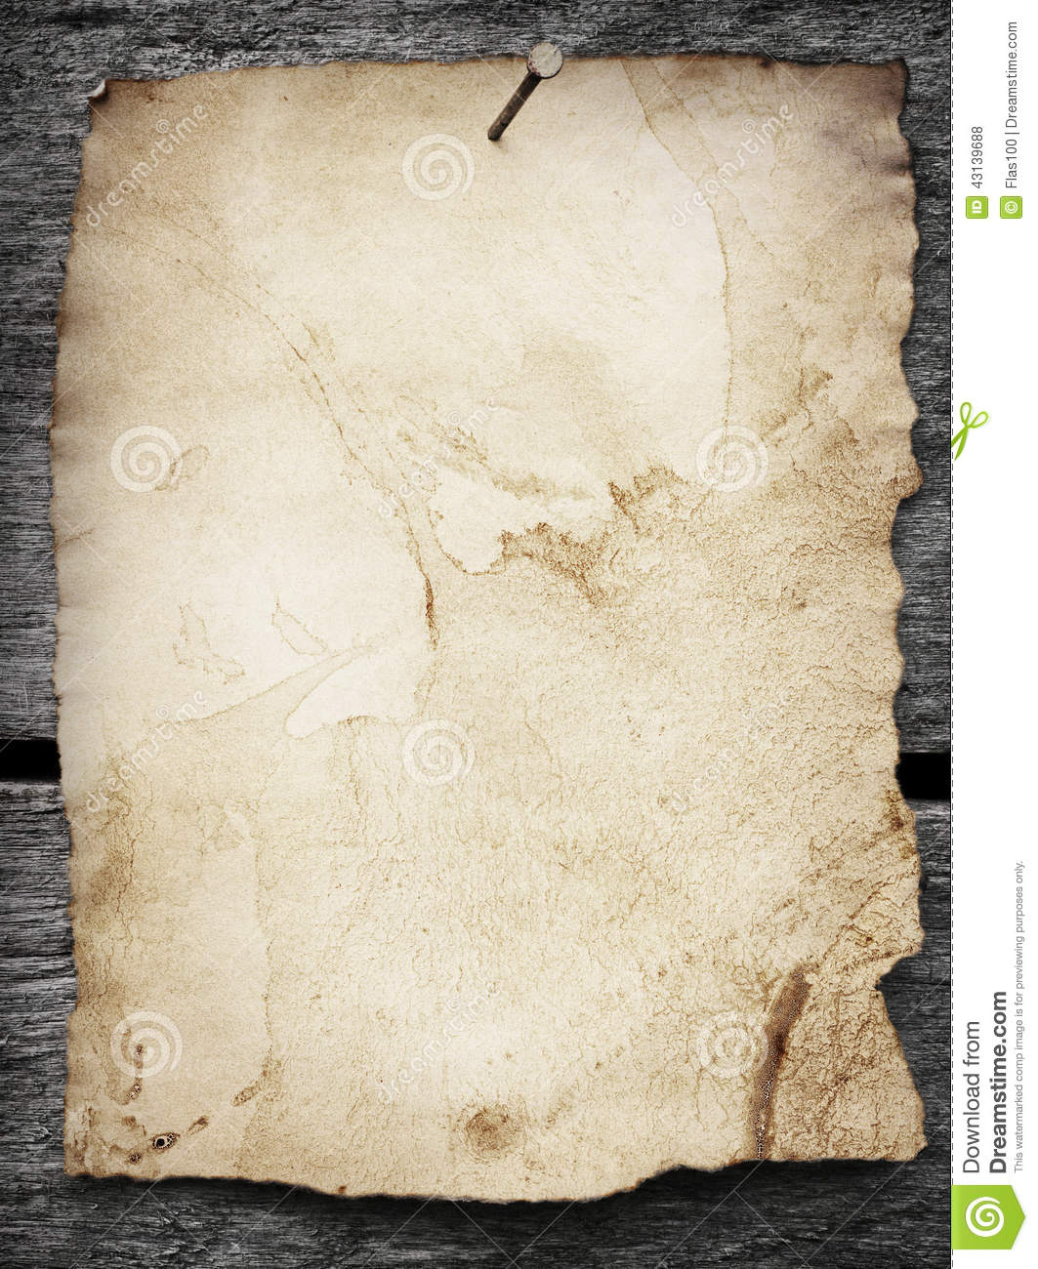
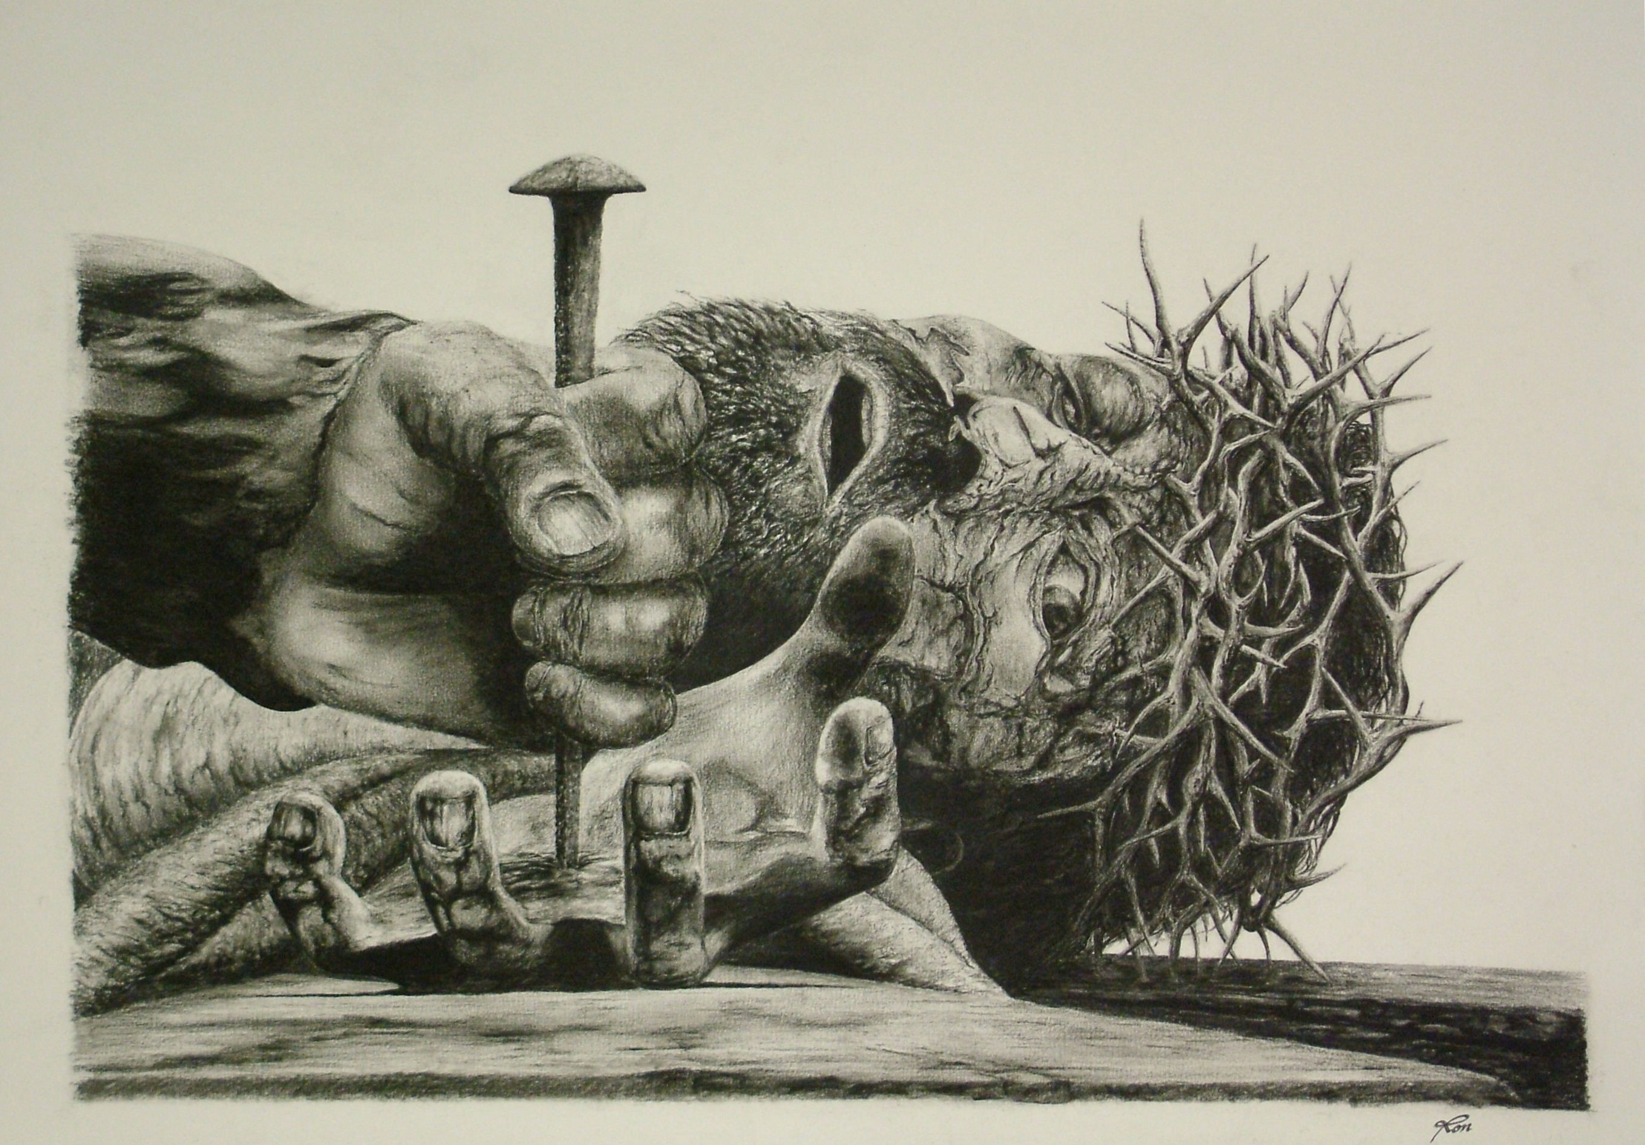
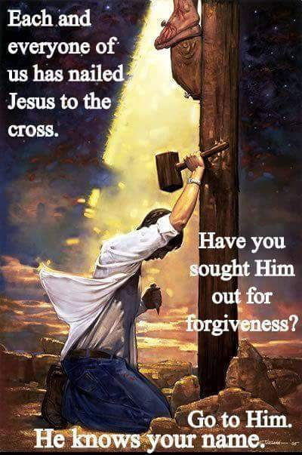
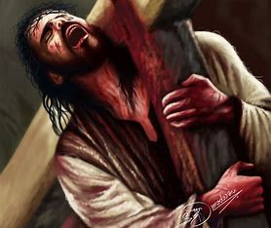

Slide 14
