Slide 1
There were three fathers to be in a hospital waiting room, waiting for their babies to be born.
The first nurse comes out and tells the first father, "Congratulations you're the father of twins!"
He says, “Great! I am the manager for the Minnesota Twins.”
The second nurse comes out and tells the second father, "Congratulations you're the father of triplets!”
He says, "That's cool! I work for 3M."
The third father runs screaming out the front door.
The third nurse comes out, and asks, “Where's the third father?"
One of the other fathers said, "Oh he just ran out the door.”
The nurse asks, "Why?"
He replied, "He works for 7-Up!"

Slide 3
Seven Ups that are Able to Keep You Up -pt3
Romans 15:1
Edward Church
August 19, 2018

Slide 4
Fear has become a Epidemic in this Age-
Jesus warned – in last days hearts failing for fear
F-
E-
A-
R-
…Fervently
…Erodes
…All
…Rest

Slide 5
The Lord has 7 “Downs" …that We Might Have the “Ups."
Fear has become a Epidemic in this Age
Jesus warned – in last days hearts failing for fear
If fear is allowed to persist it can become Depression “Down”
Many Christians now have more "downs" than they have "ups."
“down in the mouth Christianity” will never win anyone to the Lord.
We need to get all excited about being saved.

Slide 6
The Lord…
Did His Part
Now Its Time…
…For Our Part
…There are
…7 Ups
…We
…Need
The Lord…
Looked Down
Came Down
Laid Down
Went Down
Sat Down
Reaches Down
Coming Down

Slide 7
Wake Up !!
…Decide to Have a Good Day
This is the day the Lord hath made; let us rejoice and be glad in it.' Psalms 118:24
Decision
You Can Let…
Emotions Drive Actions
Actions Drive Emotions

Slide 8
Dress Up !!
The Best Way to Dress Up is to Put On a Smile.
A Smile is an Inexpensive Way to Improve Your Looks
“The Lord does not look at the things man looks at. Man looks at outward appearance, but the Lord looks at the heart.” -I Samuel 16:7
“Do not grieve, for the joy of the LORD is your strength” -Neh 8:10
Strength=
Safe Place, Refuge,
Stronghold, Protection

Slide 9
Shut Up!!
…Say Nice Things and Learn to Listen.
God gave us two ears and one mouth,
…so He must have meant for us Listen
…twice as much as we talk
'He who guards his lips guards his soul.’ -Proverbs 13:3
“Everyone should be quick to listen, slow to speak and slow to become angry” James 1:19

Slide 10
Stand Up!!
. . . For What You Believe In.
Stand for something or you will fall for anything
'Let us not be weary in doing good; for at the proper time, we will reap a harvest if we do not give up. Therefore, as we have opportunity, let us do good…’ -Gal 6:9-10

Slide 11
Look Up !!
. . to the Lord.
I look up to the mountains— does my help come from there? My help comes from the Lord, who made heaven and earth!
He will not let you stumble; the one who watches over you will not slumber. Indeed, he who watches over Israel never slumbers or sleeps -Psa 121
'I can do everything through Christ who strengthens me’ -Phil 4:13

Slide 12
Reach Up !!
. . for Something Higher.
'Trust in the Lord with all your heart, and lean not unto your own understanding. In all your ways, acknowledge Him, and He will direct your path.' Proverbs 3:5-6
Trust God from the bottom of your heart; don’t try to figure out everything on your own. Listen for God’s voice in everything you do, everywhere you go; he’s the one who will keep you on track the Message

Slide 13
Lift Up !!
. . Your Prayers.
'Do not worry about anything;
Instead PRAY ABOUT EVERYTHING.' Philippians 4:6
Let petitions and praises shape your worries into prayers, letting God know your concerns. Before you know it, a sense of God’s wholeness, everything coming together for good, will come and settle you down message

Slide 16
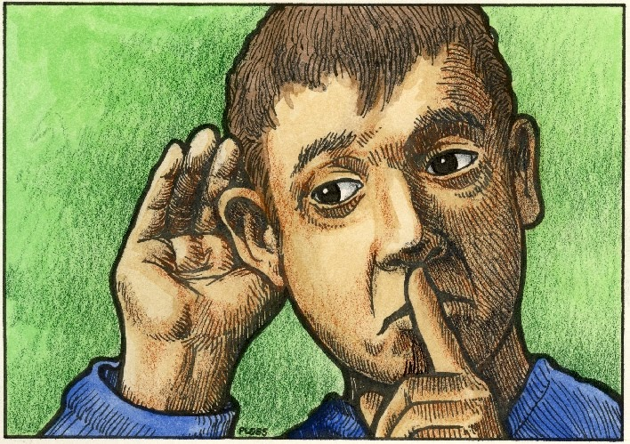
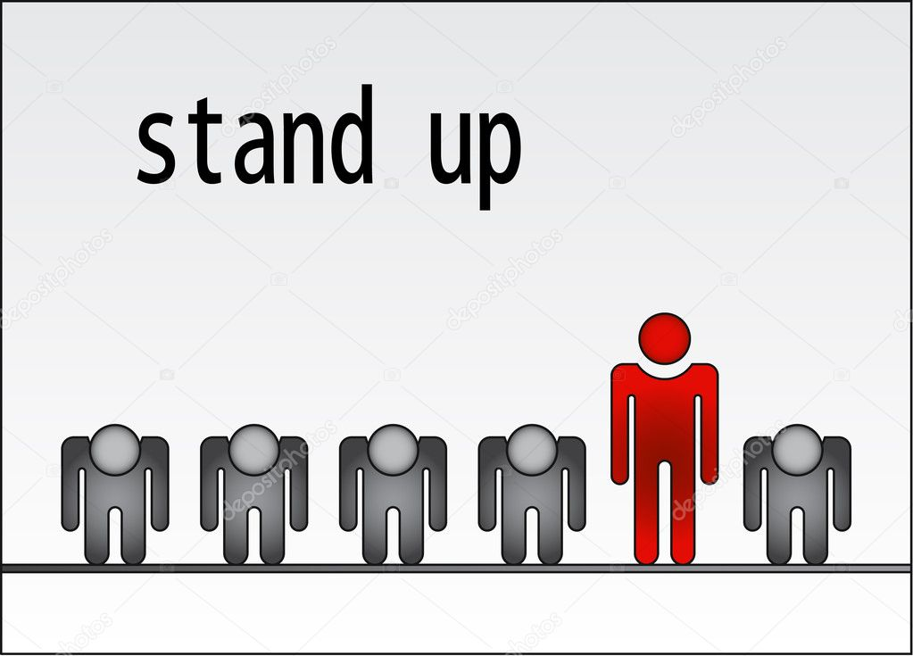
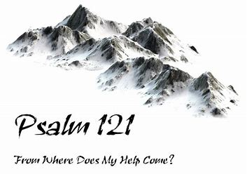

Slide 17
2. Dress Up !! — The best way to dress up is to put on a smile.
A smile is an inexpensive way to improve your looks. 'The Lord does not look at the things man looks at. Man looks at outward appearance, but the Lord looks at the heart.' I Samuel 16:7 3. Shut Up!! — Say nice things and learn to listen.
God gave us two ears and one mouth, so He must have meant for us to do twice as much listening as talking.
'He who guards his lips guards his soul.' Proverbs 13:3 4. Stand Up!! . . . for what you believe in.
Stand for something or you will fall for anything. 'Let us not be weary in doing good; for at the proper time, we will reap a harvest if we do not give up. Therefore, as we have opportunity, let us do good…' Galatians 6:9-10 5. Look Up !! . . to the Lord.
'I can do everything through Christ who strengthens me'. Philippians 4:13 6. Reach Up !! . . for something higher.
'Trust in the Lord with all your heart, and lean not unto your own understanding. In all your ways, acknowledge Him, and He will direct your path.' Proverbs 3:5-6 7. Lift Up !! . . your Prayers.
'Do not worry about anything; instead PRAY ABOUT EVERYTHING.' Philippians 4:6

Slide 18
Seven
Ups

Slide 20
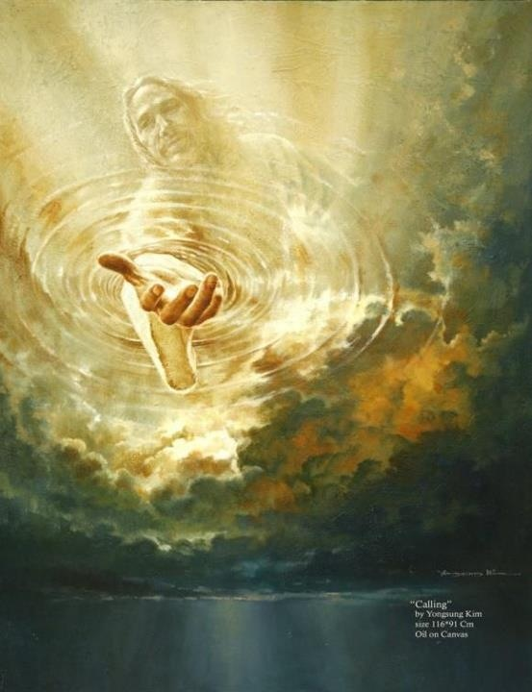

Slide 22
F. E. A. R.
F-
E-
A-
R-
…Fervently
…Erodes
…All
…Rest

Slide 23
Seven
Downs

Slide 24
FEAR
I Have the Keys
of
Death and Hell

Slide 25
Hebrews 1:1-3 ¹ God, who at sundry times and in divers manners spake in time past unto the fathers by the prophets, ² Hath in these last days spoken unto us by his Son, whom he hath appointed heir of all things, by whom also he made the worlds; ³ Who being the brightness of his glory, and the express image of his person, and upholding all things by the word of his power, when he had by himself purged our sins, sat down on the right hand of the Majesty on high;

Slide 26
The Lord Looked Down
Psalm 14:2-3, “The LORD looked down from heaven upon the children
of men, to see if there were any that did understand, and seek God”³
They are all gone aside, they are all together become filthy: there is
none that doeth good, no, not one.
He Saw the…
Depravity of Fallen People
Death that Stalks and Plagues the Earth
Destiny that Awaits the Lost Souls.

Slide 27
The Lord Came Down
John 3:31-32, “ He that cometh from above is above all: he that is of
the earth is earthly, and speaketh of the earth: he that cometh from
heaven is above all. ³² And what he hath seen and heard, that he
testifieth; and no man receiveth his testimony”
Christ Came to…
Reveal God's Love and Purpose
Reaffirm God's Laws and Precepts
Redeem God's Lost People.

Slide 28
The Lord Laid Down
1 John 3:16 (AMP) By this we come to know (progressively to recognize, to perceive, to understand) the [essential] love: that He laid down His [own] life for us; and we ought to lay [our] lives down for [those who are our] brothers [in Him].
He Stayed on the Cross
He Sacrificed His life as Lamb
He Satisfied God's demands for Salvation.

Slide 29
The Lord Went Down
1 Peter 3:18-19, ¹⁸ Christ suffered for our sins once for all time. He never sinned, but he died for sinners to bring you safely home to God. He suffered physical death, but he was raised to life in the Spirit.¹⁹ So he went and preached to the spirits in prison
He Went Down to Hell to…
Preach to Captives
Put Devil in His Place
Push Away the Fear of Death

Slide 30
The Lord Sat Down
Hebrews 12:1-3 (KJV) ¹ Wherefore seeing we also are compassed about with so great a cloud of witnesses, let us lay aside every weight, and the sin which doth so easily beset us, and let us run with patience the race that is set before us, ² Looking unto Jesus the author and finisher of our faith; who for the joy that was set before him endured the cross, despising the shame, and is set down at the right hand of the throne of God. ³ For consider him that endured such contradiction of sinners against himself, lest ye be wearied and faint in your minds.
He Finished the Work of Redemption (never chairs in Temple)
He Fulfilled the Types and Shadows
He Furnishes the Believer with Power to Serve.

Slide 31
The Lord Reaches Down
Matthew 14:31-33 (KJV) ³¹ And immediately Jesus stretched forth his
hand, and caught him, and said unto him, O thou of little faith, where
fore didst thou doubt? ³² And when they were come into the ship, the
wind ceased. ³³ Then they that were in the ship came and worshipped
him, saying, Of a truth thou art the Son of God.
Lift you out of your Death into Life Eternal
Lead you out of your Defeats into Victories
Loose you from all that Prevents Devotion to Christ.

Slide 32
The Lord Is Coming Down
1 Thessalonians 4:13-16 (KJV) ¹³ But I would not have you to be ignorant, brethren, concerning them which are asleep, that ye sorrow not, even as others which have no hope. ¹⁴ For if we believe that Jesus died and rose again, even so them also which sleep in Jesus will God bring with him. ¹⁵ For this we say unto you by the word of the Lord, that we which are alive and remain unto the coming of the Lord shall not prevent them which are asleep. ¹⁶ For the Lord himself shall descend from heaven with a shout, with the voice of the archangel, and with the trump of God: and the dead in Christ shall rise first:
Raise the Dead Saints
Rapture the Living Saints
Reward the Faithful Saints.

Slide 33
The Lord Will Put Down
Hebrews 2:7-8 (KJV) ⁷ Thou madest him a little lower than the angels; thou
crownedst him w- glory /honour, and didst set him over the works of thy hands: ⁸
Thou hast put all things in subjection under his feet. For in that he put all in
subjection under him, he left nothing that is not put under him. But now we see
not yet all things put…
Under Him..
…He will Place
Satan in the Bottomless Pit
Separated in their Rightful Place
Saints in a Glorious Paradise.

