Slide 1
An archaeologist was digging in the Negev Desert in Israel
and came upon a tomb containing a mummy.
After examining it, he called the curator of a prestigious
natural-history museum.
"I've just discovered the 3,000 year-old mummy of
a man who died of heart failure!"
the excited scientist exclaimed.
The curator replied, "Bring him in. We'll check it out."
A week later, the amazed curator called the archaeologist.
"You were right about the mummy's age and cause of death.
How in the world did you know?"
"Easy. There was a piece of paper in his hand that
said, '10,000 Shekels on Goliath'."

Slide 3
Edward Christian Church
August 26, 2018
Stay On the Wall
Weapons of Mass Distraction pt2
Nehemiah 6

Slide 4
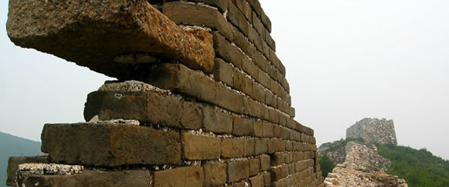
Tough Days in Jerusalem:
Walls Down
Temple and Homes Exposed
Many Under Attack
Many had Been Taken Captive
Many to Rebuild
God Raised Up a Man!!
Today
God is Raising Up a People !!

Slide 5
Satan Attacks
Whenever God Begins to Move…
…Whenever His Anointing Is Present
Satan Begins to Counter-Move
…His 3-Point Attack

Slide 6
Anatomy of Satanic Attacks
Attacks at Point of …
#1- Praise
Has to do with Attitude
Invites God’s…
Presence
Power
Provision
Peace
“But You are holy, enthroned on the praises of Israel” -Psa 22:3

Slide 7
Anatomy of Satanic Attacks
Attacks at Point of …
#2- Commitment
Has to do with Availability
Invites God’s Potential
There is No Limits to the Man / Woman Who Just Wont Quit…
...But Commits Their Way to the Lord
Mighty Army

Slide 8
Anatomy of Satanic Attacks
Attacks at Point of …
#3 Anointing
Has to Do with Ability
Invites God’s Power

Slide 9
2 Types of Attacks
Aggressive
Primary
Purpose:
Get you down
Stop forward momentum
Plural; multi-faceted
Assyria…
…attacked Israel
Babylon
…attacked Judah

Slide 10
Aggressive
Suppressive
Secondary
Purpose:
Keep you down
Prevent forward momentum
Plural; multi-faceted
Assyria…
…held Israel Captive
Babylon…
…held Judah Captive

Slide 11
There Came a Time When…
…God Said Enough is Enough
They Still Had…
…Their Part To Play
Believe That …
God had a Better Plan
God had a Better Way
God had a Better Power

Slide 12
Breakthrough
God Sent:
Ezra to Build the Temple
Starts W- a Relationship
Nehemiah to Build The Wall
Protect the Relationship
Satan Began To:
Lose Grip
Lose Momentum
Lose Captives

Slide 13
Weapons of Mass Distraction
Means are the Same…
…Methods =“Tactics”
…Are Different

Slide 14
Weapons of Mass Distraction
Ridicule (4:1-6)
Intimidation - plots of war (4:7-9)
Discouragement (4:10)
Fear (4:11-12)
Selfishness (5:1-8)

Slide 15
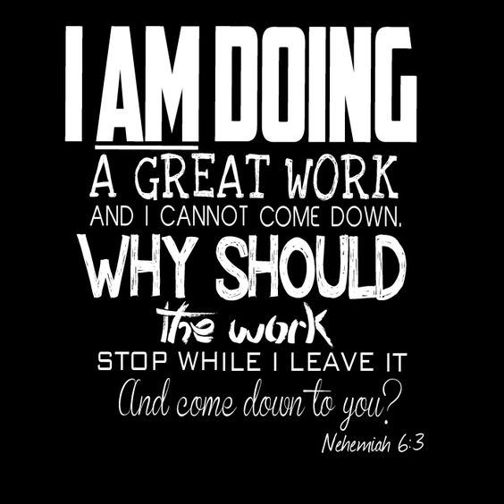
Satan Couldn’t Stop Relationship(temple)… …So He Tried to Hinder the …Relationship(wall)
He Wanted God’s People at a Place of:
Vulnerability
Attack at Will
Instability
Apparent was Unapparent
Irritability
Attitudes Effected
The Wall Construction Did Not Stop!!

Slide 17
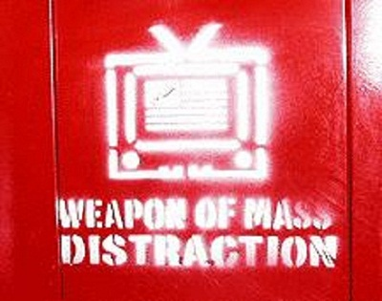

Slide 18
Weapon’s of Mass Distraction
The Enemy got desperate…
…stepped up the attack
Compromise (6:1-4)
Slander (6:5-9)
Threats (6:10-14)
Intrigue (6:17-19)

Slide 19
How to “Stay on The Wall”
1st - Perception (v 3)
He kept working
…do the Right Thing
2nd - Purpose (v 3)
“great work…”
…for the Right Reason
3rd - Prioritize (v 3)
“…can’t come down”
…in the right order

Slide 20
How to “Stay on The Wall”
4th - Persistence (v 4-5)
…with the Right Resolve
5th - Powerful Connection (v 9)
…through the Right Power
6th - Patience (v 14-15)
…in the Right Season

Slide 21
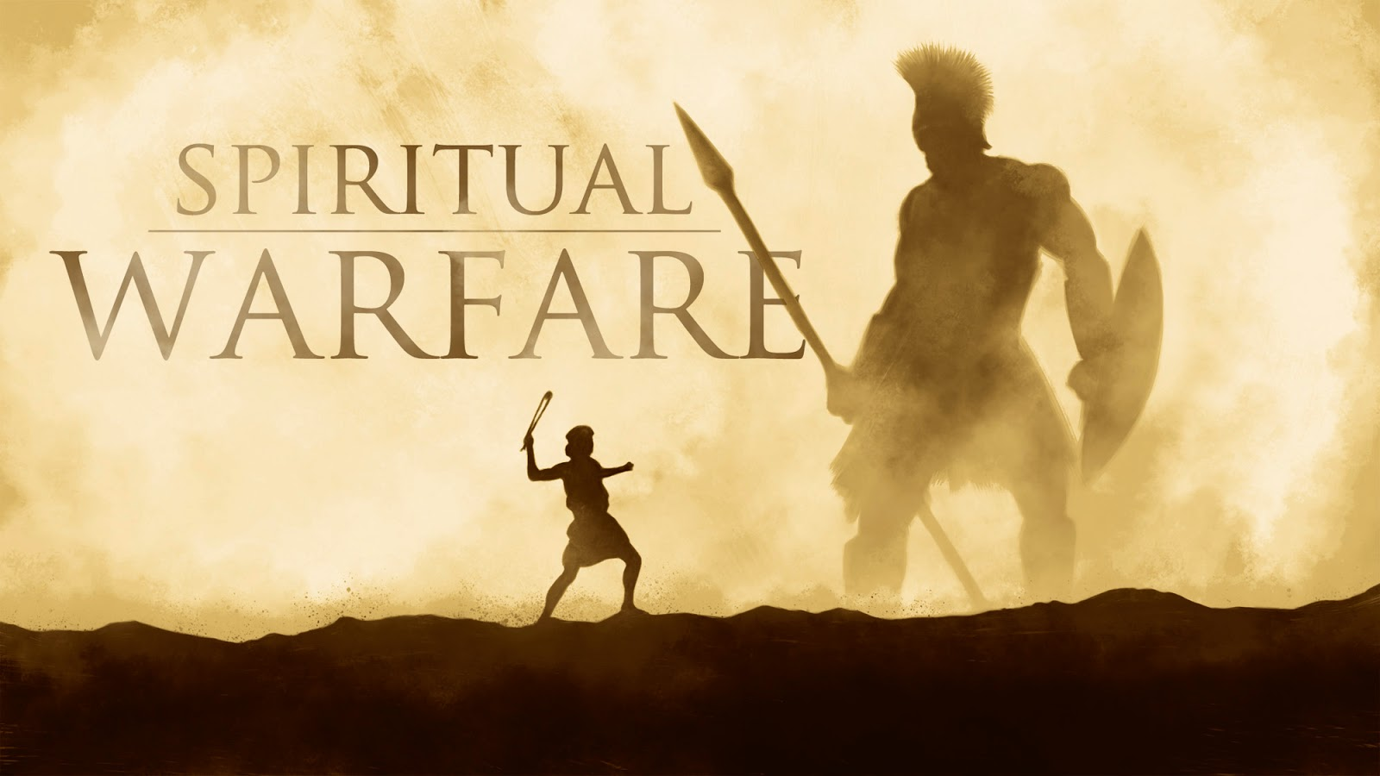

Slide 22
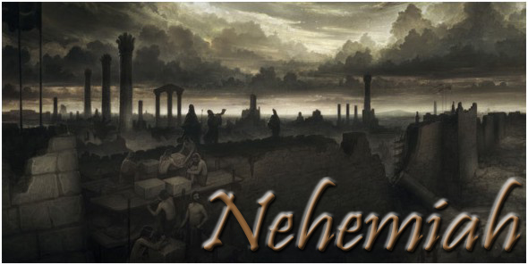

Slide 23
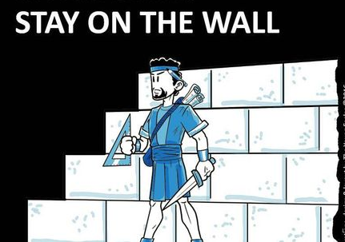
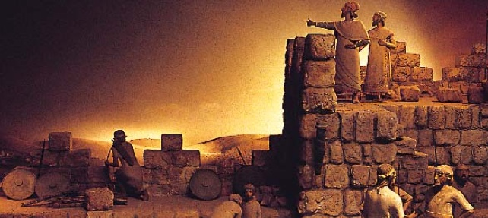

Slide 24
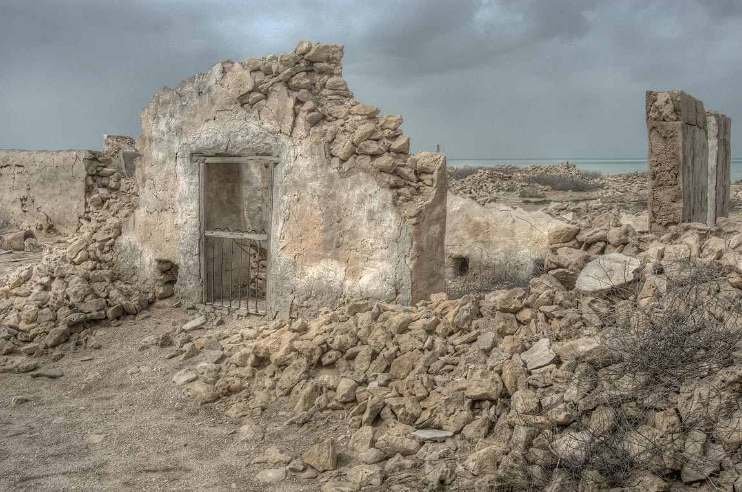
We Are Living in a Similar Time:
Walls Down
Temple and Homes Exposed
Many Under Attack
Many had Been Taken Captive
Many Lives Trying to Rebuild
God is Raising Up a People !!

Slide 25
Satan Attacks the Anointing Because It:
Breaks the Yoke -Isa 10:27
Uncommon Freedom
Moves Beyond Flesh -Zech 4:6
Uncommon Power
Makes a Way Where is No Way -Isa 59:19
Uncommon Preparation

