Slide 1
One day, Hercules, Snow White and the Quazzimodo (Hunchback of Notre Dame) were standing around talking. Hercules spoke up and said, "I bet I am the strongest man in the world."
Snow White then looked around and said, "Well I bet that I am the most beautiful person in the world."
Then Quazzimodo looks around and quietly said, "I suppose that I am the ugliest man in the world."
An old man who had been listening in on there conversation said, "There is a psychic on top of that hill up there, why don't you each go in there and ask her yourself?"
The three friends agreed and they hiked to the top of the hill. Hercules went in first and came out a few minutes later and said, "I was right, I am the strongest man in the world."
Snow White went in next. She came out a few minutes later and said, "I was also right, I am the most beautiful person in the world."
Finally it was Quazzimodo's turn. He went in and after a few minutes he came out scratching his head. He looks up at his friends and said:
"Who is Frank Richards?"

Slide 3
Five Lessons from “Five Smooth Stones”
Edward Christian Church
October 14, 2018
I Sam 17

Slide 4
David and Goliath
from Goliath's Viewpoint

Slide 5
Goliath
This was Another Day at the Office for Goliath
Goliath= Beheader
Champion= Gap-Stander
Challenger= 40 days Unanswered
Beheaded Israel w-out a Fight
Typical Warfare for Goliath
Then He Met a Little Shepherd Boy…
...Goliath's Perspective was About to Change

Slide 6
David and Goliath
There are Five Things that Goliath Did to Bring
...His Defeat by David the Shepherd Boy
…Five Misconceptions
He is Still Using These Five Things…
…to Bring Us Down
We Must Never Allow these Things…
…on the Spiritual Battlefields of Life
This Should Bring Hope to Us in Our Battles...

Slide 7
He Judged the Outcome by the… “Size of His Opponent”
(42) "...he disdained him; for he was only a youth.."
Goliath was Insulted
Boy was Sent
Not Mighty Experienced Warrior
He Laughed and Mocked
He Had Already Determined Winner
An Easy..Quick Victory
Big Mistake!

Slide 8
He Judged the Outcome by the… “Size of His Opponent”
Satan Works Through Intimidation
1 Pet 5:8, “Be sober, be vigilant; because your adversary the devil, as a roaring lion, walketh about, seeking whom he may devour:
Phil 1:28, “in nothing terrified by your adversaries:
which is to them an evident token of perdition, but
to you of salvation, and that of God”
1 Tim 4:12, "Let no man despise thy youth; but be thou an example of the believers...”

Slide 9
He Judged the Outcome by the… “Size of His Opponent”
Mightiest Dangerous Things…
…Wrapped in Tiny Packages.
Tiny Atom has Ability of Massive Destruction
Small Rattlesnake as Deadly as Large One.
the Midians overthrown by Gideon's 300.
Elijah / his Servant Stopped the Syrians.

Slide 10
He Judged the Outcome by the… “Size of His Opponent”
The Power of “Mustard Seed Faith”
Smallest Seed
Powerful Results
“Jesus said unto them, Because of your unbelief:
for verily I say unto you, If ye have faith as a grain
of mustard seed, ye shall say unto this mountain,
Remove hence to yonder place; / it shall remove;
/nothing shall be impossible unto you” Matt 17:20

Slide 11
He Judged the Outcome by the… “Size of His Opponent”
(42) “he was a youth / ruddy ..fair countenance”
Zechariah 4:10, “who hath despised the day of small things?”
Small Beginnings
Goliath Did...
...Goliath Died

Slide 12
End part 1

Slide 15
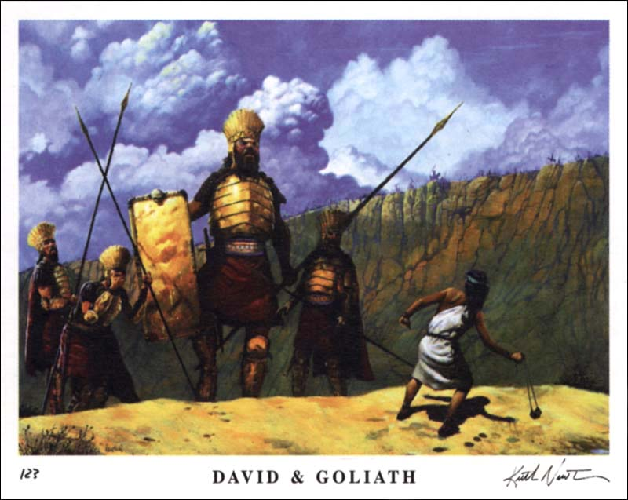
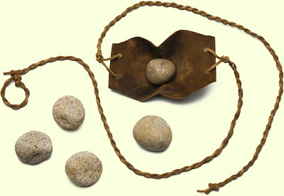
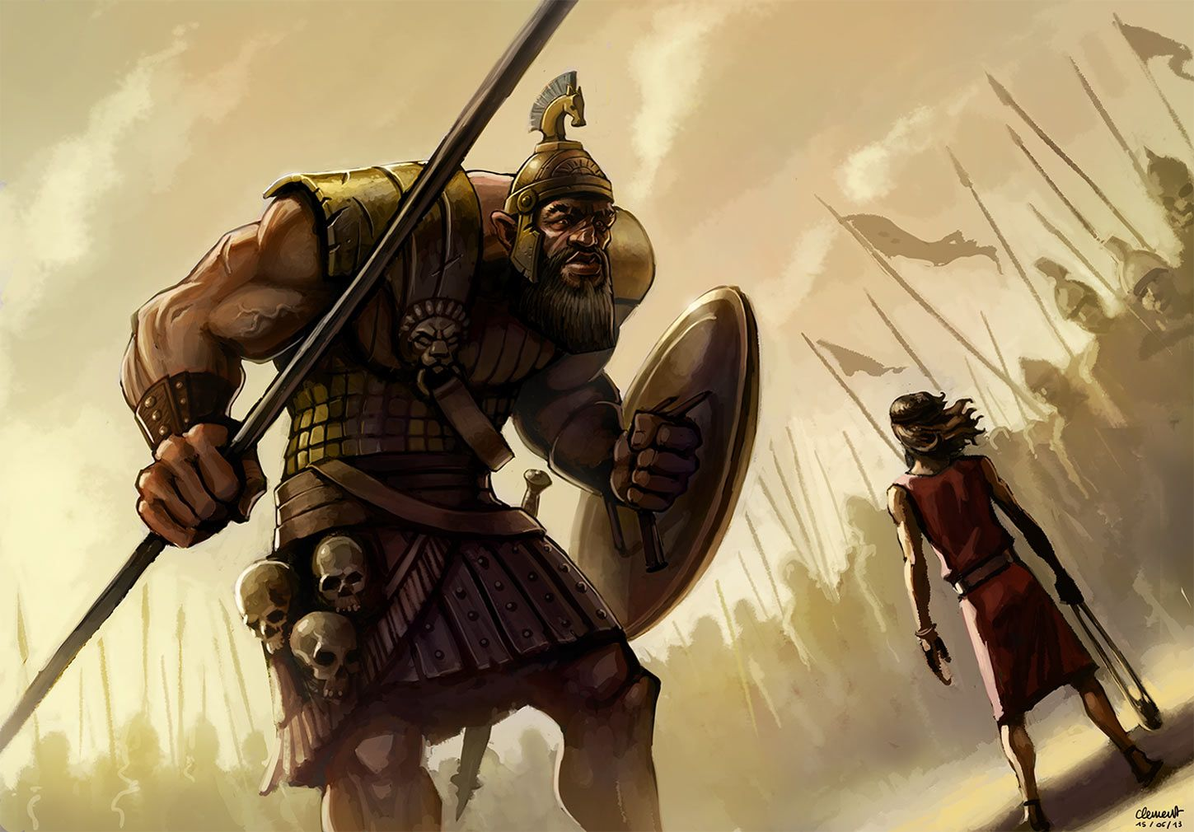
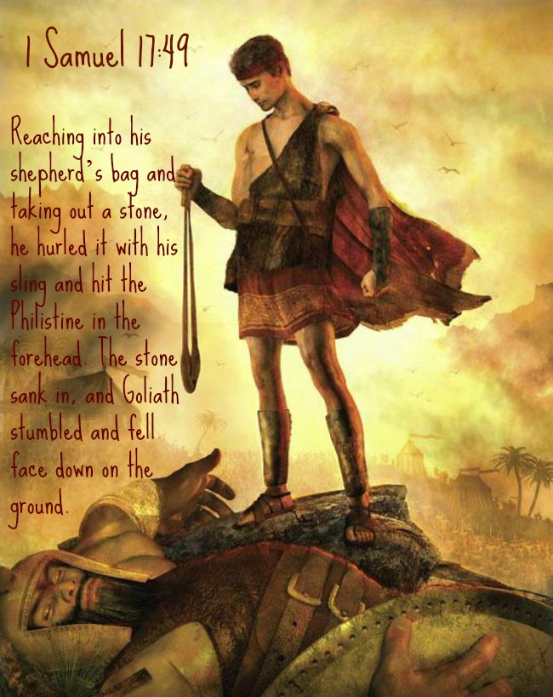

Slide 16
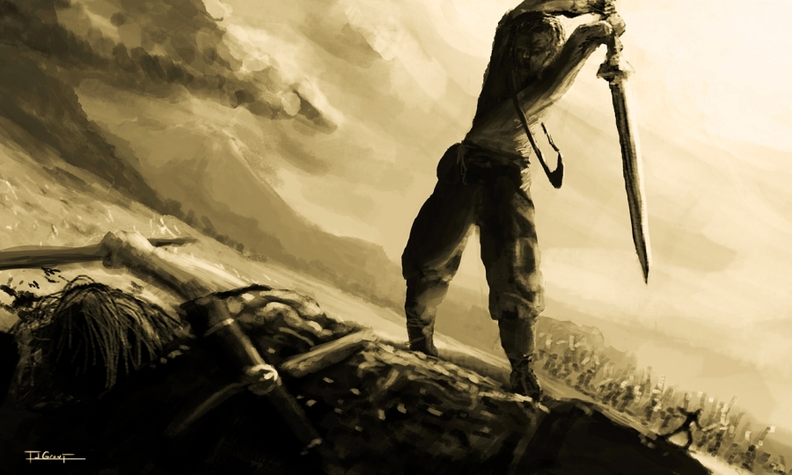
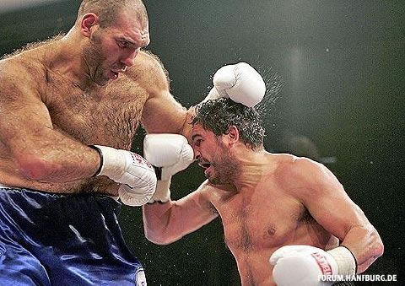
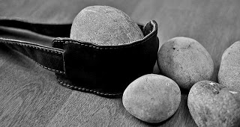

Slide 17
