Slide 1
A woman goes to the local newspaper office to see that the obituary for her recently deceased husband is published. The obit editor informs her that there is a charge of 50 cents per word. She pauses, reflects, and then she says, well then, let it read: "Fred Brown died."
Amused at the woman's thrift, the editor tells her that there is a seven-word minimum for all obituaries.
She thinks it over and in a few seconds says, "In that case, let it read, "Fred Brown died. Golf clubs for sale."
Talk about making the most of a situation

Slide 3
It Ain’t Over Til God says…
Edward Church
December 2, 2018
Jeremiah 33:1-3

Slide 4
Jeremiah 33:1-3 (AMPC)
Moreover, the word of the Lord came to Jeremiah the second time, while he was still shut up in the court of the guard, saying,
² Thus says the Lord Who made [the earth], the Lord Who formed it to establish it—the Lord is His name:
³ Call to Me and I will answer you and show you great and mighty things, fenced in and hidden, which you do not know (do not distinguish and recognize, have knowledge of and understand).

Slide 5
Jeremiah was Called the Weeping Prophet
His…
Mission seemed Impossible
Message seemed Ignored
Ministry seemed Inhibited

Slide 6
(1) the word of the Lord came unto Jeremiah the second time, while he was yet shut up in the court of the prison
While He was Yet…
Shut Up
Court of the Prison

Slide 7
(1) the word of the Lord came unto Jeremiah the second time, while he was yet shut up in the court of the prison
Word of the Lord
Came unto Jeremiah
Second Time
It Ain’t Over til God Says Its Over!

Slide 8
² Thus saith the Lord the maker thereof, the Lord that formed it, to establish it; the Lord is his name
Lord = Yehovah- self existent one
maker thereof, the Lord that
formed it, to
establish it; the
Lord is his name
Nothing is Impossible for God!

Slide 9
³ Call unto me, and I will answer thee, and show thee great and mighty things, which thou knowest not
Invitation - Call unto me
Promise - I will answer thee
show thee
Power - great and mighty things
Potential - which thou knowest not
Quit Letting Your Problem Talk to You…
…Start Talking to Your Problem

Slide 10
Jeremiah 33:20-22 (MSG)
¹⁹⁻²² God’s Message to Jeremiah: “God says, ‘If my covenant with day and my covenant with night ever fell apart so that day and night became haphazard and you never knew which was coming and when, then and only then would my covenant with my servant David fall apart and his descendants no longer rule. The same goes for the Levitical priests who serve me. Just as you can’t number the stars in the sky nor measure the sand on the seashore, neither will you be able to account for the descendants of David my servant and the Levites who serve me.’”

Slide 13
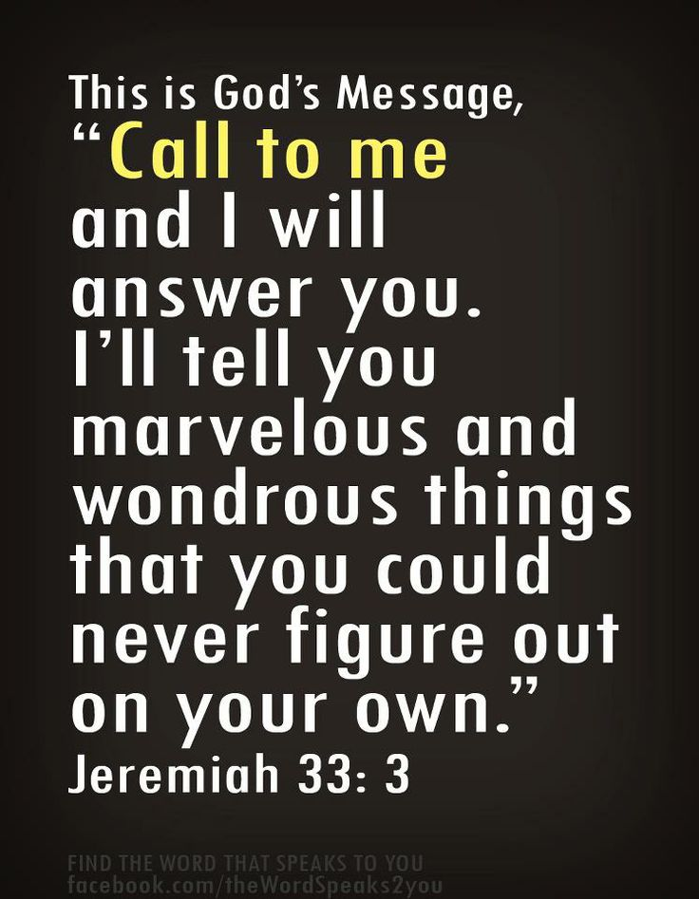
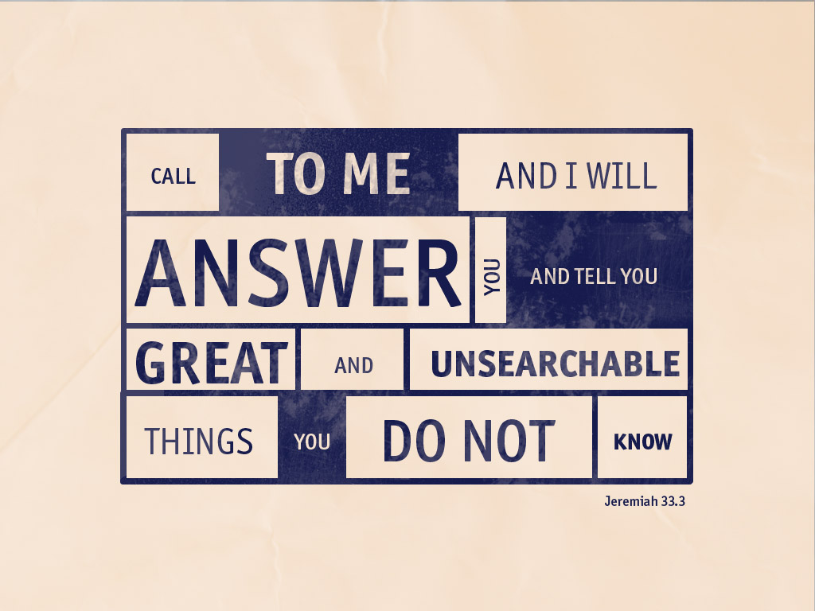
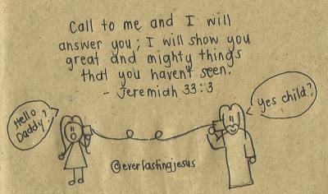
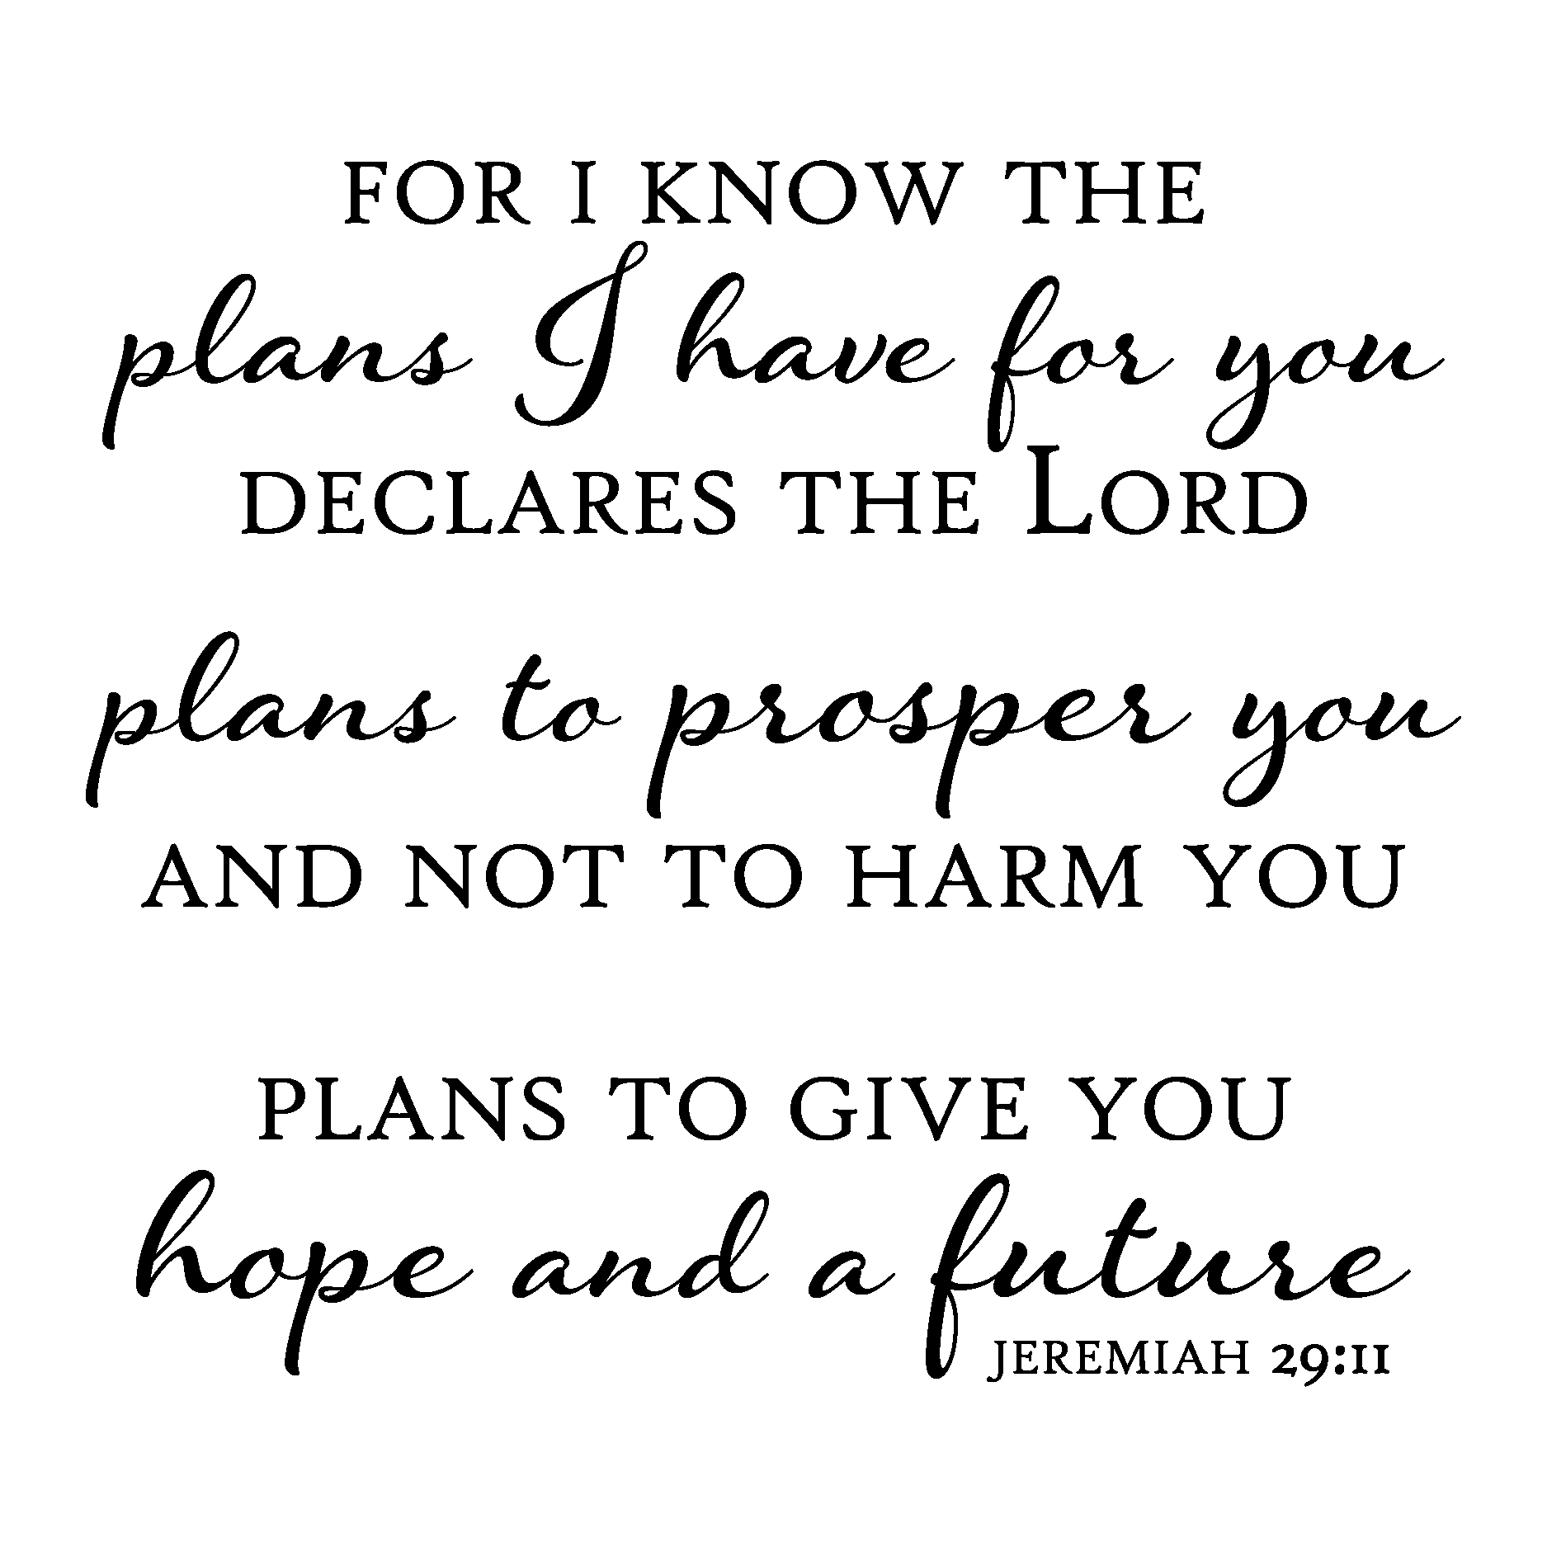
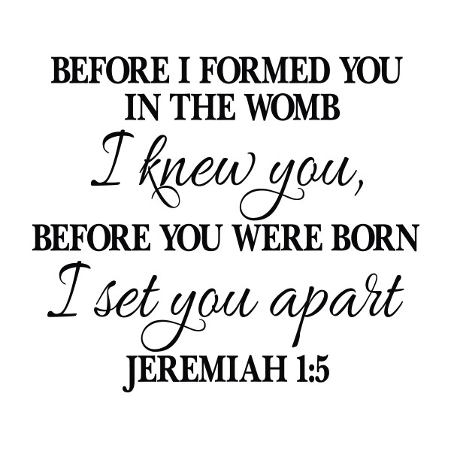

Slide 14
