Slide 1
The Santa Claus at the mall was very surprised when a young lady about twenty years old walked up and sat on his lap.
Santa doesn't usually take requests from adults, but she smiled very nicely at him, so he said, "OK, you can ask for something but it has to be for someone other than yourself. What do you want for Christmas?"
"Something for my mother," said the young lady.
"Something for your mother? Well, that's very thoughtful of you," smiled Santa. "What do you want me to bring her? "
Without blinking she replied, "A son-in-law!"

Slide 3
When Your Broken Heart …Overshadows Your …Joyful Heart
Dealing with Loss –pt1
II Samuel 12:22
Edward Church
December 9, 2018

Slide 4
Christmas is a Season of…
But Not For Some…

Slide 5
We All Experienced Loss This Season
Many Have Been Hurt..
Circumstances…Losses…
Overshadowed….
…Crowded Out The Joy
We Look at the Manger (Life)
and All We See is a Coffin (Death)

Slide 6
Seasons of Loss Come to All
There is the…
Hit
Hurt
Healing
How Much You Have Invested in the Hit…
…Determines How Hard the Process Will Be
…to Heal the Hurt

Slide 7
How Did David Deal With His Grief
…After His Loss?
…He Did Three Things

Slide 8
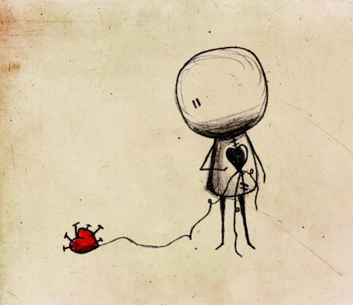
1st- He ACCEPTED What He Could Not Change
22 And he said, "While the child was alive, I fasted and wept; for I said, ’Who can tell whether the Lord will be gracious to me, that the child may live?’ 23 But now he is dead; why should I fast? Can I bring him back again? I shall go to him, but he shall not return to me." -2 Samuel 12:22-23 (NKJV)
Many are STUCK in Pain…
…Pull of Past
…Paralyzed by Present
Robs Your
Peace
Power
Amazing the Freedom…
…When We Accept This

Slide 9
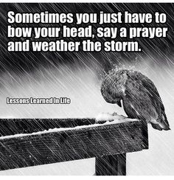

Slide 11
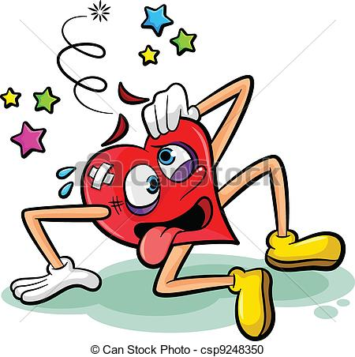
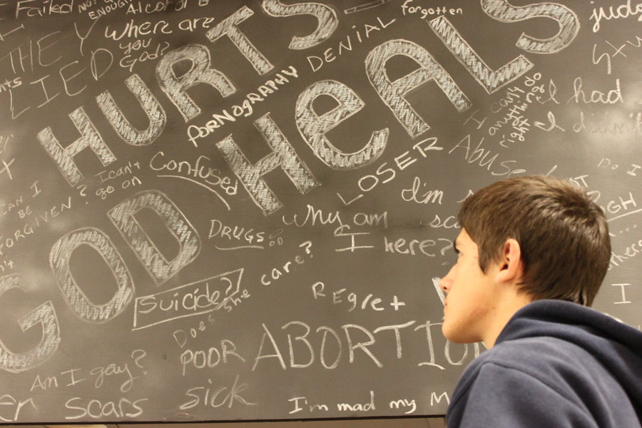
Personal

Slide 12
2nd- He FOCUSED On What was Left Not What was Lost
Then David comforted Bathsheba his wife, and went in to her and lay with her. So she bore a son, and he called his name Solomon - 2 Samuel 12:24 (NKJV)
It’s OK to Look Back to Yesterday…
But Not Dwell “On It” or “In It”

Slide 13
2nd- He FOCUSED On What was Left Not What was Lost
Then David comforted Bathsheba his wife, and went in to her and lay with her. So she bore a son, and he called his name Solomon - 2 Samuel 12:24 (NKJV)
Mis-Directed Focus Brings…
Pain
Questions “Why…?”
Pull
Re-Directed Focus Brings…
Healing
Answers “Why Not…!”
Push

Slide 14
2nd- He FOCUSED On What was Left Not What was Lost
Then David comforted Bathsheba his wife, and went in to her and lay with her. So she bore a son, and he called his name Solomon - 2 Samuel 12:24 (NKJV)
It’s OK to Look Back to Yesterday…
But Not Dwell “On It” or “In It”
The Baby was Gone…
“He can’t come to me but I can Go to Him”
Bathsheba was Still There
Reality CHECK

Slide 15
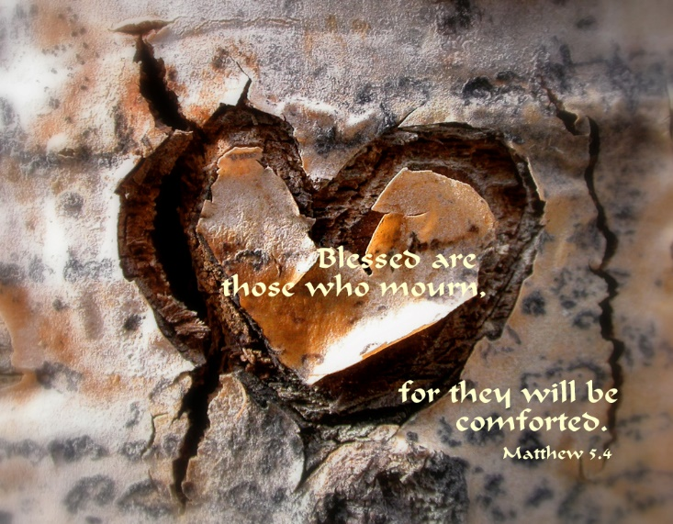
3rd- He TURNED to God
Then David arose from the earth, and washed, and anointed himself, and changed his apparel, and came into the house of the LORD, and worshipped: then he came to his own house; and when he required, they set bread before him, and he did eat. -II Sam 12:20
He…
Got Up -from where he was
Cleansed Himself- physically and spiritually
Put On Clean Clothes –changed his attitude
Went to Church –went to hear from God Again
Worshipped His God in whom he had learn to trust

Slide 16
Comforted (to console - to breathe strongly) 24
Comforted (to console - to breathe strongly)
David was a type of Christ - the Anointed One = HG Comfort
2 Cor 1:4-NLT - He comforts us in all our troubles so that we can comfort others. When they are troubled, we will be able to give them the same comfort God has given us.
Conceived - Solomon born
Solomon (shelo-mo -peaceful -fr. Shalom…
…peace, Safety, well, happy, prosper)
…..It Will Rain Again -
God Has Not Forgotten You!
He Is At Work Even Now!

Slide 17
Let God Breathe…
Hope
Healing
Happiness
Isaiah 9:6 ⁶ For unto us a child is born, unto us a son is given: and the government shall be upon his shoulder: and his name shall be called Wonderful, Counsellor, The mighty God, The everlasting Father…
…The Prince of Peace.

Slide 20
Psalm 28:7 (KJV) ⁷ The LORD is my strength and my shield; my heart trusted in him, and I am helped: therefore my heart greatly rejoiceth; and with my song will I praise him.
How Did David Deal With His Grief
…After His Loss?
He Did Three Things

Slide 21
In II Sam 12 we see king David was grieving like many of us today, because he lost someone he loved. He grieved, he cried, his heart was broken. He did what I suggest we all do today:
He got up -from where he was
He cleansed himself- physically and spiritually
He put on clean clothes –changed his attitude
Then he went to church –went to hear from God Again +Fellowship w- His People
He worshipped his God in whom he had learn to trust through out all his years. David said, "I know that my son can not come back to be with me here, But One day I will go to be with him." He knew that God, one day would work it all things

Slide 22
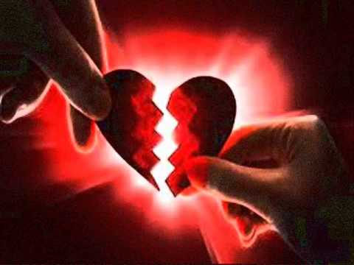
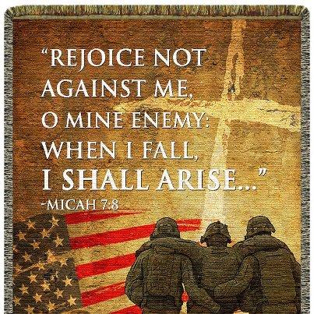
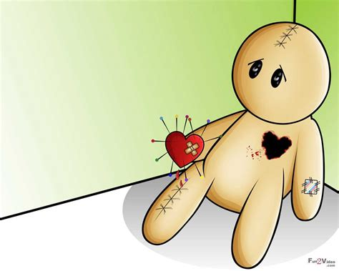

Slide 23
Neh 8:10, “Joy of the Lord is My Strength..”
Serving God Should Never be Seen as..
Hassle
Burden
Pain
Serving God Should Be Seen as…
Power
Relief
Joy
I Pet 1:8,“Joy Unspeakable / Full of Glory”

Slide 24
Psalm 28:7 (KJV) ⁷ The LORD is my strength and my shield; my heart trusted in him, and I am helped: therefore my heart greatly rejoiceth; and with my song will I praise him.

