Slide 1
A burglar decided to burgle the safe in a store. On the safe door he was very pleased to find a note reading, "Please don't use dynamite. The safe is not locked. Just turn the knob." He did so.
Instantly a heavy sandbag fell on him, the entire premises were floodlighted, and alarms started clanging.
As the police carried him out on a stretcher, he was heard moaning, "Can't trust nobody no more!"

Slide 3
In 2019
Edward Church
Phil. 2:5
Pt 3
January 13, 2019

Slide 4
Becoming a Better You
How Many Look Back over Last Year…
…and Would Like for 2019 to Be Better?????
Realize that We Have a Part to Play…
Attention
What We See
Attitude
How We Think About It
Actions
How We Respond

Slide 5
Be a Better Person
“Let this mind be in you, which was also in Christ Jesus” -Phil. 2:5
Mind= Attitude
Be= Constant
You= Personal
Jesus Attitude Toward Others was He was a Servant…
…His Attitude Toward Self was
…He Had No Problem with That

Slide 6
Quit Looking Out to Find Someone/ Something
…to Blame
But
Look In and
…Take Responsibility

Slide 7
Think Better Thoughts
⁸⁻⁹ Summing it all up, friends, I’d say you’ll do best by filling your minds and meditating on things true, noble, reputable, authentic, compelling, gracious—the best, not the worst; the beautiful, not the ugly; things to praise, not things to curse. Put into practice what you learned from me, what you heard and saw and realized. Do that, and God, who makes everything work together, will work you into his most excellent harmonies. Philippians 4:8-9 (MSG)
Hear Better Sounds
Romans 10:17-21 (NLT)
¹⁷ So faith comes from hearing, that is, hearing the Good News
about Christ

Slide 8
Becoming a Better You
See Better Sights
Heb 12:2 (AMP)
[looking away from all that will distract us and] focusing our eyes on Jesus, who is the Author and Perfecter of faith [the first incentive for our belief and the One who brings our faith to maturity], who for the joy [of accomplishing the goal] set before Him endured the cross, ^{[a]}disregarding the shame, and sat down at the right hand of the throne of God

Slide 9
Becoming a Better You
Speak Better Words
“Death and life are in the power of the tongue, and those who love it will eat its fruits.” – Proverbs 18:21, ESV
“Let the words of my mouth and the meditation of my heart be acceptable in your sight, O Lord, my rock and my redeemer.” (Amen!) – Psalm 19:14, ESV
“There is one whose rash words are like sword thrusts, but the tongue of the wise brings healing.” – Proverbs 12:18, ESV

Slide 10
Becoming a Better You
Perform Better Deeds
“And whatsoever ye do, do it heartily, as to the Lord, and not unto men” -Col. 3:23
…And whatsoever ye do
…do it heartily
…as to the Lord
…and not unto men
Col. 3:23
= Life
= Life w-in
= Life Giver
= Life Takers

Slide 11
Becoming a Better You
Perform Better Deeds
“And whatsoever ye do, do it heartily, as to the Lord, and not unto men” -Col. 3:23
Matt 25:40 (GW) -“The king will answer them, ‘I can guarantee this truth: Whatever you did for one of my brothers or sisters, no matter how unimportant they seemed, you did for me.’
The Deeds of Many are Negative…
(Selfishly Motivated, Dishonest, and Displeasing to God)
So Many Need to Be Lifted Up…
…But How Can We Lift Anybody
…From a Down Position

Slide 12
Becoming a Better You
Attend Better Places
“I was glad when they said . . . Let us go into the house of the LORD” -Ps. 122:1

Slide 13
Surrender
God has a Plan
“Forsake not assembling…” -Heb 10:25
Safety
His Plan is a Good Plan
“where no counsel is, the people fall, but in multitude, of counsellors there is safety” -Proverbs 11:14
Strength
His Plan is a Powerful Plan
one chase a thousand, and two put ten thousand to flight- Deut 32:30

Slide 14
Becoming a Better You
Attend Better Places
“I was glad when they said . . . Let us go into the house of the LORD” -Ps. 122:1
Christians Hurt Their Influence When They…
… Go To The Wrong Places In Search of Wrong Things
Be a Positive Christian
Attend Church Faithfully
Be a Part of What’s Going
Make a Positive Difference
Go with God and He Will Go With You

Slide 15
Building a Better You…
…Will build a Better
Marriage
Family
Church
Work Place

Slide 17
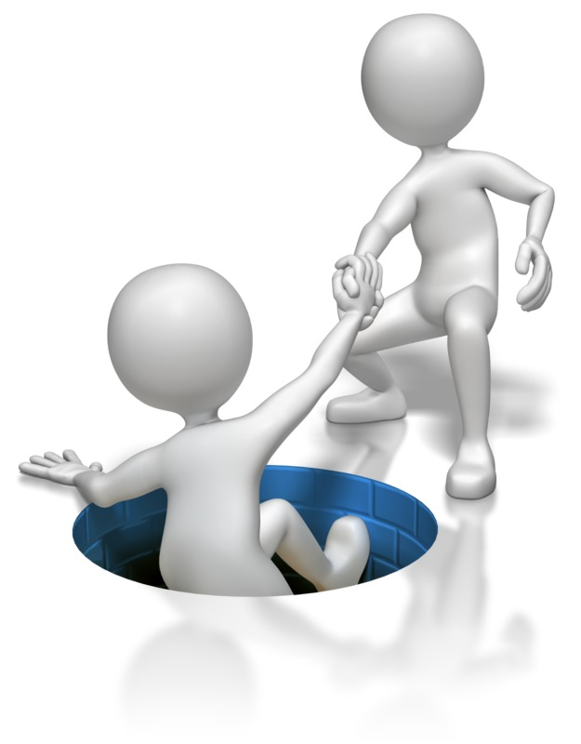
Matthew 25:40 GOD’S WORD Translation (GW)
⁴⁰ “The king will answer them, ‘I can guarantee this truth: Whatever you did for one of my brothers or sisters, no matter how unimportant they seemed, you did for me.’

Slide 18
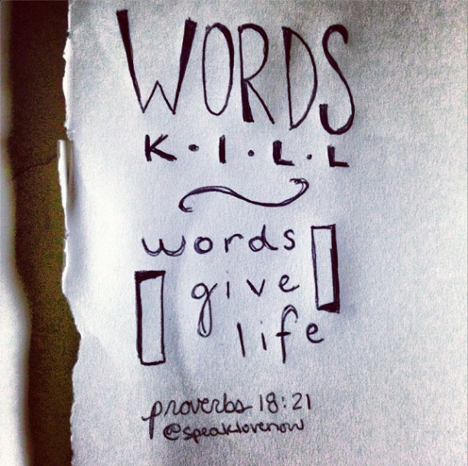

Slide 19
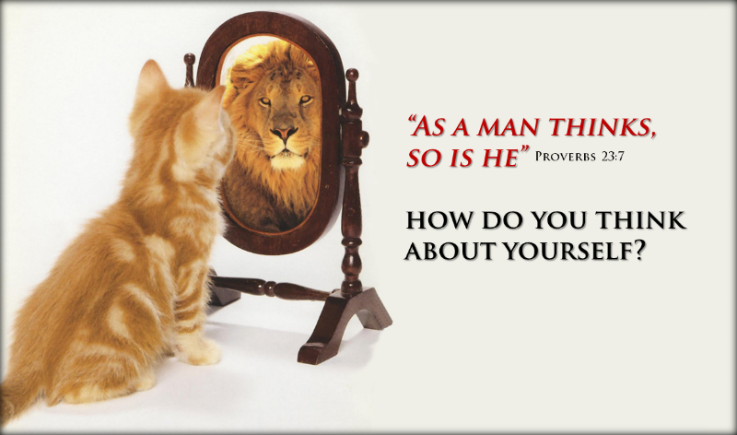

Slide 21
Discipline Our Thinking.
Quit Allowing Negatives To Dominate Our Minds.
We Must Take Deliberate Action,
…Replacing Negative Thoughts With Positives
…And Keeping An Optimistic Outlook.

Slide 22
Becoming a Better You
Hear Better Sounds
Romans 10:17-21 (NLT)
¹⁷ So faith comes from hearing, that is, hearing the Good News
about Christ
Quit Listening Negative, and Destruction
It Will Dwarf Your Spirit
We Must Listen to the Good, Resist the Bad.
We Must Hear From the Lord And Heed His Word.

Slide 23
From the Lost Book of the Bible – “Yeah But”
The Prophet “Yeah But” says:
Anything Before BUT…
Doesn’t Really Matter
Mighty Army
Take the Sentence….
I Meant To BUT…
…Out of Your Vocabulary

Slide 24
Think Better Thoughts
“Whatsoever things are of good report . . . think on these things” Phil. 4:8
Philippians 4:8-9 (MSG)
⁸⁻⁹ Summing it all up, friends, I’d say you’ll do best by filling your minds and meditating on things true, noble, reputable, authentic, compelling, gracious—the best, not the worst; the beautiful, not the ugly; things to praise, not things to curse. Put into practice what you learned from me, what you heard and saw and realized. Do that, and God, who makes everything work together, will work you into his most excellent harmonies.

Slide 25
2018

Slide 29
Colossians 3:20
…And whatsoever ye do
…do it heartily
…as to the Lord
…and not unto men
Col. 3:23
= Life
= Life w-in
= Life Giver
= Life Takers

