Slide 1
The Pillsbury Doughboy died yesterday of a yeast infection and complications from repeated pokes in the belly.
He was 71.
Doughboy was buried in a lightly greased coffin.
Dozens of celebrities turned out to pay their respects, including Mrs. Butterworth, Hungry Jack, the California Raisins, Betty Crocker, the Hostess Twinkies and Captain Crunch.
The grave site was piled high with flours.
Aunt Jemima delivered the eulogy and lovingly described Doughboy as a man who never knew how much he was kneaded.
Doughboy rose quickly in show business, but his later life was filled with turnovers. He was not considered a very smart cookie, wasting much of his dough on half-baked schemes.
Despite being a little flaky at times, he still, as a crusty old man, was considered a roll model for millions.
Doughboy is survived by his wife, Play Dough; two children John Dough and Jane Dough; plus they had one in the oven.
He is also survived by his elderly father Pop Tart.
The funeral was held at 3:50 for about 20 minutes.

Slide 3
Lessons from Gideon pt1
Judges 6
Edward Church
January 20, 2019

Slide 4
Gideon is a Mighty Example of…
…How God Can Take a…
Nobody (Inferiority Complex)
Ran (Fear Led)
Hid (Victim Mentality)
And Turn Him Around…
…and Use Him
…Turn the Situation Around

Slide 5
What Gideon Could See
Under Attack
Looked Like God was Silent
He Depended on Self
He was Hiding
Does This Sound Familiar?

Slide 6
Inferiority Complex?
¹⁵ “But Lord,” Gideon replied, “how can I rescue Israel? My clan is the weakest in the whole tribe of Manasseh, and I am the least in my entire family!”
When You Live by Fear …
…You Will Be Led By Fear
…You Leave Others Your Fear

Slide 7
What Gideon Could See
Under Attack
Looked Like God was Silent
He Depended on Self
He Was Hiding
What Gideon Could Not See
God was Not Silent !

Slide 8
The First Thing God was Going to Do is…
…Help Gideon Move Beyond His Fear

Slide 9
Be Aware that Living in a “State of Fear” is
…Not Part of God’s Plan for You
Fear-Based Thinking…
Suggests You May Not Be Fully Trusting God.
Does Not Appropriate the Grace of God.
Keeps You in Bondage to Fear.
Is Physically, Emotionally, / Spiritually Damaging.
“In God I trust; I will not be afraid. What can mortal man do to me?” -Psalm 56:4

Slide 10
Begin with a Healthy Fear (Awe) of God
Believe That God…
Created You Because He Loves You
Has a Purpose and a Plan for Your Life.
Has the Right to Have Authority Over You.
Wants You to Entrust Your Life to Him.
Has the Power to Change You.
Will Keep You Safe as You Trust in Him.
“The fear of the LORD is the beginning of knowledge,
but fools despise wisdom and discipline.” -Prov 1:7

Slide 11
God was About to Totally Change Gideons World
God Will Totally Change Yours If You Let Him!

Slide 13
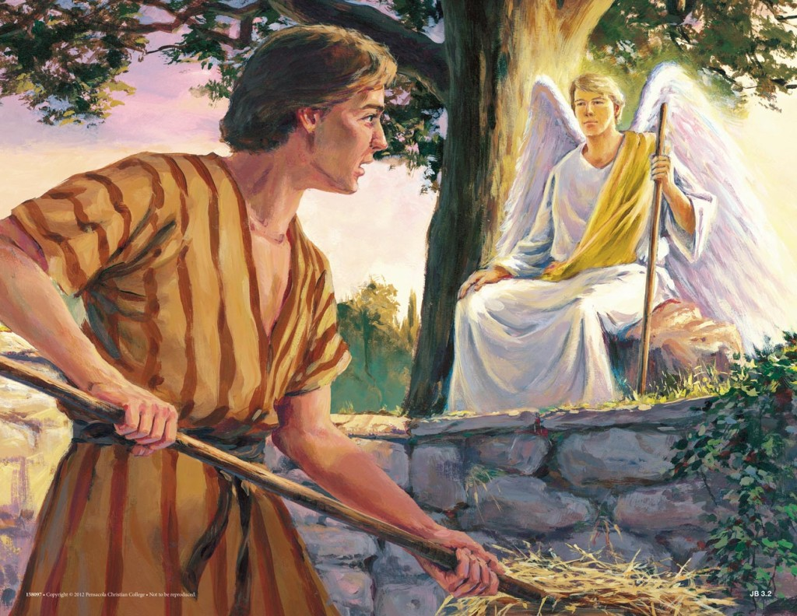
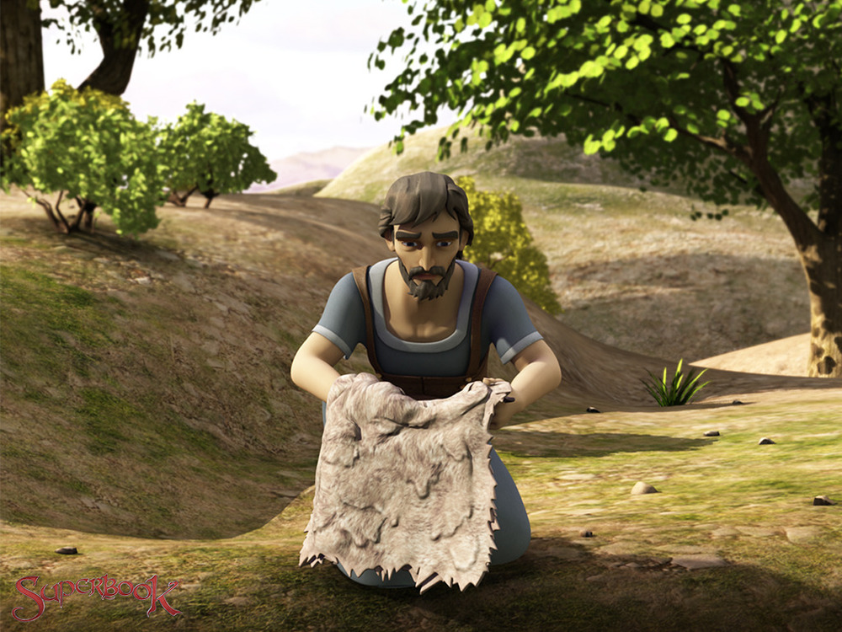
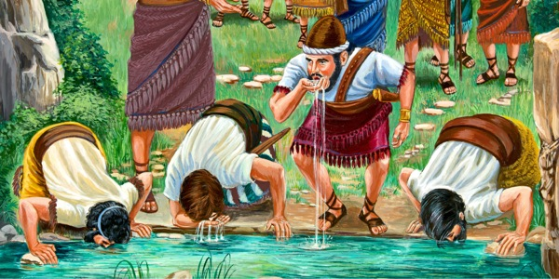
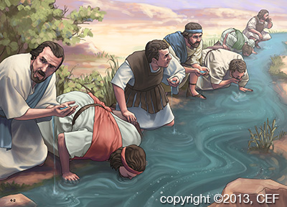
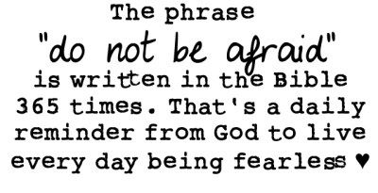
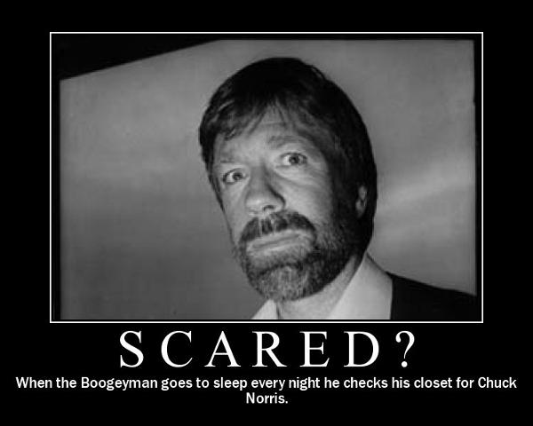
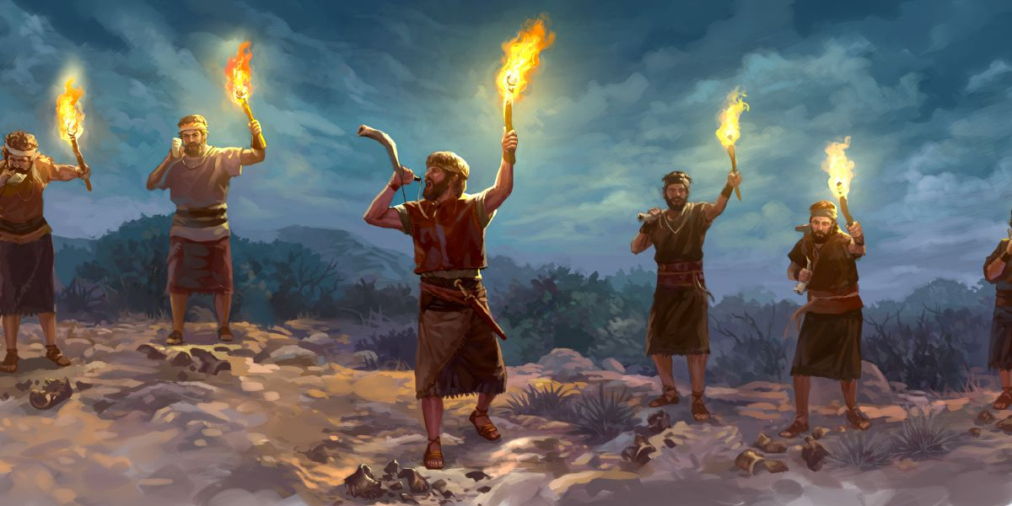
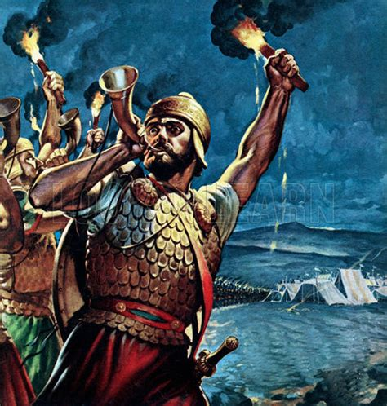
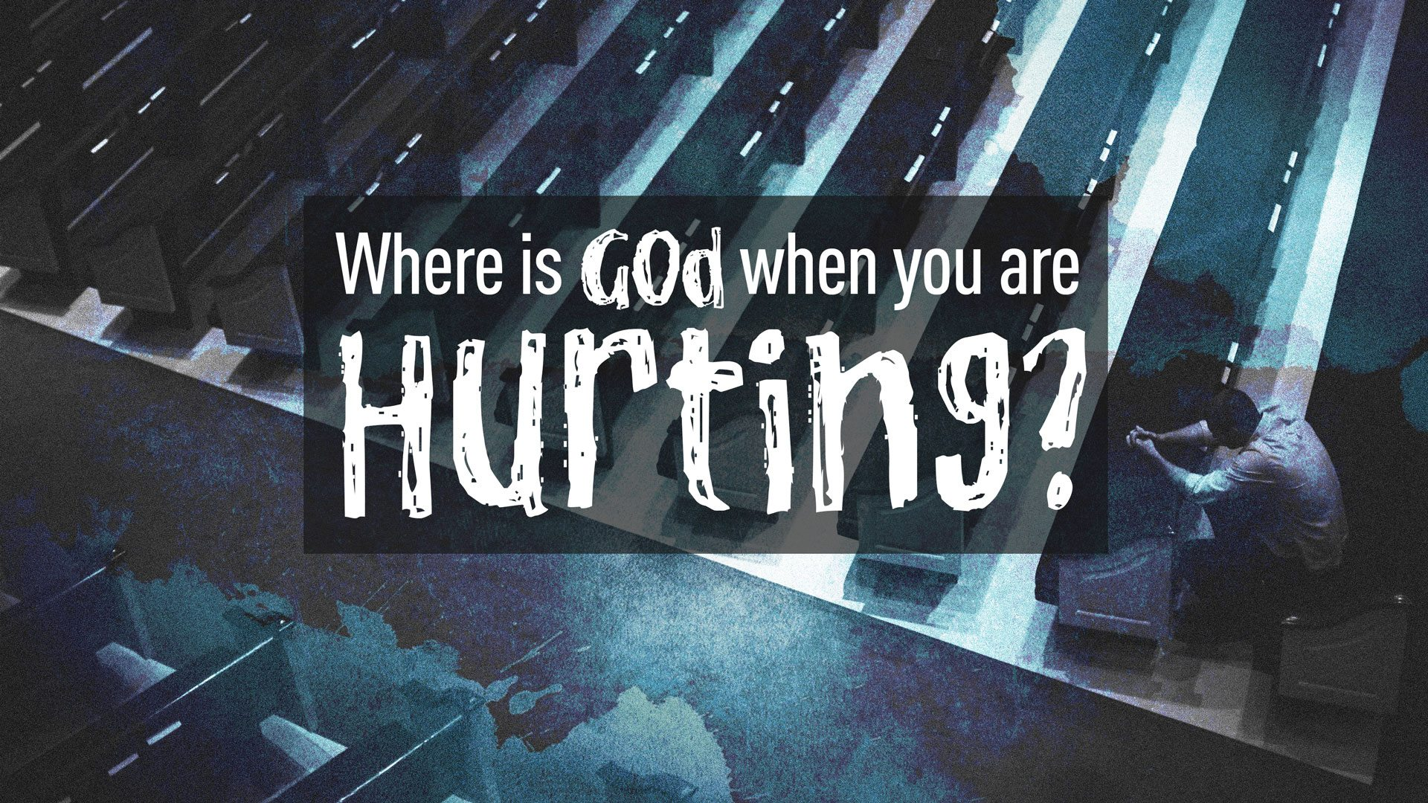
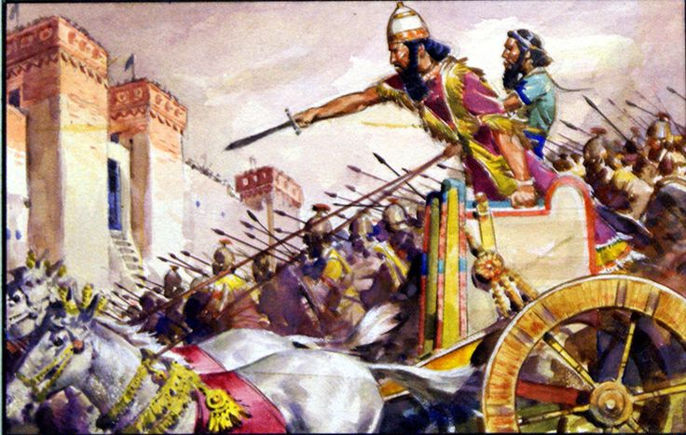

Slide 14
God Uses Tough Times to Get Our Attention -Jud 6:1-6
Actually…
…God Uses Tough Times to Bring Out the Tough in Us
Direct us …Up
Draw us …Out
Say This…
My Trouble Didn’t Happen to me…
…It Happened For Me

Slide 15
God Sees More Than We Do (6:7-12)
Gideon Did not Act Like a Mighty Warrior…
All We See are the Present Conditions/ Circumstances…
And Ask How? Why?
God sees the Past, Present, Future…
…All at One Time
God says ..I Know How ! And Asks, Why Not !
He Looked at Simon (reed) …
…and Called Him Peter (Rock)

Slide 16
God Sees More Than We Do (6:7-12)
He Looked at Simon (reed) …
…and Called Him Peter (Rock)
He knew Simon was Easily Shaken By Circumstances
Deserted Jesus in the Garden
Denied Jesus 3 Times at His Trial
But the Day was Coming when He was Unshakeable
Acts 4:13, When they saw the courage of Peter and John and realized that
they were unschooled, ordinary men, they were astonished and they took
note that these men had been with Jesus

Slide 17
God Confirms His Priorities with His Presence (6:13-24)
(16) The Lord answered Gideon and said, “I will be with you, so you can defeat the Midianites as easily as if they were only one man.”
As long as we are sitting still or moving backwards…
…don’t expect to experience His Powerful Presence
But When We Advance…move Beyond Spectators….

Slide 18
Private Preparation Leads to Public Usefulness (6:25-32)

Slide 19
God is Patient with Our Faith Process (6:33-40)
Faith doesn’t mature overnight
He meets you right where you are with what you need.

Slide 20
Success is Determined by God's Power, Not Ours (7:1-8)
first test culled 22,000 men out of the army, leaving 10,000. Still too many, said God.
So in v. 4, a second test was given. God tells Gideon to take his men down to the water and let them drink. Weed out any men who stick their face down into the water to drink; keep the ones who ladle the water to their mouths with their hands. Gideon must have gulped hard when he counted how many were disqualified: 9700 were out, leaving only 300 men.

Slide 21
Success is Determined by God's Power, Not Ours (7:1-8)
God created an impossible situation of human weakness to exalt His own strength

Slide 22
Fear Can Be Passed Down

Slide 25
When Tough Times Come…
…Instead Of Looking at Them as If
…God is Punishing You,
…Try to See Them as God's Gift of Grace

