Slide 2
Attack Panic
March 24, 2019
Joshua 1
Edward Church

Slide 3
Anxiety Test
I am ready to throw in the…………….
I am at the end of my…………………..
I am just a bundle of……………………
I am at my wits…………………………..
I feel like resigning from the human…
I am in over my…………………………..
(towel).
(rope).
(nerves).
(end).
(race).
(head).

Slide 4
Anxiety = an unpleasant state of inner turmoil, often accompanied by nervous behavior, such as pacing back / forth
It is the subjectively unpleasant feelings of dread over anticipated events, such as the feeling of imminent death.
Anxiety is not the same as fear, which is a response to a real or perceived immediate threat, whereas anxiety is the expectation of future threat.
Anxiety Creates Panic…
…Panic Attacks

Slide 5
Joshua
If Ever a Person was in Position for Panic Attacks
He was Called to…
Take Mose’s Place
…Big Shoes to Fill
Take the Land
…Big Job to Complete
Both Seemed Impossible
…Without God

Slide 6
Anxiety is Triggered Many Ways
When Your Past Triggers Negative Feelings
Sometimes a reminder of a difficult past triggers anxious emotions.
You can’t change your past, but you can change how you respond to it!
Josh 1:2- Moses my servant is dead; now therefore arise,….
When You Feel Unprepared
Josh 1:2- …arise, go over this Jordan, thou, and all this people…
When You Feel Out of Control
Your future is unknown, and change is scary, you feel out of control.
Josh 1:2- …thou, and all this people, unto the land…
When You Feel You Have No Explanation
Sometimes there is no warning or explanation to your anxiety.
Anxiety speaks false beliefs to us that leave us paralyzed.

Slide 7
Anxiety Attacks
Danger of Looking Back (1:2)
“Moses My servant is dead. Now therefore, arise, go over this
Jordan, you and all this people, to the land….”
Moses is Mentioned (6x) in vs 1-9 (57x) Rest of Book
It is Very Easy to Look at What God Has Done in Past/ Think...
…I Cannot Move Forward
Danger of Standing Still (1:3)
“Every place that the sole of your foot will tread I have given..”
Fulfilling the Promises of God Requires…
…that we Walk by Faith.

Slide 8
Dangers of Anxiety
The Danger of Giving Up (1:5) “No man shall be able to stand before you all days of your life; as I was with Moses..will be with you. I will not leave you nor forsake …”
Seems They May Have Given Up, But God Reassured Them.
The Danger of Falling Short (1:6) “Be strong /good courage, for to this people you shall divide as an inheritance the land which I swore to their fathers to give them”
The Inheritance Is the Land that God Promised.

Slide 9
Attack Panic
Joshua 1:8 (KJV) This book of the law shall not depart out of thy mouth; but thou shalt meditate therein day and night, that thou mayest observe to do according to all that is written therein: for then thou shalt make thy way prosperous, and then thou shalt have good success.
The Power of …
Meditation = to mutter under breath- talk to self
Healthy Self-Talk (builds faith)
Reverse Meditation = Worry
Unhealthy Self-Talk (deteriorates faith)

Slide 11
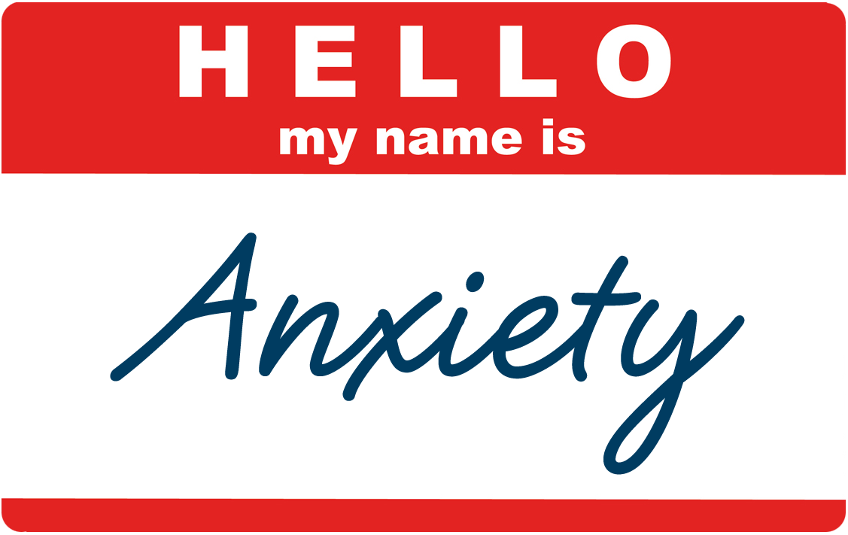
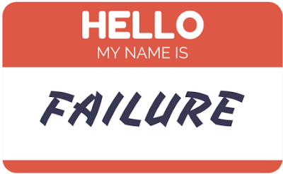
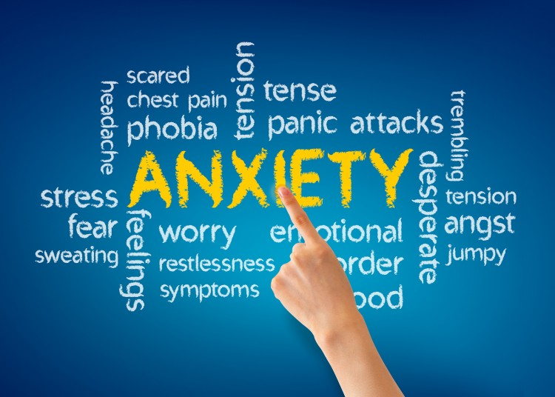

Slide 12
Part 2

Slide 13
Gives You Power to “Put Your Mind At Ease”
Philippians 4:6-7-⁶ Be careful for nothing; but in every thing by prayer and supplication with thanksgiving let your requests be made known unto God. ^{7:} And the peace of God, which passeth all understanding, shall keep your hearts and minds through Christ Jesus.
Matthew 11:28- ²⁸ Come unto me, all ye that labour and are heavy laden, and I will give you rest. ²⁹ Take my yoke upon you, and learn of me; for I am meek and lowly in heart: and ye shall find rest unto your souls. ³⁰ For my yoke is easy, and my burden is light.
Jehovah-Shalom= "the Lord is Peace"

Slide 14
Gives You Power to “Put Your Trust In Him”
Psalm 62:8- “Trust in him at all times; ye people, pour out your heart before him: God is a refuge for us. Selah”
Trust= Him in Every Situation
Talk= to Him about Every Situation
Jehovah Rohi = “the Lord is Our Shepherd”

Slide 15
Gives Power to “Transfer All Your Burdens To Him”
Psalm 62:8- Trust in him at all times; ye people, pour out your heart before him: God is a refuge for us. Selah. -
Psalm 55:22- Cast thy burden upon the LORD, and he shall sustain thee: he shall never suffer the righteous to be moved.
I Peter 5:7- Casting all your care upon him; for he careth for you
Jehovah-Jireh= "the Lord, my Provider"

Slide 16
Gives You Power to “Practice His Presence”
Psalm 61:1-2- “Hear my cry, O God; attend unto my prayer.
² From the end of the earth will I cry unto thee, when my heart is
overwhelmed: lead me to the rock that is higher than I.”
Jehovah Shammah = “the Lord is There”

Slide 17
Gives You Power to “Stand”
Joshua 1:9- Have not I commanded thee? Be strong and of a good courage; be not afraid, neither be thou dismayed: for the LORD thy God is with thee whithersoever thou goest.
Hebrews 13:6 - So that we may boldly say, The Lord is my helper, and I will not fear what man shall do unto me
Jehovah Nissi = “The Lord Is Our Banner”

Slide 19
Joshua 1:8 (KJV) This book of the law shall not depart out of thy mouth; but thou
shalt meditate therein day and night, that thou mayest observe to
do according to all that is written therein: for then thou shalt make
thy way prosperous, and then thou shalt have good success.

Slide 20
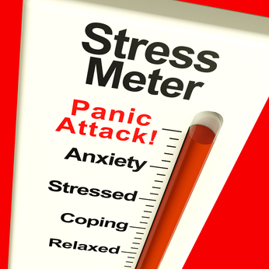
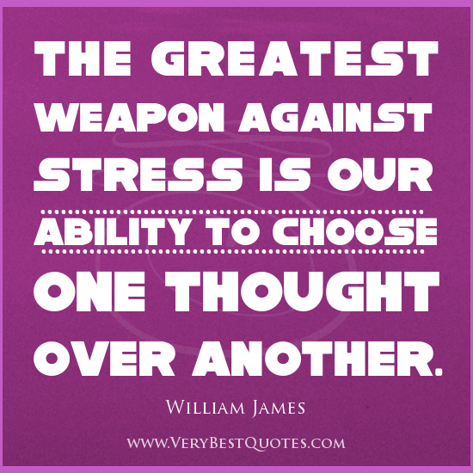
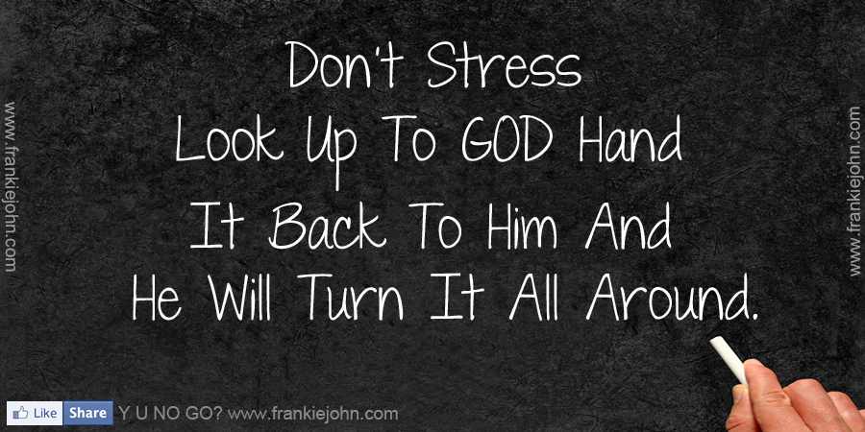
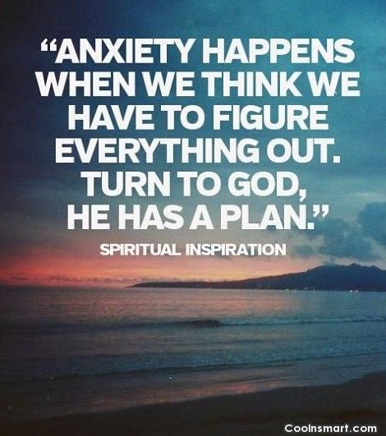
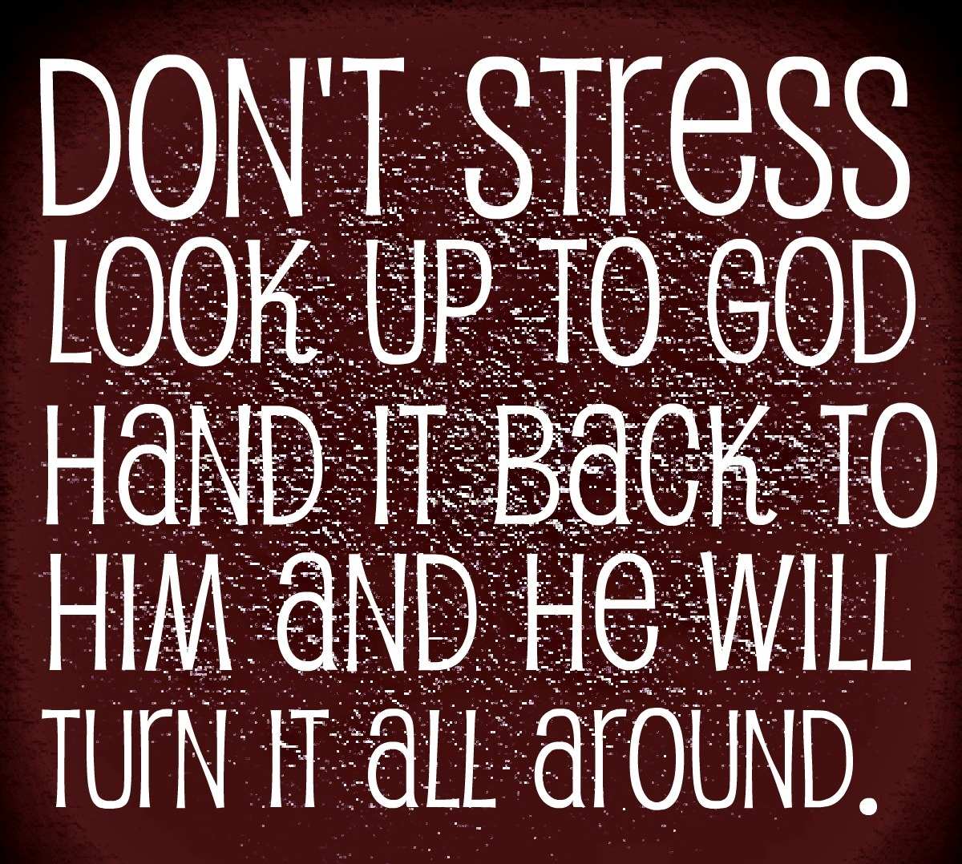

Slide 21
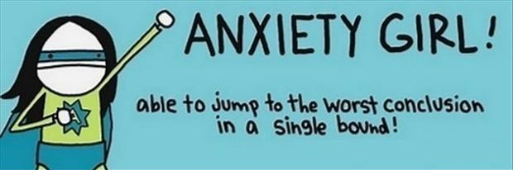
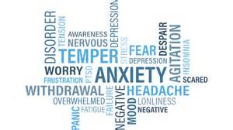
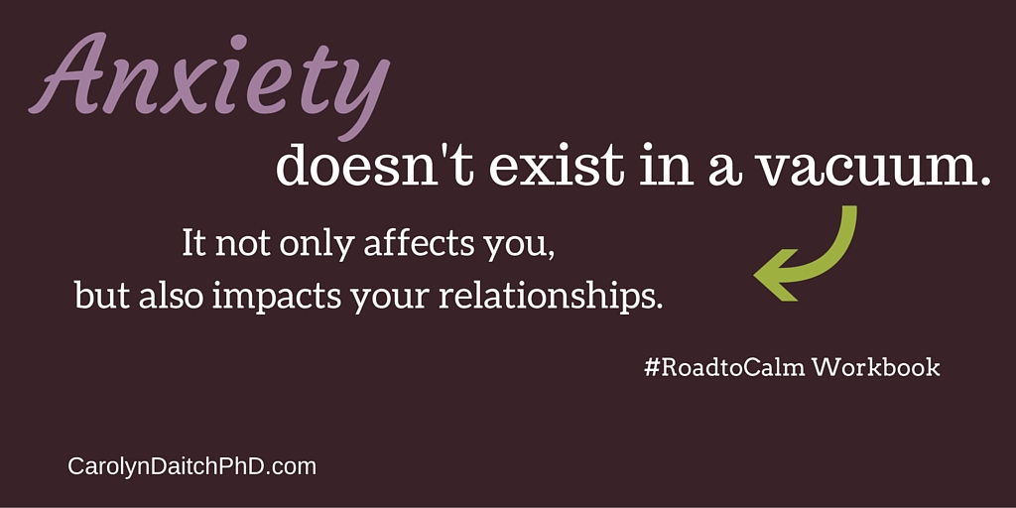
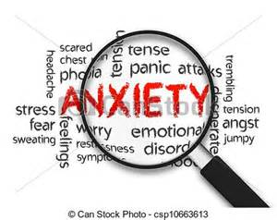

Slide 22
We live in a world that is looking for peace. Most of us are more familiar with tension, stress and anxiety than peace. Lack of peace is the result of our complex, accelerated and stressed-out world. If you can complete these sentences with the appropriate word, you need to learn what resources are offered you by the “God of Peace.” …I am ready to throw in the… (towel). …I am at the end of my…(rope). …I am just a bundle of…(nerves). …I am at my wits…(end). …I feel like resigning from the human…(race). …I am in over my…(head). How did you do? If you answered “towel,” “rope,” “nerves,” “end,” “race” and “head,” give yourself an “A.” And take a vacation. Most of us have used these phrases at one time or another in our hurried lives (4). Never forget that peace is an “inside job.”

