Slide 1
I have five siblings, three sisters and two brothers.
One night I was chatting with my Mom about how she had changed as a mother from the first child to the last.
She laughed as she told me how she had mellowed over the years:
"When your oldest sister coughed or sneezed, I called the ambulance.
When your youngest brother swallowed a dime, I just told him it was coming out of his allowance."

Slide 3
Why You Shouldn’t Give Up
When the Going Gets Tough
Edward Church
March 17, 2019

Slide 4
Life Can Never Take You…
…Where Gods Grace Cannot Sustain You
You Can RELAX in It!
Realize Nobody’s Perfect.
Psalm 119:96, “Nothing is perfect except your words” (LB)
Enjoy God’s Unconditional Love.
Let God Handle Things.
Act in Faith, not Fear.
EXchange Your Perfectionism for God’s Peace.

Slide 5
Faith May Not Stop the Problem
But It Will Bring Peace / Comfort / Help
Takes Problem Out Of Our Hand / into God’s
Fear Will Never Stop the Problem
But Extends / Compounds Problem
Depletes Peace/ Comfort / Stays In Our Hand

Slide 6
Here are 4 Good Reasons…
…Why You Should Never Think of Quitting

Slide 7
You Will Not Be Remembered for the Things You Start But Rather, for the Things You Finish.
In the Christian Race, You Are Not Rewarded Because You Finished First – You are Rewarded Because You Finished Strong.

Slide 8
Tomorrow is a Better Day
“…though weeping may endure for a night,
…joy will come in the morning” -Psa 30:5
However Bad Things May Look Today…
…Take Comfort that Tomorrow Will Be a Better Day.
It May Be Friday Now…
…But Sundays Coming
Trust in the Lord w- All Your Heart/ Lean Not On Your Own
Understanding…
…Before You Know It,
…Things Will Suddenly Start to Make Sense

Slide 9
Hope is the Raw Material for Faith
Faith Can Move Mountains, Hope Moves Faith
The Devil Will Do Anything In His Power to Make You Hopeless
Unrelenting disappointment leaves you heartsick, but a sudden good break can turn life around. Proverbs 13:12 (MSG)
As Long As You Are Still Alive, Hope Has a Chance
Hold On to Your Faith No Matter What And You Will See…

Slide 11
No Friction, No Movement
There is Positive and Negative Friction
Many are the afflictions of the righteous: but the LORD delivereth him out of them all. Psalm 34:19 (KJV) Affliction= Neg Friction
Iron sharpeneth iron; so a man sharpeneth the countenance of his friend. Prov 27:17 (KJV) Sharpen (friction)= Positive Friction
Brothers and sisters, I do not consider myself as having taken hold of this. But this one thing I do: forgetting what is behind and straining toward what is ahead, Phil 3:13 TLV =Positive Friction

Slide 12
He Will Never Leave You
Let your conversation be without covetousness; and be content with such things as ye have: for he hath said, I will never leave thee, nor forsake thee Hebrews 13:5 (KJV) Emotionally or Physically
Hebrews 13:5 (AMP) ⁵ Let your character or moral disposition be free from love of money [including greed, avarice, lust, and craving for earthly possessions] and be satisfied with your present [circumstances and with what you have]; for He [God] Himself has said, I will not in any way fail you nor give you up nor leave you without support. [I will] not, [I will] not, [I will] not in any degree leave you helpless nor forsake nor let [you] down (relax My hold on you)! [Assuredly not!]

Slide 15
Psalm 34:19 (KJV) ¹⁹ Many are the afflictions of the righteous: but the LORD delivereth him out of them all. affliction= Neg Friction
Proverbs 27:17 (KJV) ¹⁷ Iron sharpeneth iron; so a man sharpeneth the countenance of his friend. =Positive friction
Brothers and sisters, I know that I still have a long way to go. But there is one thing I do: I forget what is in the past and try as hard as I can to reach the goal before me. Phil 3:13 (ERV)= positive within

Slide 16
Even though John Stephen Akhwari did not receive the gold medal he was hoping to get, he was remembered because he was a finisher. You will not be remembered for the things you start but rather, for the things you finish. And the best part is, in the Christian race, you are not rewarded because you finished first – you are rewarded because you finished strong.

Slide 17
Mark 11:23- …if anyone says to this mountain
Matt. 17:20- …faith as grain as mustard seed, say to this mt
Proverbs 13:12 (KJV) ¹² Hope deferred maketh the heart sick: but when the desire cometh, it is a tree of life.
Proverbs 13:12 (MSG) ¹² Unrelenting disappointment leaves you heartsick, but a sudden good break can turn life around.

Slide 18
Hebrews 13:5 (KJV) ⁵ Let your conversation be without covetousness; and be content with such things as ye have: for he hath said, I will never leave thee, nor forsake thee.
Hebrews 13:5 (AMP) ^{5 …}for He [God] Himself has said, I will not in any way fail you nor give you up nor leave you without support. [I will] not, [I will] not, [I will] not in any degree leave you helpless nor forsake nor let [you] down (relax My hold on you)! [Assuredly not!]
Hebrews 13:5-6 (MSG) ⁵ Don't be obsessed with getting more material things. Be relaxed with what you have. Since God assured us, "I'll never let you down, never walk off and leave you," ⁶ we can boldly quote, God is there, ready to help; I'm fearless no matter what. Who or what can get to me?

Slide 19
2 Corinthians 4:16-17
Therefore we do not lose heart, but though our outer man is decaying, yet our inner man is being renewed day by day. For momentary, light affliction is producing for us an eternal weight of glory far beyond all comparison,
1 Corinthians 16:13 Verse Concepts
Be on the alert, stand firm in the faith, act like men, be strong.
2 Chronicles 15:7 Verse Concepts
"But you, be strong and do not lose courage, for there is reward for your work."
Psalm 55:22 Verse Concepts
Cast your burden upon the LORD and He will sustain you; He will never allow the righteous to be shaken.

Slide 21
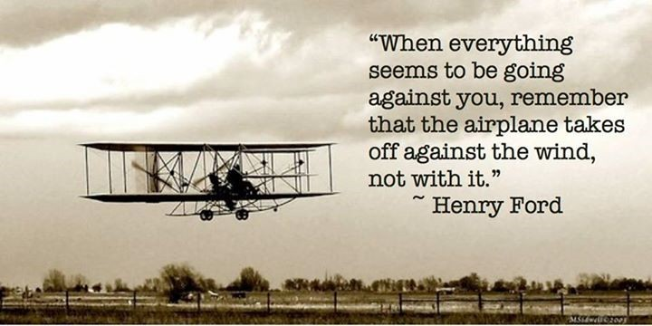

Slide 22
Why You Shouldn’t Give Up When the Going Gets Tough

Slide 26
Life can never take you
Where Gods Grace Cannot Sustain you
You can RELAX in it!
R-
E-
L-
A-
X-
Faith
Fear

