Slide 2
When the Bottom Drops Out -pt1
Edward Christian Church
July 28, 2019
Matthew 14:22-33
“Assurances We Can Count On”

Slide 3
Storms= Violent Disturbance in Atmosphere…
Causing Damage to Any Thing/ One in it’s Path
Classified=Physical, Mental, Emotional, Spiritual
Origin…
1- Satan ..Purpose to “Destroy”
John 10a …Thief cometh…steal, kill, destroy
2- God ..Purpose to “Build Up”
John 10b …But I AM Come..life..more abound..
Always in Control -Great God Jehovah
Always a Lesson - Search the Purpose

Slide 4
Matthew 14
This Passage Speaks of Unstable Times…
Vision = Obscure
Footing = Unsure
Security = Insecure
Ship -“Collective”
Peter -“Individual”
The Bottom had Dropped Out …
…2 Storms that Day at Same Time
Circumstances on Outside
Disrupted Peace on Inside

Slide 5
Matthew 14
In These Times…
It is Useless to…
…Focus on the Unsure Things
Brings Fear, Frustration, No Hope
It is Useful to…
…Focus on the Sure Things
Calms Fear, Frustration, Brings Hope
There Were 5 Things…
…that Were Sure Things
Let Us Focus on Them

Slide 6
Five Assurances in Our Storms
#1- The Lord Brought Them There (22)
“Immediately Jesus made the disciples get into the boat and go on ahead of him to the other side, while he dismissed the crowd.”
No Accident, No Blind Move
The Timing of the Storm Jesus knew:
Opportunity was Present
Storm was About to Strike
It was Test Time after the Lesson

Slide 7
The Storms of Life Reveal…
God’s Great Love for Us!
He Knows that Some Things Can Only…
…Be Learned in the Storm!!!
During These Seasons...
Remember…
James 1:12 (KJV) ¹² Blessed is the man that endureth temptation: for when he is tried, he shall receive the crown of life, which the Lord hath promised to them that love him.

Slide 8
Six Purposes for Storms in Our Life:
Cleansing - gets our attention
67Before I was afflicted I went astray, But now I keep Your word…71It is good for me that I have been afflicted, That I may learn Your statutes.
Companionship -intimate relationship
1Be merciful to me, O God, be merciful to me! For my soul trusts in You; And in the shadow of Your wings I will make my refuge, Until these calamities have passed by. -Psa 57:1
Conformity - conforming our image
Rom 8:29- For whom He foreknew, He also predestined to be conformed to the image of His Son, that He might be the firstborn among many brethren.

Slide 9
Six Purposes for Storms in Our Life:
Comfort - God doesn’t always just do something
IN us, but often He does something THROUGH us.
if you want to be a Blessing to others, you have to be Broken. A vessel that's unbroken has very limited use. 2 Cor 1:3-4
Convictions – Pain Solidifies your Conviction that God is Sufficient / will Take Care of you.
Change - Paul is a great Example of Change
when God got his Attention on Damascus Road.

Slide 11
Pt 2

Slide 12
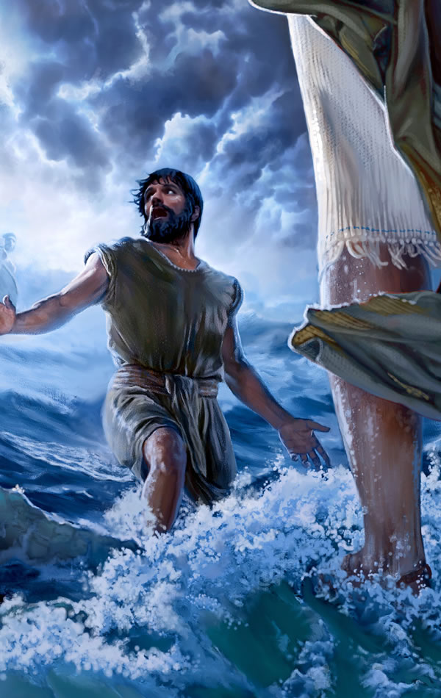
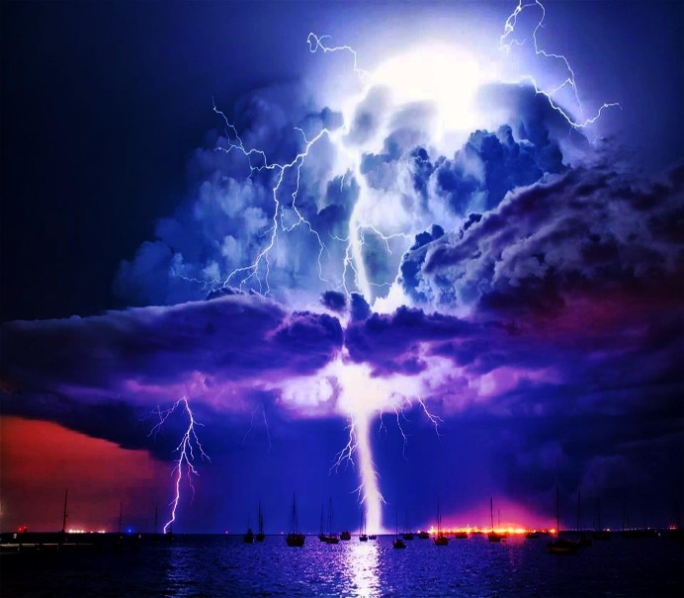
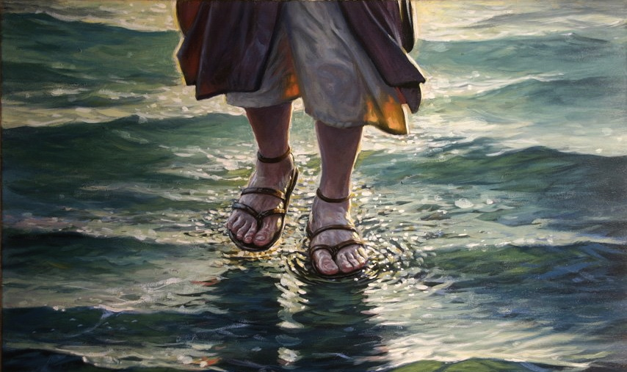
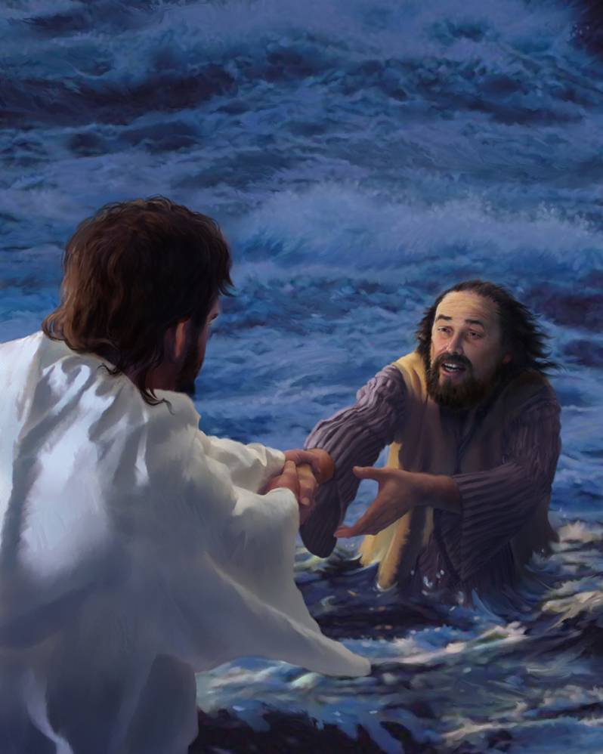
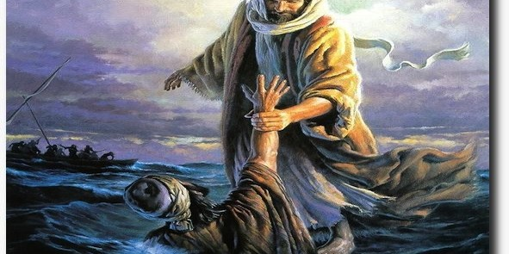

Slide 13
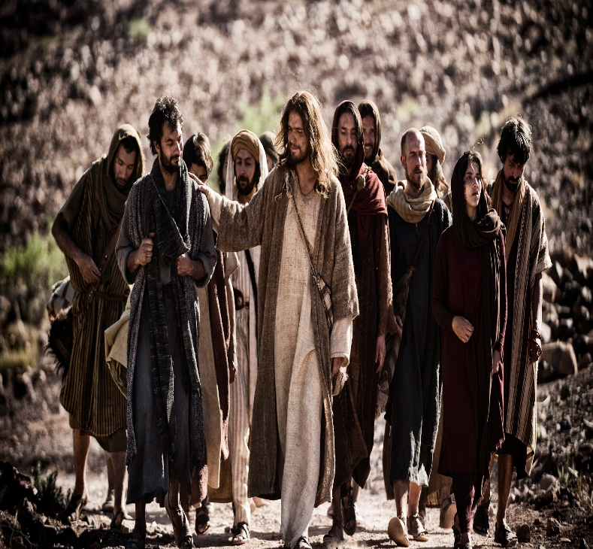
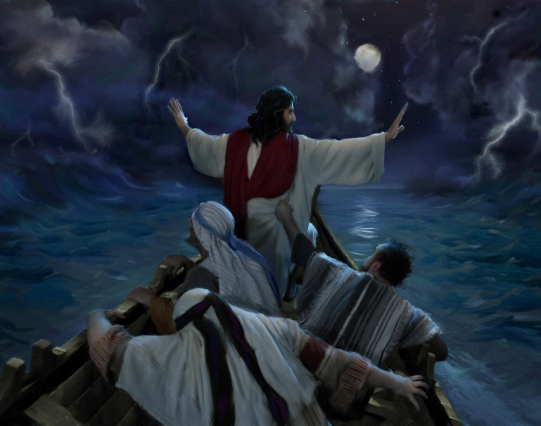
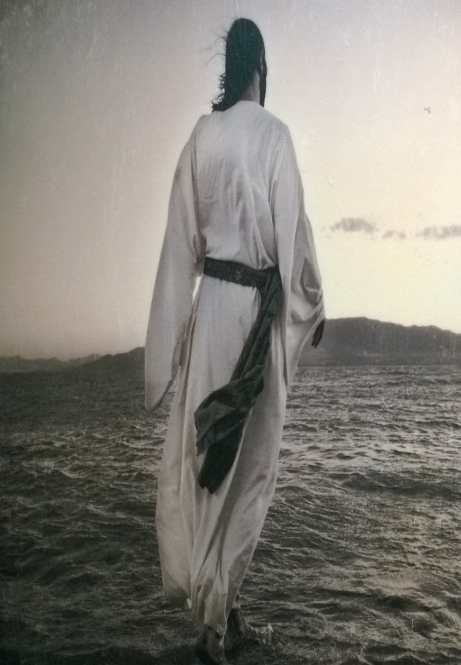

Slide 14
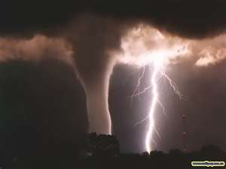
Five Assurances in Our Storms
#2- Jesus Sought God for Them…
“There Jesus Prayed For His Followers” (23)
Hebrews 4:14-16
¹⁴ Seeing then that we have a great high priest, that is passed into the heavens, Jesus the Son of God, let us hold fast our profession. ¹⁵ For we have not an high priest which cannot be touched with the feeling of our infirmities; but was in all points tempted like as we are, yet without sin.¹⁶ Let us therefore come boldly unto the throne of grace, that we may obtain mercy, and find grace to help in time of need

Slide 15
Luke 22:31-32 “Our Great Example”
We See That His Prayer Consists of:
1st - Power
that Our Faith Won’t Fail
that We Won’t Give Up/ Turn Back
2nd - Prophetic
When You are Converted -time of weakness
3rd - Protection -it will be…
Temporary ..converted
Productive ..strengthen brethren
This is Love on Its Knees.

Slide 16
Five Assurances in Our Storms
#3- Jesus Caught Them There …
“The Lord Came To His Own” (25)
He comes “JUST IN TIME”
He comes at the “DARKEST hour”
He comes “VICTORIOUS over greatest fear!”
Being swallowed up and drowning in the raging sea!
What they feared He reveals Himself victorious over!
What is Your Fear Today ?

Slide 17
Five Assurances in Our Storms
There is No Oil Without Squeezing…
No Wine Without Pressing the Grapes…
No Fragrance Without Crushing the Flowers…
And No Real Joy Without Sorrow.
If You’re Going Through a Storm and…
…The Bottom Seems to be Dropping Out,
Consider that the Storm May be in…
…God’s Will For You.

Slide 18
End part 1

Slide 19
Five Assurances in Our Storms
#4- Jesus Taught Them There…
“Jesus Helps Us Grow Through Trials” In verses 29 and 30 we read, “Come,” he said. Then Peter got down out of the boat, walked on the water and came toward Jesus. But when he saw the wind, he was afraid and, beginning to sink, cried out, “Lord, save me!” This is a picture of divine love and power meeting human need. Anyone can sit in a boat and watch, but it takes a person of real faith to leave the boat and walk on water.

Slide 20
Water Walking
What are Water Walkers?
Those Who Attempt the Impossible for God
Has Little to Do w- Circumstance
Has A lot to Do w- Attitude
Water Walkers are:
Focused on the Word
Challenged by the Word
Move Upon the Word
Here are Four Principles for Water-walkers:
1- Don’t listen to the people in the boat (nay-sayers)
2- Don’t look at the waves (circumstances)
3- Don’t look down at your feet (self)
4- Keep your eyes on Jesus!

Slide 21
Water Walking
What are Water Walkers?
What Happens Only as You Get Out of the Boat: 1. Your Faith is Exercised a. It took faith for Peter to make the first step out of the boat. b. Peter saw this as an opportunity rather than an obstacle. Initially he saw Jesus rather than the storm. 2. Your Faith is Examined a. Jesus said, “You of little faith,” not “You of no faith.” b. Peter’s faith wavered, but did not cease 3. Your Faith is Enhanced a. He didn’t lose faith in himself, but instead faith in Jesus. He realized the true source of his faith. b. Through this momentary failure Peter’s faith was challenged and enhanced.

Slide 22
Five Assurances in Our Storms
#5- Jesus Halted The Storm There…
“Jesus Will Eventually Bring Peace” Verses 31-33: “Immediately Jesus reached out his hand and caught him. You of little faith, he said. Why did you doubt? And when they climbed into the boat, the wind died down. Then those who were in the boat worshipped him, saying, Truly you are the Son of God.” Notice the progression of events here: • Jesus caught the sinking Peter • They walked to the boat together • Jesus climbed into their boat and with Him came the calm they were looking for • Little wonder that they worshipped Him
Jesus Halted Two Storms that Day
W-Out –the Weather
W-In –the Disciples

Slide 23
Four Truths about Bottom Dropping Out
Often occurs after we have experienced other victories. Peter’s sinking occurred on the heels of Jesus feeding of the 5,000. Peter witnessed a miracle, with the feeding. That miracle did not sustain him. He needed another. He needed a touch from Jesus.
can Occur Even if the person who is in the center of God’s will. We sometimes assume that a person who is struggling is out of God’s will. That is not always the case. Peter and the other disciples where in the boat because Jesus instructed them to be there. Sometimes when you obey God it puts you into the midst of the storm.
strengthens our dependence on Jesus. As Peter began to sink he asked Jesus for help. That is not a bad thing. Anytime we turn to Jesus, it is a positive experience.
does not hinder future effectiveness. Sinking people are not washed up

Slide 24
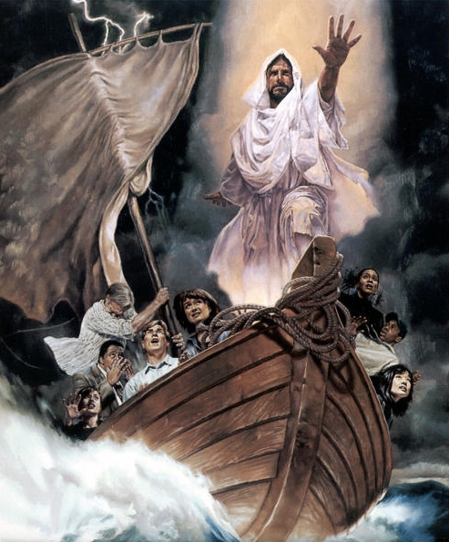
Something to Know
(God is) v1
Something to Believe
(The Lord of Hosts Is with us) v7
Something to See
(Come Behold the Works of the Lord) v8
Something to Witness
(The Exaltation of God) v10

Slide 26
Five Assurances in Our Storms
#1- The Lord Brought Them There (22)
“Immediately Jesus made the disciples get into the
boat and go on ahead of him to the other side, while
he dismissed the crowd.”
The Timing of the Storm – Jesus is…
1. Apart from the disciples (23)
Physically
Omnipresent
2. Aware of what we’re going through.
Omniscience
3. Appears in the midst of the storm
Omnipotent

Slide 27
Five Assurances in Our Storms
#1- Jesus Brought Them There (22)
Timing of the Storm
Trouble with Storms:
#1- We Cannot Predict Them…
“When”
#2- We Cannot Control Them…
“How”
#3- We Can Never Be Sure…
…of The Outcome…
“Why”

Slide 28
Bible Speaks of Three Primary Kinds of Storms from God
1-Storms of Correction -Jonah
“to awaken, to discipline, to get our attention”
Jonah 1:11
2-Storms of Perfection -Jesus/ Paul
“build character/deepen our faith/ make us more
sensitive to the suffering of others”
Heb 4:15-16
3-Storms of Reproduction –Jesus /Paul/ Job
“cause others to imitate our response to suffering or to choose our Christ”
I Pet 2:21, 4:1

Slide 29
The Storms of Life Reveal…
The Nature of My Faith.
“Do I Really Trust Him?”
The Strength of My Commitment.
“What Does it Take to Stop Me?”
The Level of My Maturity.
“How Do I Handle the Pressure? … Others?”
The Healthiness of My Attitude.
“Does the Heat Make me Hard to be Around?”
The Measure of My Teachability.
“Do I Look for Lessons in My Storm?”

Slide 30
Six Purposes for God Allowing Storms in Our life:
1. Cleansing - to get our attention Psalm 119:67, 71
2. Companionship - God desires that we walk in an intimate relationship with Him. We must be reading His Word, listening to Him; talking to Him and seeking His mind and heart to find His will for our life. Psalm 57:1-3 Psalm 63:6-8
3. Conformity - conforming us to the likeness of His Son
4. Comfort - God does not always want to just do something IN us, but often His ultimate goal is to do something THROUGH us. But if you want to be a blessing to others, you have to be broken. A vessel that's unbroken has very limited use. 2 Corinthians 1:3-4
As we go through storms, He's preparing us to be a blessing to others who go through similar difficulties. We must come to the place where we can say "Not my will but Thy will be done." When God breaks your heart He makes you useful but He also props open the door of your heart. You become very sensitive to people around you who are hurting. You don't even have to open the door when encounter one who is hurting…it automatically opens and you become a walking valuable vessel and tool in the hand of God. The deeper the valley, the darker the storm and the more intense the pain, the greater the preparation of your heart to be a blessing to other people.
5. Convictions - pain and suffering solidifies your conviction that God is sufficient, He is with you and He will take care of you.
6. Change - Paul is a great example of one who changed when God got his attention on the Damascus Road. God had tried once before to get his attention at the stoning of Stephen, but it took three days of total blindness and helplessness for change to occur.
The intensity of the storm and the length and depth of the valley can be determined by God based on our rebellion and indifference. But also the depth of brokenness required can be equaled to the degree of usefulness God sees in His purpose for us.

Slide 31
Luke 22:31-32
We See That His Prayer Consists of:
1- that Our Faith Won’t Fail,
2- that We Won’t Give Up,
3- that We Won’t Turn Back.
4- if we Do –it will be
Temporary
Productive
This is Love on Its Knees.
We dare not stop; we cannot quit!

Slide 32
Five Assurances in Our Storms
#3- Jesus Caught Them There …
“The Lord Came To His Own” Verses 24-27 tell us much about the presence of God: “But the boat was already a considerable distance from land, buffeted by the waves because the winds were against it. During the fourth watch of the night, Jesus went out to them, walking on the lake. When the disciples saw him walking on the lake, they were terrified. ‘It’s a ghost,’ they said, and cried out in fear. But Jesus immediately said to them: ‘Take courage! It is I. Don’t be afraid.’” You have to admire these disciples. They could have turned around and headed back to shore. They had been out there for nine hours. They were tired, wet, and cold—just trying to hang on. Its midnight and still no Jesus. Suddenly they see Him—walking, instead of riding. At first they don’t recognize Him. Why not? Perhaps they are too busy complaining or fighting the storm in their own strength. Could it be that they are just not looking for Him? This gives rise to a most important truth: THE LORD ALWAYS COMES TO US IN OUR DARKEST HOUR. For example, someone knocks on our door with a meal; an encouraging note or card comes in the mail at just the right time; a friend telephones us saying that he’s praying for us; while in a worship service, something in the message or in a song touches us and we feel strengthened. In each case, it is Jesus coming to us.

Slide 33
Five Assurances in Our Storms
#3- Jesus Caught Them There …
“The Lord Came To His Own” A. He Comes In The Face Of Darkness - The Bible says that Jesus came to them in "the fourth watch". Sometime between 3 AM and 6 AM, during the darkest hours of the night, Jesus came walking on the water!
(Ill. You may be walking in darkness this evening and wondering where Jesus is. You may be facing some of the darkest days of your life right now. Let me remind you that our God is ever with you, Heb. 13:5! Let me remind you that even in the darkest hours of life God is still God and He is still in control of your life. 1 Kings 8:12, "Then spake Solomon, The LORD said that he would dwell in the thick darkness."; Psalm 139:11-12, "If I say, Surely the darkness shall cover me; even the night shall be light about me.Yea, the darkness hideth not from thee; but the night shineth as the day: the darkness and the light are both alike to thee." Even the darkest hours of life cannot hide you from the face of God. He is there even when you cannot see Him.)
B. He Comes In The Face Of Disaster - The disciples were in a fight for their lives. Mark 6:48 says that they were "toiling in rowing". That is, they were struggling against the storm. I get the impression that these men were afraid for their lives. When they thought all hope was gone and that they were doomed, Jesus came walking on the waves!
(Ill. There are times when we all feel like we have lost the battle with our storm, but may I remind you that just as surely as the Lord is in control of your blessings, He is also in charge of your storms? When things look the bleakest, just look around, Jesus is about to show up! Remember, He may not keep you from going into the storm, but He will keep you in the midst of the storm! Think of the 3 Hebrews, Daniel, and Noah. God did not prevent any of these from going into the storm, but He saved them all in the midst of their storm. What He did for them, He will do for you!)
C. He Comes On The Face Of The Deep - The very thing the disciples feared, the raging sea, was the very thing God used as His vehicle to come to them. What a testimony this was! He was not telling them that the storm was not fierce, He was telling them that He was greater than the storm!
(Ill. That is still His word to you this evening! Regardless of what you are facing in life, remember that Jesus is greater than that storm you may be facing. If you will be patient and wait for Him, He will show up right on time. You will see that the storm was used by the Lord to make Himself clear to you. The very thing you fear will be the vehicle He uses to show up in your life!)
(Ill. The Apostle Paul - 2 Cor. 12:1-10. God used Paul's storm, a thorn in the flesh, to show up in and on Paul's life.)
(Ill. What I am trying to tell you is this: "Do not fear the storms of Life! They have been designed by the Lord as a means of bringing Him closer to you. He planned them and they are for your good - Rom. 8:28")

