Slide 1
After careful consideration and endless debate, The Perfect Man has finally been named:
MR. POTATO HEAD
He's tan.
He's cute.
He knows the importance of accessorizing.
And if he looks at another girl, you can rearrange his face.

Slide 3
2 Samuel 23:9-10 (KJV) ⁹ And after him was Eleazar the son of Dodo the Ahohite, one of the three mighty men with David, when they defied the Philistines that were there gathered together to battle, and the men of Israel were gone away: ¹⁰ He arose, and smote the Philistines until his hand was weary, and his hand clave unto the sword: and the LORD wrought a great victory that day; and the people returned after him only to spoil.

Slide 4
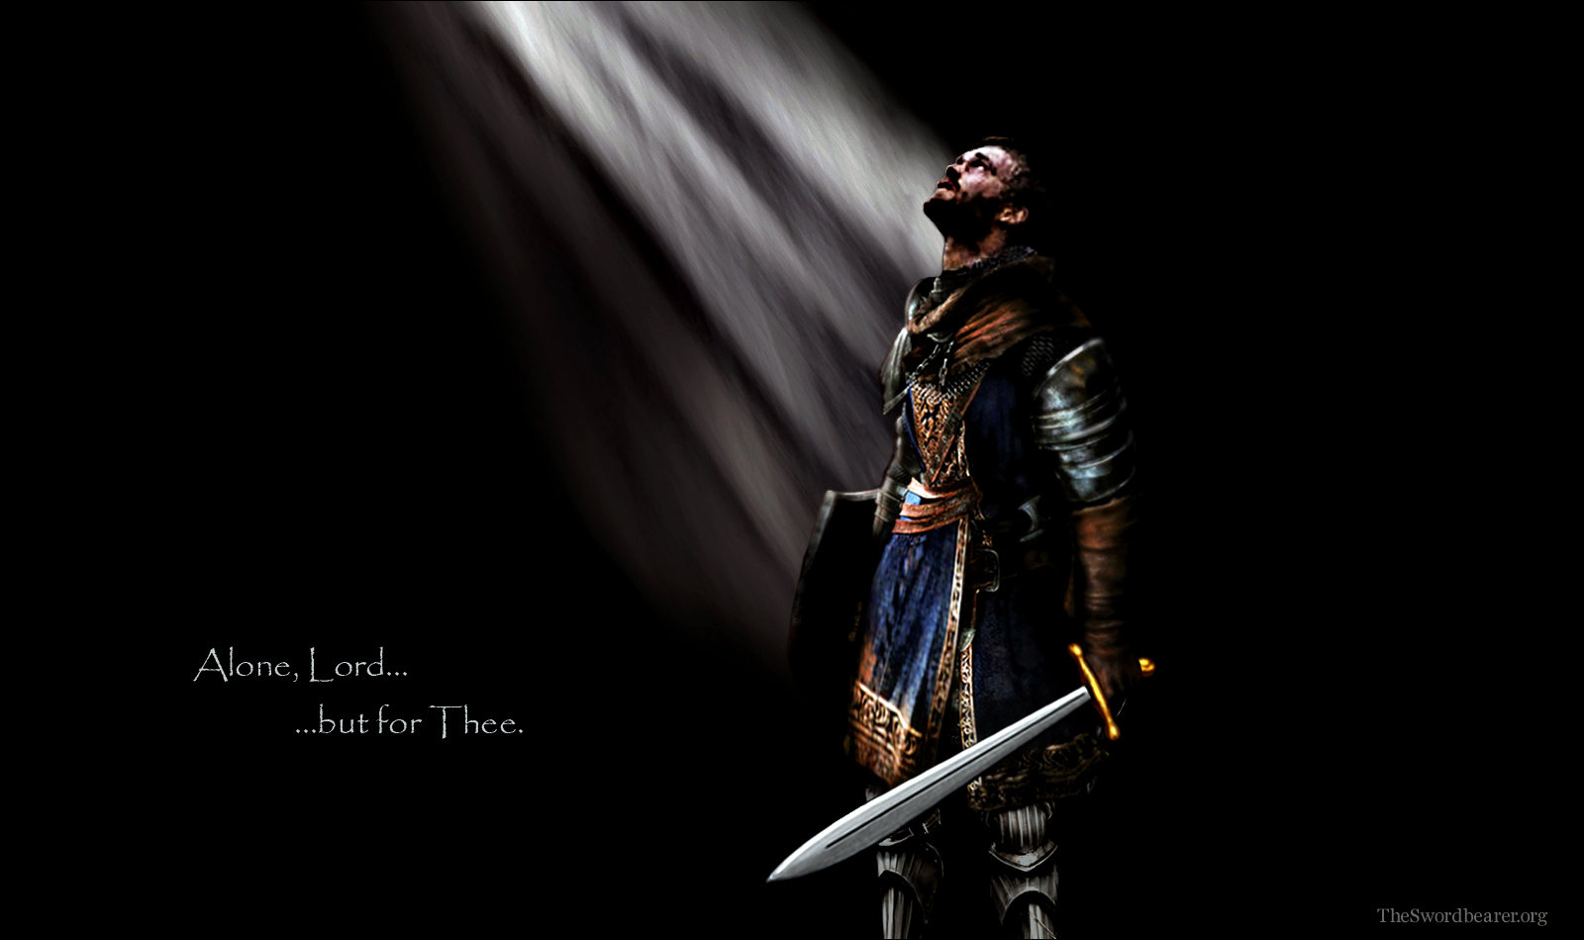
Getting a Grip…
Pt 2
II Sam 23:9-10
Edward Christian Church
July 21, 2019

Slide 5
David’s Mighty Men
They Refused To Join The Crowd
…They stood
They Refused To Be Beat By The Odds
…alone if necessary
They Refused To Sit There And Do Nothing
…and succeeded
They Saw God’s Hand
…for God gave them the Victory!!
They Stood, Alone if Necessary
…and Succeeded
…for God Gave Them the Victory

Slide 6
Eleazar's Moment
Surge of Demonic Activity
Phil. Gathered(come to bring destruction)
to Battle(to engage in actual warfare…)
Surrender
Army Gone Away(move to higher ground)

Slide 7
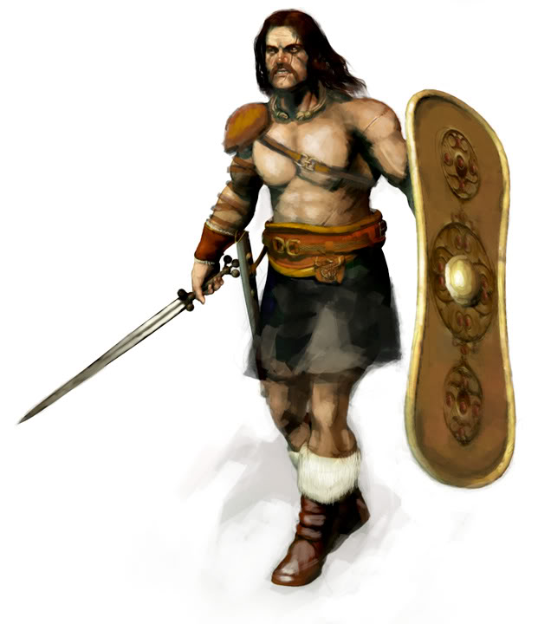
Eleazar's Moment
He Stood
Alone
And Fought

Slide 8
Eleazar's Moment
Grew Tired -“Weary”
Grew Trust - Refused to Give Up!
Jer 12:5 -if footmen wearied…
II Cor 4:16
Faint Not (quit, give up)
Renewed (intense radical renovation)
Each Step
Invited
Attack
Power
Romans 5:20

Slide 9
Eleazer
He Refused to...
Quit
Let Go
Not to Fight
How did He Accomplish So Much?
He had a Grip on…

Slide 10
His Past
He Came from Behind…
Not to Life of Excuses But…
…to Excel in Life
Among the 400 at Adullam
His Focus was Ahead Not Behind
His Past Didn’t Prevent But Propelled

Slide 11
He Had Grip on His Present
He was on a Field of
Harvest – “Lentils”
John 4:35 - Say not ye, there are yet four months, /cometh harvest? behold, .Lift up your eyes/ look on the fields; for they are white already to harvest.
Matt 9:37…the harvest truly [is] plenteous, but the labourers [are] few;
Battle – “Pasdammin”
Boundary of Blood

Slide 12
Grip on His Weapon (10)
Sure Weapon
Sword -short 2-edged- curved up -12”…
…used in hand / hand combat
Prominent in Infantry
Powerful Weapon
Eph 6:17, “Sword of the Spirit”- “machete”
Rhema Word -Word in Season …
God’s Word Applied to my Situation
Isa 50:4,“word in season to weary..”
…Power of Hope and Guidance

Slide 13
Grip on His Weapon (10)
His Grasp was Made Firmer…
…by the Conflict
Heb 10:35, “Cast not away therefore your
confidence, which hath great recompence of
reward.”
Psa 78:9, “children of Ephraim, being armed, /
carrying bows, turned back in the day of battle.”
Eph 6:13-14,“having done all to stand (exhaust
self)….stand(hold ground)

Slide 14
Grip on His Weapon (10)
His Refusal to Let Go “Grip”…
…Made his Sword Cleave to him!
Principles
#1 -Whatever we Cling to Shapes our Grasp
#2 -When we Cling to the Right Thing…
…It Will Get us Beyond the Bad Things
#3 -the Word is the Right Thing… it has
Unique Staying Power…it Clings Back!
Luke 21:33, “Heaven and earth shall pass away: but my words shall not pass away”

Slide 15
His Weapon

Slide 16
End Part 2

Slide 17
2 Samuel 23:9-10 (MSG) ⁹ Eleazar son of Dodai the Ahohite was the next of the elite Three. He was with David when the Philistines poked fun at them at Pas Dammim. When the Philistines drew up for battle, Israel retreated. ¹⁰ But Eleazar stood his ground and killed Philistines right and left until he was exhausted—but he never let go of his sword! A big win for GOD that day. The army then rejoined Eleazar, but all there was left to do was the clean-up.

Slide 18
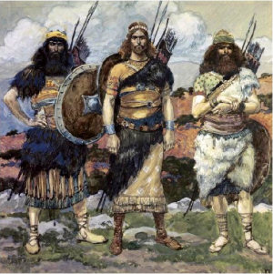
1 Chronicles 11:12-14 (KJV) ¹² And after him was Eleazar the son of Dodo, the Ahohite, who was one of the three mighties. ¹³ He was with David at Pasdammim, and there the Philistines were gathered together to battle, where was a parcel of ground full of barley; and the people fled from before the Philistines. ¹⁴ And they set themselves in the midst of that parcel, and delivered it, and slew the Philistines; and the LORD saved them by a great deliverance.

Slide 20
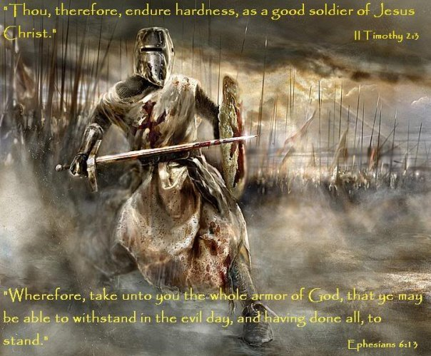

Slide 21
His Present -v9
#3- His Courage -look @ situation
a- the Surge of Demonic Activity
Phil. gathered(come to bring destruction)
to battle(to engage in actual warfare…
…not just talk)
b- the Surrender
Army gone away(move to higher ground)

Slide 22
His Present -v9
a- the Surge of Demonic Activity
b- the Surrender of God’s People
c- the Stamina of God’s Man
The Intent
-Defied (to expose…to bring down)
The Extent
-Arose (to arise w/ purpose –again -estab)
-Smote (go forward -to strike severely)

Slide 23
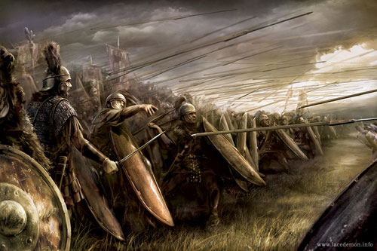
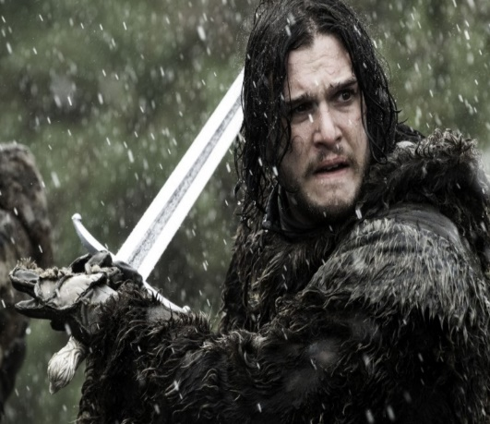
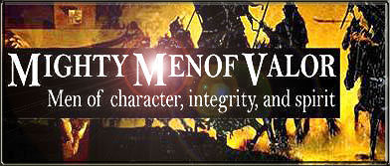
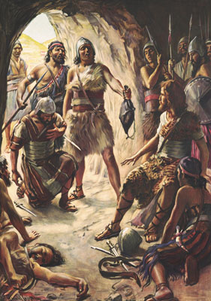
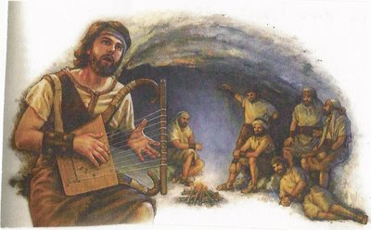

Slide 24
Eleazar's Moment
Surge of Demonic Activity
Surrender of God’s People gideon moment
Stamina of God’s Man
Intent
Defied (to expose…to bring down)
Extent
Arose (to arise w/ purpose -again -est)
Smote (go forward -to strike severely)

Slide 25
His Present (9)
His Name
Eleazar (God is Helper)
El “Almighty” + “to surround”
Dodo (burning love-passion)
son of (builder -to carry on)
His Position
2nd of David’s Mightiest
Tribe of Benjamin…
…Most Warlike Tribe

Slide 26
Hebrews 10:35 (KJV) ³⁵ Cast not away therefore your confidence, which hath great recompence of reward.

Slide 27
Hebrews 10:35 (KJV) ³⁵ Cast not away therefore your confidence, which hath great recompence of reward.

Slide 28
Eleazar's Moment
look @ situation his time..stand in gap/watch God move or refuse to stand /watch satan win
the Surge of Demonic Activity
Phil. gathered(come to bring destruction)
to battle(to engage in actual warfare…)
the Surrender
Army gone away(move to higher ground)

Slide 29
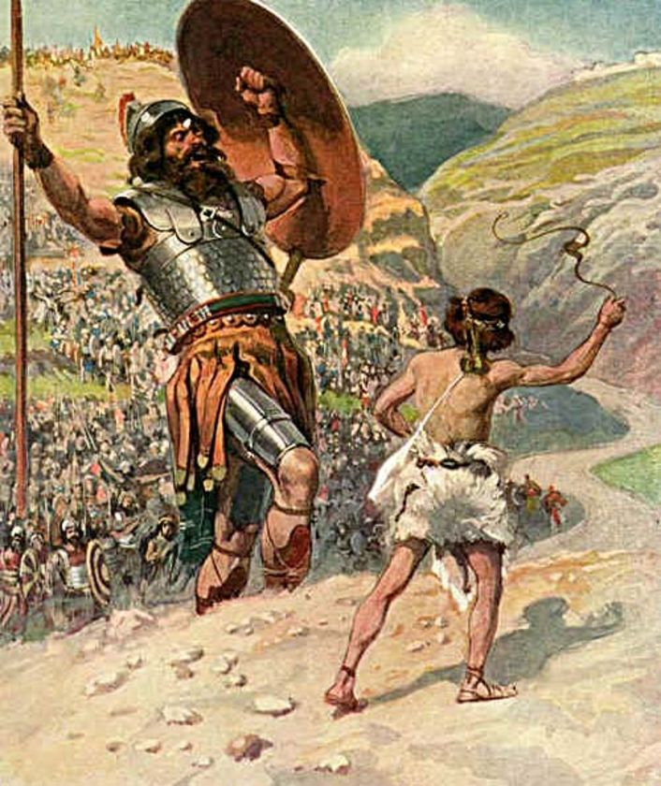
His Example
Had a Great Example "David”
Not Afraid of Challenge
Put It All On The Line...
Gave It All to God
Gave It All He Had

Slide 30
Example
1st- You Follow Example
David- “ran toward giant”
Saul- “ran from giant”
2nd- You Become an Example
Stood Ground
Refused to Quit

