Slide 2
August 18, 2019
Edward Church
God Never Wastes Our Pain

Slide 3
Pain
Unwanted
Unavoidable
Our Pain
Never Unnoticed
By God
By Man
Pain
Common
Continual
Change

Slide 4
God Designed Pain to Produce Scars…
In Heaven
…the Only Thing Man Made
…Are The Scars On Jesus
Placed There By Man..
…For Man
God
Allowed This..
Ordered This
Only Way To Fulfill His Plan
God
Never Wastes
Our
Pain

Slide 5
It Had Been Three Days Since…
…The Devastating Events
Arrest
Trial
Scourging
Crucifixion of Jesus
…at Each Place Scars were Placed on Jesus
They Saw His Lifeless Body…
taken down from the cross
buried in a tomb
On the Third Day They Would Discover…

Slide 6
On the Third Day…
They Discovered Jesus Had…
Risen
Glorified Body
ALL Things New
…Except - He Still Had the Scars
Why?
Those Scars Had…
Purpose
Power
Priority

Slide 7
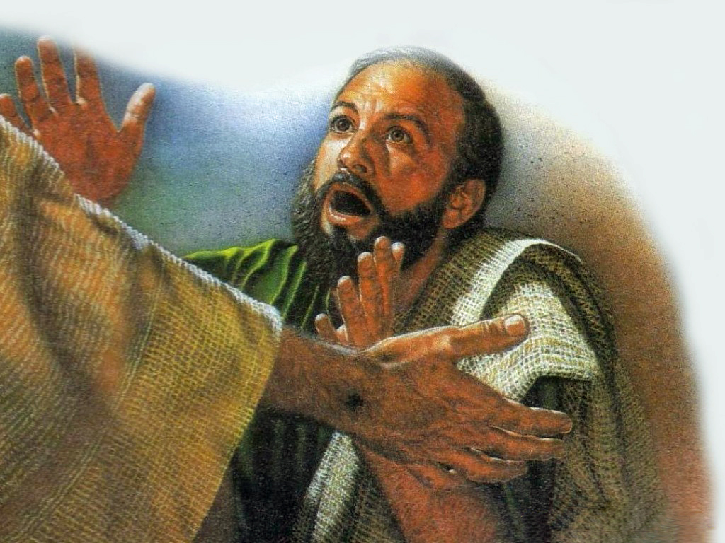
Indicates Identity…
…Purpose
Indicated It Was Truly Jesus
….Hands- Feet- Side
Showed He Went Through Something
…Not a Joke, Dream, Game -Real Death
Thomas- “Unless I see the Scars”
When He Did –
He Cried “My Lord and My God!”
Same With Us –
Show That We Have Been Thru BUT…
…God was With Us!

Slide 8
Indicates Point of Injury…
…Power
Point of Injury
Reminder of Pain
Proof You Have Been Through Something…
…But It Didn’t Stop You

Slide 9
Indicates Point of Healing…
…Priority
…He Never Takes Your Pain Lightly
He’s Been There…
First…
…He Survived -He Arose!
For Us…
…We Can Thrive
…Because He Arose..We Can Too!
For Others…
…When they see us Rise
…It Brings Them Hope!

Slide 10
Because He Lives…
I can Face Tomorrow!
All Fear is Gone
I Know He Holds the Future
Life is Worth the Living
Just Because He Lives

Slide 11
You May Think God Can’t Use You
…Because Of Your Scars
Remember
God Wants To Use You
…Because Of Your Scars
Scars Don’t Diminish Your Value…
…It Increases Your Value

Slide 13
God Never Wastes Our Pain

Slide 14
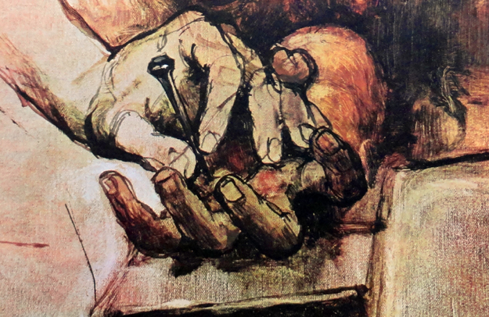
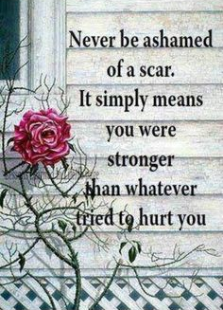

Slide 15
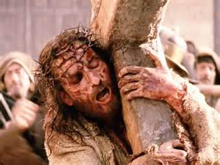
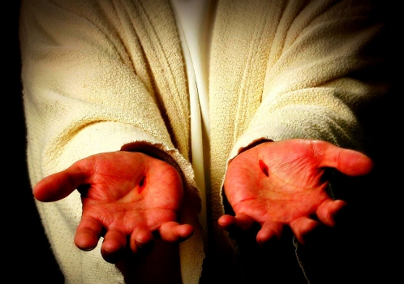

Slide 16
