Slide 1
Jokes
The math teacher saw that little Johnny wasn't paying attention in class.
She called on him and said, "Johnny! What are 2 and 4 and 28 and 44?"
Little Johnny quickly replied, "NBC, CBS, HBO and the Cartoon Network!"

Slide 3
Dealing With Difficult People
Sept 29, 2019
Edward Church
Pt 2
Philippians 2:3-4

Slide 4
How Many Know People Who… …Remind You of This?
We All Have Them…
…in Our
Past
Present
Future
Cant always Avoid…
..but Can Learn How to Handle

Slide 5
Do Make Sure You’re Not the One Being Difficult
The Problems May Have Their Origin Within Your Own Heart
If So, Fix Yourself First
Philippians 2:3-4
Let nothing be done through selfish ambition or conceit, but in lowliness of mind let each esteem others better than himself. 4Let each of you look out not only for his own interests, but also for the interests of others.

Slide 6
Don’t Try to Change the Other Person
People Change When THEY Want To…
…Not When YOU Want Them To.
We Don’t Don’t How to Break Them…
…Where to Break Them
…Or How Much
…This is God’s Job
"For it is God which worketh in you both to will and to do of His good pleasure" -Philippians 2:13
Consider This:
They May Be God’s Sand Paper
God Could Be Changing You

Slide 7
Don’t Lecture
Lectures Can Turn Into Nagging; Building Walls Instead of Bridges
Since Nagging Usually Creates More Problems Than It Solves…
…Save Your Breath.
Prov 15:1, A soft answer turns away wrath, But a harsh word stirs up anger.
Prov 21:9, Better to dwell in a corner of a housetop, Than in a house shared with a contentious woman (or man)

Slide 8
Do Not Protect Them from Consequences
When You Protect Other People From Their Consequences…
You’re Doing Them A Disservice
Your Becoming An Enabler.
Most People Don’t Learn New Behaviors Until…
…The Old Behaviors Stop Working,
Hebrews 12:5, 6-
5And you have forgotten the exhortation which speaks to you as to sons: “My son, do not despise the chastening of the LORD, Nor be discouraged when you are rebuked by Him; 6For whom the LORD loves He chastens, And scourges every son whom He receives.”

Slide 9
Don’t Allow Yourself to Become Caught Up in the Other Person’s Emotional Outbursts
If Someone is Ranting, or Worse, You Have the Right to Get Up/ Leave.
Remember:
Emotions are Highly Contagious, You Could Become Angry, Too.
Make the Conscious Effort to Remain Calm (Proverbs 22:24, 25)
24Make no friendship with an angry man, And with a furious man do not go, 25Lest you learn his ways And set a snare for your soul.

Slide 10
Do Stand Up for Yourself
If You’re Being Mistreated…
Physically
Emotionally
It’s time to start taking care of yourself.
It doesn’t require an angry outburst
But in a calm, mature, resolute manner.
For He Himself has said, “I will never leave you nor forsake you.” 6So we may boldly say: “The LORD is my helper; I will not fear. What can man do to me?” -Heb 13:5

Slide 11
Do Forgive
If You Can’t Forgive Those Who Have Hurt You,
You’re Hurting Yourself More Than You’re Hurting Anyone Else.
Forgiveness Should Not Be Confused With Enabling
After You’ve Forgiven The Difficult Person In Your Life…
…You Are Not Compelled To Accept Continued Mistreatment
14“ For if you forgive men their trespasses, your heavenly Father will also forgive you. 15“ But if you do not forgive men their trespasses, neither will your Father forgive your trespasses. –Matt 6:14-15

Slide 12
Do Learn to Laugh in the Difficult Times
Life Has a Lighter Side—look For It…
…Especially When Times are Tough.
Laughter is medicine for the soul, so take your medicine early and often. (Proverbs 17:22)

Slide 13
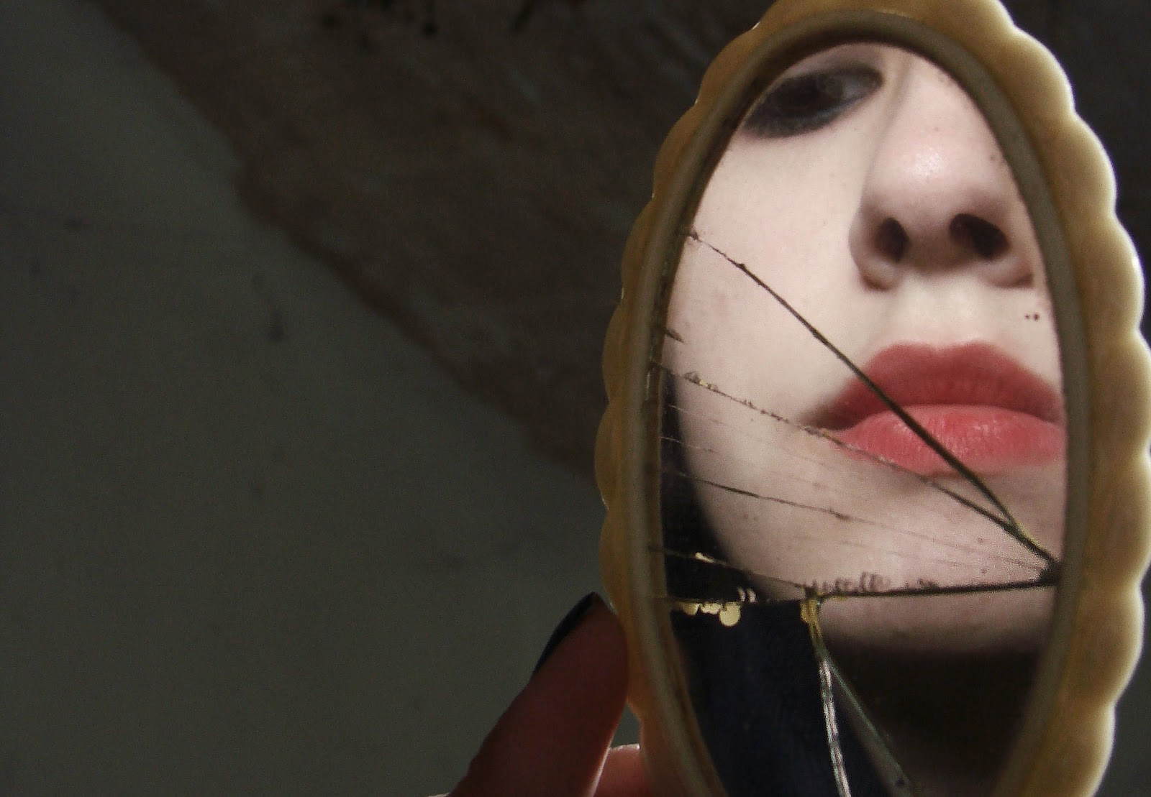
Do Accept Personal Responsibility…
Make Your Own Corner of the World Peaceful, Productive, Purposeful
If Your World Is a Little Crazy…
…Perhaps It’s Time to Consult Who You See in the Mirror.

Slide 14
W- God’s Help, You Can Discover a Peace that Passes Understanding

Slide 17
All of us Can Be Grumpy & Difficult to Deal With
From Time to Time We Will…
…Encounter Folks Who Behave in the Same Way, or Worse
When You to Deal With Difficult People (And You Will)…
…The Following Tips Should Help:

Slide 19
A keen sense of humor helps us to
overlook the unbecoming,
understand the unconventional,
tolerate the unpleasant,
overcome the unexpected, and
outlast the unbearable.
BILLY GRAHAM

Slide 20
