Slide 2
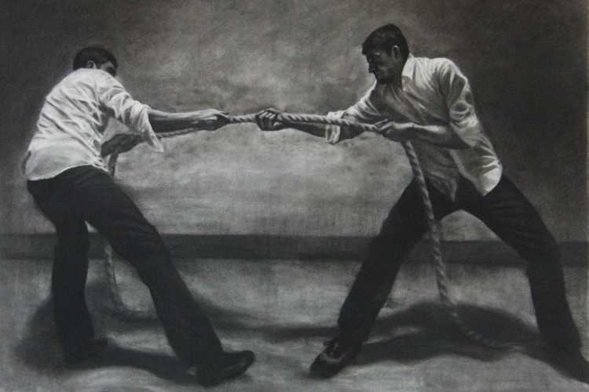
Edward Christian Church
Numbers 13:23-30
Dealing with Life’s Struggles
October 13 , 2019

Slide 3
The Struggle Principle
The Christian Life Requires Us to…
…Walk by Faith Not by Sight (2 Cor 5:7)
Move Beyond Our:
Feelings
Limitations
Prepare for Battle:
Major Events (Expected)
Everyday Struggles (Unexpected)

Slide 4
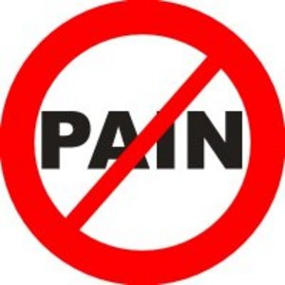
The Struggle Principle
When We Choose to Walk by Faith
Met with Resistance
Resistance = Struggle
Without Struggle…
…Faith is Hindered
We Don’t Want to…
Experience Struggle
Can’t Walk by Faith Without It

Slide 5
Faith Without Struggle is…
Weak
Puny
Ineffective
Wishful thinking

Slide 6
The Struggle Principle
Whenever God Gives Us a Promise…
He Also…
…Gives Us a Problem
…Problems Produce Struggle
Abraham
David
Faith Causes Us to Grasp the Promise…
…Problems Cause the Promise to Grab Back

Slide 7
The Struggle Principle
Has God Given You a Promise…
And Your Facing…?
Loss
Hurt
Health Problems
Remember…

Slide 8
Struggle is a Sign…
#1- There is Still Life in You!
Potential
2 Cor 4:8-10- ⁸ We are troubled on every side, yet not distressed; we are perplexed, but not in despair; ⁹ Persecuted, but not forsaken; cast down, but not destroyed; ¹⁰ Always bearing about in the body the dying of the Lord Jesus, that the life also of Jesus might be made manifest in our body.

Slide 9
Struggle is a Sign…
#1- There is Still Life in You! -Potential
#2- Satan Does Not Have You Yet
Problem
1 Cor 10:13, “There hath no temptation taken you
but such as is common to man: but
God is Faithful,
who will not suffer you to be tempted above
That ye are able; but will with the temptation also
Make a way to escape, that ye may be able to bear it”

Slide 10
Struggle is a Sign…
#1- There is Still Life in You! -Potential
#2- Satan Does Not Have You Yet -Problem
#3- God Still Has Need of You
Purpose
Ezk 37:1-14
Dry bones- No Hope –Marrow dried up
Raise up an Army !!!

Slide 11
Struggle is a Sign…
#1- There is Still Life in You! -Potential
#2- Satan Does Not Have You Yet -Problem
#3- God Still Has Need of You -Purpose
#4- God is Defending You
Power
Zech 4:6-⁶ Then he answered and spake unto me,
saying, This is the word of the LORD unto
Zerubbabel, saying, Not by might, nor by power, but
by my spirit, saith the LORD of hosts.
2 Cor 4:7 -But we have this treasure in earthen
vessels, that the excellency of the power may be of
God, and not of us.

Slide 12
Struggle is a Sign…
#1- There is Still Life in You! - Potential
#2- Satan Does Not Have You Yet - Problem
#3- God Still Has Need of You - Purpose
#4- God is Defending You – Power
#5- Break Thru is On the Way
Promise
Psalms 34:19 (KJV) Many are the afflictions of the righteous: but the
LORD delivereth him out of them all.

Slide 13
Struggle is a Sign…
Psalms 34:19 (KJV) Many are the afflictions of the righteous: but the
LORD delivereth him out of them all.
Many (abundant and Increasing)
Afflictions (stress- struggles)
Righteous (God’s Children)
Lord (Self-Existent One - Father)
Delivereth (defend, deliver, escape, × without fail, part, pluck, preserve, recover)

Slide 14
Struggle and Psalms 34:19
Delivereth (defend, deliver, escape, × without fail, part, pluck, preserve, recover)
Notice:
Promise (same)
Method (different)
God Steps Up, in Front of, Pulls You Out,
Pulls You Through
Results (same)
Romans 8:37, “Nay, in all these things we are more than conquerors through him that loved us”

Slide 16
Isa 40:29-31, “He giveth power to the faint; and to them that have no might he increaseth strength. ³⁰ Even the youths shall faint and be weary, and the young men shall utterly fall: ³¹ But they that wait upon the LORD shall renew their strength; they shall mount up with wings as eagles; they shall run, and not be weary; and they shall walk, and not faint”

Slide 18
2 Cor 4:8-10
Pressed, but not Crushed
Something Inside
“Greater is he that is in you, than he that is in the world” – 1 John 4:4
I’m Confused, But I’m Not Freaking Out
He is in Control
“And we know that God causes everything to work
together for the good of those who love God and are
called according to his purpose” – Rom 8:28 NLT

Slide 19
2 Cor 4:8-10
Pursued and Under Attack…
…Not Left Behind
“He will never leave me or Forsake me” -Heb 13:5
Never Abandon me Physically or Emotionally
I’m Knocked Down, Not Knocked Out
Fear can Knock You Down
But it Doesn’t Have to Keep You Down

Slide 20
Part 1b

