Slide 1
Two Canadian geese decided to fly south for the winter. A frog was sitting next to them as they decided this and he decided he wanted to go as well. The geese laughed and said "you're just a frog- you can't fly!" The frog knew that he didn't want to stay in the cold, so he thought and thought and thought. "I got an idea!" the frog said. He found a long stick. "You two hold this stick in your claws and I'll hold on to the middle." "With what?" the geese asked. "Your little hands could never hold on to a stick!" "With my mouth" said the frog, proud of his idea. So the geese put the stick in their claws, the frog clamped on with his mouth and they began to fly south successfully. A day or two later, a crowd of people looked up and saw the two geese flying overhead, holding a stick with a frog holding on in the middle with his mouth. Someone in the crowd exclaimed, "What a brilliant idea- I wonder who thought of that?" The frog proudly exclaimed "I did!"

Slide 3
Edward Christian Church
November 24, 2019
“The Crucified Life”
Pt2

Slide 4
Satan Desires to…
..Affect Your Thinking, Life, Relationships
In Order to…
..Infect Your Thinking, Life, Relationships

Slide 5
We Live in a…
…“What’s in it for Me” Society
This Attitude Hinders the…
…Move of God (inward)
…Work of God (outward)
Jesus Warns Against this Attitude…
…He Also Tells Us How to Get Beyond it!
Let this mind (attitude) be in you, which was also in Christ Jesus… Phil 2:5

Slide 6
The Radical Servant
At Calvary…
…It Was About Us
Now …
It’s About Jesus …
…and Building His Kingdom
Romans 12:1
I beseech you therefore, brethren, by the
mercies of God, that ye present your bodies
a living sacrifice, holy, acceptable unto God,
which is your reasonable service.

Slide 7
Paul’s Angry Letter
Paul Saw the…
…Potential Hindrance + Devastation of
…Trying to Face 2 Directions
...at the Same Time
…Peril of a Divided Heart
James 1:8, “A double minded man is
unstable in all his ways”
Destructive –Mix Faith with Fear
Distraction –Looking 2 Ways

Slide 8
Direction “Facing Only One”
Proper Look … “Focused Look”
Not Looking to the Left or Right
Luke 9:51,“set (face to danger) his face toward Jerusalem- He knew what awaited, still
Isa 50:7, “set face like flint (hard, impassive, determined, fixed. shall not be ashamed)
Josh 1:1-7 -Not Look to Right or Left

Slide 9
Decision “Not Going Back”
Mind that is Made Up
I Kings 19:21 –Elisha burned his plows
Symbolic –leaving past behind
Cannot Let Past Poison Present
Cannot Let Past Prevent Future
Every Sunday
Past is Behind Us ..
Future Ahead of Us..
God is with Us
Nothing Shall Be Impossible!!!!!

Slide 10
Decision “Not Going Back”
Mind that is Made Up
Mind that is Motivated
Action Follows a Made-up Mind
Danger of Not Following Through
Luke 9:62, “no man having put hand to plow…
and looking back …”
Decision - “any man hand to plow…”
God Did Not Force Him
Distracted -“and looking back..”
Damaged -“not Fit for Kingdom”

Slide 11
Decision “Not Going Back”
Mind that is Made Up
Mind that is Motivated
Mind that is Maintained
so Easy to Lose Heart on Eve of Breakthrough
-Isa 26:3, “..Perfect Peace ..mind stayed ..Him
Mind Stayed (lean upon for strength)
Peace Peace (complete completeness)
…Greatest Peace-inward, Outward,
…At All Times, In Any Circumstance

Slide 14
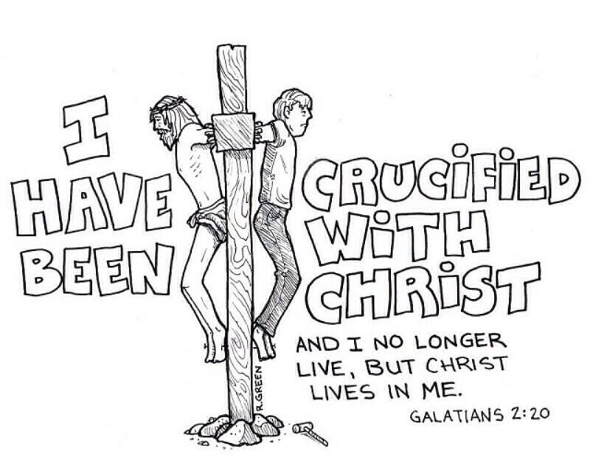
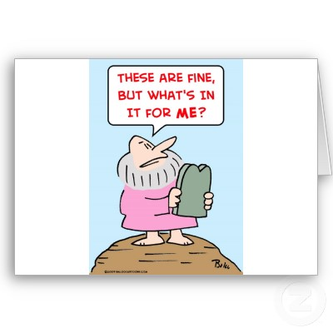
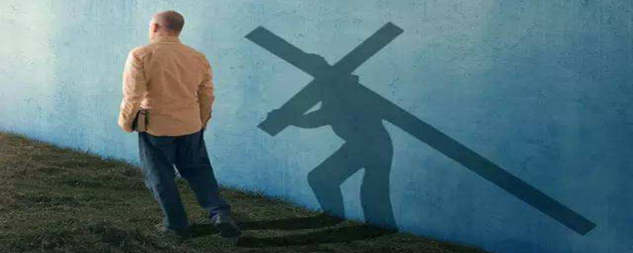

Slide 15
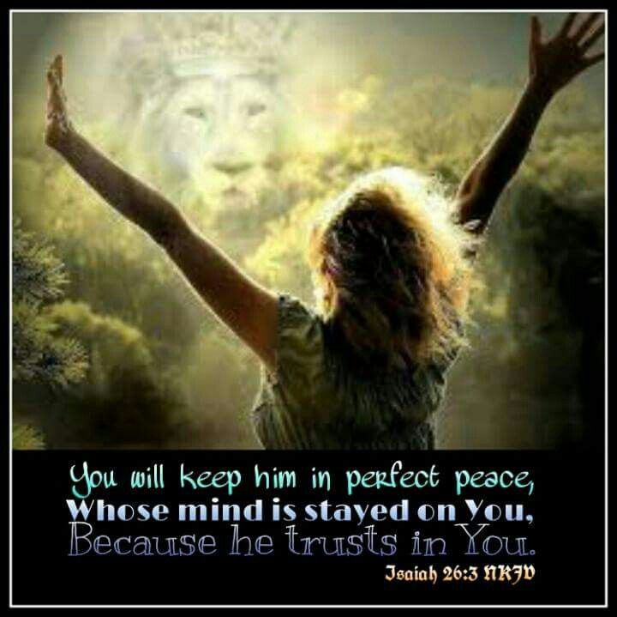
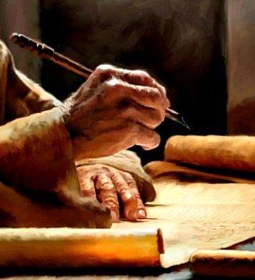

Slide 16
III. The Death “No Plans of His Own”
1- a Personal Death
a- Rom 12:1-2, “present ..bodies a living sac..”
This Type of Sacrificial Altar Represents:
Dedication “Present…”
…Climb on It
Determination “Living…”
…Stay on It
Desire “Acceptable…”
…for Right Reasons
This Type of Sacrifice Produces Growth

Slide 17
Four Levels Of Christian Growth
1st Level - “a lot of me" & “a little of You, God"
"They don’t appreciate me or recognize me."
Opinionated
Easily Offended
2nd Level - "Some of me" & "Some of You, God"
"I’ll do this for you God if you do that for me."
Discipleship is a Trade-off

Slide 18
Four Levels Of Christian Growth
1st Level - “a lot of me" & “a little of You, God“
2nd Level - "Some of me" & "Some of You, God"
3rd Level - “a little of me" & “a lot of You, God"
"I’ve just got these few areas I can’t let go of."
Growth Has Started- Still More Needed
4th Level - "None of me" & "All of You, God"
"I do all things as unto the Lord"
Maturity has Brought True “Change”
Flesh is Truly “Crucified”
Jesus is Lord / in “Control”
Peace and Power -We are His “Conduit”

Slide 19
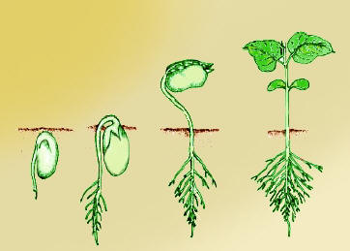
III. The Death “No Plans of His Own”
1- a Personal Death -Rom 12:1-2
2- a Productive Death –
John 12:24-25
Verily, verily, I say unto you, Except a corn of wheat
fall into the ground and die, it abideth alone: but if it
die, it bringeth forth much fruit.
²⁵ He that loveth his life shall lose it; and he that
hateth his life in this world shall keep it unto life
eternal.

Slide 20
The Mystery of the Seed
John 12:24
Verily, verily, I say unto you, Except a corn of wheat
(Seed)fall into the ground and die, it abideth alone:
A Seed is a Vessel of Potential
The Potential is Never Discovered until it Dies
but if it die, it bringeth forth much fruit.
Potential Realized
Potential Multiplied

Slide 21
John 12:24
1st- Detachment,“..fall to the ground”
1- Place of Aloneness …not loneliness
One is Productive …One Is Non Productive
One is Discipline …One Is Distress
One is Controlled …One Is Uncontrolled
One Brings Peace …One Is No Peace
God Shows His Love by…
…Allowing Detachment in Our Life

Slide 22
John 12:24
1st- Detachment,“..fall to the ground”
1- Place of Aloneness …not loneliness
God Shows His Love by…
…Allowing Detachment in our Life
He Brings Us to a Place Where We…
…Have No One Else to Blame
…Have No One Else to Depend on But Him
Here We Deal with Unhealthy Attitudes…
Self
Others
God
Doubts -Fears -Faith

Slide 23
John 12:24
1st- Detachment,“..fall to the ground”
2nd- Death,“..die..”
Here You Die to those Unhealthy Attitudes
1- Loosens Hard Outer Shell
2- Submersion Word/ Worship
3- Take Root in Word
4- Brings True Humility
5- Brings True Praise

Slide 24
John 12:24
1st- Detachment,“..fall to the ground”
2nd- Death,“..die..”
3rd- Discovery,“..fruit..”
1- Preparation
Rain (Storms)
Fertilizer (Trials)
2- Production
4th- Desolate, “abideth alone”
1- Lonely – diff than Aloneness
2- Empty

Slide 25
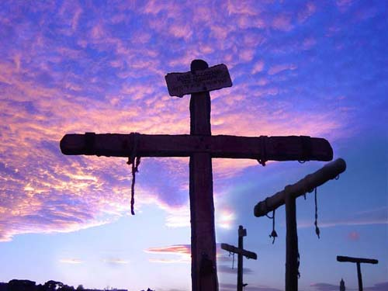
III. The Death “No Plans of His Own”
1- a Personal Death
2- a Productive Death
a- John 12:24
3- a Practiced Death –
a- I Cor 15:31, “…I die daily.”
-Paul addressing Corinth
Unhealthy Attitudes
Spiritual Pride
Spiritual Maturity

Slide 26
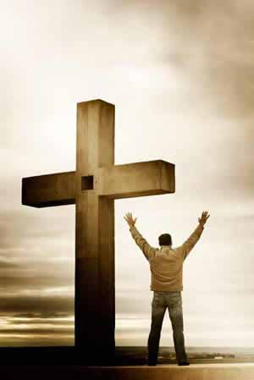
Galatians 2:20 ²⁰ I am crucified with Christ: nevertheless I live; yet not I, but Christ liveth in me: and the life which I now live in the flesh I live by the faith of the Son of God, who loved me, and gave himself for me.

Slide 28
Discovery- Development
Then the Lord sends
Rain (Storms)
Fertilizer (Trials)
Video – bring the Rain

Slide 30
Detachment
Usually in this Place
you feel anything but productive
Feel alone
(Diff in alone/ aloneness)
…one productive/ counterproductive
Painful
Deceived
Forsaken
Hard to realize that God is working a
Special Work in you
In this Secret/ dark place –
Development –roots grow down

Slide 31
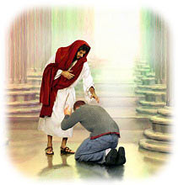
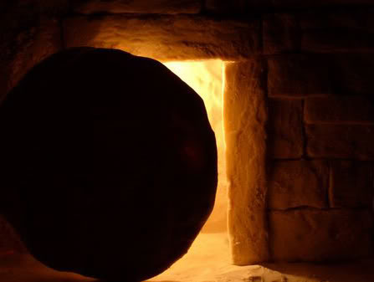
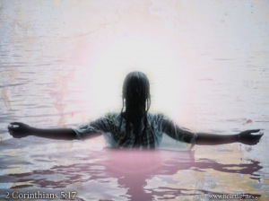
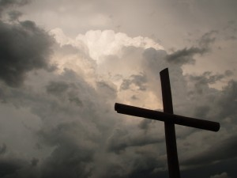
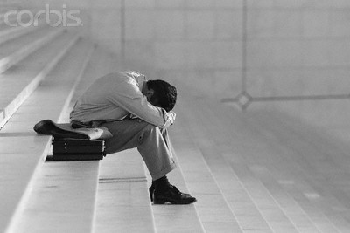
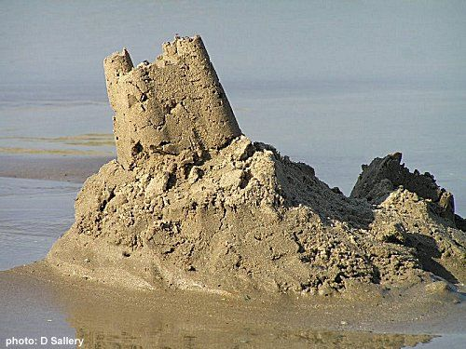
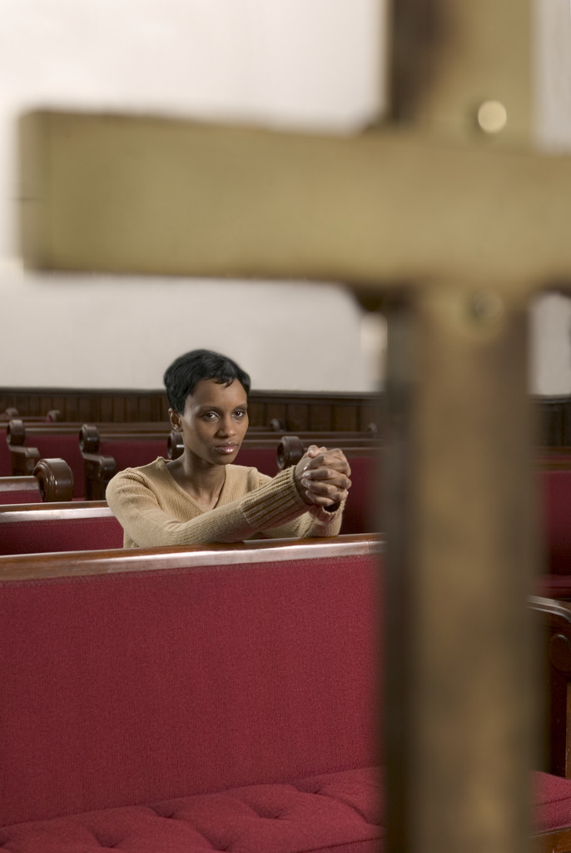
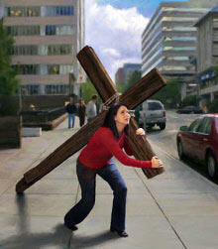
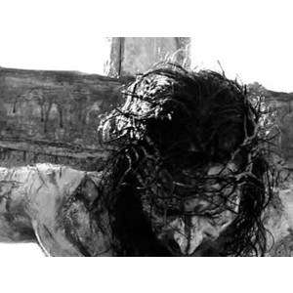

Slide 32
II. The Decision “Not Going Back”
1- a Mind that is Made Up
2- a Mind that is Motivated
3- a Mind that is Maintained
so Easy to Lose Heart on Eve of Breakthrough
-Isa 26:3, “..Perfect Peace ..mind stayed ..Him
Mind Stayed (lean upon for strength)
Peace Peace (complete completeness)
…Greatest Peace-inward, Outward,
…At All Times, All Events,

Slide 33
Discovery- Development
Then the Lord sends
Rain (Storms)
Fertilizer (Trials)
Video – bring the Rain

Slide 34
John 12:24-25 (KJV)
²⁴ Verily, verily, I say unto you, Except a
corn of wheat(seed) fall into the ground and die,
it abideth alone: but if it die, it bringeth forth
much fruit. (potential)
²⁵ He that loveth his life shall lose it; and he
that hateth his life in this world shall keep it
unto life eternal.

Slide 36
Loneliness vs. Aloneness
Aloneness
1- Controlled
2- Discipline
3- Profitable
4- Find Solace /Peace
5- Sought
Loneliness
1- Uncontrolled
2- Distress
3- Unprofitable
4- No Solace /Peace
5- Avoided

Slide 37
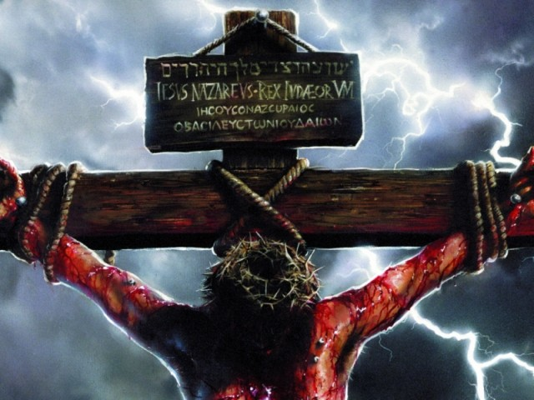
Let’s Get Radical for Jesus!!
He Got Radical for You
It’s Your Move !!!

Slide 39
Get Radical !

Slide 40
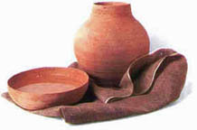
Radical Christianity
Radical-
Uncompromising, Militant, Extreme, Revolutionary, Excellent…
…Effecting all around
The World we Face Today is…
…Characterized by the Word
“Radical”
If We are to Step Beyond…
…Church as Usual
We Need to Be Radical Too!
Jesus Was!!!!

Slide 41
Distraction
How is It so Effective?
#1 –If you are Hot for God…
a- it cools you down
b- it keeps you Down
#2 –If You are cool for God
a- It Prevents you from Getting Hot
b- It Removes any incentive to

Slide 42
The Radical Servant
We Live in a…
…“What’s in it for Me” Society
This Attitude has Slowly Crept into …
…Our Churches

Slide 43
Distraction
One of Satan’s Tools
James 1 –Double-minded Man Unstable
Because He is trying to Balance the _______
Why is Distraction so Effective?
1- it is Subtle –it sneaks up
2- it is Patient –like a trap waiting to be sprung

Slide 44
Paul’s Angry Letter
He Looked at the Galatians / Saw the…
Potential Hindrance + Devastation of …
…Trying to Face 2 Directions @ the Same Time
the Unnecessary Peril of a Divided Heart
James 1:8
A double minded man is unstable in all his ways.
Destructive –Mix Faith/ Fear
Distraction –Looking 2 Ways

Slide 45
Distraction
One of Satan’s Chief Tools
Any Type of Activity that Consumes…
1- You
2- Time
3- Interest
…To the Point God Becomes a Blur

Slide 46
Distraction
One of Satan’s Chief Tools
1- it is Subtle Tool
It Sneaks Up So Soft It Is Unnoticeable
2- it is a Deceptive Tool
It Makes You Feel Effective (temporarily)
3- it is a Patient Tool
Like a Trap Waiting to Be Sprung
4- it is a Cooling Tool
Cools you Down/ Keeps you Down or
Prevents You From Ever Getting Hot

Slide 47
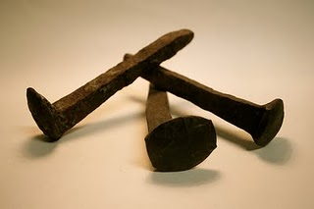
Strange Paradox
The Answer to Distraction -Gal 2:20
the Test –crucified w/ Christ
– not always an easy task
the Testimony –I live yet not I but Christ in me
the Transfer – the life I Now live..I live by faith

Slide 48
I. The Direction “Facing Only One”
1- a Proper Look … “Focused Look”
a- He’s Not Looking to the Left or Right
Luke 9:51,“set (face to danger) his face toward Jerusalem- He knew what awaited, still
Isa 50:7, “set face like flint (hard, impassive, determined, fixed. shall not be ashamed)
Josh 1:1-7 - God said Not Look to Right or Left

Slide 49
I. The Direction “Facing Only One”
1- a Proper Look – “Focus”
2- a Progressive Look –not Behind but Ahead
Phil 3:13-14- forgetting(total put out mind), reaching(to stretch), pressing(agonize),
3- a Prophetic Look –
Should Give Hope + Encouragement
Luke 21:25-28, “hearts fail..look up(opp. of world) for red. draweth nigh..”
1- rep State of Mind –Look Up -depressed
2- rep State Expectancy –draweth nigh

Slide 50
II. The Decision “Not Going Back”
1- a Mind that is Made Up
I Kings 19:21 –Elisha burned his plows
(Symbolic –Leaving Past Behind)
Cannot Let Past Poison Present
Cannot Let Past Prevent Future

Slide 51
II. The Decision “Not Going Back”
1- a Mind that is Made Up
2- a Mind that is Motivated
Action Follows a Made-up Mind
Danger of Not Following Through
Luke 9:62, “no man having put hand to plow…
and looking back …”
1- Decision - “any man hand to plow…”
God didn’t Force him
2- Distracted -“and looking back..”
3- Damaged -“not Fit for Kingdom”

Slide 52
Radical Christianity
Radical
Uncompromising, Militant, Extreme, Revolutionary, Excellent…
…Effecting all around
If We are to Step Beyond…
…Church as Usual
We Need to Be Radical !
Jesus Was!!!!

Slide 53
The Direction “Facing Only One”
1- a Proper Look … “Focused Look”
a- He’s Not Looking to the Left or Right
Luke 9:51,“set (face to danger) his face toward Jerusalem- He knew what awaited, still
Isa 50:7, “set face like flint (hard, impassive, determined, fixed. shall not be ashamed)
Josh 1:1-7 - God said Not Look to Right or Left

Slide 54
Strange Paradox
The Pathway to Selflessness
Test
crucified w/ Christ
not always an easy task
Testimony
I live yet not I but Christ in me
Transfer
the life I Now live..I live by faith

Slide 55
Direction “Facing Only One”
Proper Look “Focus”
Progressive Look “Not Behind but Ahead”
Phil 3:13-14- forgetting(total put out mind),
reaching(to stretch), pressing(agonize)
Prophetic Look
Should Give Hope + Encouragement
Luke 21:25-28, “hearts fail..look up(opp. of world) for red. Draweth
rep State of Mind –Look Up –depressed
rep State Expectancy –”Red..draweth nigh..”

Slide 56
The Decision “Not Going Back”
Mind that is Made Up
Action Follows a Made-up Mind
Mind that is Motivated
Mind that is Maintained
Don’t Give Up on the Edge …
…of BreakThru

