Slide 1
A condemned prisoner awaiting execution was granted the usual privilege of choosing the dishes he wanted to eat for his last meal. He ordered a large mess of mushrooms.
"Why all the mushrooms and nothing else?" inquired the guard.
"Well," replied the prisoner, "I always wanted to try them, but was afraid to eat them before!"

Slide 3
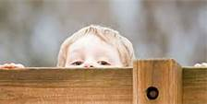
How to Get Over…
…Not Being Able to Get Over
Edward Christian Church
January 26, 2020
2 Timothy 1:6-7
Stepping Beyond a…
…Spiritual Inferiority Complex

Slide 4

Timothy was Called to Tremendous Challenge
He Felt…
      Insufficient
      Ill-Equipped
      Less Than
Paul was Experiencing His Own Troubles…Yet
Took Time to Encourage Timothy in
“His Time of Weakening Faith”
He was Experiencing a Time of…
“Spiritual Inferiority”

Slide 5
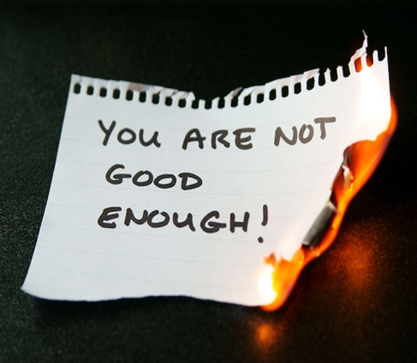
We Are All Called to Face Tremendous Challenges
It is Easy to Feel…
      Insufficient
      Ill-Equipped
      Less Than
To Experience Our Own Time of…
“Spiritual Inferiority”
We All Have the Tendency to Feel this Way...
          Moments
          Seasons

Slide 6
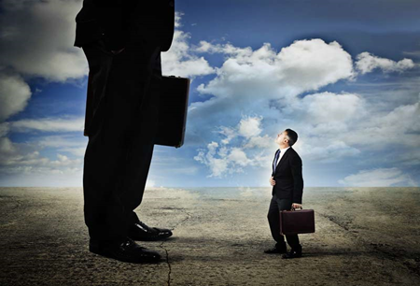
Signs of Inferiority
Insecure Relationship with…
…God
  Doubt His Word /Salvation
  Consumed by Guilt
…Self
  Doubt You Can be Loved by (God / Others)
  Doubt You Can Be Used by God
…Others
  Blame Game
  Compares Self to…
Prevents You From Being as Effective in God…
…as You Could Be

Slide 7
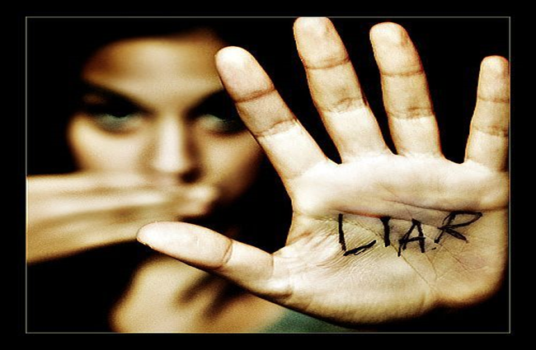
Truth about Inferiority
II Tim 1:7
Not Given Spirit of…
…Fear (timidity –spt inferiority)
But…
  Power
  Love
  Sound Mind
Inferiority is the Opposite
  Weak
  Self-Centered
  Confused

Slide 8

Truth about Inferiority
How Do I Step Beyond ?
Realize… Fear Is…
    from Satan
    Based on Lies
    a Choice
    I DO NOT have to Accept IT!
Choose…
Faith in God /
His Ability to Handle…
my Past, Present, Future
my Problems, my Giants

Slide 9

How Do I Step Beyond ?
Realize… Fear Is…
F= from Satan
E= established on Lies
A= always comes w-a Choice
R= refuse to Accept IT!
Choose…
Faith in God /
His Ability to Handle…
my Past, Present, Future
my Problems, my Giants

Slide 10
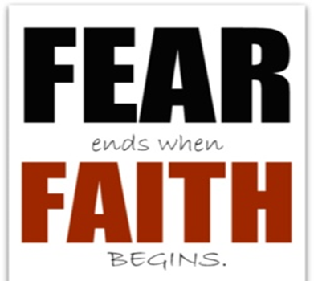
Three Step Process to
Overcoming Spiritual Inferiority
Step #1: Know the God Who You Serve
(He Knows You and Your Circumstance…
…Better than You)
Exodus 6:1-2, “Then the LORD said unto Moses, Now shalt thou see what I will do to Pharaoh: for with a strong hand shall he let them go, and w- a strong hand shall he drive them out of his land.
²And God spake unto Moses, and said unto him,
I am the LORD(Jehovah)”-Self Existent One
Hebrews 13:8, “Jesus Christ the same yesterday,
and to day, and for ever”

Slide 11
Step #2: Know Who You Are…
…in the God You Serve
(Focus on Him, not the Enemy)
Psalms 139:14, “I will praise thee; for I am fearfully /wonderfully made: marvellous are thy works / that
my soul knoweth right well.”
Rom 8:31,“If God be for us, who can be against us?”
John 3:16, “For God so loved the world, that he gave his only begotten Son,.whosoever believeth ..”
Phil 4:13, “I can do all things through Christ which strengtheneth me”

Slide 12
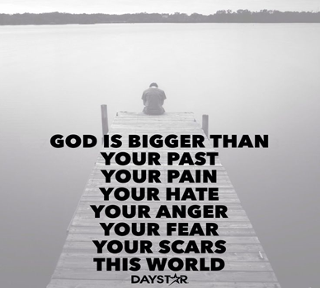
Step #3: Know the Enemy …
…of the God You Serve
(Remember He is Powerful not All-Powerful)
“Be sober, be vigilant; ..your adversary
the devil, as a roaring lion, walketh about,
seeking whom he may devour:” 1 Peter 5:8
2 Cor 2:11,“ Lest Satan should get an advantage
of us: for we are not ignorant of his devices.”
Rev 12:11, “they overcame him by the blood of the Lamb, and by the word of their testimony; and they loved not their lives unto the death”

Slide 13
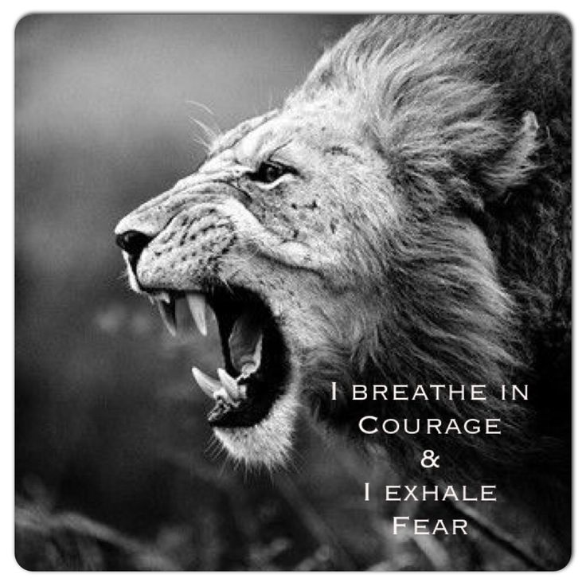
Philippians 4:13 (AMP)
¹³ I have strength for all things in Christ Who empowers me [I am ready for anything and equal to anything through Him Who infuses inner strength into me; I am self-sufficient in Christ's sufficiency].

Slide 15

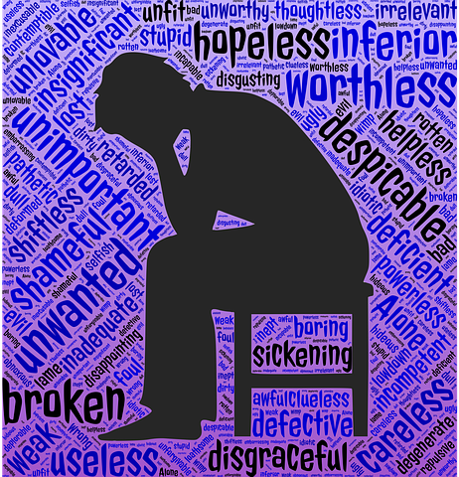
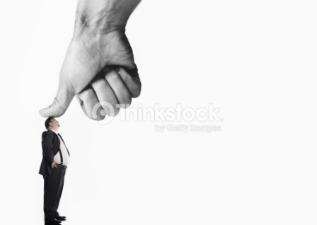
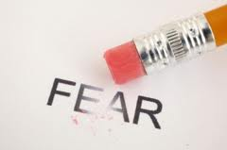

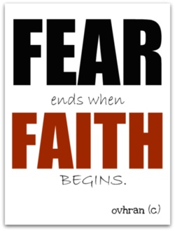
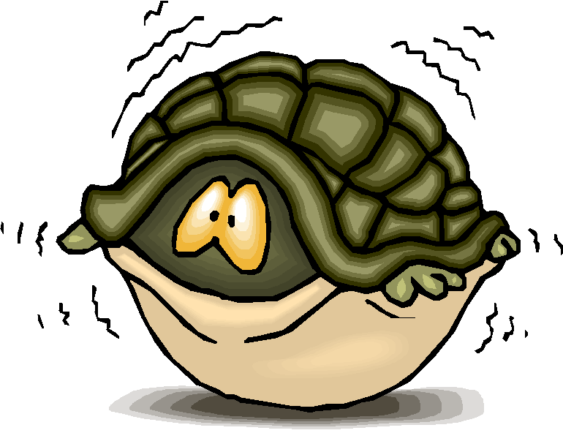


Slide 16
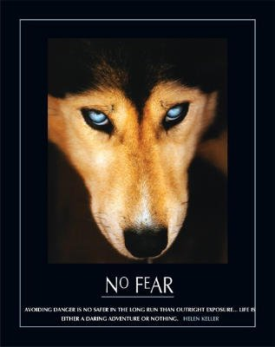

Have You Ever Felt Inadequate?

Slide 17
“I can do all things through Christ which strengtheneth me” (Phil. 4:13). Knowing that God is on our side, we can face our inferiorities and overcome them. We must learn to have an optimistic view of life, not a pessimistic, negative attitude.
“Rejoice in the Lord always: again I say, Rejoice” (Phil. 4:4).

Slide 19
II Timothy 1:7
For God- deity, chief magistrate
hath not given- it’s not from God
Spirit- Attitude-Inward Belief expressed Outward
Fear- (deilos); timidity :- fear –anxiety
Power- (dunamai); force – to receive breaking
blow/ not break! -vs Weak
Love- (agapao); ability to love the unlovable -vs Self-centered
Sound Mind- discipline, i.e. self-control: Ability
to think under Pressure -vs Confused

Slide 20
II Timothy 1:6
You -Personal
speaks of taking Personal Responsibility
Stir Up -Priority
You need to keep fresh fire alive
–don’t wait for me to praise! You!!!
Gift -Power
This Comes from God and Not Ourselves-
To Do His Work
Which is In Thee –Promise
God Will Not Leave Us Helpless –
Everybody has a Divine Gift
by the putting on of my hands -Purpose –
Freely You Received Freely you Give

Slide 23
Anxious Fear Works from a Point of Weakness -Driven by Fear = Delayed Development
God Desires Us Not to be Driven by Fear but by Faith-
Works from Point of Strength = Development
Fear causes us to Doubt our Foundation
Anxious fear totally Removes our Foundation

Slide 24
Fear
1- Most Common Commandment
  365 times
2- Rational Fear
  Protects
  Prioritizes
3- Irrational Fear
  Paralyzes
  Prevents

Slide 25
Categories
Eulabeia- is the type of fear that shows an utmost respect for something or alarm/ shock
Can be Healthy or Unhealthy
Phobeo- is the type of fear that somebody has that shocks them or causes them to be struck with paralysis.
Can be Healthy or Unhealthy (Becomes Negative Emotion)

Slide 26
Categories
Eulabeia-
Phobeo-
Deilia- means timidity or cowardice.
Always Unhealthy (Moves to Negative Attitude)
We have a tendency to “
Major on the Minors/ Minor on the Majors”
this Produces Fear!

Slide 27
Ea Yr comes w- Familiar Challenges but also Unique – this yr no different- Economy/ Terror -who would have thought we would be mourning the deaths at Newtown
We live changing and challenging times. Only 53 and can say never seen anything like it. Economy, gas and food prices... They use to inch it up little by little.. Now they know we have grown beyond the shock people in one sense become numb.. In another itches become afraid.

