Slide 1
A boss was complaining in a staff meeting the other day that he wasn't getting any respect. Later that morning he went out and got a small sign that read, "I'm the Boss." He then taped it to his office door.
Later that day when he returned from lunch, he found that someone had taped a note to the sign that said: "Your wife called. She wants you to bring her sign back."

Slide 3
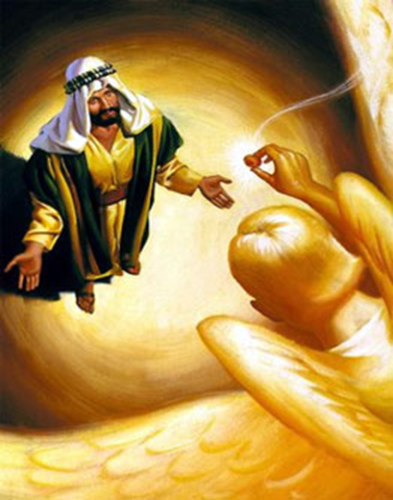
The Way It Really Is
“Getting Back Our Focus”
Isaiah 6:1-9
Edward Church
1-12-2020

Slide 4
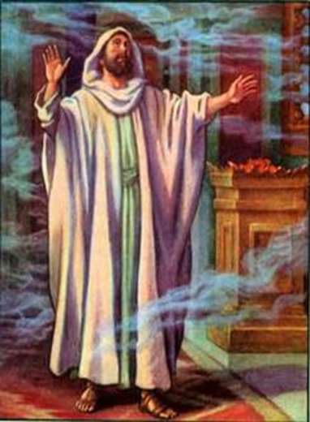
Isaiah 6 (KJV)
In the year that king Uzziah died I saw also the Lord sitting upon a throne, high and lifted up, and his train filled the temple.
² Above it stood the seraphims: each one had six wings; with twain he covered his face, and with twain he covered his feet, and with twain he did fly.
³ And one cried unto another, and said, Holy, holy, holy, is the Lord of hosts: the whole earth is full of his glory.
⁴ And the posts of the door moved at the voice of him that cried, and the house was filled with smoke.
⁵ Then said I, Woe is me! for I am undone; because I am a man of unclean lips, and I dwell in the midst of a people of unclean lips: for mine eyes have seen the King, the Lord of hosts.
⁶ Then flew one of the seraphims unto me, having a live coal in his hand, which he had taken with the tongs from off the altar:
⁷ And he laid it upon my mouth, and said, Lo, this hath touched thy lips; and thine iniquity is taken away, and thy sin purged.
⁸ Also I heard the voice of the Lord, saying, Whom shall I send, and who will go for us? Then said I, Here am I; send me.

Slide 5
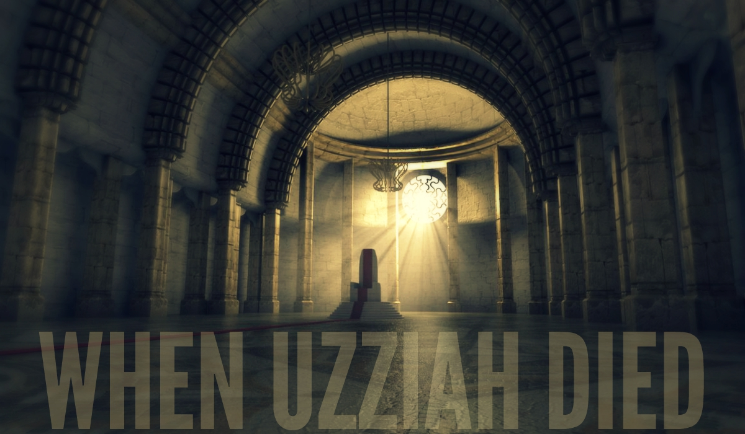

Unstable Times
Politically
Physically
Spiritually
Sound Familiar?
They Lost Their Focus

Slide 6
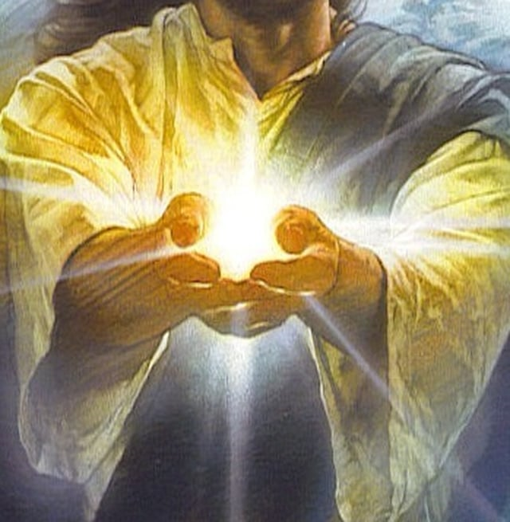
“Getting Back Our Focus”
The Way It Really Is

Slide 7
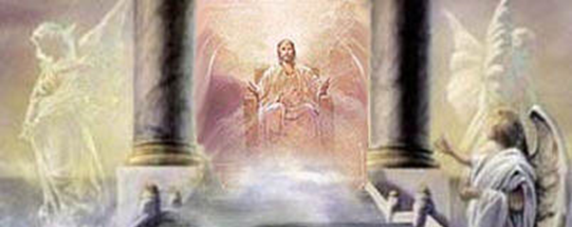
He is On the Throne (1)
Focus
He Is The…
  King of Kings- Lord of Lords
  Ruler of All Things
  In Control –Always Has /Always Will Be
  Absolute Sovereign Ruler of Everything
  Not About To Give Up His Reign

Slide 8
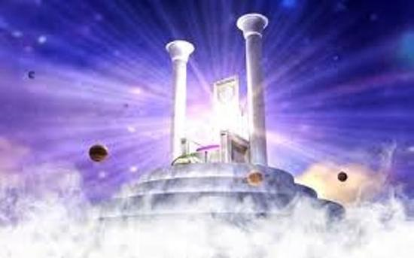
He is High and Lifted Up (1)
He Is Above All Things
Nothing Has Dominion Over Him
Everything Is Under Him
  All Governments…
  All Power…
  All People…
  … And You
Focus

Slide 9
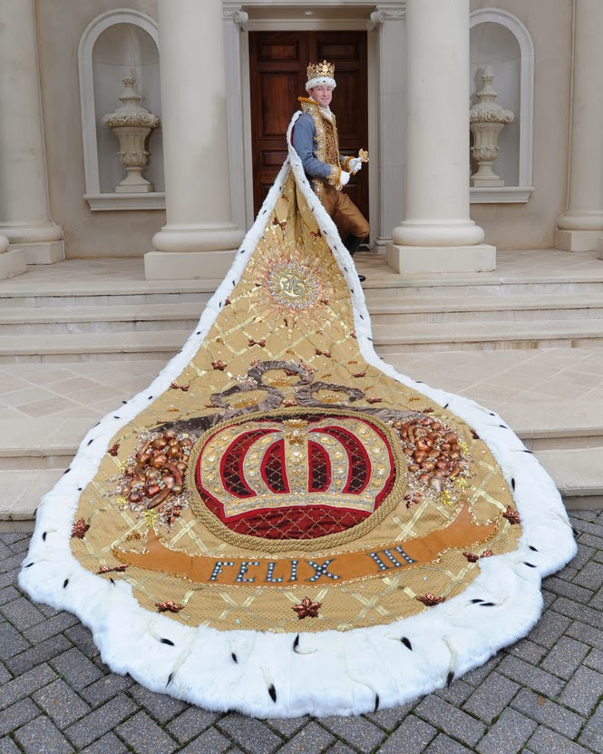
His Train Fills the Temple (1)
His Train Represents His Power
His Power is Everywhere…
…and Reaches Everywhere
  We Cannot …
    Escape God
    Hide From Him
    Run From Him
Sooner or Later…
…Everyone Will Stand Before Him
Focus

Slide 10
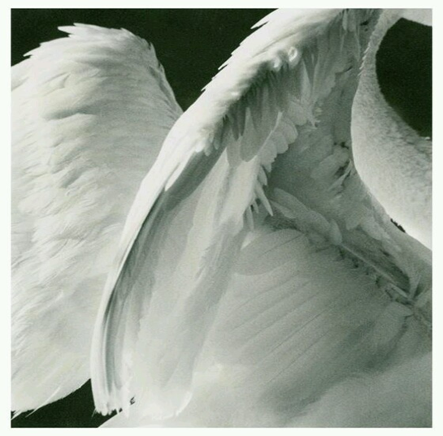
He is Holy (3)
Focus
He is…
…Set Apart from…
…Everyone and Everything
    Perfect
    Sinless
    Uncompromising w- Sin

Slide 11
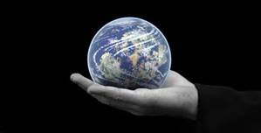
His Power is Awesome (4)
When He Speaks…
…the Earth Shakes
In His Hands He Holds…
  All Creation
  Our Lives
He Has The Power To…
      Do Anything He Wishes
      Speak and It’s Done
Focus

Slide 12
That’s How It Really Is
Focus

Slide 13
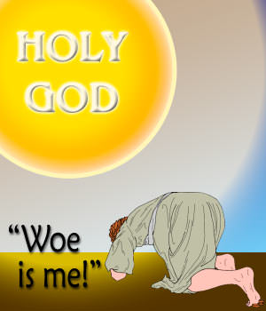
How We Really Are
We’re in Trouble. “Woe is me! for I am undone…”
How Can We Dare to Stand Before God?
  Here Is The High and Almighty God
  Here We Are, Low and Dirty and Weak
We’re Hopeless. “because I am a man of unclean lips…”
  When We Stand Before God…
    Our Sin Is Magnified
    We See Ourselves As God Sees Us
Focus

Slide 14
How We Really Are
We’re in Trouble- “Woe is me! for I am undone…”
We’re Hopeless- “..I am a man of unclean lips…”
We Have No One to Help Us- “I dwell in the midst
of a people of unclean lips…”
  Everybody is a Sinner
  There is No One to Turn To
  We Stand ALONE Before God
  Even Trump, the Senate /Congress!
Focus

Slide 15
His Touch!
The Same One Who Reveals Our Condition…
…Heals Our Condition
He Loves us too Much…
…to Leave Us the Same as He Found Us
Focus

Slide 16

His Touch!
Then one of the seraphim flew to me with a burning coal he had taken from the altar with a pair of tongs. ⁷ He touched my lips with it and said, “See, this coal has touched your lips. Now your guilt is removed, and your sins are forgiven.”
Isaiah’s Actions Affected God…
      God Initiated…
            Contact (1-4)
            Cleansing (5)
            Calling (6-8)
Focus

Slide 17
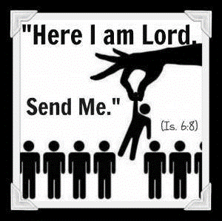
God’s Actions Effected Isaiah
⁸ Then I heard the Lord asking, “Whom should I send as a messenger to this people? Who will go for us?”
I said, “Here I am. Send me”
Who Shall I Send?
  He looked Up -Saw God as He Is!
  He Looked In -Saw Self as He Was!
  He Looked Out -Saw Others as They Are!
What Would Happen If …
… If Everyone Rescues One !

Slide 18
Isaiah 6 (NLT)
6 It was in the year King Uzziah died^{[a]} that I saw the Lord. He was sitting on a lofty throne, and the train of his robe filled the Temple. ² Attending him were mighty seraphim, each having six wings. With two wings they covered their faces, with two they covered their feet, and with two they flew. ³ They were calling out to each other, “Holy, holy, holy is the Lord of Heaven’s Armies! The whole earth is filled with his glory!” ⁴ Their voices shook the Temple to its foundations, and the entire building was filled with smoke. ⁵ Then I said, “It’s all over! I am doomed, for I am a sinful man. I have filthy lips, and I live among a people with filthy lips. Yet I have seen the King, the Lord of Heaven’s Armies.” ⁶ Then one of the seraphim flew to me with a burning coal he had taken from the altar with a pair of tongs. ⁷ He touched my lips with it and said, “See, this coal has touched your lips. Now your guilt is removed, and your sins are forgiven.” ⁸ Then I heard the Lord asking, “Whom should I send as a messenger to this people? Who will go for us?” I said, “Here I am. Send me.”

Slide 19


Slide 20
God Initiated…
  Contact (1-4)
  Cleansing (5)
  Calling (6-8)

Slide 21
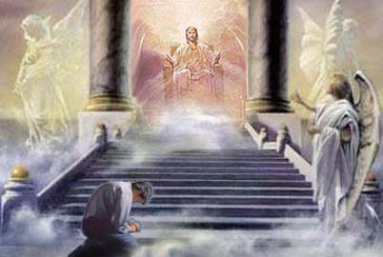
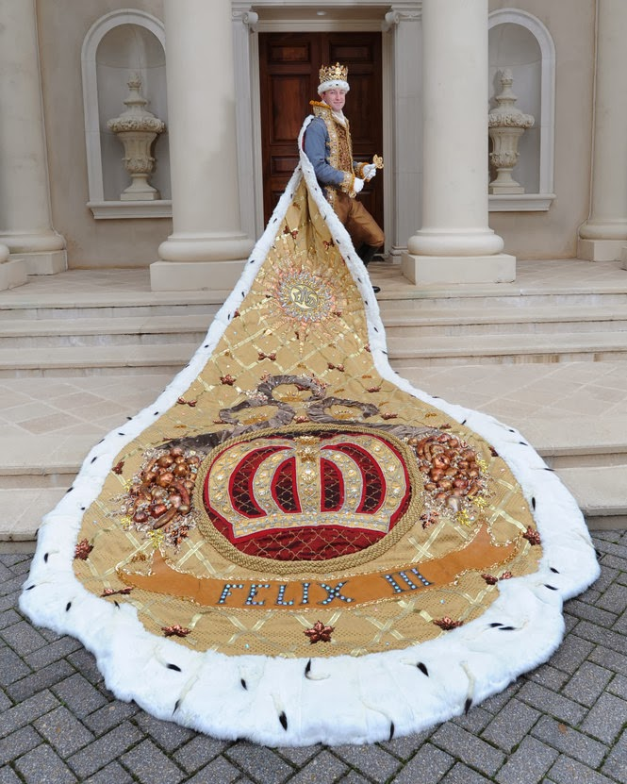
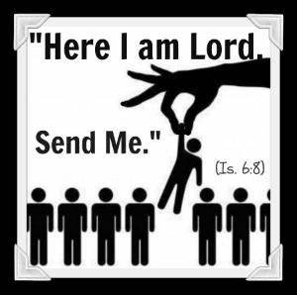

Slide 22
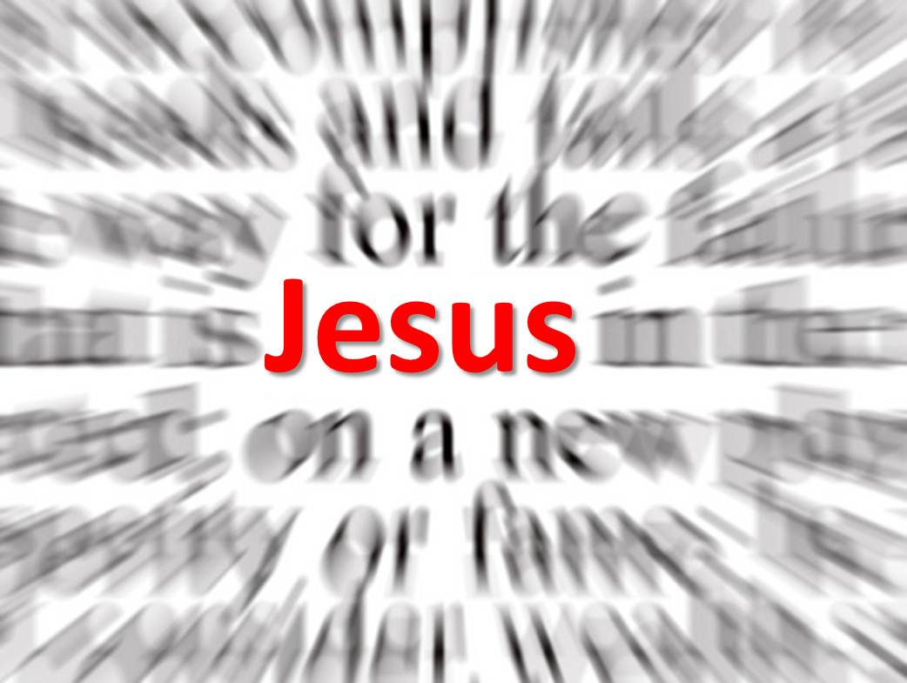

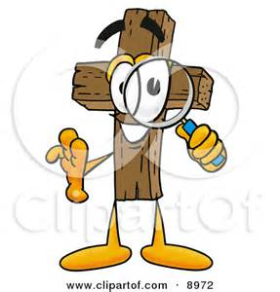
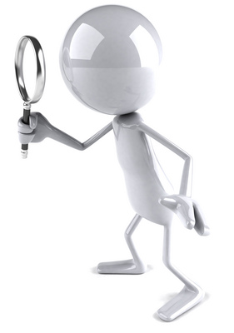



Slide 23



