Slide 1
OILY HAIR
Trying to control my dry hair, I treated my scalp
with olive oil before washing it.
Worried that the oil might leave an odor,
I washed my hair several times.
That night when I went to bed,
I leaned over to my husband and asked,
"Do I smell like olive oil?"
"No," he said, sniffing me.
"Do I smell like Popeye?"

Slide 3
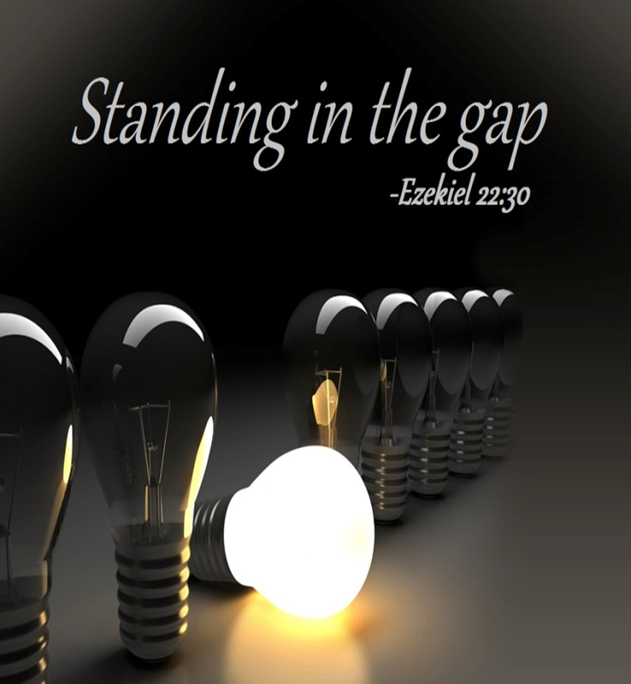

June 21, 2020
Edward Christian Church
“Fathers”
The Difference Makers
Father’s Day 2020

Slide 4
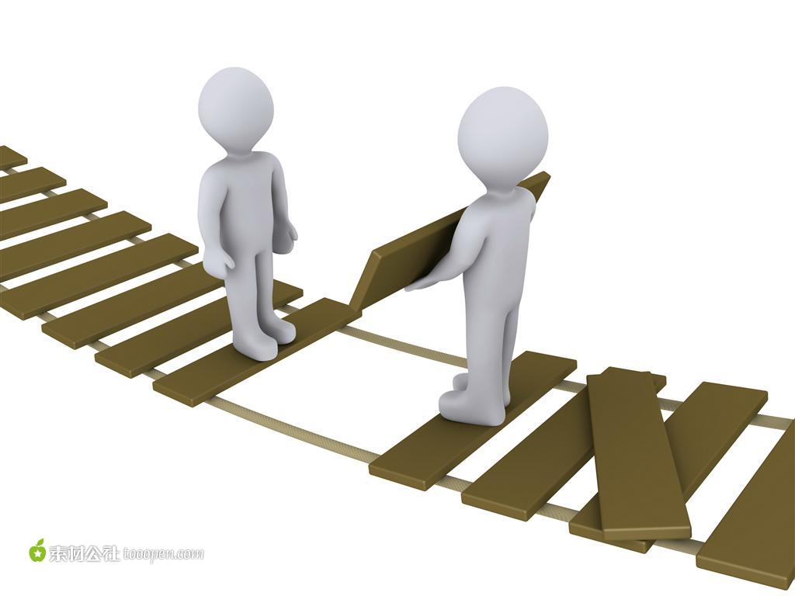
Ezekiel 22:30
"I looked for someone among you
who could build walls or stand in front
of me by the gaps in the walls to
defend the land and keep it from being
destroyed. But I couldn't find anyone

Slide 5
The Problem
There’s a
G a p
in our Nation, Schools, Families, Homes
Separation between God and His People

Slide 6

God’s Plan / Pursuit -
“I sought for a MAN..”
Not a
  Committee
  Neighbor
  Someone Else
  Better Time
But a Man!
Man, Husband/ Dad, Steward …
…Champion, Foot-man,
…Mighty Man

Slide 7
Gap Standers
The Bible is Full of Gap Standers
i.e. “Difference Makers”
    Nehemiah (wall)
    David (Goliath)
Common Factors
  Sent
    God Called
  Selfless
    It’s Never About Them
  Service
    It’s About Helping Others

Slide 8
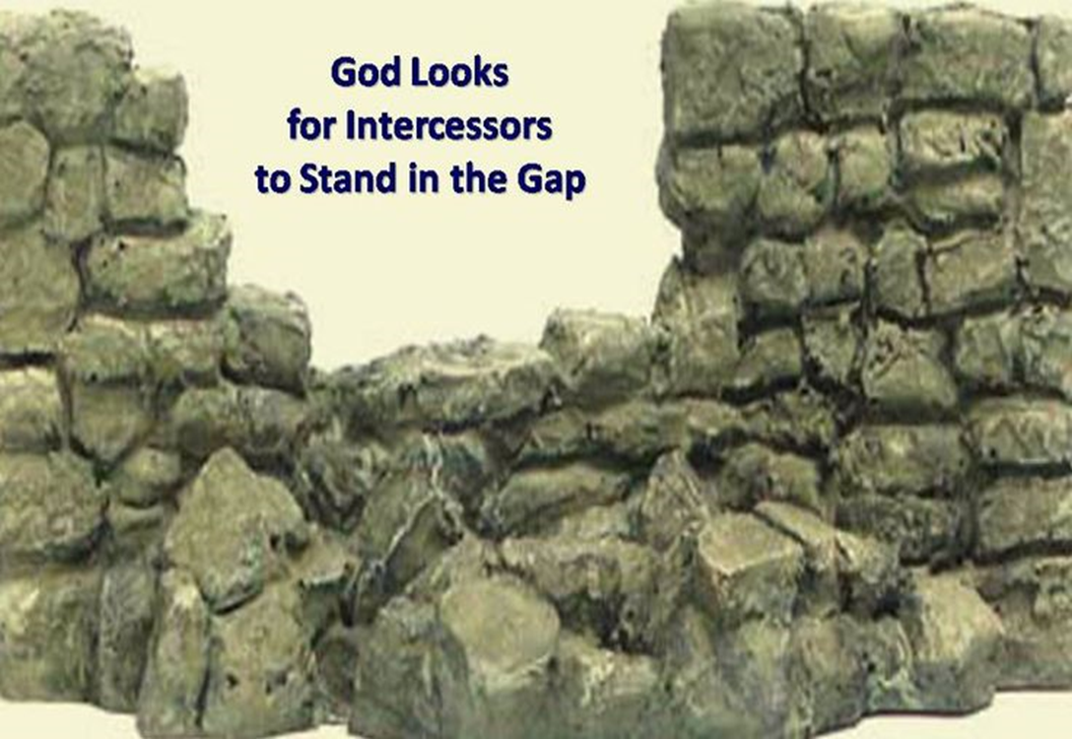
God’s Plan / Pursuit -
“I sought for a MAN..”
God's Choice- "From among them..."
  Able to Relate –Close to Heart
God’s Representative - “…before Me…”
God's Burden- “..for The Land…”
  Our World, Community, Homes, Schools, Neighborhood, Employment.

Slide 9

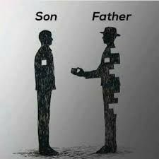
God’s Path -
“..stand in the gap”
Gap – breach/ broken wall
Gaps Between Man and God
…That Only You Can Fill
Faith
Family
Found in the Land

Slide 10


God’s Path -
“..stand in the gap”
Stand –appointed to arise…
…and remain firm
Time to Get…
Beyond Ourselves
Into the Fight
Stay in the Fight

Slide 11

God’s Power –
“to make up the hedge”
Make up the Hedge –
Repair the Breach - close off- build a wall
Nehemiah- Trowel /Sword
David- Israel /Philistines
Jesus- Cross made up the Hedge –
Bridged the Gap
Dad- we make up the hedge today

Slide 12

God’s Purpose –
“…that I should not destroy it…”
Destroy - decay, ruin, corrupt, destroy , lose, perish, spill
Make up the Hedge – Repair the Breach
Stand - to stand, abide (behind), arise, remain, repair, + serve, stand fast/ firm
In the Gap - a breach, a break

Slide 13
God’s Purpose –
“…that I should not destroy it…”
Destroy - decay, ruin, corrupt, destroy, lose, perish, spill
Deliverance
Doesn’t Come from an Army…
…But a Man (husband/ dad)
  Noah- Ark
  Moses- Ark

Slide 14

God’s Purpose –
“…that I should not destroy it…”
Ezekiel 22:30-31The Message (MSG)
“I looked for someone to stand up for me against all this, to repair the defenses of the city, to take a stand for me and stand in the gap to protect this land so I wouldn’t have to destroy it. I couldn’t find anyone. Not one.”
Ezekiel 22:30-31 DLV
“I looked for a dad to stand up for me against all this, to repair the defenses of the family, / to take a stand for me and stand in the gap to protect this country so I wouldn’t have to destroy it. I couldn’t find anyone. Not one.”

Slide 15
How About You?

Slide 17
Ezekiel 22:30
1. The Plan
-I sought a man among them
2. The Path
-To stand in the Gap
3. The Power
-To make up the Hedge
4. The Purpose
-That I would not Destroy it

Slide 18
God’s Purpose –
“…that I should not destroy it…”
Stand in the Gap-
Builder of Walls-
Ck sermons ezek 22:30
Make sched..daniel special

Slide 19




Slide 20
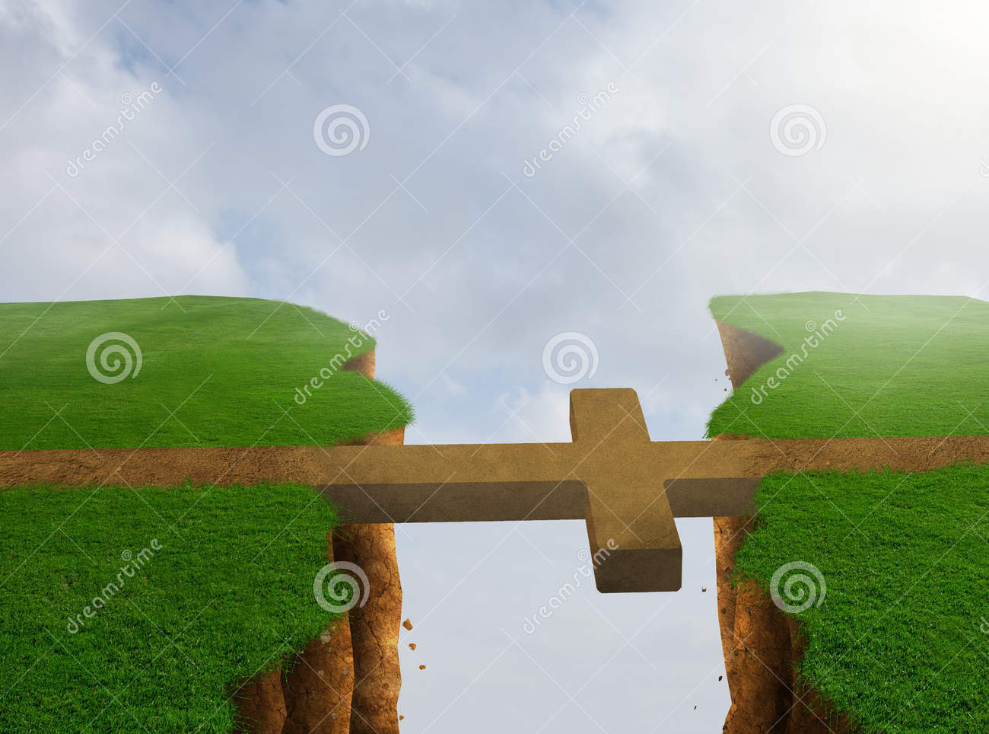

Slide 21


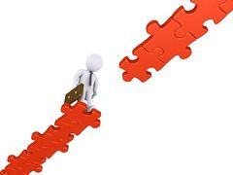


Slide 23
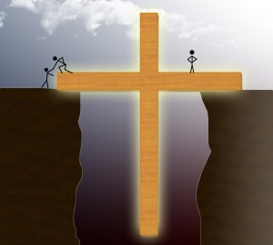
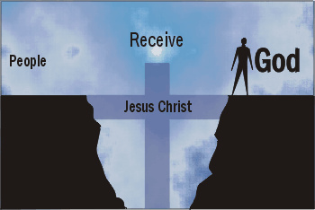

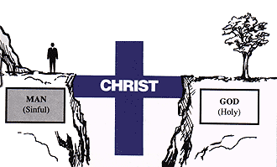
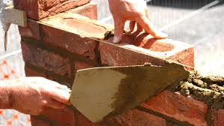

Slide 24
It’s Time…
F -
A -
T -
H -
E -
R -
-fighter
-attentive
-time
-help
-example
-restore

Slide 25
God’s Path -
“..stand in the gap”
Gap – breach/ broken wall
There are “Gaps” that Only You Can Fill…
Family
in the Land
Stand
Time to Get…
Beyond Ourselves
Get into the Fight
our hands dirty!

Slide 26
God’s Purpose –
“…that I should not destroy it…”
Destroy - decay, ruin, corrupt, destroy , lose, perish, spill
Make up the Hedge – Repair the Breach - close off- build a wall
Stand - to stand, abide (behind), arise, remain, repair, + serve, stand fast/ firm
In the Gap - a breach, a break

