Slide 2
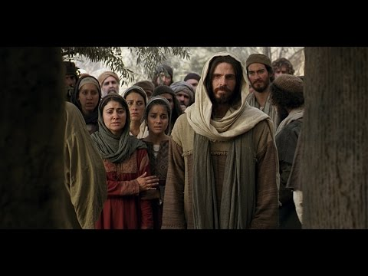
“Where Are You Jesus?”
What If Jesus Had of Been There? –pt1
John 11:21
Edward Church
June 7, 2020

Slide 3
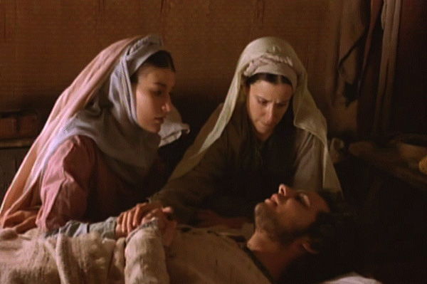
What If Jesus Had Been There?
John 11:21,“Then said Martha unto Jesus, Lord, if thou hadst been here, my brother had not died”
Let’s Look at the Story of Lazarus –Mary / Martha
from a Different Viewpoint
1st- the Place
    Bethany = House of Joy
= House of Pain
Its an Intriguing Fact of Life…
…the Thing that can be a Source of Joy
…can Also be a Source of Pain

Slide 4
What If Jesus Had Been There?
John 11:21,“Then said Martha unto Jesus, Lord, if thou hadst been here, my brother had not died”
Let’s Look at the Story of Lazarus –Mary / Martha
from a Different Viewpoint
He Wants to Perfect You…
…Not Pamper You
…And Challenge Your Faith
If Jesus Had of Been There…
…They Would NOT have Discovered
…Seven Things We Need to Know

Slide 5
#1- God Always Hears Our Cries (1-5)
1-5 (Phillips) …Lazarus who became seriously ill. So the sisters sent word to Jesus: "Lord, your friend is ill." When Jesus received the message, he said, "This illness is not meant to end in death; it is going to bring glory to God - for it will show the glory of the Son of God." ⁵ So when he heard of Lazarus' illness he stayed where he was two days longer
  Daniel 10:12, "Don't be afraid, Daniel..the 1st day..began to pray- I heard”
  Mk 4:38, “Master carest not that we perish?” Mk 4:38
Whatever He Permits to Enter the Arena of Our Lives…
…He Has Purpose Wrapped Up In It
The Reason We Don’t Always…
  See
  Feel
  Experience
…Immediate Answers (the Next 6 Things Give Insight)

Slide 6

#2- It’s Always Too Early to Give Up on God (4)
“When He heard this, Jesus said, “This sickness is not unto death. NO, it is for God’s glory so that God’s Son may be glorified through it.”
  2 Things – God has a Plan and Timing
“When Jesus heard that, he said, This sickness is not unto death, but for the glory of God, that the Son of God might be glorified thereby”
“And I am glad for your sakes that I was not there, to the intent ye may believe; nevertheless let us go unto him”
  Delays are Not Denials
⁵ Now Jesus loved Martha, and her sister, and Lazarus. ⁶ When he had heard therefore that he was sick, he abode two days still in the same place where he was

Slide 7
#2- It’s Always Too Early to Give Up on God (4)
So What Does This Mean To You Today?
Being a Christian Does Not Mean We Will Never Go Thru Storms
When Sits Enter Your Life Bigger than Your Capacity to Handle…
…Take It to the Lord in Prayer
When You Pray, Rem you are Not Sending Breaking News to God…
…He Knows Everything that Has/ Will Ever Happen to Us
Whatever He Permits to Enter the Arena of Our Lives…
…He has Purpose Wrapped Up in It
  His Timing is Not Our Timing
Never Give Up On God…
…No Matter How Grim the Circumstances May Seem!

Slide 8
#3- God Can Resurrect Your Dead Things! (17)
“ ‘ ‘Jesus found that Lazarus had already been in tomb for 4 days”
Waits Two More Days / Then Takes Off for Bethany
  Arrives After He had Been Dead for 4 Days
  By this Point He Was Legally Dead
  Jewish Custom -Wait Until the 4th day to Ensure Truly Dead
Jesus Arrives After…
  Professional Mourners There
  Body Prepared For Burial/ Wrapped It In Grave Clothes
  Body Had Already Begun to Stink
Seemed Hopeless..
…But Jesus Was About to Remove All Doubt!

