Slide 1
Two Nuns run out of gas a mile from the gas station.
They are rummaging around the car for a gas can, or some other container to hold the fuel but all they can find is a bed pan.
So they take the bed pan and walk the mile to the station, fill the pan and walk back to the car.
So there they are, two Nuns in full Nun garb pouring gas into the vehicle from a bed pan.
A man driving by sees the Nuns, sees the bed pan and exclaims:
"Oh, Lord! Now that is faith!"

Slide 3
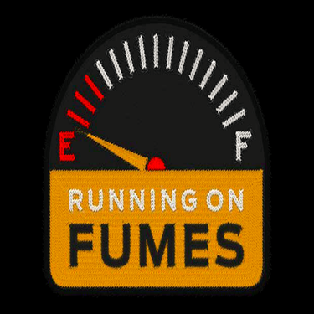
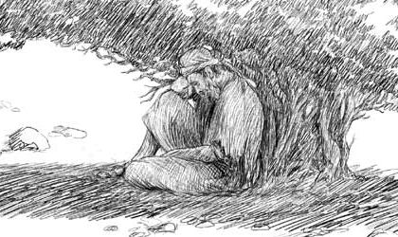
Edward Church
7-26-2020
Edward Christian Church
7- 26-2020
1 Kings 19

Slide 4
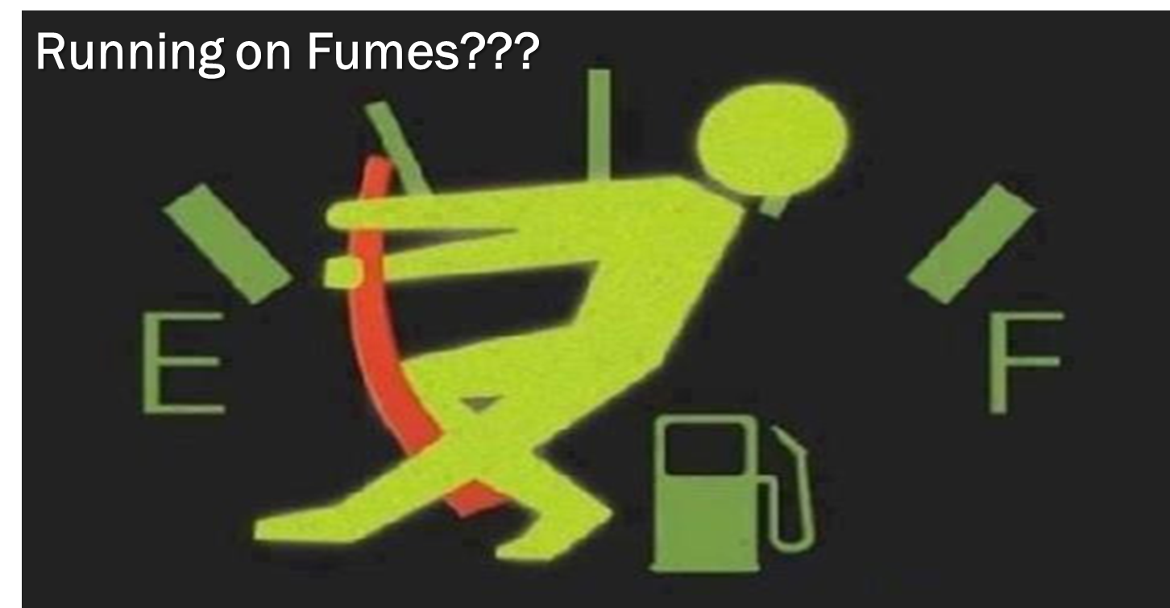
Survey Asks…
Have You…
  Gone as Far as You Can Go
  Taken All You Can Take
  Given All You Can Give
Welcome to…
…Running on Fumes!

Slide 5
  Mentally
  Physically
  Spiritually
Exhausted

Slide 6
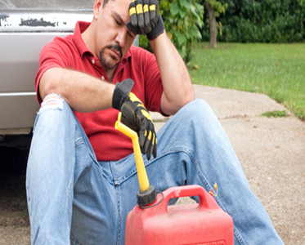
The Danger of Running on Fumes…
  Fumes Lead to Burnout
  Burnout Creates Brokenness
  Brokenness Drives Depression

Slide 7

2020
The Year of the Perfect Storm
Global Pandemic
Global Unrest
Personal Challenges

Slide 8
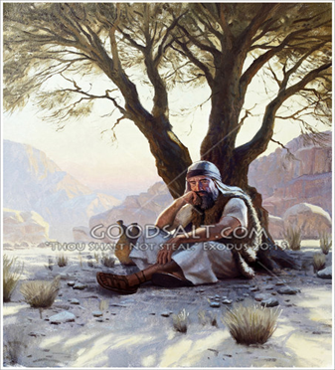
Running on Feeling (Spt High)
  1 Kings 18:46
    Elijah was Running On Emotions
Running on Fear (Spt Low)
  1 Kings 19:1-3
    Elijah Is Up And Running Again.
    This Time, Elijah Is Running On Fear
Running on Fumes (Spt Exhaustion)
  1 Ki 19:4-5
    Elijah Has Run Out Of Gas.

Slide 9
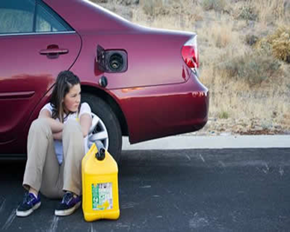

Does this Describe You?
Has Your Life of Faith…
Become a
Life of Fear?
Life of Fumes?
Remember
God Sees You!
He Has Never Left You!

Slide 11
2 Corinthians 8:9 (KJV)
⁹ For ye know the grace of our Lord Jesus Christ, that, though he was rich, yet for your sakes he became poor, that ye through his poverty might be rich.

Slide 12
Made [himself] nothing; to have no reputation; to empty oneself; to be completely empty.
Practical Application Jesus Christ made Himself of no reputation; that is, He emptied Himself. It is the picture of pouring water out of a glass until it is empty or of dumping something until it is all removed (William Barclay. The Letters to the Philippians, Colossians, and Thessalonians, p.44). The very picture of being completely empty stirs a feeling of just how far Christ went in humbling Himself for us. What was it that was poured or emptied out of Jesus Christ when He left heaven and came to earth? (This is what theologians call the kenosis theory.) Note that this passage does not say. It only says that Christ emptied Himself. Other Scriptures, however, give some indication. (See POSB note, pt.4—§ Mark 13:32 for more discussion.)
Christ did not lay aside His deity when He came to earth. He could not cease to be who He was: God. No person can ever cease to be who he is. A person may take on different traits and behave differently; a person may change his behavior and looks, but he is the same person in being, nature, and essence. Jesus Christ is God; therefore, He is always God—He always possesses the nature of God. (See note—§ John 1:1-2.)
Christ laid aside some of His rights as God:
ð He laid aside His right to experience only the glory and majesty, honor and worship of heaven. In coming to earth as a man, He was to experience anything but glory and majesty, honor and worship. Men would treat Him far differently than they would a heavenly being.
ð He laid aside His right to appear only in heaven and to appear only as the Sovereign God of heaven. In coming to earth as a man, He was, of course, to appear as a man on earth.
Practical Word Studies in The New Testament.

Slide 13
1. Running on Feeling.
(1 Ki 18:46 KJV) And the hand of the LORD was on Elijah; and he girded up his loins, and ran before Ahab to the entrance of Jezreel.
After the seventh prayer, the rain came in the shape of a man’s hand. Suddenly the sky was black, and the thundering rains came.
In our text, Elijah is running in the rain. What is his motivation? He was sure that revival had indeed come to Israel. He outran the chariot of King Ahab. He came to the entrance of the palace. No doubt, he must of thought, I will be an invited honored guest? After all, his God had won the contest of fire!
Elijah was running on the emotion of hope. He was running on feelings. He felt good about his victory. Have you ever had your hopes suddenly dashed? Elijah was about to!
2. Running on Fear.
(1 Ki 19:1 KJV) And Ahab told Jezebel all that Elijah had done, and withal how he had slain all the prophets with the sword.
(1 Ki 19:2 KJV) Then Jezebel sent a messenger unto Elijah, saying, So let the gods do to me, and more also, if I make not thy life as the life of one of them by to morrow about this time.
(1 Ki 19:3 KJV) And when he saw that, he arose, and went for his life, and came to Beersheba, which belongeth to Judah, and left his servant there.
Queen Jezebel was not about to repent. She wanted the life of Elijah, and meant to do it by days end!
Elijah is up and running again. This time, Elijah is running on fear.
Fear will motivate a man. Fear sells. Everyone wants to be safe. Some people only to come to Church, because, they feel safe there.
Unfortunately, for those who seek only safe harbors, God has called us to minister into the world of Jezebels!
We are to take up a cross and the message of the gospel and launch out into the deep. And Jezebel wants to take your life from you!
3. Running on Fumes.
(1 Ki 19:4 KJV) But he himself went a day’s journey into the wilderness, and came and sat down under a juniper tree: and he requested for himself that he might die; and said, It is enough; now, O LORD, take away my life; for I am not better than my fathers.
(1 Ki 19:5 KJV) And as he lay and slept under a juniper tree, behold, then an angel touched him, and said unto him, Arise and eat.
In this text, Elijah has run out of gas. He is fully immersed in depression.
And so will you be, if you do not find the proper fuel source of the Christian life!
A Christian is not to live by feelings. A Christian is not to live by fear. A Christian is to live by…
4. Running on Faith!
(1 Ki 19:8 KJV) And he arose, and did eat and drink, and went in the strength of that meat forty days and forty nights unto Horeb the mount of God.

Slide 14
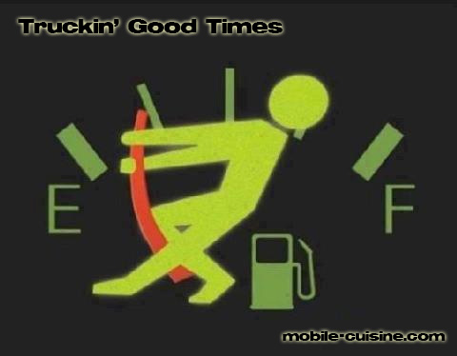


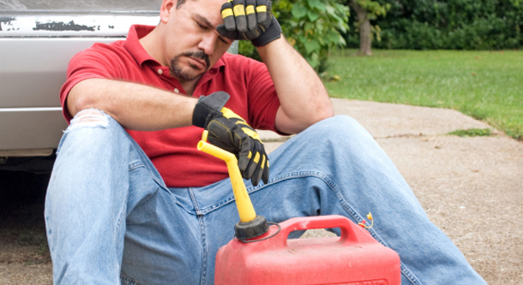

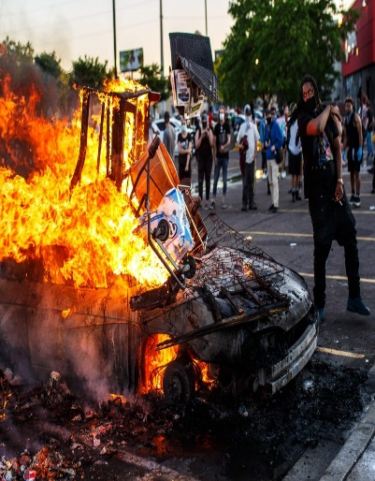
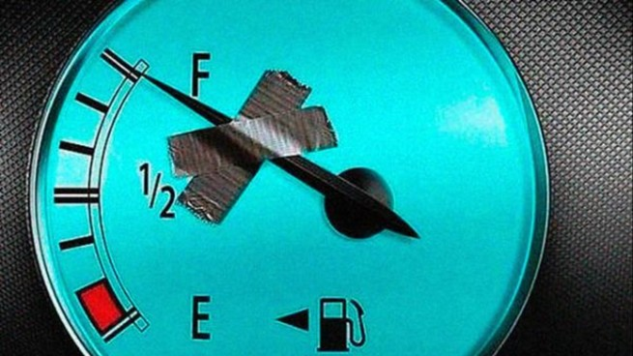
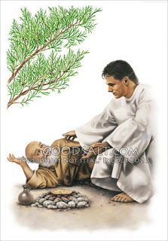
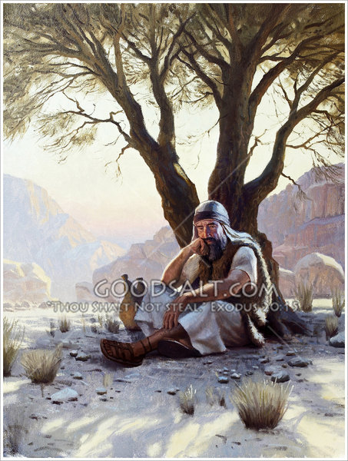

Slide 15
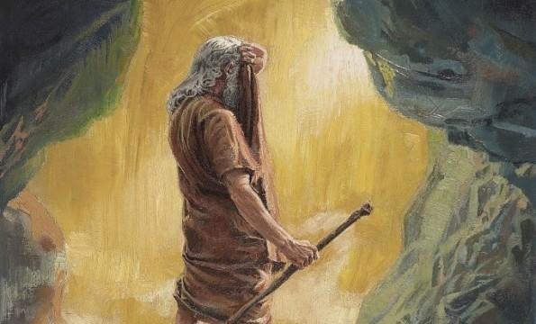


Slide 16
Why Does God Allow Us to…
…Get to this Point?
  Points to Power of the Cross…
      We All Need His Help
  Brings Message of Grace/ Mercy to Life
      Now It’s Personal
  Prompts Reliance upon Him/ Others
      We Can’t Do It Alone
  Show Us/ Others We Can Still Be Used…
      Even in the Worst of Situations
  Move Beyond Guilt to Usefulness Again!

Slide 17
Symptoms of emotional exhaustion can manifest in emotional, physical and behavioral ways
Feeling a sense of failure and self-doubt
Feeling helpless, trapped and defeated
Feeling detached and alone in the world
Feeling unmotivated
Feeling negative, cynical and dissatisfied
Feeling tired and drained most of the time
Feeling sick a lot, and having a lowered immunity to illness
Frequent headaches and other aches and pains
Changes in sleep or appetite
Withdrawing from responsibilities
Isolating yourself from others
Procrastinating or taking longer than usual to get things done
Using food, drugs, alcohol, shopping to cope with feelings, or avoid feelings
Irritability, or taking frustrations out on others
Missing work, or coming in late and leaving early

Slide 18
The madness on a grand scale is manifest with countless crazies on the more local scale – drug dealers – snipers – cereal killers – even school bullies (if you want to become really local).
There is no shortage of craziness out there and the temptation for godly people is to disengage and head for the hills – literally or figuratively.

Slide 19
An oak tree is the perfection of an acorn. And somebody has written these words:
When you’re discouraged and feeling a little blue, take a look at a mighty oak and see what a nut can do (Laughter).
That oak tree is the perfection of an acorn. It is, it means maturity. We grow under stress.

Slide 20
Attitude
Attitude Provides…
  Perspective
  Power
    Mirror- How We See Ourselves
    Lens- How We See Others/ Situations
    Map- How We Choose Our Paths
  Persuasion
    Steers (direction)
    Stations (starts, hinders, stops)

Slide 21



Have You Been Hurt?
God Uses Hurt People…
…to Help Hurting People
Hurt (past tense)
Been through Pain, Grief, Stress, Loss
and
  Came Out on the Other Side
  Became a “Wounded Healer”

Slide 22


Have You Been Hurt?
Hurt People
…Hurt People
There’s a Big Difference Between:
Pain that’s Been…
    Dealt With
    Pushed Down
One Leads to…
    Development (fresh)
    Depression (stagnant)

Slide 23
Have You Been Hurt?
John 16:33, “in this world...tribulation…
...be of good cheer...overcome world”
  Tribulation (stress; pressure) (Affect)
  Be of Good Cheer (Courage) (Attitude)
    Deal with It; Go Forward (Action)
  I Have Already Overcome (Achieved-Acquired)
John 16:33 (MSG) I've told you all this so that trusting me, you will be unshakable and assured, deeply at peace. In this godless world you will continue to experience difficulties. But take heart! I've conquered the world."

Slide 24
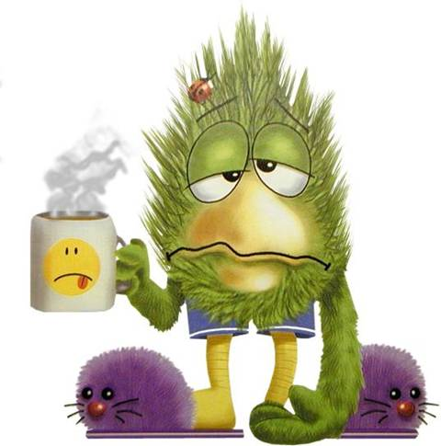
What is Burnout?
Burn-out happens when:
You have gone as far as you can go
Taken all you can take
Given all you can give
You find yourself…
…Running on Empty!

Slide 25
Burnout
Our Society is…
…Burned Out
Our Families are…
…Burned Out
Our Churches are…
…Burned Out
It is the mark of…
…Our Generation

Slide 26
Three Things About Depression
It is…
Ancient Problem
Universal Problem
No Respecter of Persons

Slide 27
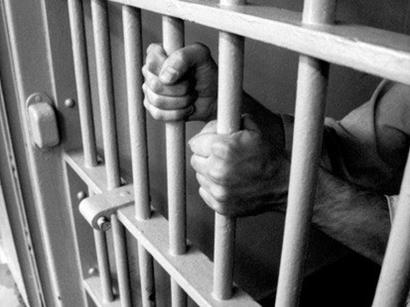
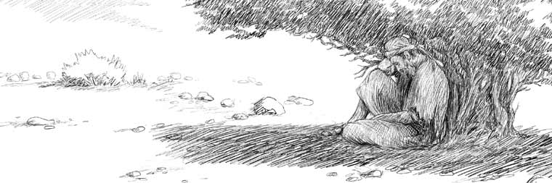

Symptoms of Depression
Weight Loss or Weight Gain
Loss of Sleep and Energy
Lose Interest in Most or All…
…Pleasurable Activities
Reduced Ability to Concentrate
Overcome w/ Feelings of…
    Hopelessness
    Uselessness

Slide 28
The Key To Elijah’s Depression (3,4)
“When He Saw That ….”
Elijah Changed…
His Focus -Ceased to Walk by Faith
“And when he saw that…”
His Force -Boldness to Fear
“he arose, and went for his life…”
His Feelings -Became Depressed
“came to Beersheba, which belongeth to Judah,
and left his servant there. ..Juniper Tree…”

Slide 29

Five Factors of Elijah’s Depression
Elijah Faced…
Physical Exhaustion (5)
  Intense Activity-chap 18
    Rebuilt Altar - Showdown
    Killed 850 False Prophets
    Prayed Intensely for Rain
    Ran for Over 20 Miles
Emotional Exhaustion (3a, 4)
  He’s on Emotional Roller Coaster
    Arose and Ran for His Life (3)
    Take My Life -Kill Me! (4)

Slide 30
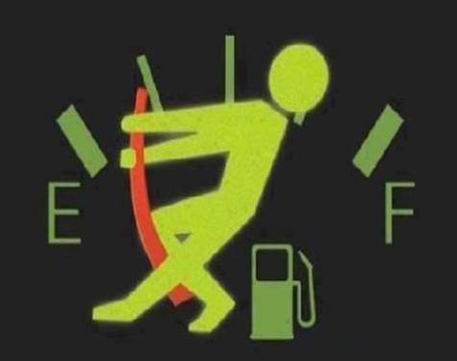
Running on Fumes???

Slide 31
Depression and the Bible
Moses – Numbers 11:1-15
David – Psalms 31:9-13
Job – Job 7:2-3
Jeremiah – 20:14-18
Elijah –I Kings 19

Slide 32

Five Factors of Elijah’s Depression
Elijah Faced…
Physical Exhaustion (5)
Emotional Exhaustion (4)
Social Exhaustion (1, 2)
  Relationship Conflict
    Confronted / killed 850 prophets
    Jezebel sent out Death Threats
Spiritual Exhaustion (10, 14)
  Down Played His Work
  Exaggerated His Situation
Lord Just Take Me!!!

Slide 33
You Can BE Set Free!
Psa 126:5,Those who sow in tears will reap w- songs of joy
Psa 143:7-8, Answer me quickly, O Lord; my spirit fails. Do not hide your face from me or I will be like those who go down to the pit. Let the morning bring me word of your unfailing love, for I have put my trust in you. Show me the way I should go, for to you I’ll lift up my soul.
Psa 147:3, He heals the brokenhearted / binds up wounds
Psa 145:14, The LORD upholds all those who fall and lifts up all who are bowed down.
Prov 12:25, Anxiety in a man’s heart weighs it down (depression), but a good word cheers it up
Finding
Freedom !

Slide 34
How to Get Depressed in 3 Easy Steps
#1- Find a Place By Yourself. Depression shuts out the thing we need most: people. Don’t want to face people.
#2- Focus on the Negative. We all have negative times in our lives, but when we make little things in to big things and let them overwhelm us
#3- Forget God’s Provision.
God provided through a widow who had nothing. Called down fire from heaven, saw one of the greatest revivals in Israel. God had never failed Elijah. Has God ever failed you?

Slide 36
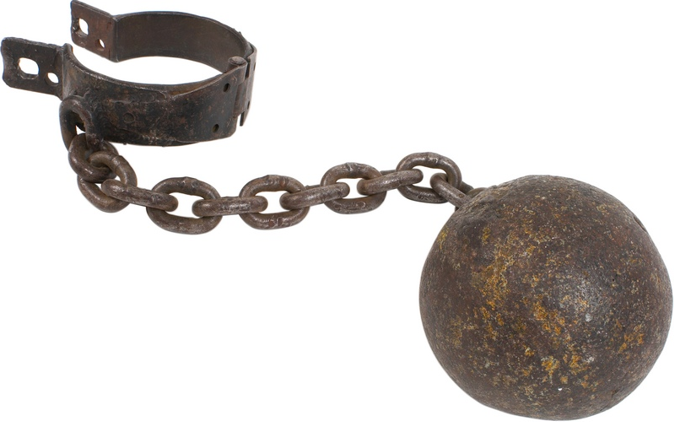

Slide 37
Deut 31:8 – The Lord himself goes before you and will be with you; he will never leave you nor forsake you. Do not be afraid; do not be discouraged.
Deut 33:27 – The eternal God is your refuge, and underneath are the everlasting arms.
2 Sam 22:17-22 – He sent from above, he took me; he drew me out of many waters; (18) He delivered me from my strong enemy, and from them that hated me: for they were too strong for me. (19) They prevented me in the day of my calamity: but the Lord was my stay. (20) He brought me forth also into a large place: he delivered me, because he delighted in me. (21) The Lord rewarded me according to my righteousness: according to the cleanness of my hands hath he recompensed me. (22) For I have kept the ways of the Lord, and have not wickedly departed from my God.
2 Sam 22:29 – You are my lamp O Lord; the Lord turns my darkness into light.
Ecclesiastes 9:4 – Anyone who is among the living has hope.
Psalms 9:9 – The Lord is a refuge for the oppressed, a stronghold in times of trouble.
Psa 27:14 – Wait on the LORD: be of good courage, and He shall strengthen thine heart: wait, I say, on the LORD.
Psa 31:22,24 – You heard my cry for mercy when I called to you for help… Be strong and take heart, all you who hope in the Lord.
Psa 34:18, 19 – The LORD is close to the brokenhearted and saves those who are crushed in spirit. (19) A righteous man may have many troubles, but the Lord delivers him from them all.
Psa 37:23-24 – If the Lord delights in a man’s way, he makes his steps firm; though he stumbles, he will not fall, for the Lord upholds him with his hand.
Psa 43:5 – Why are you downcast, O my soul? Why so disturbed within me? Put your hope in God.
Psa 55:22 – Cast your cares on the Lord and he will sustain you; he will never let the righteous fall.
Psalm 62:5 – Find rest, O my soul, in God alone; my hope comes from him

Slide 38
Psalm 126:5 – Those who sow in tears will reap with songs of joy.
Psalm 143:7-8 – Answer me quickly, O Lord; my spirit fails. Do not hide your face from me or I will be like those who go down to the pit. Let the morning bring me word of your unfailing love, for I have put my trust in you. Show me the way I should go, for to you I’ll lift up my soul.
Psalm 147:3 – He heals the brokenhearted and binds up their wounds.
Psalm 145:14 – The LORD upholds all those who fall and lifts up all who are bowed down.
Proverbs 12:25 – Anxiety in a man’s heart weighs it down (depression), but a good word cheers it up.
Isaiah 26:3-4, Thou wilt keep him in perfect peace, whose mind is stayed on Thee: because he trusts in Thee. Trust ye in the LORD for ever: for in the LORD JEHOVAH is everlasting strength. (Perfect means complete. If I keep my part of the promise by staying steadfastly focused on the Lord Jesus Christ, He will keep His promise to give me His perfect peace. See also Philippians 4:6-7 below)

Slide 39
Part 2

Slide 40
3 Lessons On Conquering Depression
Finding
Freedom !

Slide 41
#1- Fresh Provision (5-8)
“..lay and slept…Angel touched…”
Recuperated -Slept
Reenergized -Ate
Recuperated -Slept
Reenergized -Ate
God was Restoring Him Physically
  Prepared His Food/ Gave Him Rest
God was Restoring Him Spiritually
  Propelled Him to Get to Mt. Horeb

Slide 42
#2- Fresh Profession (9-11)
“What Are You Doing Here”
God Knew that He Needed to Unload…
  To Proper Person –God
  In Proper Way – Mt of God
  1st- We Need to Talk to God About it!
  Then…
  We Need to Find Somebody We Can Trust …
  …to Talk it Out!

Slide 43
#3- Fresh Perspective (11-14, 18)
“What Doest Thou Here Elijah?”
God Showed Him that He Does Not Always Communicate the Same Way
God Showed Him that His Perspective…
…was Wrong
God Showed Him that He Still Had…
…a Group of People He Could Trust
Realize There is More to It Than I See!

Slide 44
#4- Fresh Purpose (15-17)
“…go anoint…”
Go Take Care of Kingdom Work
  Physical
Go Take Care of My Work
  Spiritual
Elijah Mentored Elisha 10 years
God wasn’t Through with him !!!
God is Not Through with You !!!

Slide 45

#4- Fresh Purpose (15-17)
“…go anoint…”
You Decide If You Get Back Up!
You Decide If this is the Last Chapter
You Don’t Have to Be Defined…
…By Your Depression
Get Back Up!!!

Slide 47
I Second That Emotion!
Edward Christian Church
June 27, 2010
Overcoming
Depression
pt1
John 21, Luke 22

Slide 48
Depression
Most People Have Felt Sad or Depressed at Times.
Feeling Depressed can be a Normal Reaction to Loss, Life's Struggles, or an Injured Self-esteem.
But when Feelings of Intense Sadness -- including Feeling Helpless, Hopeless, And Worthless -- Last for Days to Weeks and Keep You from Functioning…
…It May Very Well Be Depression

Slide 49
Symptoms of Depression
Weight Loss or Weight Gain
Loss of Sleep and Energy
Lose Interest in Most or All…
…Pleasurable Activities
4. Reduced Ability to Concentrate.
5. Overcome w/ Feelings of Hopelessness…
…or Uselessness.

Slide 50
Depression and the Bible
Moses – Numbers 11:1-15
David – Psalms 31:9-13
Job – 7:2-3
Jeremiah – 20:14-18
Elijah –I Kings 19

Slide 52
Why Does God Confront?
#1- God Confronted His Actions –v. 9 God did not call Elijah to live in a cave, but to stand up for the Lord. By the way, God did not save you for you to be discouraged and defeated. He saved you to experience His peace and His joy, Phil. 4:6; 1 Pet. 1:8.
#2- God Confronted His Attitude –v. 11-13 Elijah wanted to see the spectacular and the majestic. God had to teach him to look at the little things. (Ill. Too often, we get defeated when God does not do the big things in our lives. If we would learn to praise Him for the little things, we would have plenty to praise Him for! We need to remember that God’s greatest work is the work that moves the heart!)
#3- God Confronted His Assumptions –v. 14-18 Elijah made two foolish assumptions and became defeated as a result.
1. v. 14, 18 Elijah Assumed That He Was Forsaken – God reminded him that he still had 7,000 pure hearts in Israel.
2. v. 15-17 Elijah Assumed That He Was Finished – Elijah thought his life and ministry were over, and he was ready to die. God reminded him that he still had big plans for Elijah’s tomorrow.

Slide 53
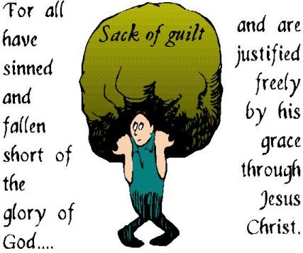

Slide 54


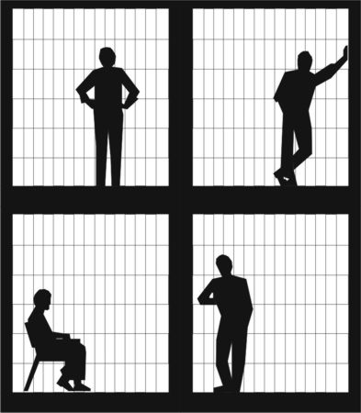

Slide 55
The Key To Elijah’s Depression (3)
“When He Saw That ….”
#1- He Saw The Wrong Things -v3a
-He changes Focus fr. Eternal to Temporal
#2- He Sought The Wrong Things –v3b-4a
-He Changes Force –from Boldness to fear
Elijah “went for his life,” yet he “requested for himself that he might die.”
#3- He Said The Wrong Things –v4b
-He Changes Feelings
Elijah said, “I am not better than my fathers.”

Slide 56
Five Factors of Elijah’s Depression
1.His depression came after a time of intense ministry output.
2. After relational conflict. Problem with boss, breaking up with boyfriend, argument with wife.
3.After physical exhaustion. Just killed 450 false prophets. Prayed intensely for rain, and then in the power of the Holy Spirit ran for over 20 miles.
4. After a major victory. He saw the whole nation of Israel come to revival all at once.
5. After a huge disappointment. He expectations may have been for repentance

Slide 57
Have You Been Hurt?
John 16:33, “in this world...tribulation.
...be of good cheer...overcome world”
#1 The Problem
  “in this world” (we are here)
  “tribulation” (stress; pressure)
      Opportunity to be depressed
#2 The Push
  “I have told you” (He already knows)
  “Be of good cheer...” (attitude)
  Deal with it; go forward (action)

Slide 58
Have You Been Hurt?
#3- The Promise
  “I have overcome the world ”
  Lean on Me
  Draw strength from Me
Realize that you are not the only one.
Others have faced depression too!

Slide 59
Depression
Most People Have Felt Sad or Depressed at Times.
Feeling Depressed can be a Normal Reaction to Loss, Life's Struggles, or an Injured Self-esteem.
But when Feelings of Intense Sadness -- including Feeling Helpless, Hopeless, And Worthless -- Last for Days to Weeks and Keep You from Functioning…
…It May Very Well Be Depression

Slide 60

Have You Been Hurt?
Moses
Job
Elijah
Jonah
Saul
David
Jesus in the Garden

Slide 61
What is Burnout?
Burn-Out Happens When:
Go as Far as You Can Go
Taken All You Can Take
Given All You Can Give
You Find Yourself…
…Running on Empty!
Run to the Well!

