Slide 2
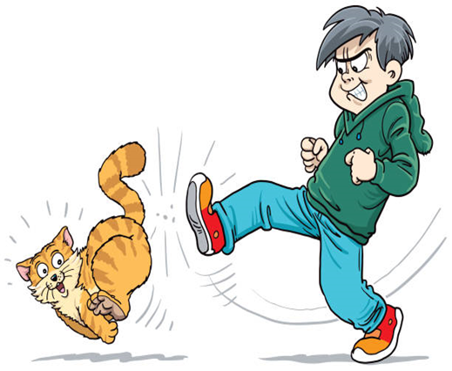
Anger
Edward Church
Ephesians 4:26-27
Pt 2
Kicking the Cat
August 23, 2020

Slide 3
  "BE ANGRY [at sin--at immorality, at injustice, at ungodly behavior], YET DO NOT SIN; do not let your anger [cause you shame, nor allow it to] last until the sun goes down. And do not give the devil an opportunity [to lead you into sin by holding a grudge, or nurturing anger, or harboring resentment, or cultivating bitterness]." EPHESIANS 4:26-27 Amp
  Go ahead and be angry. You do well to be angry— but don’t use your anger as fuel for revenge. And don’t stay angry. Don’t go to bed angry. Don’t give the Devil that kind of foothold in your life. Eph 4:26-27 Message

Slide 4

Anger’s Nature
Anger is a God Given Powerful Emotion…
…Response to an Injustice or Pain or Threat…
...a person makes the Conscious Choice
…to Take Action to Immediately Stop the
…Threatening Behavior of
…Another Outside Force.
        Moses Got Angry
        David Got Angry
        God Got Angry
        Jesus Got Angry

Slide 5

Anger Statistics
Anger is the Watch Word of Our Age
  From Road Rage to Dom. Violence to Mental Problems
The Average Male Loses Temper About 6 Times a Week
  Often Gets Mad at Circumstances More Than People
The Average Female Loses Temper About 3 Times a Week
  Often Gets Mad at People More Than Circumstances
Anger is Usually Handled in 2 Ways
  Blow Up
  Clam Up
We Are More Likely to Express Our Anger At Home…
…Severely Affecting Relationships

Slide 6

What God Says About Anger
1st, Anger is NOT a Sin
  Be angry and sin not…
  In your anger, do not sin…
  Anger is a Healthy Emotional Signal that…
  …Something Needs to Be Addressed
2nd, Anger CAN Lead Us Into Sin
  Do Not Let the Sun Go Down on Your Wrath
  Anger Must Be Expressed Appropriately…
  …When Not Vented Properly
  …Leads To Wrath
  Anger= excitement of mind, justifiable abhorrence
  Wrath= to enrage, become exasperated, lose control
  Sin= to miss the mark and so not share in the prize

Slide 7
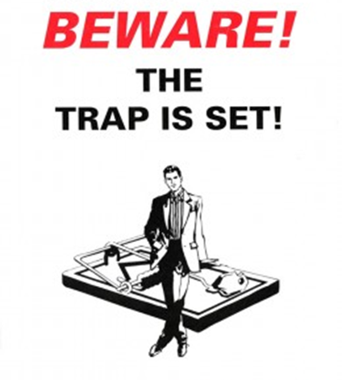
What God Says About Anger
1st, Anger is NOT a Sin -Be angry and sin not…
2nd, Anger CAN Lead Us Into Sin –not let sun go down on wrath…
3rd, Unresolved Anger OPENS the Door to Spiritual Bondage
  Neither give place to the devil
  Place= Foothold, Wedge, Lever
Unbridled Anger Leads to…
…Destructive Attitudes and Actions
4th, Anger HINDERS Spiritual Maturity
  James 1:19-20 (Phillips) In view of what he has made us then, dear brothers, let every man be quick to listen but slow to use his tongue, and slow to lose his temper. For man's temper is never the means of achieving God's true goodness.

Slide 8
Five Important Steps to Get Out of the Anger Trap:
Step 1: SORT IT OUT
  Try to Understand Why You Are Angry.
  There is a Difference Between Normal Irritations in Life and..
…a Persistent State of Anger.
Step 2: COUNT THE COST
  One Blowup Can Erase 20 Acts of Kindness.
  Anger Can Cost Us Dearly If We Do Not Keep It in Check.
Step 3: LET IT OUT
  Release Your Anger to God In Prayer.
  Tell God How You Feel… He Can Handle It.
  Then Go Talk About It W- a Friend or Offender
Whatever You Do, Don’t Keep Your Anger Locked Up In Your Heart. Repressed Anger Visits in a Host of Emotional - Relational Problems.

Slide 9
Five Important Steps To Get Out of the Anger Trap:
Step 4: SET LIMITS
Control Your Words and Behavior.
Watch Your Mouth: “When words are many, sin is not absent. But he who keeps a tight rein on his tongue is wise” -Prov 10:19
Don’t Cross Line of Verbal or Physical Abuse No Matter How Frustrated You Get. Don’t Justify -Excuse Such Abusive Behaviors.
Step 5: GIVE IT UP
As Christians, we do not have the right to remain angry.
In Christ, we have given up that right.
We surrender our anger to Him/ forgive others as He has us.
When we forgive, we are free from resentment, bitterness,/ anger.

Slide 10
As we walk today through the mine field of relationships replete with misunderstandings, remember the word of God:
“Be angry and sin not. Do not let the sun go down upon your wrath” -Ephesians 4:26

Slide 11
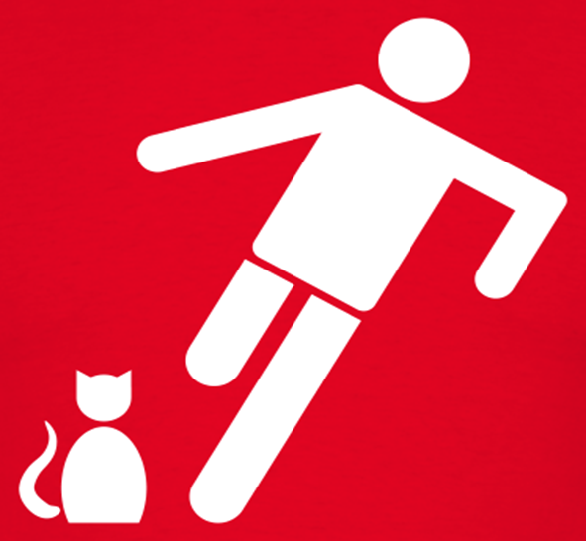
Just a Thought
Anger is an acid that can do more harm to the vessel in which it is stored than to anything on which it is poured
“Never go to bed mad. Stay up / fight.” -Phyllis Diller
“Speak when you are angry and you will make the best speech you will ever regret.”
“When angry, count four. When very angry, swear.”
-Mark Twain
I may look calm on the outside, but I have killed you three times in my head
I wouldn’t have to manage my anger if people would manage their stupidity.

Slide 12
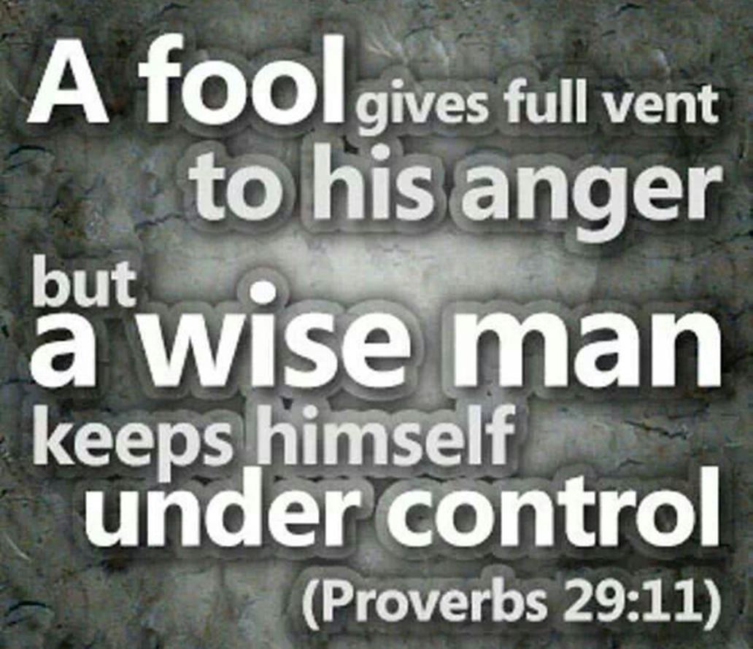

Slide 14
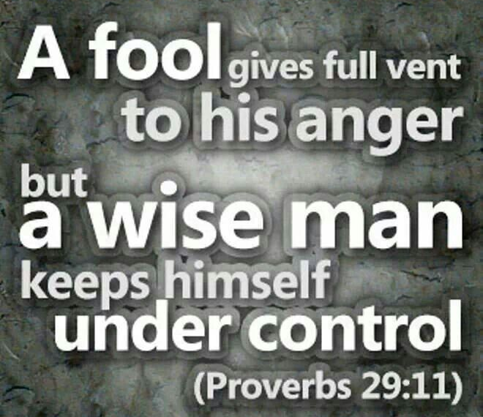
OJ overcame extreme odds
In the End
Couldn’t overcome his Anger

Slide 15




Slide 16
How Do I Handle My Anger?
Principle 1: Admit the Sin in Your Anger -4:26
P #2: Confront Anger by Seeing Satan in It- 4:27
4th Step Is To “Diffuse It”
  Deal w- it so it doesn’t Explode…
  …becoming a Doorway
Travel Light
1- God Does Not Stay Angry -Micah 7:18, Psa 30:5
2- Settle Matters Quickly -Eph 4:27
3- Refuse to recreate Satan’s Character

Slide 17
Dangerous Anger
Made Cain Kill Abel.
Made Saul Lose His Throne.
Made Moses Smite the Rock.
Warning!
When Anger is Not Met with a Biblical Solution
…You Can End Up Killing Yourself.
If it does not kill you - Physically
it gets you - Emotionally
Ultimate End is to Kill You - Spiritually.

Slide 18




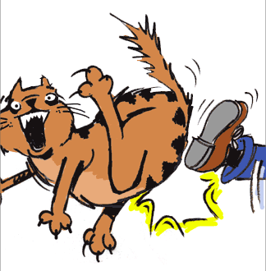


Slide 19




Slide 20
There Are Four Sources of Anger
Hurt
  Your Heart Is Wounded.
Injustice
  Your Right Is Violated.
Fear
  Your Future Is Threatened.
Frustration
  Your Effort Is Unsuccessful.

Slide 21

Anger’s Nurture
Anger is Fed by Feelings of…
  Disappointment
  Rejection
  Embarrassment
Anger Pits You Against Whatever Sparked the Emotion
  It Is the Opposite of the Feeling of Love.
  Love Draws You Toward the Person…
…Anger Sets You Against the Person

Slide 22
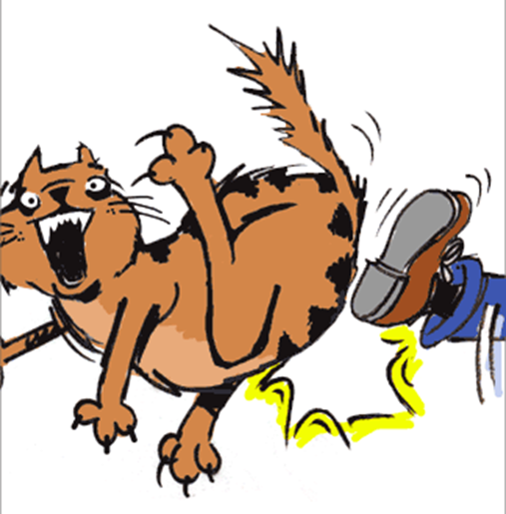
Anger Is Never Neutral
It Always has Consequences…
...Confrontation
...Explode
…Implode
…Rubs Off
…Nasty Environment
Challenge
  (healthy)
Compound
  (unhealthy)
Collapse
  (unhealthy)
Contagious
  (unhealthy)
Contaminates
  (unhealthy)

Slide 23

Anger’s Negatives
Psalms 37:8 Refrain from anger, and forsake wrath! Fret not yourself; it tends only to evil.
Psa 37:8 HCSB Refrain from anger and give up your rage; do not be agitated—it can only bring harm
Proverbs 29:22 A man of wrath stirs up strife, and one given to anger causes much transgression.
Prov 29:22 Message Angry people stir up a lot of discord; the intemperate stir up trouble.
  Loss of…
    Confidence:
    Energy
    Faith
    Freedom
    Identity
    Perspective
    Sensitivity
    Vision

Slide 24

Anger’s Nucleus
  Loss of
  Confidence: Feeling insecure about your relationship with God and your ability to respond wisely to difficulties
  Energy: Lacking strength for your service to God and others
  Faith: Failing to believe that God is working in your life
  Freedom: Becoming a prisoner of your emotions and unable to serve God freely
  Identity: Becoming like the person toward whom you are bitter rather than becoming like Christ
  Perspective: Allowing your emotions to distort your thinking
  Sensitivity: Failing to hear the Spirit of God speaking to your heart
  Vision: Losing a sense of God's purpose for your life

Slide 25
Anger’s Nature
Anger is a God Given Powerful Emotion…
…Response to an Injustice or Pain or Threat…
...a Person Makes the Conscious Choice
…to Take Action to Immediately Stop the
…Threatening Behavior of
…Another Outside Force.
        Moses Got Angry
        David Got Angry
        God Got Angry
        Jesus Got Angry

